Slide 1
Toy Meta-model
Tallarna – Think Friday

Slide 2
AGENDA
Introduction​
Primary goals
Data Model
DEMO
Q&A

Slide 3
Introduction
Develop a simple meta-model
Explore different approaches to constructing the meta-model
Gain practical experience in the subject
Generate diverse ideas to consider enhancing our system
Enjoy the process and have some fun

Slide 4
PRIMARY GOALS
What was my focus?

Slide 5
Primary Goals
Choose a technology I'm comfortable with
Concentrate on the data model itself
Properly buildup the relationships between the components
Create something that I can visualize (Proof-of-Concept)
Deliver something at the end of the day

Slide 6
Tech STACK
Node.js (with Nest.js)
MySQL (with TypeORM)
Other available options
Other databases (Postgres, Mongo, etc.)
Other graph-based databases (neo4j, etc.)
Data Warehouse
Knowledge base system with RDS Graphs
GrpahQL

Slide 7
THE DATA MODEL
or what was my end goal?

Slide 8


Slide 9
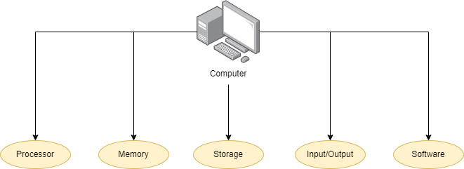


Slide 10
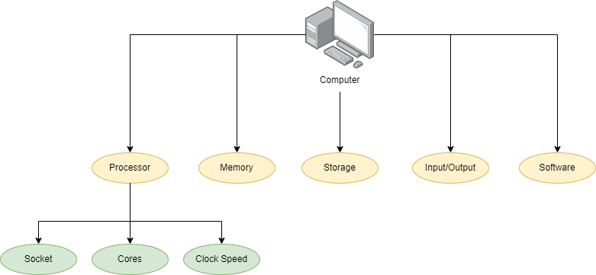
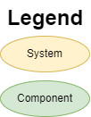

Slide 11
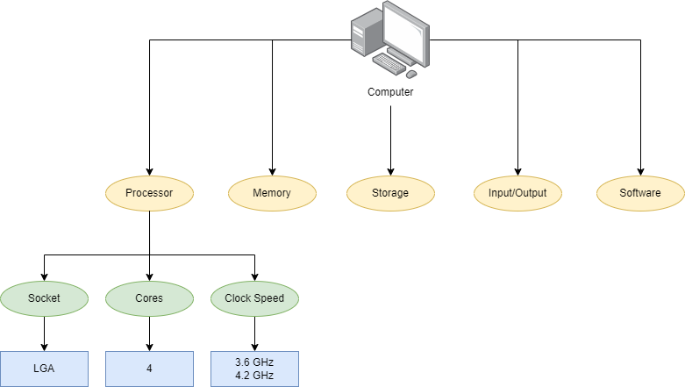
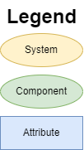

Slide 12
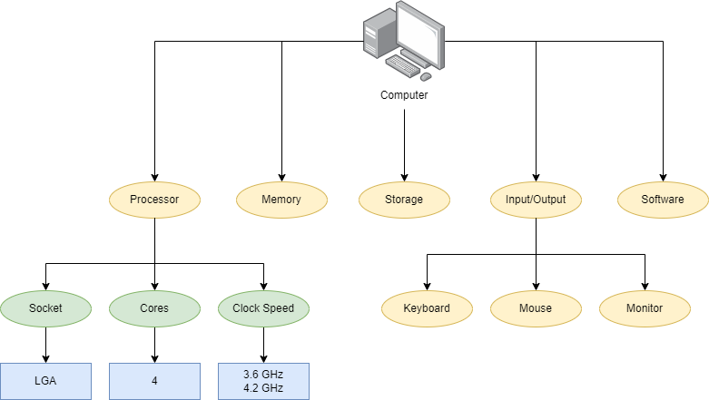

Slide 13
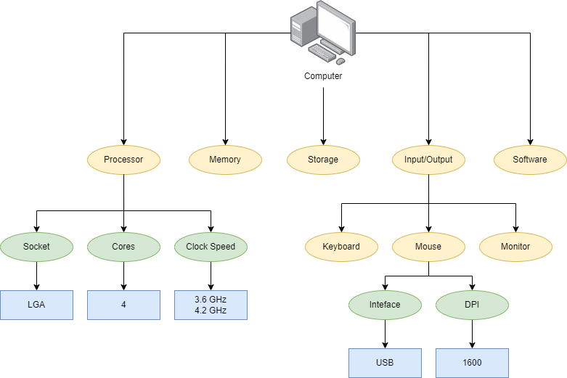

Slide 14
Data MOdel
How it’s made?*

Slide 15
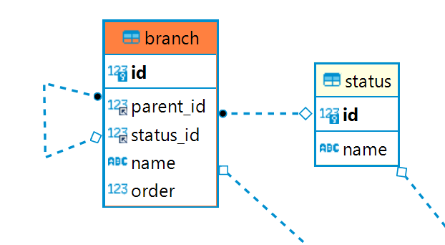
Systems

Slide 16
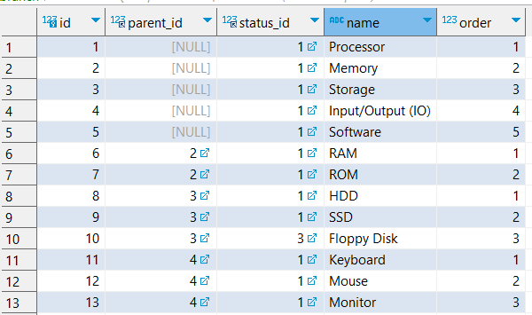
Systems

Slide 17
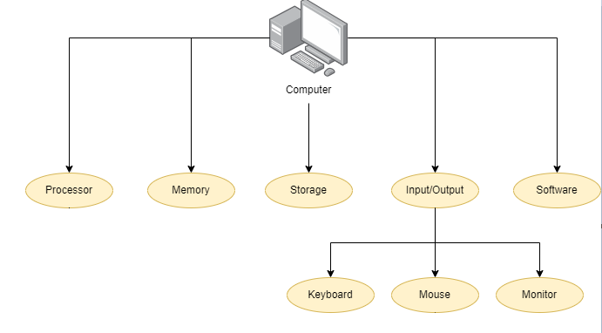
Systems

Slide 18
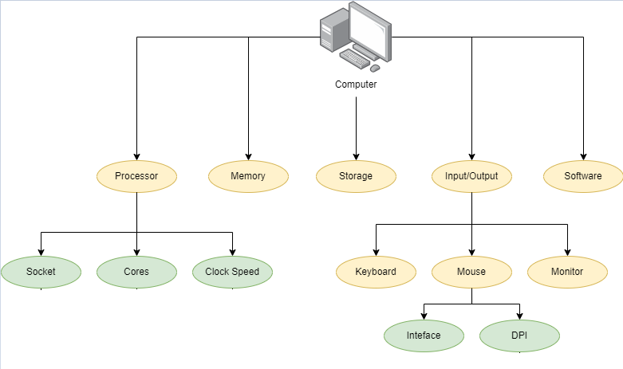
COMPONENTS

Slide 19
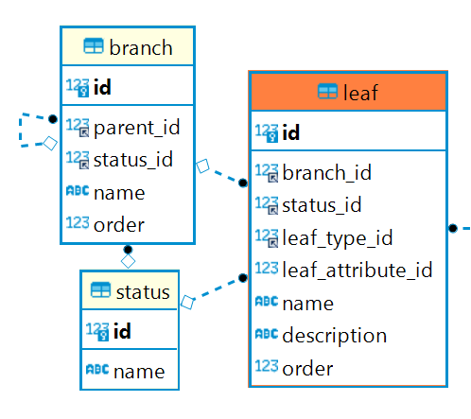
COMPONENTS

Slide 20
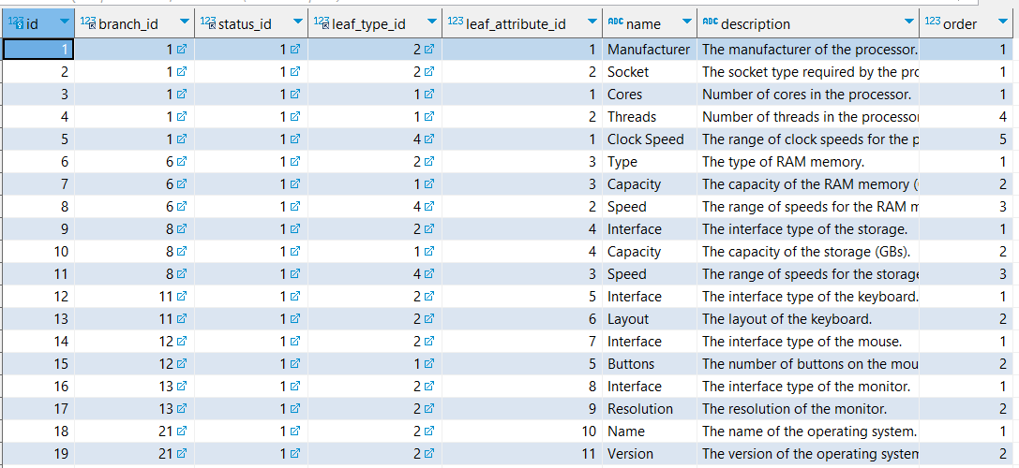
COMPONENTS

Slide 21
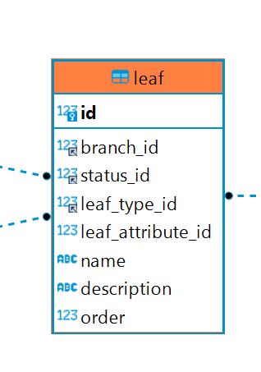
COMPONENTS

Slide 22
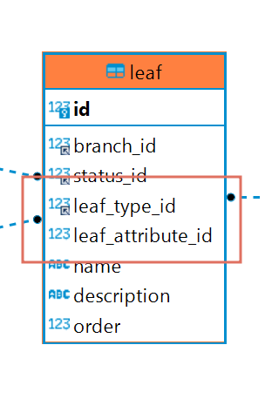
COMPONENTS

Slide 23
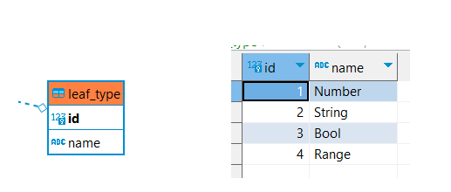
COMPONENTS

Slide 25
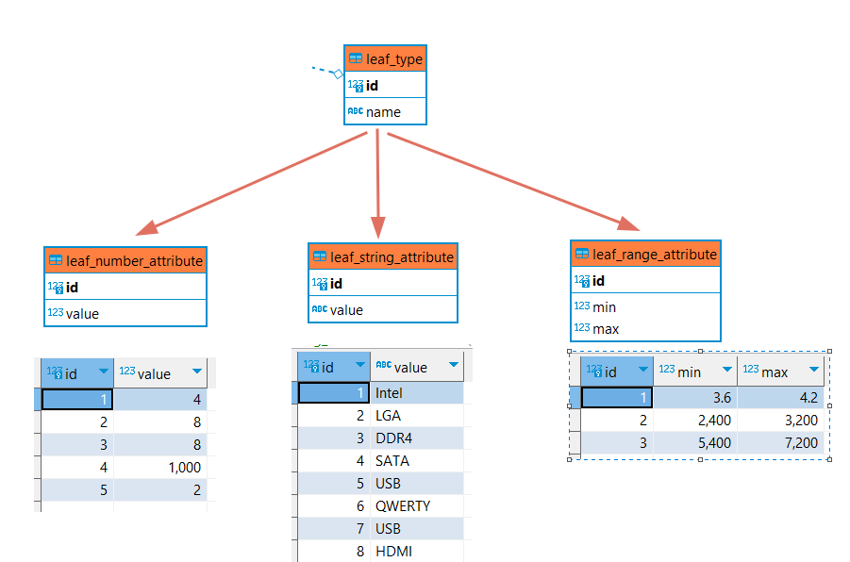
ATTRIBUTES

Slide 26
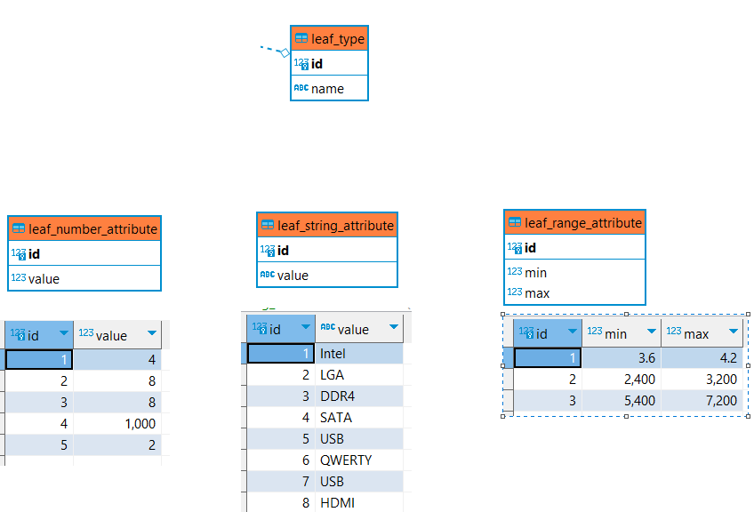
ATTRIBUTES

Slide 27
ATTRIBUTES

Slide 28
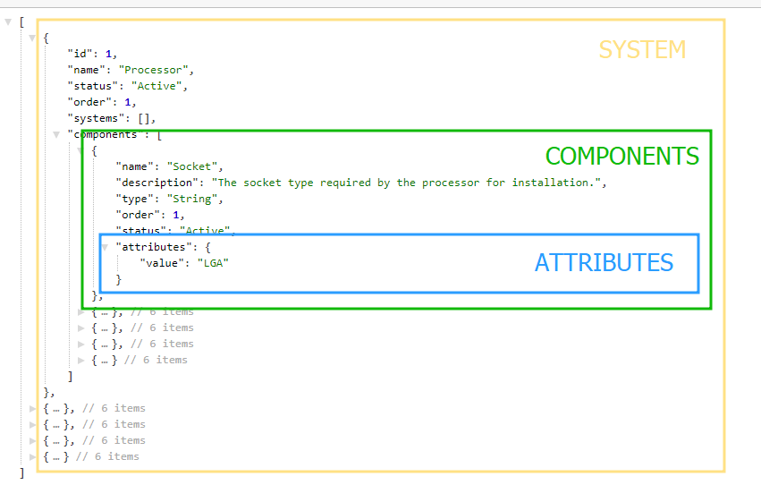

Slide 29
Demo
Do you want to see it?

Slide 30
THANK YOU!
Let’s have a discussion now ^_^

