Slide 1

Java
Servlets
Александр Помосов

Slide 2
Servlets
Отметьтесь на портале.
‹#›

Slide 3
Agenda
Collections revisited
Streams
Threads
Servlets
‹#›
Notes:
‹#›

Slide 4
Agenda
Collections revisited
Streams
Threads
Servlets
‹#›
Notes:
‹#›

Slide 5
Collections
Let’s talk
‹#›

Slide 6
Collections practice
@see ru.atom.collections.practice
Implement Uniq and Sort via collections
Uniq - returns only unique strings
Sort - return sorted strings (case-insensitive order)
(2 points)
‹#›

Slide 7
Agenda
Collections revisited
Streams
Threads
Servlets
‹#›
Notes:
‹#›

Slide 8
Streams
Stream - a sequence of elements supporting sequential and parallel aggregate operations
interface Stream<T> extends BaseStream<T, Stream<T>>
‹#›

Slide 9
Streams example
Arrays.asList("a1", "a2", "b1", "c2", "c1")
.stream()
.filter(s -> s.startsWith("c"))
.map(String::toUpperCase)
.sorted()
.forEach(System.out::println);
Stream pileline
‹#›

Slide 10
Streams operations
intermediate operations return Stream examples: filter(), map(), sorted()
terminal operations return void or some aggregated result examples: forEach(), toArray(), reduce(), collect()
‹#›

Slide 11
Streams operations
parallelism parallel() - uses common ThreadPool
non-interference data source is not modified during stream pipeline lifetime
stateles no global mutable state affect stream pipeline
ordering no ordering leads to better optimization
‹#›
http://docs.oracle.com/javase/8/docs/api/java/util/stream/package-summary.html

Slide 12
Streams examples
@see ru.atom.streams.examples
‹#›

Slide 13
Streams practice
@see ru.atom.streams.practice
Implement Uniq and Sort via Streams (2 points)
@see ru.atom.tinder.client
Implement findYoungerThan29() groupByLocation() (2 points)
‹#›

Slide 14
Agenda
Collections revisited
Streams
Threads
Servlets
‹#›

Slide 15
Concurrency vs parallelism
Why do we need parallel execution?
‹#›

Slide 16
Concurrency vs parallelism
Concurrency - contention on shared resources
Parallelism is possible without concurrency
Java is implemented with concurrency in mind (unlike e.g. Python).
Concurrency is hard (later)
‹#›

Slide 17
Processes and threads
What’s the difference?
‹#›

Slide 18
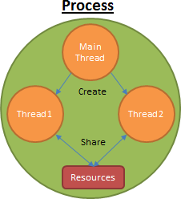
Processes and threads
Processes have dedicated resources (memory space)
Threads share memory space
‹#›

Slide 19
Thread and Runnable
class Thread implements Runnable{
//here all the interface for thread management
}
@FunctionalInterface
interface Runnable{
//will be executed when thread starts
public abstract void run();
}
‹#›

Slide 20
Thread creation and interface
@see ru.atom.thread.examples.CreateThreadExample
‹#›

Slide 21
Thread public methods
@See ru.atom.thread.examples
start(); //executes run() of provided Runnable
targetThread.sleep(long millis); //Sleeps for (not exactly) “millis” milliseconds
interrupt(); //Throws InterruptedException if waiting
//sets Thread.isInterrupted otherwise
targetThread.join(); //Block current Thread until target finishes
yeild(); //Recommendation for scheduler to switch to another thread
‹#›

Slide 22
How to destroy a thread?
@See ru.atom.thread.practice.NeutralizerBombTest
‹#›

Slide 23
Agenda
Collections revisited
Streams
Threads
Servlets
‹#›

Slide 24
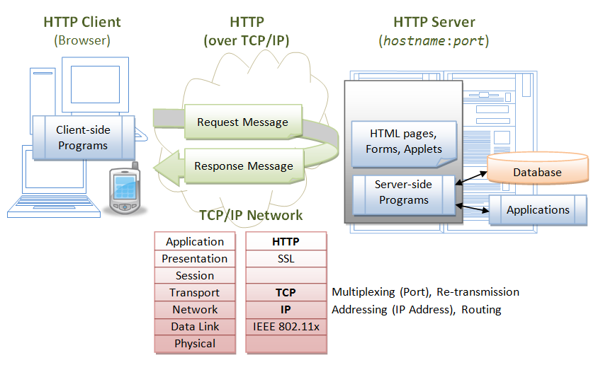
Web application architecture
REST Service is a Web Application
‹#›

Slide 25
Web server
Examples:
Apache HTTP Server
NGINX
Can be embedded into application
(as library)
Jetty
Static pages are not interesting.
How to server dynamic content?
‹#›

Slide 26
Application servers
Java EE provides a set of APIs that every Application Server must implement
JavaEE - EJB, JMS, CDI, JTA, the servlet API (including JSP, JSTL), etc.
Application server is an Enterprise Level Solution
Application Server examples:
Sun GlassFish, IBM WebSphere, RedHat JBoss Application Server
What if we need a simpler solution?
‹#›

Slide 27
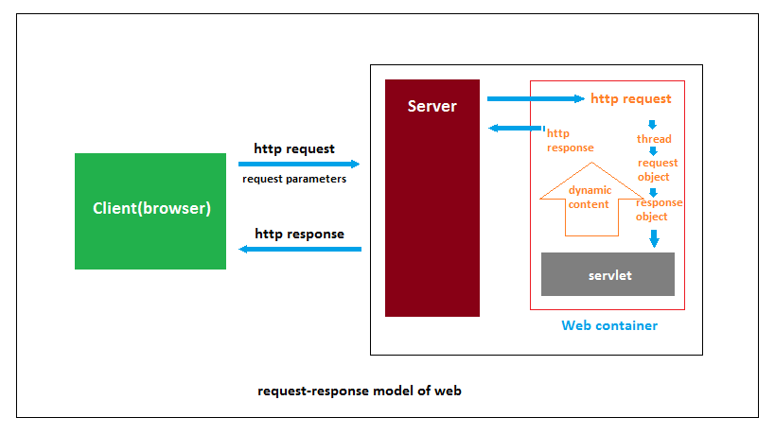
Servlet
java program that extends capabilities of server with custom logic
‹#›

Slide 28
Servlet example
@see ru.atom.servlets.examples
‹#›

Slide 29
More production-ready way
Tinder servlets with Jersey: @see ru.atom.tinder.server
‹#›

Slide 30
Servlet practice
Implement REST API for MatchMaker
GET /activeGameSessions
return json - collection of session identifiers
Session is identified via UUID
(2 points)
‹#›

Slide 31

Спасибо
за внимание!
Александр Помосов
a.pomosov@corp.mail.ru

