Slide 1
V - Shaped Model
Team 2 (Kmps Tax Pvt Ltd)
Shweta Rawat - 902483
Keerthana Achalla - 902224
Mentor – Deepa Thangaraj

Slide 2
SDLC V - MODEL
The process executes in a sequential manner in V-shape.
Verification and Validation model.
Testing phase parallel to each development phase.
Verification and Validation phases are joined by coding phase

Slide 3
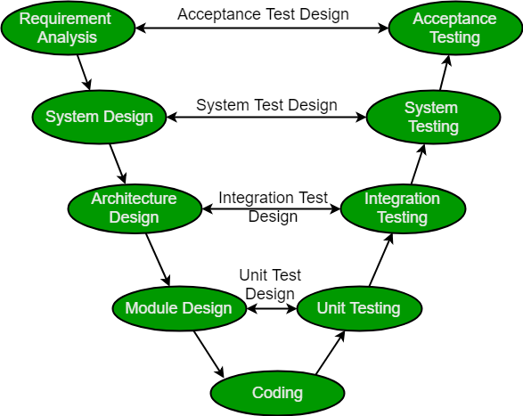
ARCHITECTURE

Slide 4
Design phase
Requirement Analysis
System Design
Architectural Design
Module Design
=> Coding

Slide 5
Testing Phase
Coding
Acceptance Testing
System Testing
Integration Testing
Unit Testing

Slide 6
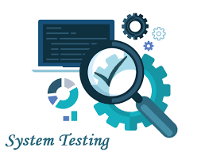
SYSTEM TESTING
A level of testing that
validates the complete and fully integrated software product. The purpose of a system test is to evaluate the end-to-end system specifications.
Usually, the software is only one element of a larger computer-based system.

Slide 7
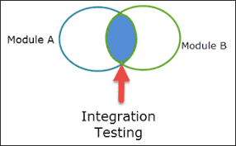
Integrated Testing
It defined as a type of testing where software modules are integrated logically and tested as a group. A typical software project consists of multiple software modules, coded by different programmers. Integration Testing focuses on checking data communication amongst these modules. Hence it is also termed as 'I & T' (Integration and Testing), 'String Testing' and sometimes 'Thread Testing'.

Slide 8
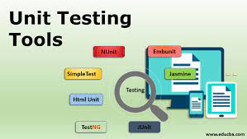
UNIT TESTING
It is a type of software testing where individual units or components of a software are tested. The purpose is to validate that each unit of the software code performs as expected. Unit Testing is done during the development (coding phase) of an application by the developers.

Slide 9
Testing
Cons
– Tester must have the technical background to have a coding knowledge in order to perform this type of testing effectively.
– Access to code is required
– It might not discover the missing functions as it targets the existing software
Pros
– More efficiently discover the hidden bugs in the software
– It helps in optimizing the code
– It spots the bugs and problems very fast

Slide 10
Advantages of V- Model
Highly disciplined model and Phases are completed one at a time.
Good for small projects where project requirements are clear.
Easy to understand Simple to use.
Error-free and good quality product due to Verification and Validation
Enables project management to track progress accurately.

Slide 11
Disadvantages of V- Model
High risk and uncertainty.
Not a good for complex and object-oriented projects.
Not suitable for projects where requirements are not clear and contains high risk of changing.
Does not support iteration of phases.

Slide 12
Use case - Tax software
Tax-related software with respect to the calculations, which is based on laws and regulations. Where continuous verification and validation is required at each step.
In such case, V- model is the best choice

Slide 13


