Slide 1
V - Shaped Model
Shweta Rawat
Keerthana Achala
Mentor – Deepa Thangaraj

Slide 2
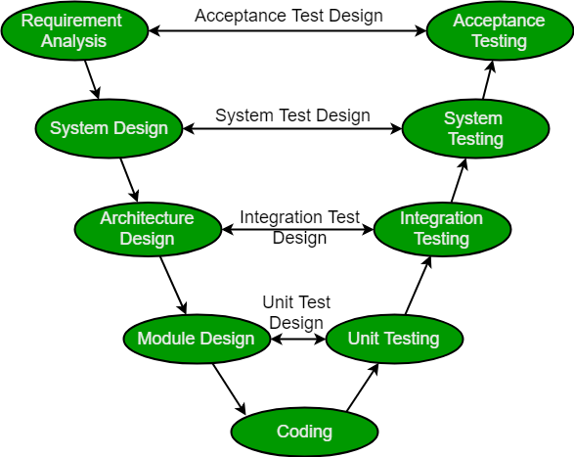
ARCHITECTURE

