Slide 1


Digital Portfolio
STUDENT NAME: SRI VALLAPAN R
REGISTER NO : asunm1301212402437
NMID:E77263601FB9FD592BB452EF933A8A0F
ROLL NO :24H206
DEPARTMENT: BCA
COLLEGE: AM JAIN COLLEGE
UNIVERSITY OF MADRAS
1

Slide 2

PROJECT TITLE
INTREACTIVE DIGITALPORTFOLIO USING FRONT END DEVELOPMENT
2

Slide 3




AGEN DA
1.Problem Statement 2.Project Overview 3.End Users 4.Tools and Technologies 5.Portfolio design and Layout 6.Features and Functionality 7.Results and Screenshots 8. Conclusion 9.Github Link
3/21/2024 Annual Review
3

Slide 4


PROBLEM STATEMENT
Traditional resumes and static portfolios often fail to engage viewers and effectively showcase an individual’s skills. There is a need for an interactive digital portfolio built using front-end technologies (HTML, CSS, JavaScript) that is responsive, visually appealing, and user-friendly, allowing individuals to present their skills, projects, and contact information in a more engaging way.
4

Slide 5

PROJECT OVERVIEW
The project“InteractiveDigital Portfolio using Front-
End Development” focuses on creating a responsive and user-friendly web-based portfolio to showcase an individual’s profile, skills, projects, and contact details. Using front-end technologies like HTML, CSS, and JavaScript, the portfolio will provide an engaging interface with smooth navigation and interactive features. It aims to replace traditional static resumes with a modern, digital platform that enhances personal branding and accessibility across devices.
5

Slide 6
WHO ARE THE END USERS?
1. Students & Job Seekers – who usetheportfolio to showcase their skills, projects, and achievements to recruiters. 2. Recruiters & Employers – who viewtheportfolio to evaluate the candidate’s abilities, creativity,andtechnical expertise. 3. Freelancers & Professionals – whopresent their work to potential clients or collaborators. 4. Educators & Peers – who may reviewtheportfolio for academic, mentoring, or networkingpurposes.
6

Slide 7


TOOLS AND TECHNIQUES
Frontend: HTML5, CSS3, JavaScript (ES6+). Styling & Frameworks: Tailwind CSS, Figma (design mockups). Libraries: Particles.js for background animation. Version Control: Git & GitHub.
7

Slide 8

POTFOLIO DESIGN AN LAYOUT
• Clean and modern one-page layout.
• Sections included: About, Resume, Projects, Contact.
• Navigation bar with smooth scrolling.
• Responsive design for desktop and mobile screens.
• Consistent color scheme using gradient backgrounds.
• Use of shadows, hover effects, and UI elements for interactivity.
• Font: Poppins for clean readability and modern look.
8

Slide 9
FEATURES AN FUNCTIONALITY
• Responsive design: optimized for mobile, tablet, and desktop.
• Smooth scrolling and section navigation.
• Animated background using Particles.js.
• Interactive buttons and hover effects.
• Social media integration (GitHub link with icon).
• Organized project showcase with GitHub links.
• Clean code structure using modular components.
• Contact section with clickable email link.

Slide 10

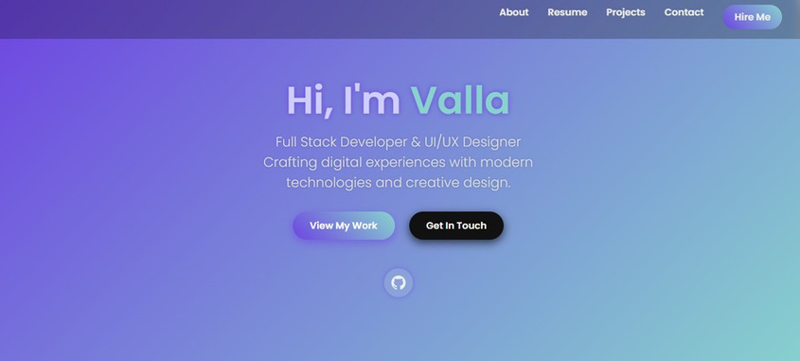
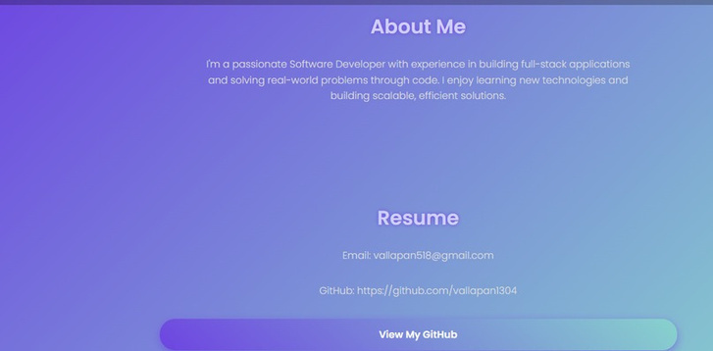

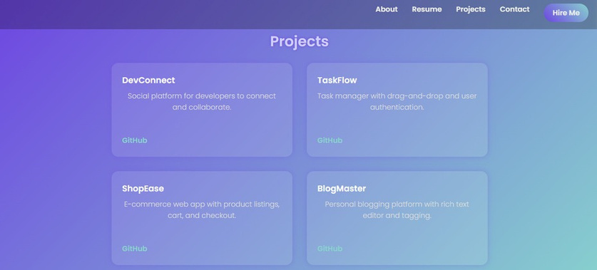
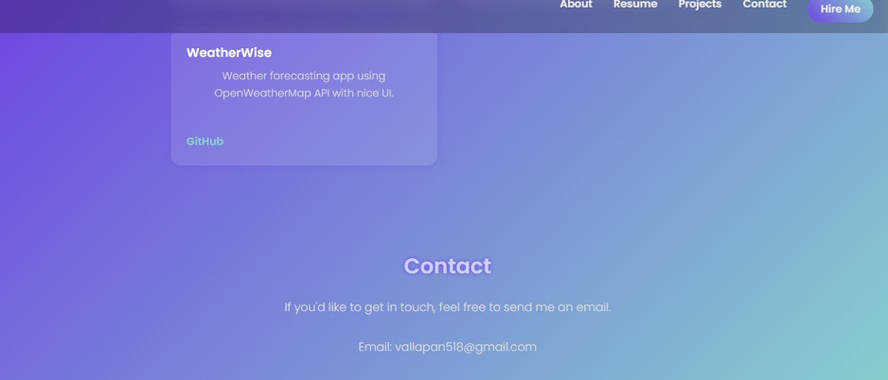
RESULTS AND SCREENSHOTS
3/21/2024 Annual Review
10

Slide 11
CONCLUSION
The project “Interactive Digital Portfolio using Front-End Development” successfully demonstrates how modern web technologies like HTML, CSS, and JavaScript can be used to build a responsive, user-friendly, and engaging portfolio. Unlike traditional resumes, this portfolio provides an interactive platform to showcase personal details, skills, and projects in a professional manner. It enhances personal branding, improves accessibility across devices, and serves as an effective tool for students, job seekers, and professionals to present their capabilities to recruiters and clients.
11

Slide 12

SERVER LINK : https://github.com/valla2007/vallapan.git
DIPLOMENTARY LINK : https://valla2007.gIthub.io/vallapan/

