Slide 1
CATEGORIZATION OF DESCRIPTIVE ANSWERS
Under the guidance of
Dr. Lingaraju G M
Professor
Department Of ISE, RIT
1MS16IS058 Prerana J
1MS16IS071 RishabhAgarwal
1MS16IS078 Rubina Kaur Ajmani
1MS16IS133 Vallabh Chugh

Slide 2
PROBLEM STATEMENT
Automated Evaluation: Answers submitted by various students is evaluated against the Model-Answers provided by the Faculty using Machine learning algorithms and Natural learning processing techniques to predict the correct semantics and similarity and assign scores grading them in different categories.

Slide 3
INTRODUCTION
The result obtained by a student is crucial as it is one of the most important metric used for assessing the integration of one’s ideas and ability to recall and academic achievement.
But it is very expensive and time consuming to grade manually.
Manual grading of essays depends on instructors' prejudice and varies from evaluator to evaluator hence is an error-prone process.
Providing a method which is automated with minimal human intervention helps not only in saving the faculty's time but also provides a robust mechanism for evaluation as it is unbiased towards any individual submission.

Slide 4
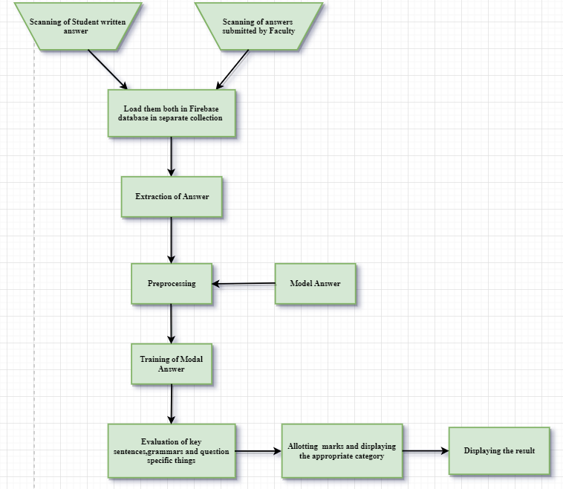
Implemented Modules
Fig:1- Flow Chart:
The datac i.e. in terms of Model and Student submitted answers is taken and preprocessed after which ML and NLP techniques are being applied on the cleaned data and marks and category of answer are returned as final Output.

Slide 5
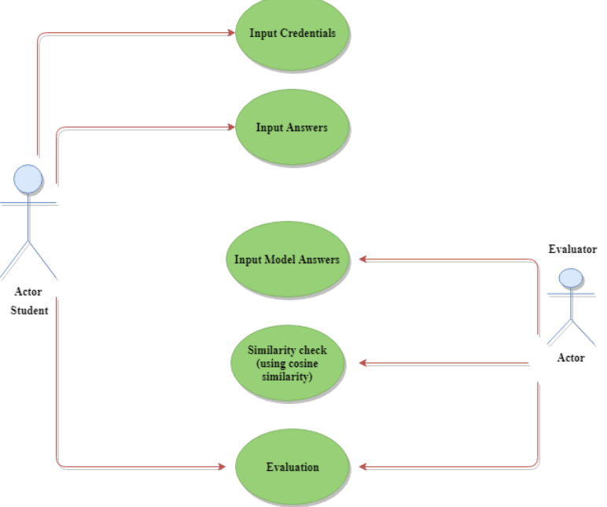
Fig: 2- Workflow of the proposed project

Slide 6
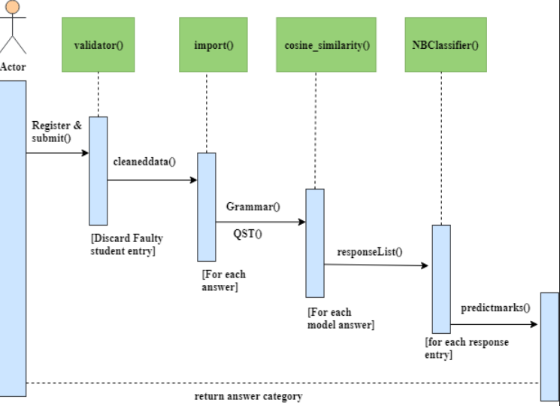
Fig: 3- Sequence Diagram

Slide 7
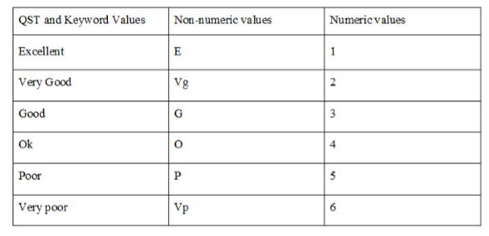
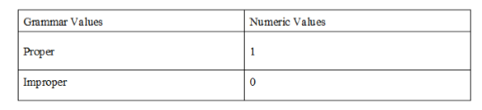
Testing
For any test answer, values of Keyword and Grammar and QST are computed which are used to categorize the submitted answers among various classes along with generated marks out of 5.
Fig:4- Metrics used for evaluating features

Slide 8
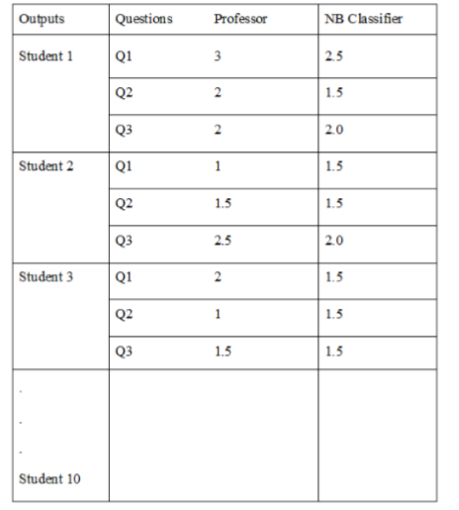
Result and Discussion
We have tested our model using the dataset of Student written answers and Faculty’s model answers.
The values that we have deﬁned in the table are set according to the marks awarded by the faculty and by our automated model.
The accuracy of the evaluation can be increased by feeding it a huge and accurate training dataset.
Fig: 5- Final Output

Slide 9
Conclusion
The project works with the same factors which an actual human being considers while evaluation such as length of the answer, presence of keywords, and context of key-words.
Use of Natural Language Processing coupled with robust classiﬁcation techniques will allow students to have a certain degree of freedom while writing the answer as the system checks for the presence of keywords, synonyms, right word context and coverage of all concepts.
It is concluded that using ML techniques will give satisfactory results due to holistic evaluation.

Slide 10
Future Directions
Providing software support to universities to ease their evaluation process.
The system would assign preliminary grades to all student’s answers. It will yield fast, effective and affordable solutions .
Opportunities to challenge our students with more sophisticated measures of ability.

Slide 11
References
Dharma Reddy Tetali, Dr. Kiran Kumar G, Lakshmi Ramana “Evaluation of Subjective Answers (APTESA)” IJMET, Volume 8, Issue 7, July 2017, Article ID: IJMET_08_07_029.
Piyush Patil, Sachin Patil, Vaibhav Miniyar, Amol Bandal
“Subjective Answer Evaluation Using Machine Learning” IJPAM, International Journal of Pure and Applied Mathematics, Volume 118 No. 24 2018, ISSN: 1314-3395.

Slide 12
THANK YOU

