Slide 1

SMART WATER MANAGEMENT SYSTEM USING TIME SERIES ANALYSIS
Department of CSE
GROUP-15
Siddharth Deshwal
Karan Sharma
Vallabh Mishra
Siddhartha Anand
PROJECT GUIDE
MS.UPASANA
ASST. PROFESSOR

Slide 2
Problem Statement
India faces a severe water crisis, affecting 600 million people with high to extreme water stress.
The country ranks 120th out of 122 in the water quality index, with 70% of water contaminated.
Groundwater, supplying 40% of India's drinking water, is rapidly depleting.
21 major Indian cities were predicted to run out of groundwater by this year.

Slide 3
Objectives
Phase 1 focuses on predicting water consumption using Machine Learning algorithms.
This prediction will help forecast water scarcity in various areas.
Data analysis will identify areas with higher water consumption for informed decision-making.
The model will provide statistics on water usage by different sectors and predict future consumption.
The main variable is the quantity of water in gallons, and the forecast will predict monthly water consumption levels.

Slide 4
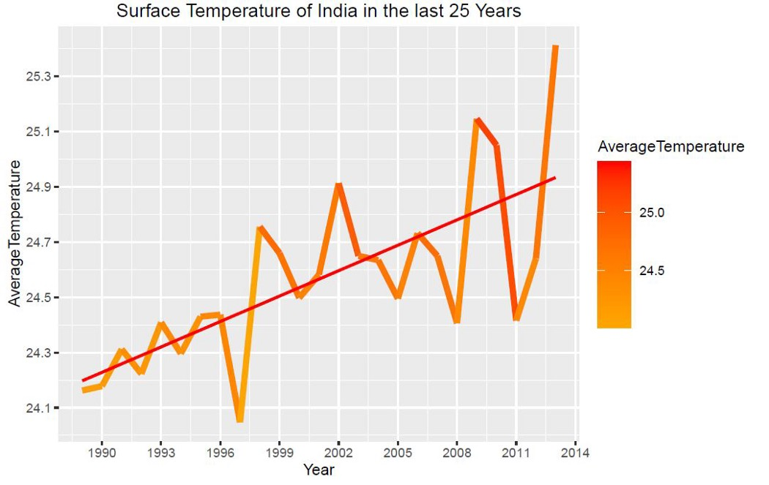
Continued..
India's average temperature is constantly increasing, due to which water reservoirs are constantly drying up.

Slide 5
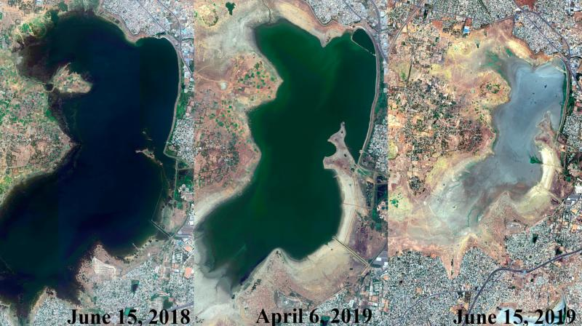
Case Study : Chennai
• Chennai's largest water reservoir Red Hill Water Reservoir is continuously drying up due to which there is going to be a huge water shortage in the in Chennai.

Slide 6
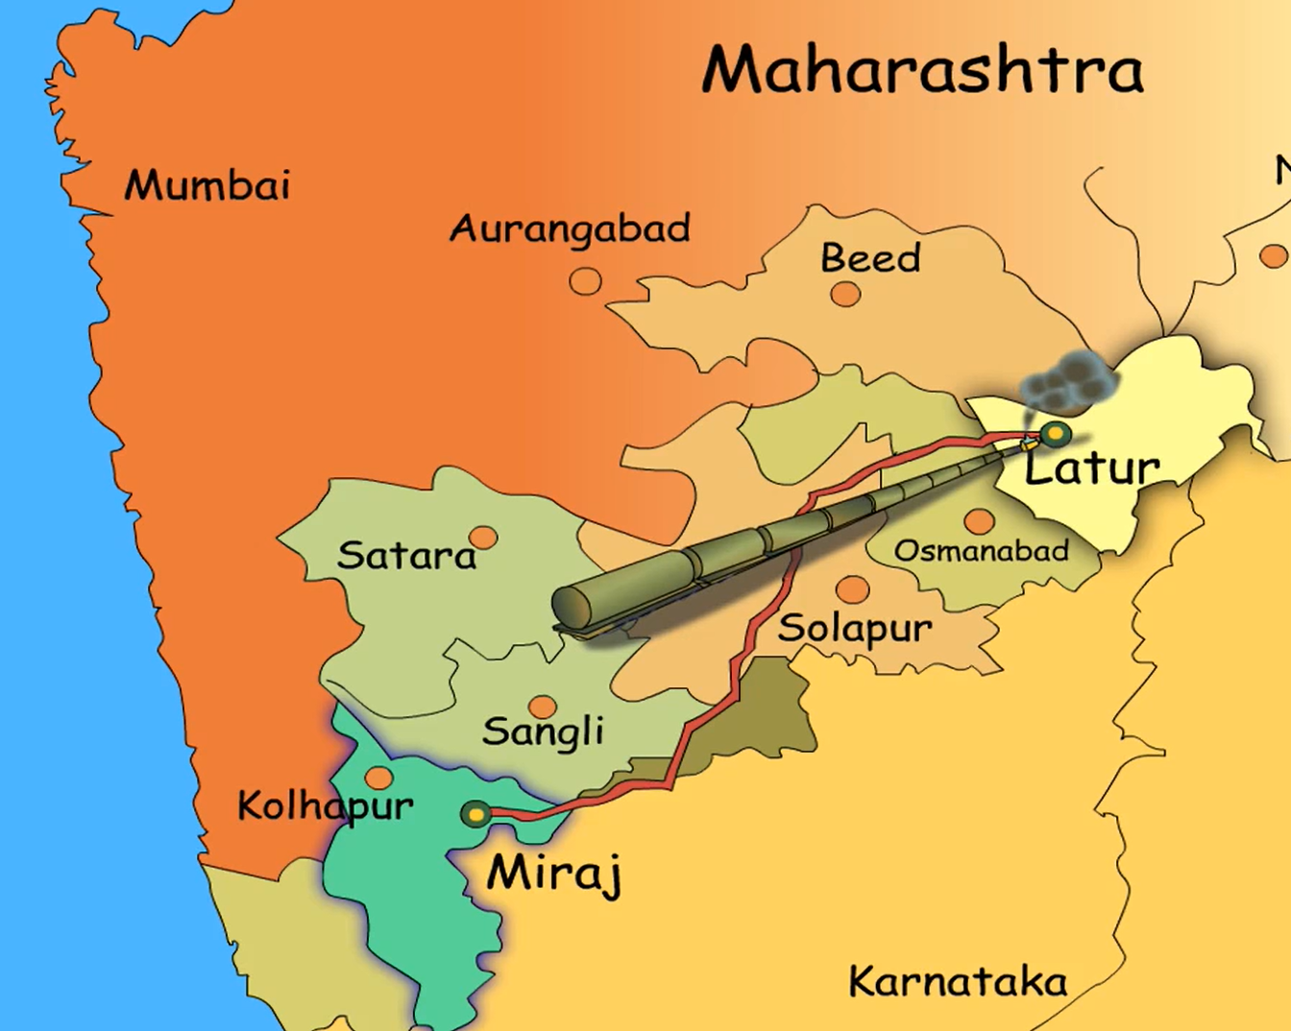
Case Study: Latur
There was not a single drop of water in 3100 villages out of the total 8522 villages of Marathawada in Maharashtra. To meet the shortage of water in Latur, 500000 liters of water was being sent to Latur every third day from Miraj place, located 342 km from Latur.

Slide 7
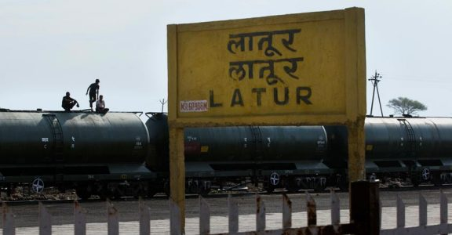
Continued..
To meet the shortage of water in Latur, water was being transported from various parts of Maharashtra and India by tank train to Latur.

Slide 8
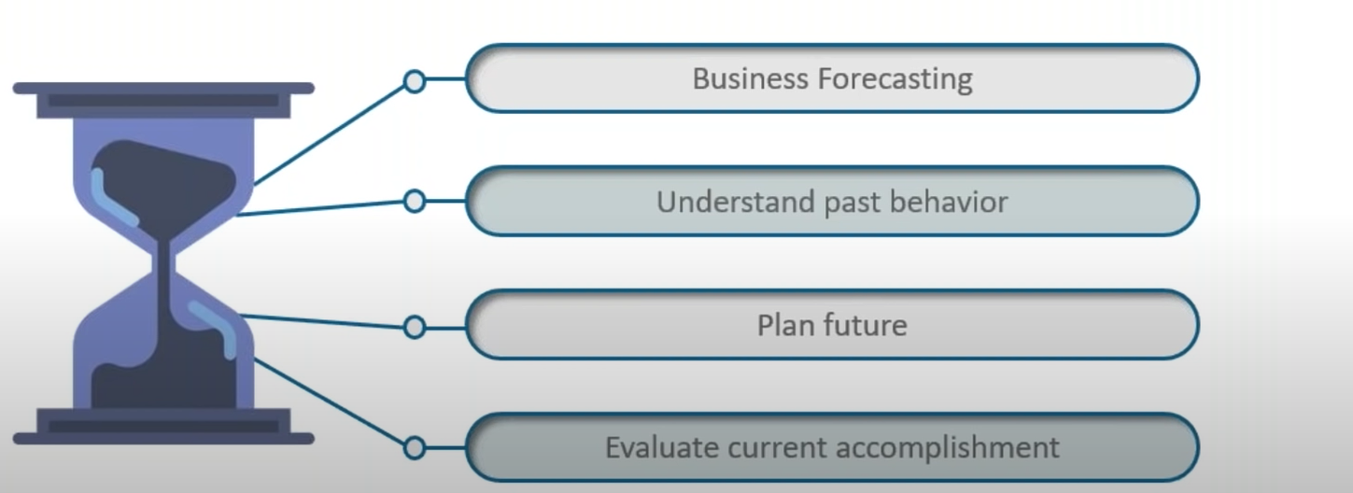
Time Series Analysis
Time series is a set of observation taken at specified times usually at equal intervals. On x-axis we have a time the y-axis the magnitude of the data. For this project we are taking date on x-axis and quantity of water (total gallons) in y-axis.

Slide 9
Feasibility Study
Technical Feasibility
Operational Feasibility
Financial Feasibility
Environmental Feasibility

Slide 10
Literature Survey
Author(s) & Year | Methodology/Models Used | Key Findings/Outcomes
Almohseen & Al-Rimawi (2024) | ARIMA model | Time series models like ARIMA can accurately predict short- and long-term water demand, improving water allocation.
Zhang et al. (2024) | ARIMA model | Forecasting models are useful for managing water release and ensuring resource availability.
Hosseini & Sarukkalige (2024) | ARIMA and other time series models | Time series analysis enhances water management by improving inflow prediction accuracy.
Kisi (2013) | ANN compared to traditional time series models | ANN models can handle complex, non-linear patterns and are effective for inflow prediction.
Deo & Şahin (2015) | ANN models | Integrating machine learning models improves water storage and release efficiency in reservoirs.
Omar & Mazhar (2018) | IoT for data collection and realtime monitoring | Combining real-time monitoring with predictive models enhances adaptive reservoir operations.
Yaseen et al. (2016) | LSTM, deep learning techniques | LSTM models capture long-term dependencies and outperform traditional forecasting methods.
Xu et al. (2019) | Deep learning models based on river flow data | Deep learning models can handle complex datasets and improve flood prediction accuracy.
Beck et al. (2017) | Merging gauge, satellite, and reanalysis data | Using multi-source data improves precipitation forecasts, crucial for reservoir inflow prediction.
Liu & Gupta (2007) | Data assimilation framework | A data assimilation framework helps manage uncertainty in water level forecasts, enhancing decision-making.

Slide 11
Functional And Non-Functional Requirement
1.Functional Requirements:
Real-time Monitoring
Time Series Analysis
Alerting and Notifications
Leak Detection
Data Visualization

Slide 12
2. Non-Functional Requirement
Performance
Scalability
Usability
Security

Slide 13
Hardware Requirement
Microcontroller/Processing Unit
Sensors
Communication Modules
Data Storage Device
Display/Monitoring Interface

Slide 14
Software Requirement
Operating System
Programming Languages
Libraries and Frameworks
Data Storage
Data Analysis Tools

Slide 15
Reference
[1]Almohseen, S. A., & Al-Rimawi, H. (2020). Time series forecasting of water demand using ARIMA models. Water Resources Management, 34(3), 897–910.
[2]Beck, H. E., van Dijk, A. I. J. M., Levizzani, V., Schellekens, J., Miralles, D. G., Martens, B., & de Roo, A. (2017). MSWEP: 3-hourly 0.25° global gridded precipitation (1979–2015) by merging gauge, satellite, and reanalysis data. Hydrology and Earth System Sciences, 21(1), 589–615.
[3]Deo, R. C., & Şahin, M. (2015). Application of the artificial neural network model for prediction of monthly mean streamflow and estimation of reservoir yield in the Great Barrier Reef catchment. Journal of Hydrologic Engineering, 20(9), 04014055.
[4]Hosseini, S. M., & Sarukkalige, R. (2014). Long-term reservoir inflow forecasting using time series models. Water Resources Management, 28(10), 2791–2807.

Slide 16
THANKYOU

