Slide 1
FP-Growth Algorithm
-Tejavath Thirupathi

Slide 2
Frequent pattern Growth Algorithm:-
FP-Growth is a efficient and scalable method for mining the complete set of frequent pattern using a tree structure for the storing information about frequent pattern called the FP tree.
It is improvement of Apriori Algorithm.
FP Growth uses a depth-first search.

Slide 3
Advantages of FP Growth Algorithm:-
This algorithm needs to scan the database twice when compared to Apriori, which scans the transactions for each iteration.
To scan DB time consuming.
The pairing of items is not done in this algorithm, making it faster.

Slide 4
Algo(steps):-
The data set is scanned once to determine the support count of each item.
Infrequent items are discarded, while the frequent items are sorted in decreasing support counts.
More frequency --> more priority
Same frequency --> FCFS

Slide 5
Example:-
Tid | Items
T1 | E,K,M,N,O,Y
T2 | D,E,K,N,O,Y
T3 | A,E,K,M
T4 | C,K,M,V,Y
T5 | C,E,I,K,O,O
items | frequency
A | 1
C | 2
D | 1
E | 4 >=3
I | 1
K | 5 >=3
M | 3 >=3
N | 2
O | 3 >=3
U | 1
Y | 3 >=3
Min_support=3

Slide 6
Infrequent items are eliminated
More frequency --> more priority
Ordering items according to priority
Tid | frequency
E | 4
K | 5
M | 3
O | 3
Y | 3
Tid | frequency
K | 5
E | 4
M | 3
O | 3
Y | 3

Slide 7
Cont...
Tid | Items | Ordered- Itemset
T1 | E,K,M,N.O,Y | K,E,M,O,Y
T2 | D,E,K,N,O,Y | K,E,O,Y
T3 | A,E,K,M | K,E,M
T4 | C,K,M,U,Y | K,M,Y
T5 | C,E,I,K,O,O | K,E,O

Slide 8
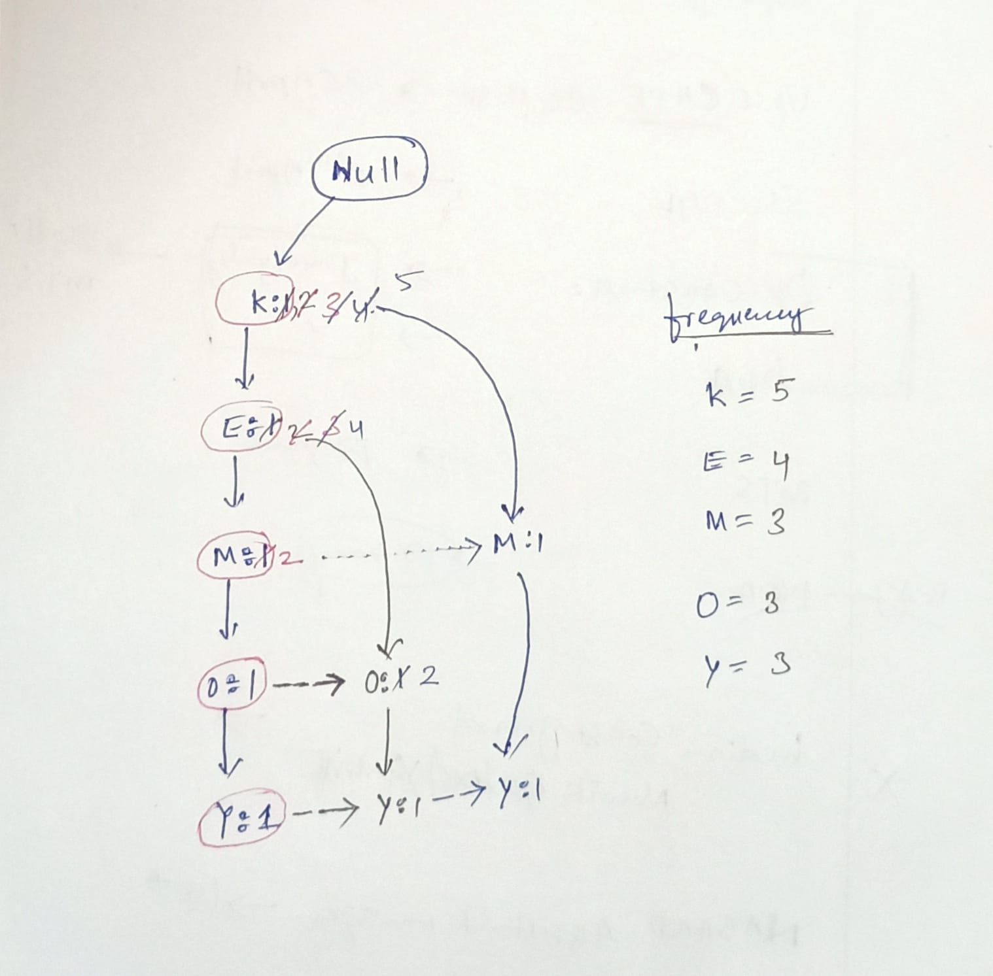
FP-tree:-

Slide 9
Cont...
Items | Conditional pattern base | Conditional frequent pattern
Y | {{ K,E,M,O : 1 },{ K,E,O : 1}, { K,M : 1 }} | { K : 3}
O | {{ K,E,M : 1 },{ K,E : 2 }} | { K,E : 3}
M | {{ K,E : 3 }, { K : 1 }} | { K : 3 }
E | { K : 1 } | { K : 4}
K | --- | ---

Slide 10
Cont...
Tid | Frequent pattern Generation
Y | {<K,Y : 3 >}
O | {<K,O : 3 >, <E,O : 3 >, <E,K,O : 3 >}
M | {<K,M : 3 >}
E | {<E, K : 3 >}
K | ---

