Slide 1
DIGITAL STEGANOGRAPHY
BY
V SAI DURGA

Slide 2
AGENDA
Introduction
Tools used for development
Data Base Table
Use Case Diagram
ER Diagram

Slide 3
Introduction
In this project, DIGITAL STEGANOGRAPHY gives a solution for transmitting secret formation with out affecting unintended users.

Slide 4
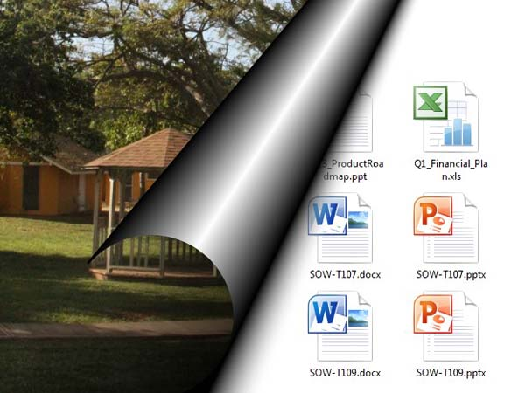

Slide 5
Tools used for development
Eclipse IDE
Ms-word
Paint
Database server –Oracle 11g

Slide 6
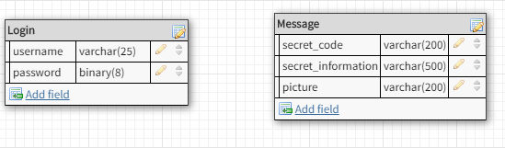
Data Base Table

Slide 7
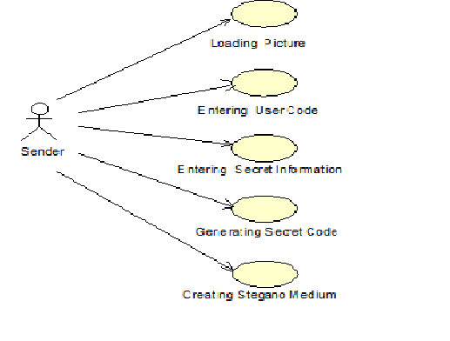
Use Case Diagram(sender)

Slide 8
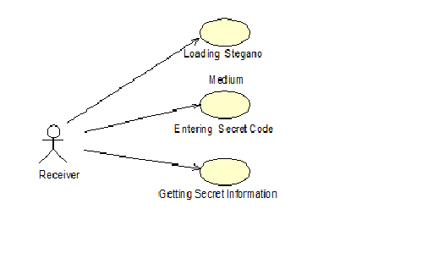
Use Case Diagram(receiver)

Slide 9
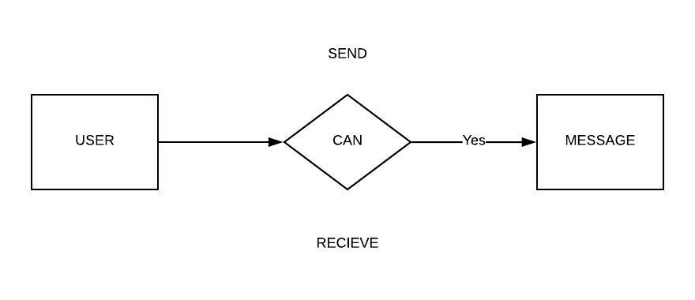
ER diagram

Slide 10


