Slide 1
INTERN MANAGER https://intermanagerui.herokuappom/#/login
BY
RAMU VALLAPURAPU
AKHIL KASUVOJULA
VENKATESH VEMULA
ANUSHA KANAGALA

Slide 2
Purpose and People ?
The main Idea of this project is to develop an application to make the internship submission process simple and easy
Student who wants to apply for Internship can utilize this application with ease.

Slide 3
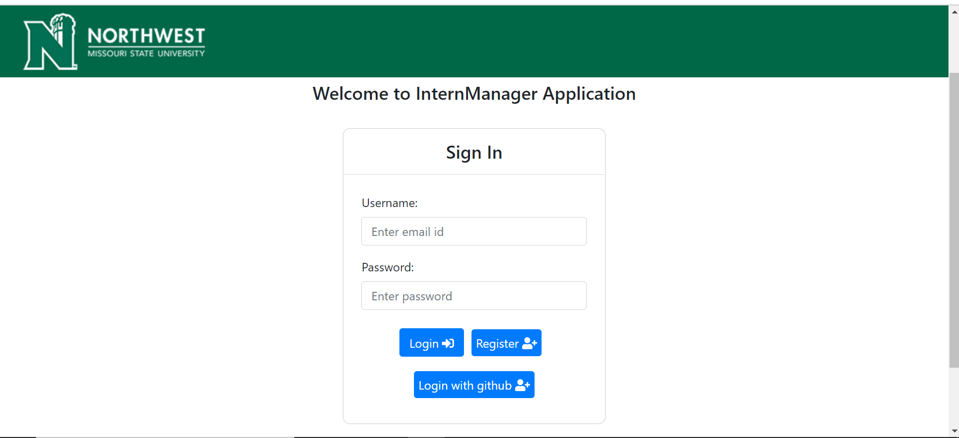
HOME PAGE
In the front-end we are using vue.js
In the back-end we are using adonisjs
Home Page displays various options for the users to login into their page.

Slide 4
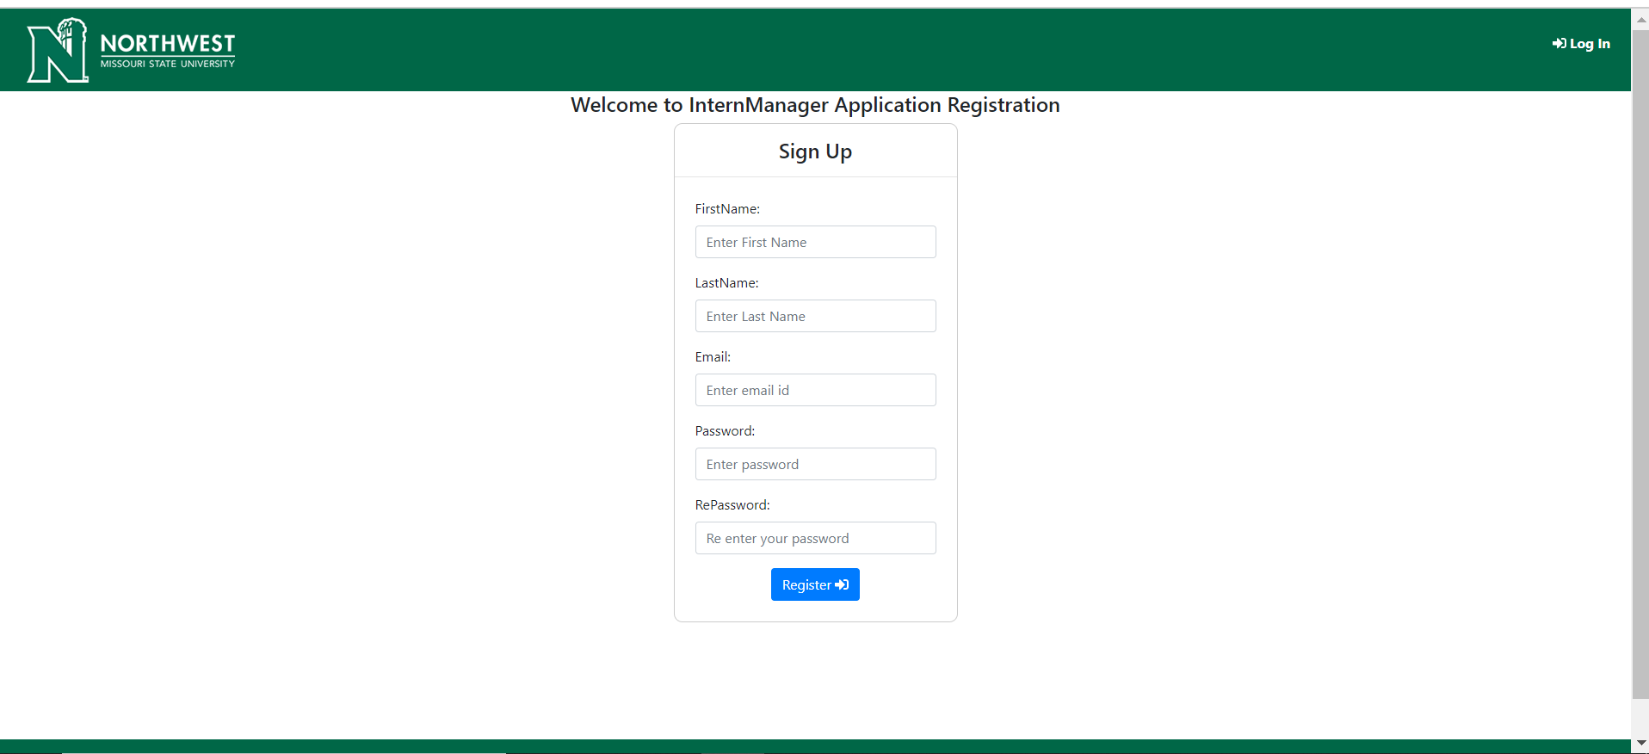
Register Page
We have created this page for the users to register while applying for the internships.
This helps the users to register easily into the portal.

Slide 5
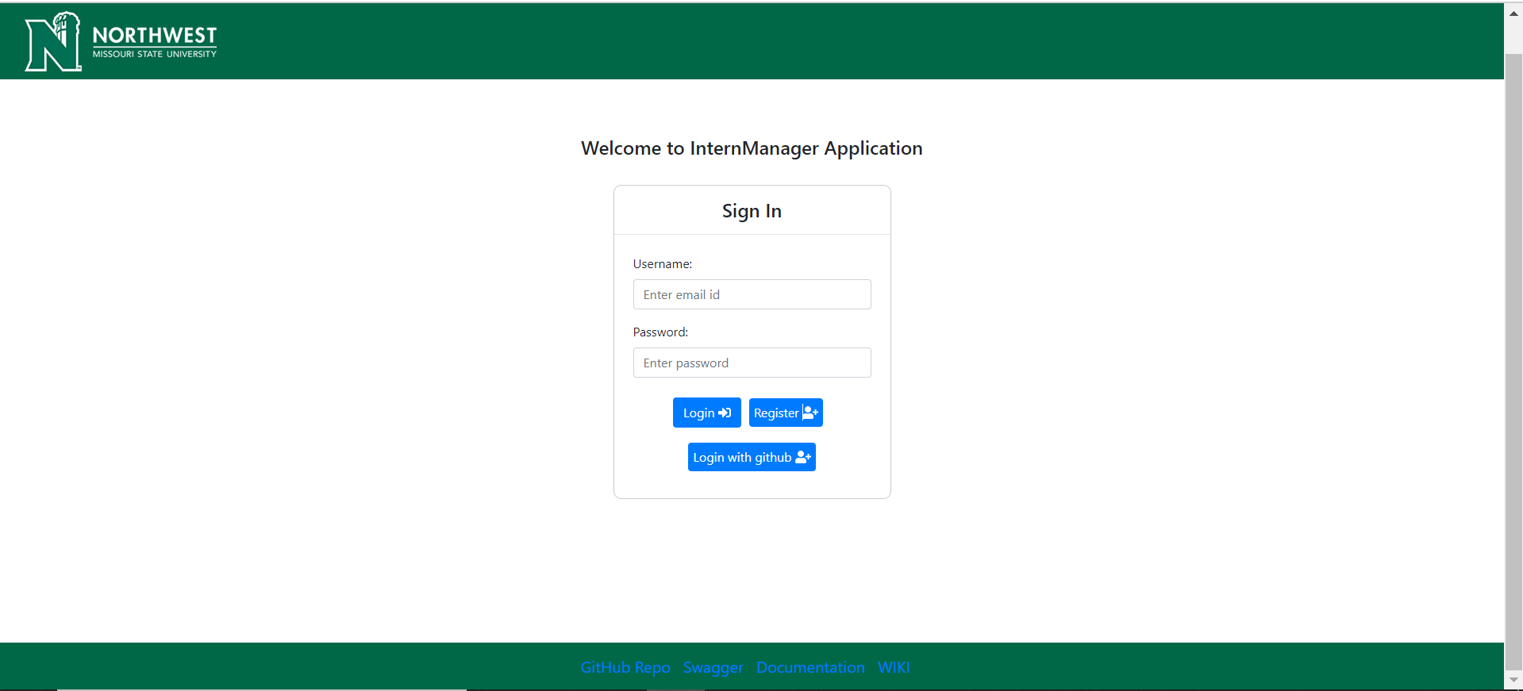
Sign In Page
Users sign into their page by using their valid login details.
Dashboard differs based on profiles
We have 2 different roles, and they are Student and Faculty

Slide 6
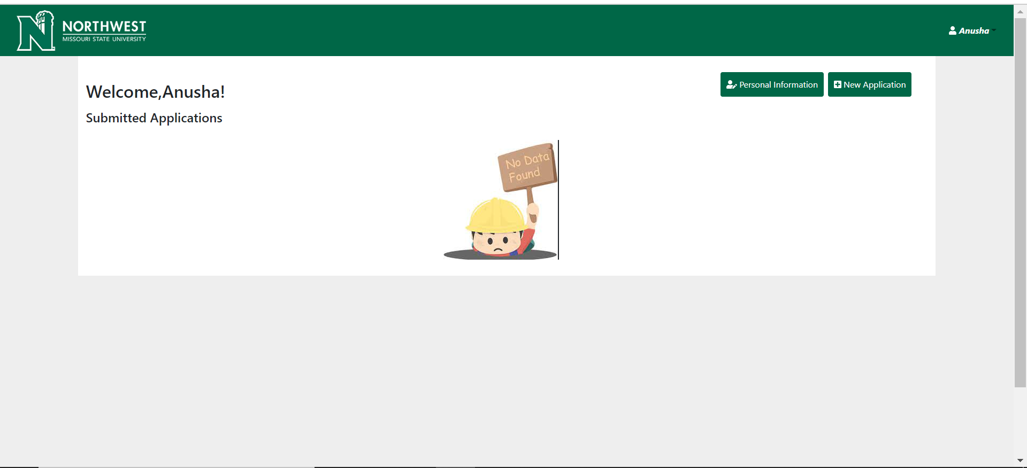
Student Dashboard
This page displays the data of the users/interns once they login into their page.

Slide 7
Results
Developing applications from early stage make us to learn lot of things.
Learn how Teamwork and Communication will plays a crucial role.
Links:
https://github.com/vallapurapuramu/GDP02-Sec01-Group03-InternManager
https://vallapurapuramu.github.io/swagger-github-pages/
https://vallapurapuramu.github.io/internmanager-documentation/#/
https://github.com/vallapurapuramu/GDP02-Sec01-Group03-InternManager/wiki
https://app.codacy.com/gh/vallapurapuramu/intermangaer-ui/dashboard

Slide 8

Thank You…!

