Slide 1
EE 312
Software Implementation I
References
Vallath Nandakumar
Dept of ECE, UT Austin

Slide 2
What is a reference
C++ references allow you to create a second name for a variable that you can use to read or modify the original data stored in that variable.
  The reference is an alias.
A reference may be treated exactly as though it were the original variable for the purpose of accessing and modifying the value of the original variable
  even if the second name (the reference) is located within a different scope.

Slide 3
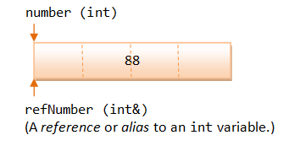
Example
int number = 88; // Declare an int variable called number
int & refNumber = number; // Declare a reference (alias) to the variable number
// Both refNumber and number refer to the same value
Notes:
http://www.ntu.edu.sg/home/ehchua/programming/cpp/cp4_pointerreference.html

Slide 4
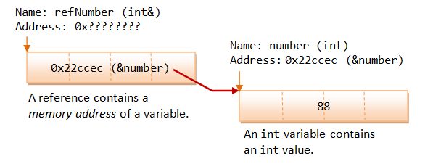
How references work
A reference works as a pointer. A reference is declared as an alias of a variable. It stores the address of the variable.

Slide 5
Functions
References as function arguments
  The most common way of using references is as function arguments
  effectively a way to change the original data passed into the function.
  Reduces the amount of copying

Slide 6
Syntax
int& foo = ....;
Must be initialized upon creation.
Address of RHS variable kept on hand for later modification of variable.
int x; int& foo = x;
// foo is now a reference to x so this sets x to 56 foo = 56;
std::cout << x <<std::endl;

Slide 7
Functions taking reference parameters
void swap (int& first, int& second) {
int temp = first; first = second;
second = temp;
}
Both arguments are passed "by reference"--the caller of the function need not even be aware of it:
int a = 2; int b = 3; swap( a, b );
After the swap, a will be 3 and b will be 2.

Slide 8
C++ References vs Pointers
You cannot have NULL references. You must always be able to assume that a reference is connected to a legitimate piece of storage.
Once a reference is initialized to an object, it cannot be changed to refer to another object.
  Pointers can be pointed to another object at any time.
A reference must be initialized when it is created. Pointers can be initialized at any time.

