Slide 1
Composition, Inheritance EE 312 ECE, UT Austin

Slide 2
Composition
A class has member objects that make up, or compose, the class.
E.g. a Node class has two other Node objects – left and right.
A Car class has an Engine object as a member.
A Customer class has a string object as a member.

Slide 3
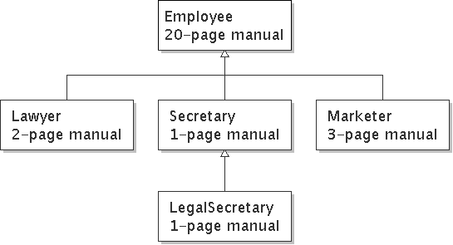
Law firm employee analogy
common rules: hours, vacation, benefits, regulations ...
all employees attend a common orientation to learn general company rules
each employee receives a 20-page manual of common rules
each subdivision also has specific rules:
employee receives a smaller (1-3 page) manual of these rules
smaller manual adds some new rules and also changes some rules from the large manual

Slide 4
Separating behavior
Why not just have a 22 page Lawyer manual, a 21-page Secretary manual, a 23-page Marketer manual, etc.?
Some advantages of the separate manuals:
maintenance: Only one update if a common rule changes.
locality: Quick discovery of all rules specific to lawyers.
Some key ideas from this example:
General rules are useful (the 20-page manual).
Specific rules that may override general ones are also useful.

Slide 5
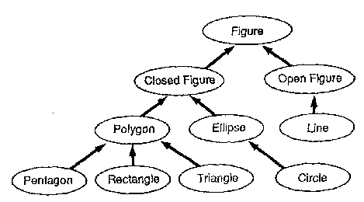
Is-a relationships, hierarchies
is-a relationship: A hierarchical connection where one category can be treated as a specialized version of another.
every marketer is an employee
every legal secretary is a secretary
inheritance hierarchy: A set of classes connected by is-a relationships that can share common code.
Notes:
Talk about the need for multiple inheritances. For example, a person might be an employee of a law firm that has offices in multiple states. They have to inherit methods from TexasEmployee class and the firm's Employee class.

Slide 6
Employee regulations
Consider the following employee regulations:
Employees work 40 hours / week.
Employees make $40,000 per year, except legal secretaries who make $5,000 extra per year ($45,000 total), and marketers who make $10,000 extra per year ($50,000 total).
Employees have 2 weeks of paid vacation leave per year, except lawyers who get an extra week (a total of 3).
Employees should use a yellow form to apply for leave, except for lawyers who use a pink form.
Each type of employee has some unique behavior:
Lawyers know how to sue.
Marketers know how to advertise.
Secretaries know how to take dictation.
Legal secretaries know how to prepare legal documents.

Slide 7
A Useful class
#ifndef USEFUL_H
#define USEFUL_H
class X {
int i;
public:
X() { i = 0; }
void set(int ii) { i = ii; }
int read() const { return i; }
int permute() { return i = i * 47; }
};
#endif // USEFUL_H ///:~

Slide 8
Desire for code-sharing
We'd like to be able to say:
// A class to represent Y.
class Y {
copy all the contents from the X class;
public void newFnUniqueToY () {
}
}

Slide 9
A Derived class
class Y : public X {
int j; // Different from X's i
public:
Y() { j = 0; }
int change() {
j = permute(); // Different name call
return j;
}
void set(int ii) {
j = ii;
X::set(ii); // Same-name function call
}
};

Slide 10
Inheritance
inheritance: A way to form new classes based on existing classes, taking on their attributes/behavior.
a way to group related classes
a way to share code between two or more classes
One class can extend another, absorbing its data/behavior.
Base class: The parent class that is being extended.
Derived class: The child class that extends the base class and inherits its behavior.
Derived class gets a copy of every field and method from base class

Slide 11
Overriding methods
override: To write a new version of a method in a derived class that replaces the base class's version.
No special syntax required to override a base class method. Just write a new version of it in the derived class.

Slide 12
Levels of inheritance
Multiple levels of inheritance in a hierarchy are allowed.

