Slide 1
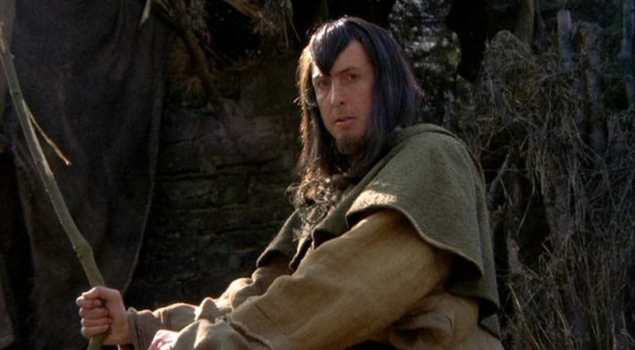
Binary Search Trees
"Yes. Shrubberies are my trade. I am a shrubber. My name is 'Roger the Shrubber'. I arrange, design, and sell shrubberies."
-Monty Python and The Holy Grail

Slide 2
The Problem with Linked Lists
Accessing a item from a linked list takes O(N) time for an arbitrary element
Binary trees can improve upon this and reduce access to O(log N) time for the average case
Expands on the binary search technique and allows insertions and deletions
Worst case degenerates to O(N) but this can be avoided by using balanced trees (AVL, Red-Black)
Binary Search Trees

Slide 3
Binary Search Trees
A binary search tree is a binary tree in which every node's left subtree holds values less than the node's value, and every right subtree holds values greater than the node's value.
A new node is added as a leaf.
root
parent
17
<
>
left child
11
19
right child
Binary Search Trees

Slide 4
BST Insertion
Add the following values one at a time to an initially empty binary search tree using the traditional, naïve algorithm:
90 20 9 98 10 28 -25
What is the resulting tree?
Binary Search Trees

Slide 5
Traversals
What is the result of an inorder traversal of the resulting tree?
How could a preorder traversal be useful?
Binary Search Trees
Notes:
The wikipedia article has a nice concise description of when you would want to use the different types of depth-first search:
Pre-order traversal while duplicating nodes and values can make a complete duplicate of a binary tree. It can also be used to make a prefix expression (Polish notation) from expression trees: traverse the expression tree pre-orderly.
In-order traversal is very commonly used on binary search trees because it returns values from the underlying set in order, according to the comparator that set up the binary search tree (hence the name).
Post-order traversal while deleting or freeing nodes and values can delete or free an entire binary tree. It can also generate a postfix representation of a binary tree.
It boils down to the logistical needs of an algorithm. For example, if you don't use post-order traversal during deletion, then you lose the references you need for deleting the child trees.
http://programmers.stackexchange.com/questions/186667/usefulness-of-pre-and-post-order-traversal-of-binary-trees

Slide 6
Node for Binary Search Trees
Binary Search Trees

Slide 7
Worst Case Performance
Insert the following values into an initially empty binary search tree using the traditional, naïve algorithm:
2 3 5 7 11 13 17
What is the height of the tree?
What is the worst case height of a BST?
Binary Search Trees

Slide 8
Add an Element, Recursive
Binary Search Trees

Slide 9
Add an Element, Iterative
Binary Search Trees

Slide 10
Performance of Binary Trees
For the three core operations (add, access, remove) a binary search tree (BST) has an average case performance of O(log N)
Even when using the naïve insertion / removal algorithms
  no checks to maintain balance
  balance achieved based on the randomness of the data inserted
Binary Search Trees

Slide 11
Remove an Element
Three cases
  node is a leaf, 0 children (easy)
  node has 1 child (easy)
  node has 2 children (interesting)
Binary Search Trees

Slide 12
Removal Leaf
100
90
110
80
95
105
120
70
85
97

Slide 13
Removal Leaf
100
90
110
80
95
105
120
70
Null
97

Slide 14
Removal Leaf
100
90
110
80
95
105
120
70
85
97

Slide 15
Removal Node with single child
100
90
110
80
Null
105
120
70
85
97

Slide 16
Removal Node with 2 children
100
90
110
80
95
105
120
70
85
97

Slide 17
Removal Node with 2 children
105
90
110
80
95
105
120
70
85
97

Slide 18
Removal Node with 2 children
105
90
110
80
95
Null
120
70
85
97

Slide 19
Properties of a BST
The minimum value is in the left most node
The maximum value is in the right most node
  useful when removing an element from the BST
Binary Search Trees

