Slide 1
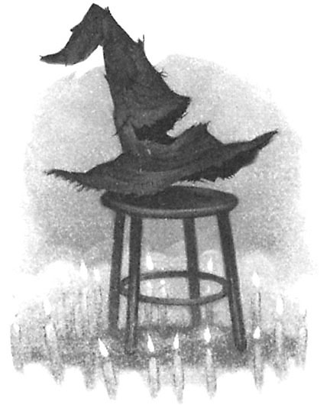
EE 312
Sorting and Searching
"There's nothing in your head the sorting hat can't see. So try me on and I will tell you where you ought to be."
-The Sorting Hat,
Harry Potter and
the Sorcerer's Stone

Slide 2
Searching
Given an array of ints find the index of the first occurrence of a target int
Given the above array and a target of 27 the method returns 2
What if not present?
What if more than one occurrence?
index | 0 | 1 | 2 | 3 | 4 | 5
value | 89 | 0 | 27 | -5 | 42 | 11

Slide 3
linear or sequential search

Slide 4
Sorting
A fundamental application for computers
Done to make finding data (searching) faster
Many different algorithms for sorting
One of the difficulties with sorting is working with a fixed size storage container (array)
  if resize, that is expensive (slow)
  Trying to apply a human technique of sorting can be difficult
  try sorting a pile of papers and clearly write out the algorithm you follow

Slide 5
Selection Sort
To sort a list into ascending order:
  Find the smallest item in an array, the minimum
  Put that value in the first element of the array
    Where to put the value that was in the first location?
  And now…?

Slide 6
Selection Sort in Practice
44 68 191 119 119 37 83 82 191 45 158 130 76 153 39 25
http://tinyurl.com/d7kxxxf
animation of selection sort algorithm

Slide 7
Implementation of
Selection Sort
Include printf commands to trace the sort

Slide 8
Insertion Sort
Another of the simple sorts
The first item is sorted
Compare the second item to the first
  if smaller swap
Third item, compare to item next to it
  need to swap
  after swap compare again
And so forth…

Slide 9
Insertion Sort in Practice
44 68 191 119 119 37 83 82 191 45 158 130 76 153 39 25
http://tinyurl.com/d8spm2l
animation of insertion sort algorithm

Slide 10
Insertion sort pseudo-code
i ← 1
while i < length(A)
j ← i
while j > 0 and A[j-1] > A[j]
swap A[j] and A[j-1]
j ← j - 1
end while i ← i + 1
end while

Slide 11
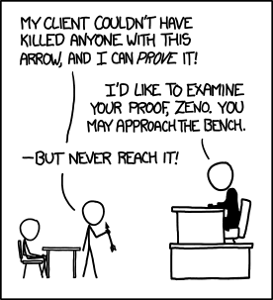
Binary Search

Slide 12
Searching in a Sorted List
If items are sorted then we can divide and conquer
dividing your work in half with each step
  generally a good thing
The Binary Search on List in Ascending order
  Start at middle of list
  is that the item?
  If not is it less than or greater than the item?
  less than, move to second half of list
  greater than, move to first half of list
  repeat until found or sub list size = 0

Slide 13
Binary Search
list
low item middle item high item
Is middle item what we are looking for? If not is it
more or less than the target item? (Assume lower)
list
low middle high
item item item
and so forth…

Slide 14
128
64
32
16
8
4
2
1

Slide 15
Implement Binary Search
0 1 2 3 4 5 6 7 8 9 10 11 12 13 14 15
2
3
5
7
11
13
17
19
23
29
31
37
41
43
47
53

Slide 16
Trace When Key == 3
Trace When Key == 30
Variables of Interest?

