Slide 1

Classes and Objects, state and behavior
"A 'class' is where we teach an 'object' to behave."
-Rich Pattis
Copyright Pearson Education, 2010_x000b_Based on slides bu Marty Stepp and Stuart Reges _x000b_from http://www.buildingjavaprograms.com/

Slide 2
Agenda
Object-oriented programming basics – classes and objects
C++ basics

Slide 3
Classes and objects
class: A program entity that represents A template for a new type of object.
object: An entity that combines state and behavior.
  object-oriented programming (OOP): Programs that perform their behavior as interactions between objects.

Slide 4
Classes
C++ classes are structs
  Fields, like structs
    ints, pointers, arrays, etc.
  Addition of functions that operate on the fields

Slide 5
Clients of objects
client program: A program that uses objects.

Slide 6
An object
Everything is an object. Think of an object as a fancy variable; it stores data, but you can “make requests” to that object, asking it to perform operations on itself. In theory, you can take any conceptual component in the problem you’re trying to solve (dogs, buildings, services, etc.) and represent it as an object in your program.

Slide 7
Programming with objects
A program is a bunch of objects telling each other what to do by sending messages. To make a request of an object, you “send a message” to that object. More concretely, you can think of a message as a request to call a function that belongs to a particular object.

Slide 8
Each object has its own memory made up of other objects. Put another way, you create a new kind of object by making a package containing existing objects. Thus, you can build complexity in a program while hiding it behind the simplicity of objects.

Slide 9
Every object has a type. Using the parlance, each object is an instance of a class, in which “class” is synonymous with “type.” The most important distinguishing characteristic of a class is “What messages can you send to it?”

Slide 10
All objects of a particular type can receive the same messages.
Because an object of type “circle” is also an object of type “shape,” a circle is guaranteed to accept shape messages.
This means you can write code that talks to shapes and automatically handles anything that fits the description of a shape. This substitutability is one of the most powerful concepts in OOP.

Slide 11
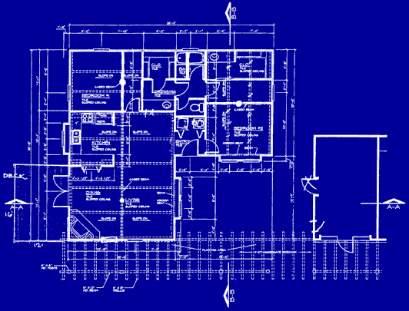
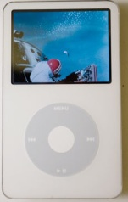
Blueprint analogy
iPod blueprint
state:
current song
volume
battery life
behavior:
power on/off
change station/song
change volume
choose random song
creates
iPod #1
state:
song = "1,000,000 Miles"
volume = 17
battery life = 2.5 hrs
behavior:
power on/off
change station/song
change volume
choose random song
iPod #2
state:
song = "Letting You"
volume = 9
battery life = 3.41 hrs
behavior:
power on/off
change station/song
change volume
choose random song
iPod #3
state:
song = "Discipline"
volume = 24
battery life = 1.8 hrs
behavior:
power on/off
change station/song
change volume
choose random song

Slide 12
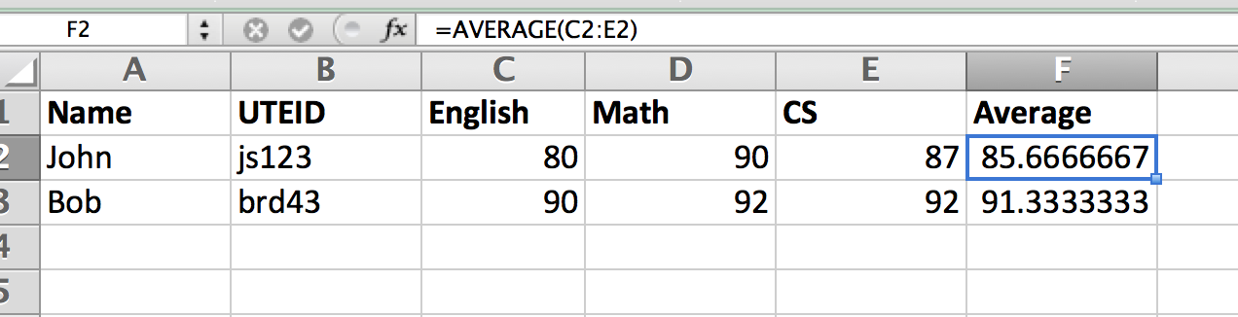
Spreadsheet analogy
Functions are
formulas.
Field names
in top row.
Student objects
in rows.

Slide 13

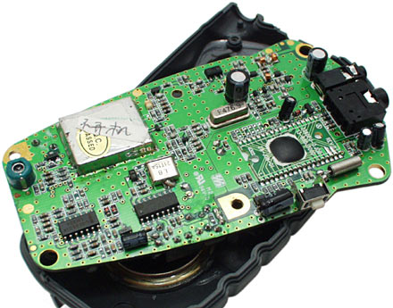
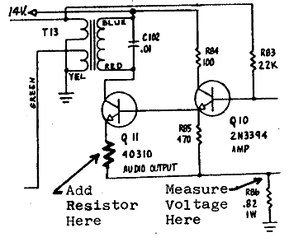
Abstraction
abstraction: A distancing between ideas and details.
  We can use objects without knowing how they work.
abstraction in an iPod:
  You understand its external behavior (buttons, screen).
  You don't understand its inner details, and you don't need to.

Slide 14
Object and Client
Consider a Student object
  Might contain data such as name (a string), GPA (a double), current enrollment status (a bool), transcript (another object within this object).
Consider its client
  A program that computes merit scholarship eligibility using an array of Student objects, returning another array of Student objects

Slide 15
Linked List in C
struct LinkedList {};
*LinkedList createLL() {}
void destroyLL(*LinkedList) {}

Slide 16
Constructors
A struct needs to be initialized. Why not keep the initialization task in the struct?
  Constructors (special functions)
A constructor first allocates the necessary memory.
  A pointer to the struct, called ‘this’ is generated.
Then the constructor runs the statements in it to initialize the struct.
‘this’ is returned.

Slide 17
Destructors
When a struct’s job is done, it must be freed.
Use the destructor to free a struct’s contents.
Never free ‘this’ in a destructor.

Slide 18
Encapsulation
Having data and functions bundled up
Keeping some details hidden from clients
Inheritance, Polymorphism covered in other classes

