Slide 1
Recursion
EE 312
Copyright (c) Pearson 2013.
All rights reserved.

Slide 2
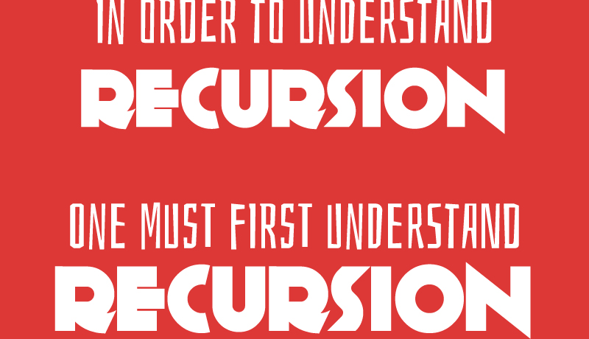

Slide 3
Recursion
recursion: The definition of an operation in terms of itself.
  Solving a problem using recursion depends on solving
  smaller occurrences of the same problem.
recursive programming: Writing methods that call themselves to solve problems recursively.
  An equally powerful substitute for iteration (loops)
  Particularly well-suited to solving certain types of problems

Slide 4
Why learn recursion?
"cultural experience" - A different way of thinking of problems
Can solve some kinds of problems better than iteration
Leads to elegant, simplistic, short code (when used well)
Many programming languages ("functional" languages such as Scheme, ML, and Haskell) use recursion exclusively (no loops)

Slide 5
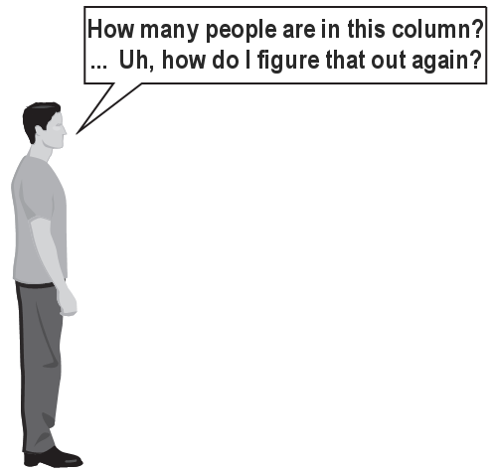
Exercise
(To a student in the front row)
How many students total are directly behind you in your "column" of the classroom?
  You have poor vision, so you can
  see only the people right next to you.
  So you can't just look back and count.
  But you are allowed to ask
  questions of the person next to you.
  How can we solve this problem?
  (recursively )

Slide 6
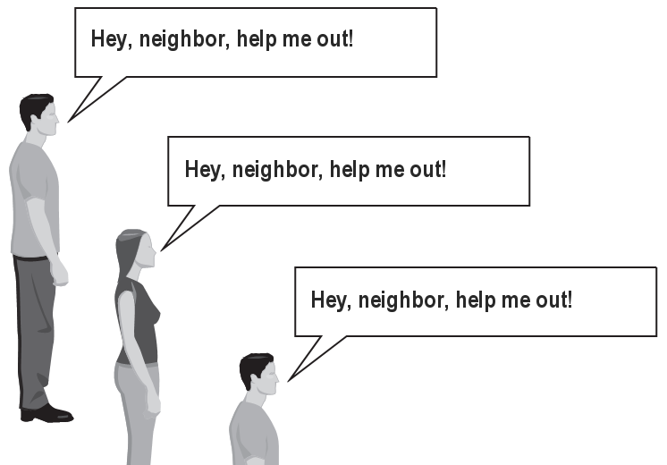
The idea
Recursion is all about breaking a big problem into smaller occurrences of that same problem.
  Each person can solve a small part of the problem.
    What is a small version of the problem that would be easy to answer?
    What information from a neighbor might help me?

Slide 7
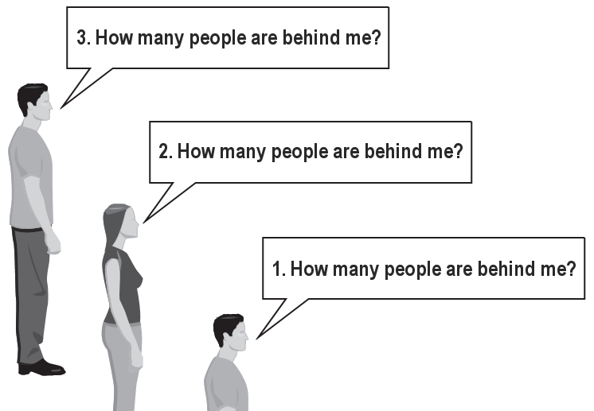
Recursive algorithm
Number of people behind me:
  If there is someone behind me,
  ask him/her how many people are behind him/her.
    When they respond with a value N, then I will answer N + 1.
  If there is nobody behind me, I will answer 0.

Slide 8
Recursion and cases
Every recursive algorithm involves at least 2 cases:
  base case: A simple occurrence that can be answered directly.
  recursive case: A more complex occurrence of the problem that cannot be directly answered, but can instead be described in terms of smaller occurrences of the same problem.
  Some recursive algorithms have more than one base or recursive case, but all have at least one of each.
  A crucial part of recursive programming is identifying these cases.

Slide 9
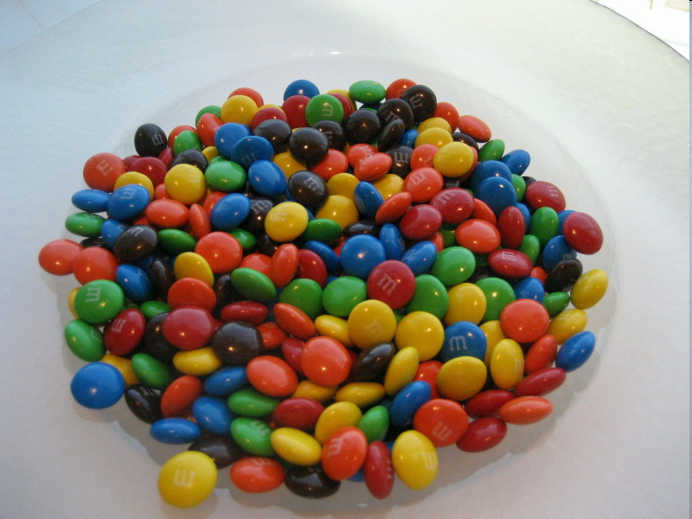
Another recursive task
How can we remove exactly half of the M&M's in a large bowl, without dumping them all out or being able to count them?
  What if multiple people help out with solving the problem?
  Can each person do a small part of the work?
  What is a number of M&M's
  that it is easy to double,
  even if you can't count?
  (What is a "base case"?)

Slide 10
!Recursion
Recursion is not really calling the same function
  The arguments are different, so the stack frame is different.
  As far as the computer goes, they are different functions that are being called.

Slide 11
3 essentials for recursion solutions
Way to make the problem data smaller and smaller, so that it approaches some easily solvable value.
Way to solve the base case, the smallest data input problem.
An assumption, or leap of faith, that we have a method of solving a smaller version of the problem, and a call to that function within our function.
  The recursive case

Slide 12
Recursion
Consider the following method to print a line of * characters:
  // Prints a line containing the given number of stars.
  // Precondition: n >= 0
  void printStars(int n) {
  for (int i = 0; i < n; i++) {
  printf(“%s”, ”*");
  }
  puts(“”); // end the line of output
  }
Write a recursive version of this method (that calls itself).
  Solve the problem without using any loops.
  Hint: Your solution should print just one star at a time.

Slide 13
A basic case
What are the cases to consider?
  What is a very easy number of stars to print without a loop?
  void printStars(int n) {
  if (n == 1) {
  // base case; just print one star
  printf(“%s\n”, ”*");
  } else {
  ...
  }
  }

Slide 14
Handling more cases
Handling additional cases, with no loops (in a bad way):
  printStars(int n) {
  if (n == 1) {
  // base case; just print one star
  printf(“%s\n”, ”*");
  } else if (n == 2) {
  printf(“%s”, ”*");
  printf(“%s\n”, ”*");
  } else if (n == 3) {
  printf(“%s”, ”*");
  printf(“%s”, ”*");
  printf(“%s\n”, ”*");
  } else ...
  }

Slide 15
Handling more cases 2
Taking advantage of the repeated pattern (somewhat better):
  void printStars(int n) {
  if (n == 1) {
  // base case; just print one star
  printf(“%s\n”, ”*”);
  } else if (n == 2) {
  printf(“%s”, ”*”);
  printStars(1); // prints "*"
  } else if (n == 3) {
  printf(“%s”, ”*”);
  printStars(2); // prints "**"
  } else if (n == 4) {
  printf(“%s”, ”*”);
  printStars(3); // prints "***"
  } else ...
  }

Slide 16
Using recursion properly
Condensing the recursive cases into a single case:
  void printStars(int n) {
  if (n == 1) {
  // base case; just print one star
  printf(“%s\n”, ”*”);
  } else {
  // recursive case; print one more star
  System.out.print("*");
  printStars(n - 1);
  }
  }

Slide 17
"Recursion Zen"
The real, even simpler, base case is an n of 0, not 1:
  void printStars(int n) {
  if (n == 0) {
  // base case; just end the line of output
  puts(“”);
  } else {
  // recursive case; print one more star
  printf(“%s\n”, ”*”);
  printStars(n - 1);
  }
  }
  Recursion Zen: The art of properly identifying the best set of cases for a recursive algorithm and expressing them elegantly.

Slide 18
Exercise
Write a recursive method pow accepts an integer base and exponent and returns the base raised to that exponent.
  Example: pow(3, 4) returns 81
  Solve the problem recursively and without using loops.

Slide 19
Exercise
Write a recursive method printBinary that accepts an integer and prints that number's representation in binary (base 2).
  Example: printBinary(7) prints 111
  Example: printBinary(12) prints 1100
  Example: printBinary(42) prints 101010
  Write the method recursively and without using any loops.
place | 10 | 1 |  | 32 | 16 | 8 | 4 | 2 | 1
value | 4 | 2 |  | 1 | 0 | 1 | 0 | 1 | 0

Slide 20
Case analysis
Recursion is about solving a small piece of a large problem.
  What is 69743 in binary?
    Do we know anything about its representation in binary?
  Case analysis:
    What is/are easy numbers to print in binary?
    Can we express a larger number in terms of a smaller number(s)?
  Suppose we are examining some arbitrary integer N.
    if N's binary representation is 10010101011
    (N / 2)'s binary representation is 1001010101
    (N % 2)'s binary representation is 1

Slide 21
printBinary solution
  // Prints the given integer's binary representation.
  // Precondition: n >= 0
  void printBinary(int n) {
  if (n < 2) {
  // base case; same as base 10
  printf(“%d\n”, n);
  } else {
  // recursive case; break number apart
  printBinary(n / 2);
  printBinary(n % 2);
  }
  }
  Can we eliminate the precondition and deal with negatives?

Slide 22
printBinary solution 2
  // Prints the given integer's binary representation.
  void printBinary(int n) {
  if (n < 0) {
  // recursive case for negative numbers
  printf(“%s”, "-");
  printBinary(-n);
  } else if (n < 2) {
  // base case; same as base 10
  printf(“%d\n”, n);
  } else {
  // recursive case; break number apart
  printBinary(n / 2);
  printBinary(n % 2);
  }
  }

Slide 23
Exercise
Write a recursive method isPalindrome accepts a String and returns true if it reads the same forwards as backwards.
  isPalindrome("madam") → true
  isPalindrome("racecar") → true
  isPalindrome("step on no pets") → true
  isPalindrome("able was I ere I saw elba") → true
  isPalindrome("Java") → false
  isPalindrome("rotater") → false
  isPalindrome("byebye") → false
  isPalindrome("notion") → false

