Slide 1
Efficiency – Complexity
Algorithm Analysis
"bit twiddling: 1. (pejorative) An exercise in tuning (see tune) in which incredible amounts of time and effort go to produce little noticeable improvement, often with the result that the code becomes incomprehensible."
- The Hackers Dictionary, version 4.4.7

Slide 2
Question 1
Primes
EE 312
Complexity 2

Slide 3
Efficiency
Computer Scientists don’t just write programs.
They also analyze them.
How efficient is a program?
  How much time does it take program to complete?
  How much memory does a program use?
  How do these change as the amount of data changes?
EE 312
Complexity 2

Slide 4
Technique
Informal approach for this class
  more formal techniques in theory classes
Many simplifications
  view algorithms as C/C++ programs
  count executable statements in program or method
  find number of statements as function of the amount of data
  focus on the dominant term in the function
EE 312
Complexity 2

Slide 5
Counting Statements
int x; // one statement
x = 12; // one statement
int y = z * x + 3 % 5 * x / i; // 1
x++; // one statement
bool p = x < y && y % 2 == 0 ||
z >= y * x; // 1
int list[100]; // 1, on stack
list[0] = x * x + y * y; // 1
int* p = (int*)(malloc(100)); // ???
EE 312
Complexity 2

Slide 6
Example
How many statements are executed by method total as a function of n
Let N = length
  N is commonly used as a variable that denotes the amount of data
int total(int values[], int length) {
int result = 0;
for(int i = 0; i < length; i++)
result += values[i];
return result;
}
EE 422C
Efficiency - Complexity

Slide 7
Question 2
Malloc
EE 312
Complexity 2

Slide 8
Counting Up Statements
int result = 0; 1
int i = 0; 1
i < length; N + 1
i++ N
result += values[i]; N
return total; 1
T(N) = 3N + 4
T(N) is the number of executable statements in method total as function of length
EE 422C
Efficiency - Complexity

Slide 9
Question 3
Which of the following is true?
Method total is O(N)
Method total is O(N²)
Method total is O(N!)
Method total is O(N^{N})
All of the above are true
EE 312
Complexity 2

Slide 10
Sidetrack, the logarithm
3² = 9
likewise log₃ 9 = 2
  "The log to the base 3 of 9 is 2."
The way to think about log is:
  "the log to the base x of y is the number you can raise x to to get y."
  Say to yourself "The log is the exponent." (and say it over and over until you believe it.)
  In CS we work with base 2 logs, a lot
log₂ 32 = ? log₂ 8 = ? log₂ 1024 = ? log₁₀ 1000 = ?
EE 312
Complexity 2

Slide 11
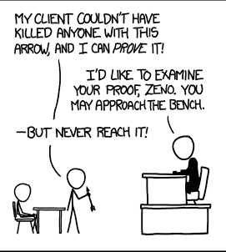
When Do Logarithms Occur
Algorithms have a logarithmic term when they use a divide and conquer technique
the data set keeps getting divided by 2
int foo(int n) {
// pre n > 0
int total = 0;
while( n > 0 ) {
n = n / 2;
total++;
}
return total;
}
What is the order of the above code?
O(1) B. O(logN) C. O(N)
D. O(Nlog N) E. O(N²)
EE 312
Complexity 2

Slide 12
Dealing with other methods
What do I do about method calls?
double sum = 0.0;
for(int i = 0; i < n; i++)
sum += fsqrt(i);
Long way
  go to that method and count statements
Short way
  substitute the simplified Big O function for that method.
  if fsqrt is constant time, O(1), simply count sum += fsqrt(i); as one statement.
EE 312
Complexity 2

Slide 13
Dealing With Other Methods
int foo(int N, int list []) {
int total = 0;
for(int i = 0; i < N; i++)
total += countDups(list[i], list, N);
return total;
}
// method countDups is O(N) where N is the
// length of the array it is passed
What is the Big O of foo?
O(1) B. O(N) C. O(NlogN)
D. O(N²) E. O(N!)
EE 312
Complexity 2

Slide 14
Independent Loops
// for a matrix
void scale(int factor) {
for(int r = 0; r < numRows(); r++)
for(int c = 0; c < numCols(); c++)
iCells[r][c] *= factor;
}
Assume an numRows() = N and numCols() = N.
In other words, a square Matrix.
numRows and numCols are O(1)
What is the T(N)? What is the Big O?
O(1) B. O(N) C. O(NlogN)
D. O(N²) E. O(N!)
EE 312
Complexity 2

Slide 15
Significant Improvement – Algorithm with Smaller Big O function
Problem: Given an array of ints replace any element equal to 0 with the maximum positive value to the right of that element. (if no positive value to the right, leave unchanged.)
Given:
[0, 9, 0, 13, 0, 0, 7, 1, -1, 0, 1, 0]
Becomes:
[13, 9, 13, 13, 7, 7, 7, 1, -1, 1, 1, 0]
EE 312
Complexity 2

Slide 16
Replace Zeros – Typical Solution
void replace0s(int size, int data[]){
for(int i = 0; i < size-1; i++){
if( data[i] == 0 ) {
int max = 0;
for(int j = i+1; j<size; j++)
max = fmax(max, data[j]);
data[i] = max;
}
}
}
Assume all values are zeros. (worst case)
Example of a dependent loop.
EE 312
Complexity 2

Slide 17
Replace Zeros – Alternate Solution
void replace0s(int size, int data[]){
int max =
Math.max(0, data[size– 1]);
int start = size– 2;
for(int i = start; i >= 0; i--){
if( data[i] == 0 )
data[i] = max;
else
max = fmax(max, data[i]);
}
}
Big O of this approach?
O(1) B. O(N) C. O(NlogN)
D. O(N²) E. O(N!)
EE 312
Complexity 2

Slide 18
A Useful Proportion
Since F(N) characterizes the running time of an algorithm the following proportion should hold true:
F(N₀) / F(N₁) ~= time₀ / time₁
An algorithm that is O(N²) takes 3 seconds to run given 10,000 pieces of data.
  How long do you expect it to take when there are 30,000 pieces of data?
EE 312
Complexity 2

Slide 19
Why Use Big O?
As we build data structures Big O is the tool we will use to decide under what conditions one data structure is better than another
Think about performance when there is a lot of data.
  "It worked so well with small data sets..."
  Joel Spolsky, Schlemiel the painter's Algorithm
Lots of trade offs
  some data structures good for certain types of problems, bad for other types
  often able to trade SPACE for TIME.
  Faster solution that uses more space
  Slower solution that uses less space
EE 312
Complexity 2

Slide 20
Big O Space
Big O could be used to specify how much space is needed for a particular algorithm
  in other words how many variables are needed
Often there is a time – space tradeoff
  can often take less time if willing to use more memory
  can often use less memory if willing to take longer
  truly beautiful solutions take less time and space
The biggest difference between time and space is that you can't reuse time. - Merrick Furst
EE 312
Complexity 2

Slide 21
Quantifiers on Big O
It is often useful to discuss different cases for an algorithm
Best Case: what is the best we can hope for?
  least interesting
Average Case (a.k.a. expected running time): what usually happens with the algorithm?
Worst Case: what is the worst we can expect of the algorithm?
  very interesting to compare this to the average case
EE 312
Complexity 2

Slide 22
Best, Average, Worst Case
To Determine the best, average, and worst case Big O we must make assumptions about the data set
Best case -> what are the properties of the data set that will lead to the fewest number of executable statements (steps in the algorithm)
Worst case -> what are the properties of the data set that will lead to the largest number of executable statements
Average case -> Usually this means assuming the data is randomly distributed
  or if I ran the algorithm a large number of times with different sets of data what would the average amount of work be for those runs?
EE 312
Complexity 2

Slide 23
Another Example
double minimum(int n, double values[])
{double minValue = values[0];
for(int i = 1; i < n; i++)
if(values[i] < minValue)
minValue = values[i];
return minValue;
}
T(N)? F(N)? Big O? Best case? Worst Case? Average Case?
If no other information, assume asking worst case
EE 312
Complexity 2

Slide 24
Example of Dominance
Look at an extreme example. Assume the actual number as a function of the amount of data is:
N²/10000 + 2Nlog₁₀ N+ 100000
Is it plausible to say the N² term dominates even though it is divided by 10000 and that the algorithm is O(N²)?
What if we separate the equation into (N²/10000) and (2N log₁₀ N + 100000) and graph the results.
EE 312
Complexity 2

Slide 25
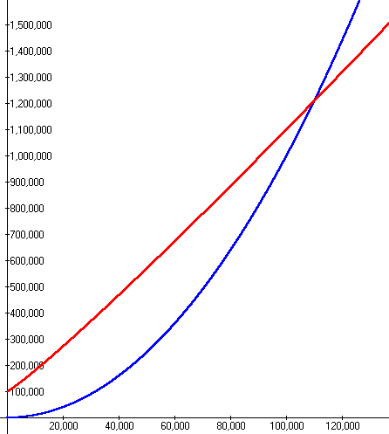
Summing Execution Times
For large values of N the N² term dominates so the algorithm is O(N²)
When does it make sense to use a computer?
red line is
2Nlog10 N + 100000
blue line is
N²/10000
EE 312
Complexity 2

Slide 26
Comparing Grades
Assume we have a problem
Algorithm A solves the problem correctly and is O(N²)
Algorithm B solves the same problem correctly and is O(N log₂N )
Which algorithm is faster?
One of the assumptions of Big O is that the data set is large.
The "grades" should be accurate tools if this is true
EE 312
Complexity 2

Slide 27
Running Times
Assume N = 100,000 and processor speed is 1,000,000,000 operations per second
Function | Running Time
2^{N} | 3.2 x 10³⁰⁰⁸⁶ years
N⁴ | 3171 years
N³ | 11.6 days
N² | 10 seconds
N N | 0.032 seconds
N log N | 0.0017 seconds
N | 0.0001 seconds
N | 3.2 x 10⁻⁷ seconds
log N | 1.2 x 10⁻⁸ seconds
EE 312
Complexity 2

Slide 28
Theory to Practice OR
Dijkstra says: "Pictures are for the Weak."
 | 1000 | 2000 | 4000 | 8000 | 16000 | 32000 | 64000 | 128K
O(N) | 2.2x10⁻⁵ | 2.7x10⁻⁵ | 5.4x10⁻⁵ | 4.2x10⁻⁵ | 6.8x10⁻⁵ | 1.2x10⁻⁴ | 2.3x10⁻⁴ | 5.1x10⁻⁴
O(NlogN) | 8.5x10⁻⁵ | 1.9x10⁻⁴ | 3.7x10⁻⁴ | 4.7x10⁻⁴ | 1.0x10⁻³ | 2.1x10⁻³ | 4.6x10⁻³ | 1.2x10⁻²
O(N^{3/2}) | 3.5x10⁻⁵ | 6.9x10⁻⁴ | 1.7x10⁻³ | 5.0x10⁻³ | 1.4x10⁻² | 3.8x10⁻² | 0.11 | 0.30
O(N²) ind. | 3.4x10⁻³ | 1.4x10⁻³ | 4.4x10⁻³ | 0.22 | 0.86 | 3.45 | 13.79 | ⁽⁵⁵⁾
O(N²) dep. | 1.8x10⁻³ | 7.1x10⁻³ | 2.7x10⁻² | 0.11 | 0.43 | 1.73 | 6.90 | ^{(27.6)}
O(N³) | 3.40 | 27.26 | ⁽²¹⁸⁾ | ⁽¹⁷⁴⁵⁾ ^{29 min.} | ^{(13,957)} ^{233 min} | ^{(112k)} ^{31 hrs} | ^{(896k)} ^{10 days} | ^{(7.2m)} ^{80 days}
Times in Seconds. Red indicates predicated value.
EE 312
Complexity 2

Slide 29
Change between Data Points
 | 1000 | 2000 | 4000 | 8000 | 16000 | 32000 | 64000 | 128K | 256k | 512k
O(N) | - | ^{1.21} | ^{2.02} | ^{0.78} | ^{1.62} | ^{1.76} | ^{1.89} | ^{2.24} | ^{2.11} | ^{1.62}
O(NlogN) | ⁻ | ^{2.18} | ^{1.99} | ^{1.27} | ^{2.13} | ^{2.15} | ^{2.15} | ^{2.71} | ^{1.64} | ^{2.40}
O(N^{3/2}) | ⁻ | ^{1.98} | ^{2.48} | ^{2.87} | ^{2.79} | ^{2.76} | ^{2.85} | ^{2.79} | ^{2.82} | ^{2.81}
O(N²) ind | ⁻ | ^{4.06} | ^{3.98} | ^{3.94} | ^{3.99} | ^{4.00} | ^{3.99} | ⁻ | ⁻ | ⁻
O(N²) dep | ⁻ | ^{4.00} | ^{3.82} | ^{3.97} | ^{4.00} | ^{4.01} | ^{3.98} | ⁻ | ⁻ | ⁻
O(N³) | ⁻ | ^{8.03} | ⁻ | ⁻ | ⁻ | ⁻ | ⁻ | ⁻ | ⁻ | ⁻
Value obtained by Time_{x} / Time_{x-1}
EE 312
Complexity 2

Slide 30
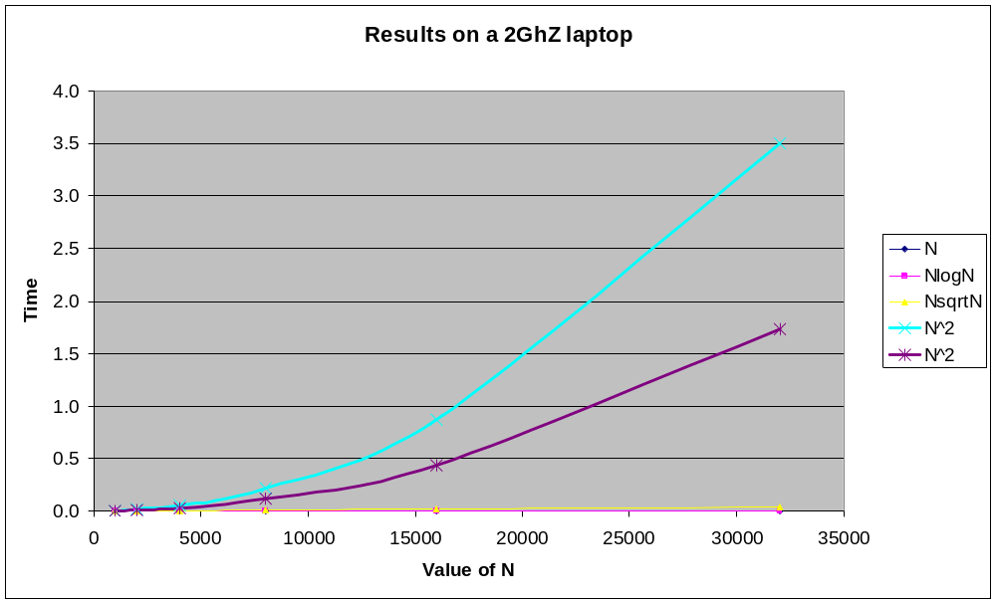
Okay, Pictures
EE 312
Complexity 2

Slide 31
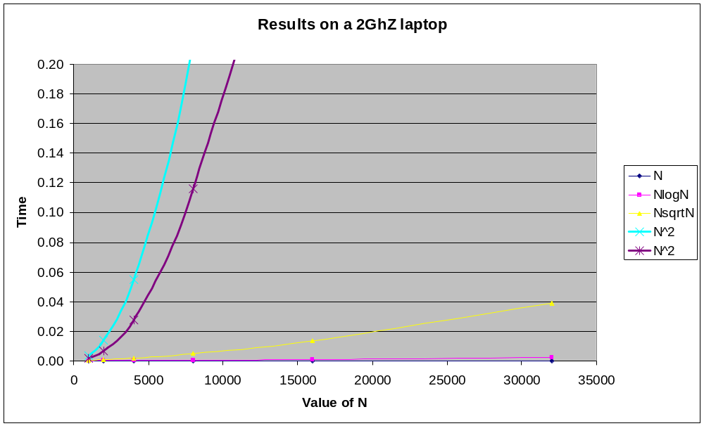
Put a Cap on Time
EE 312
Complexity 2

Slide 32
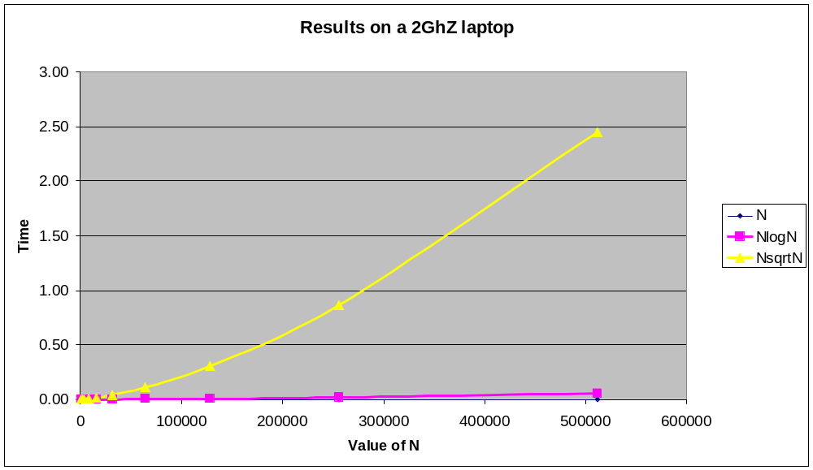
No O(N^2) Data
EE 312
Complexity 2

Slide 33
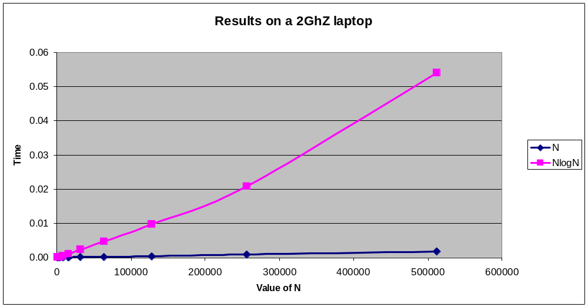
Just O(N) and O(NlogN)
EE 312
Complexity 2

Slide 34
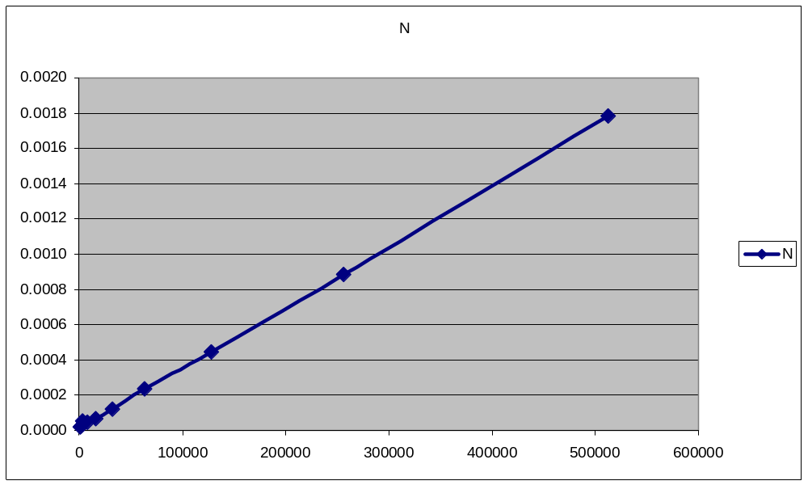
Just O(N)
EE 312
Complexity 2

Slide 35
10⁹ instructions/sec, runtimes
N | O(log N) | O(N) | O(N log N) | O(N²)
10 | 0.000000003 | 0.00000001 | 0.000000033 | 0.0000001
100 | 0.000000007 | 0.00000010 | 0.000000664 | 0.0001000
1,000 | 0.000000010 | 0.00000100 | 0.000010000 | 0.001
10,000 | 0.000000013 | 0.00001000 | 0.000132900 | 0.1 min
100,000 | 0.000000017 | 0.00010000 | 0.001661000 | 10 seconds
1,000,000 | 0.000000020 | 0.001 | 0.0199 | 16.7 minutes
1,000,000,000 | 0.000000030 | 1.0 second | 30 seconds | 31.7 years
EE 312
Complexity 2

Slide 36
Formal Definition of Big O (repeated)
T(N) is O( F(N) ) if there are positive constants c and N₀ such that T(N) < cF(N) when N > N₀
  N is the size of the data set the algorithm works on
  T(N) is a function that characterizes the actual running time of the algorithm
  F(N) is a function that characterizes an upper bounds on T(N). It is a limit on the running time of the algorithm
  c and N₀ are constants
EE 312
Complexity 2

Slide 37
More on the Formal Definition
There is a point N₀ such that for all values of N that are past this point, T(N) is bounded by some multiple of F(N)
Thus if T(N) of the algorithm is O( N^2 ) then, ignoring constants, at some point we can bound the running time by a quadratic function.
given a linear algorithm it is technically correct to say the running time is O(N ^ 2). O(N) is a more precise answer as to the Big O of the linear algorithm
  thus the caveat “pick the most restrictive function” in Big O type questions.
EE 312
Complexity 2

Slide 38
What it All Means
T(N) is the actual growth rate of the algorithm
  can be equated to the number of executable statements in a program or chunk of code
F(N) is the function that bounds the growth rate from above (upper bound)
T(N) may not necessarily equal F(N)
  constants and lesser terms ignored because it is a bounding function
EE 312
Complexity 2

