Slide 1
EE 312
Day 2, intro

Slide 2
Last class
Wrote a C program in the Linux environment
This will be THE STANDARD environment for grading your homework assignments

Slide 3
How to catch up
Ask questions in class
Ask questions during recitation
Attend office hours – even if you have no questions
Do your work there

Slide 4
This class
Makefile
Write a more complex program
CLion
Variables

Slide 5
Makefile
A Makefile is a text file that specifies a recipe to create a program from components
The program is the executable file, e.g. a.out
The components are the .c files and the library files
Makefile is created by a human, and a program called make reads the Makefile and executes the instructions.

Slide 6
Targets and Dependencies
A Makefile specifies targets that have to be ‘made’, and dependencies that affect the making of the target.
Rules (instructions) for making each target are specified.
If a target is a file (as is common) and is newer than all its dependencies, it will not be re-created. The file’s datestamp is used to determine which is newer – the
Each dependency could be a file that is itself a target for another set of rules, with another set of dependencies.

Slide 7
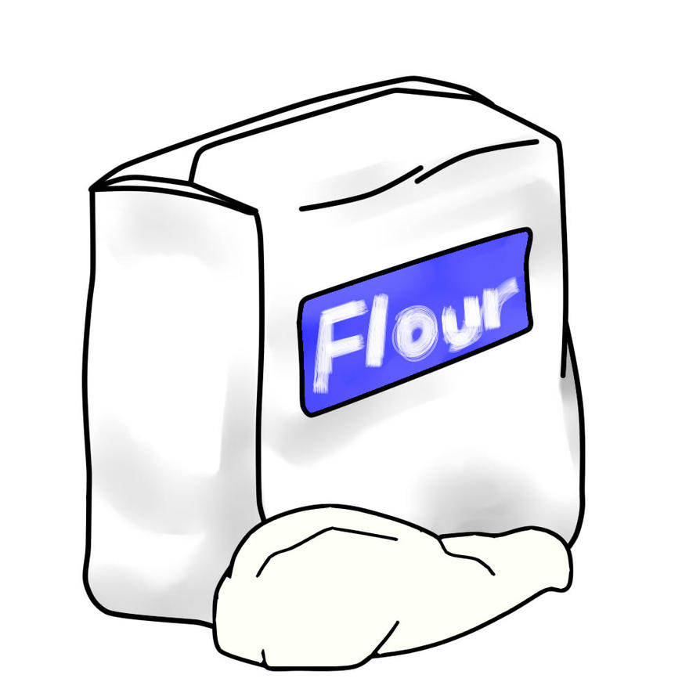

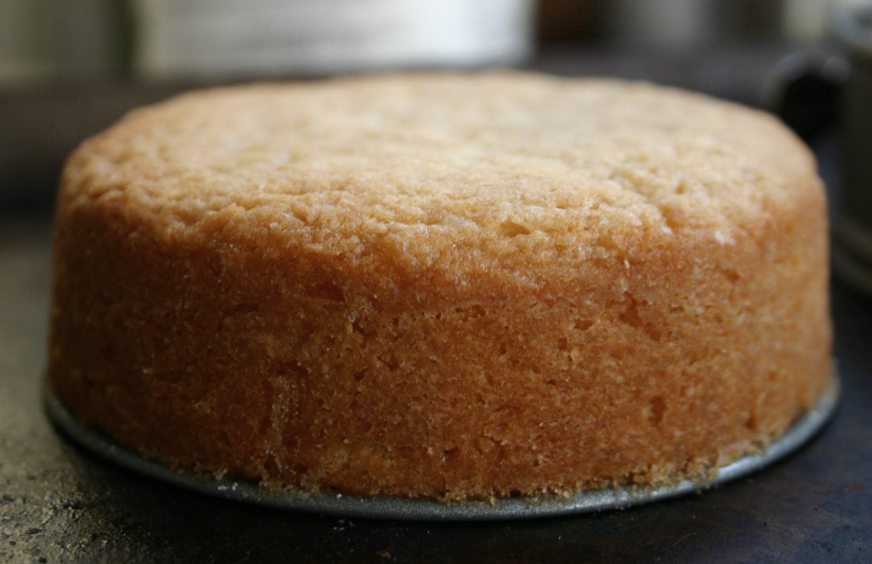



Baking a Cake
Dependency
Rule: Bake batter
Rule: Mix ingredients
Target
Rule: Frost cake
Dependency

Slide 8

Clean up
Target: clean
Rule: Discard cake, batter, and plain cake,
but not flour or eggs or icing

Slide 9
How to. use a Makefile
To make a target, type in
make target
at the prompt in a Linux terminal.
To pretend to make a target to see what will be done,

Slide 10
FAQ
How do I get instant Piazza notifications?
Click on the right hand top corner gear, and change Email settings.
I am not getting Piazza email updates, although I have access, and my settings are for email updates.
Contact Piazza help right away.

Slide 11
FAQ
Should I use Linux or Windows/Mac?
You can develop on Windows or Mac, and port to Linux for final testing.
Can I use command line and make on Windows?
Yes, but it is a bit complicated and not recommended.
Having to learn a new language and a new programming environment is confusing.
This is unfortunately a reality because all of you have different machines. In industry, you can expect such challenges anyway.

Slide 12
FAQ
Can I use a GUI on Linux or Mac to program
Yes, use CLion

Slide 13
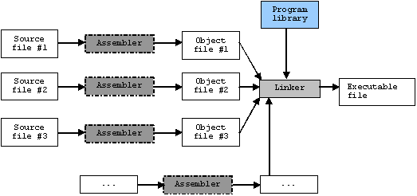

Slide 14
Agenda
Integer, character, and boolean types
Benefits of int32 and related types (<stdint.h>)
Formalize meaning of type in C (i.e., strongly typed)
Memory location concept
Local and global variables
Strings
Arrays

Slide 15
C types
Every expression in C has a well-defined, fixed type
42 -- type type is int
3.14159 -- type is double
“Hello World" -- type is char*
Variables in C also must have a well-defined fixed type – that type is set when the variable is defined
int x = 42;
char* s = ``Hello World’’;
It's worth restating -- every expression in C has a well-defined fixed type
x + 1 -- type is int
“Hello World"[2] -- type is char

Slide 16
What is a Type?
Types in C/C++ are vitally important (as they are in almost all programming languages)
Specifies how many bytes of memory must be allocated to store the variable
Specifies how the bits in the memory location(s) for that variable will be interpreted (e.g., 2s complement or binary for int32_t or uint32_t respectively)

Slide 17
What is a Type?
Specifies what operations are permissible with the variable
E.g., the % operator is defined for integer variables, but is not defined for floating point variables in C
Pointer variables have unary * but no binary * operator
Numeric variables are the opposite (binary * but not unary *)
Specifies what instruction(s) are used to implement operations on that variable
Floating point multiplication uses a completely different circuit than integer multiplication inside the CPU

Slide 18
Standard Integer Types
char, short, int, long, long long
The last type long long is an extension supported by most compilers in C. It is part of C++ since C++-11
int is the default type for literals like 42 or -12
The standard integer types have undefined sizes except
char is one byte
Each type is at least as long as the preceding type (int has at least as many bits as short, short has at least as many bits as char, and so forth)
There are signed and unsigned forms of each type
int, signed int, and signed are synonyms
unsigned int and unsigned are synonyms

Slide 19
Preferred Integer Types
Use char for character data
Use int32_t as your default (small) integer
Use int64_t if you are working with large integers
Use uint32_t if you have a size, a quantity or an array index (things that can't be negative)
Use uint64_t if you need larger sizes/indices
(C++ only) Use bool if you need to represent true (1) or false (0)
There are plenty of good exceptions to these rules, but good exceptions require good engineering to justify them.

Slide 20
Variables, Globals and Locals
Always prefer locals to globals (why?)
A global variable is defined outside of any functions; a local variable is defined inside a function
int32 t a global;
int main(void) {
int32 t a local;
}
Global variables are created before main starts executing and last until after the program has shut down. Globals can be accessed from any function.
Local variables are created only when their host function is actually called, and are destroyed when the function returns (locals are sometimes called “automatic"). A local variable can only be accessed from inside its host function

Slide 21
Scoping
The global/local distinction is very important because the two types have very different storage implementations. Scoping is less fundamental, but has a big impact on C program style (and can be confusing)
Each new { that you add creates a new scope in C/C++.
Each new scope can have a brand new set of “even more local" variables
When the compiler tries to match the use of a variable to the definition of the same variable, it works from the innermost scope outward, until it finds the match

Slide 22
Scoping Example
int main(void) {
int32_t x = 1; // local x #1
if(x == 1) { //new { creates a new scope
int32_t x = 2; // different x, local x #2
}
printf("x is %d\n", x); // prints 1
}
A very common beginner mistake is to write: int32_t x = 2;
when the programmer meant to write: x = 2;

Slide 23
Declaring a variable or function
When you declare a variable, a function, or even a struct, all you are doing is saying: there is something with this name, and it has this type.
The compiler can then handle most (but not all) uses of that name without needing the full definition of that name.
Declaring a value--without defining it--allows you to write code that the compiler can understand without having to put all of the details.
This is particularly useful if you are working with multiple source files, and you need to use a function in multiple files. You don't want to put the body of the function in multiple files, but you do need to provide a declaration for it.

Slide 24
Defining a variable or function
Defining something means providing all of the necessary information to create that thing in its entirety. Defining a function means providing a function body; defining a class means giving all of the methods of the class and the fields.
Once something is defined, that also counts as declaring it; so you can often both declare and define a function, struct, class or variable at the same time. But you don't have to.

Slide 25
Declarations and Definitions
Every variable (and function) in C/C++ must be defined exactly once, but it can be declared multiple times
Local variables cannot be declared without also defining them
Global variables can be declared (and not defined) by adding the extern keyword
int32_t a_global; // definition
extern int32_t a_global; // declaration
Definitions are also declarations, declarations are not definitions. Usually declarations are placed in .h files so that global variables can be used (i.e., shared) by functions spread across multiple source files (.c and .cpp files)
The important point is that a definition actually allocates memory (and may also provide an initial value). The declaration simply says, "this variable exists somewhere"

Slide 26
Function Declarations and Definitions
Function declarations are often informally called "prototypes"
A function definition has {} and a body
A function declaration just has ; instead of the body
The keyword extern can be optionally added for a function declaration but has no effect
void doit(void); // a declaration
extern void doit(void); // another declaration
void doit(void) { // a definition
printf("Hello World\n");
}

Slide 27
Declare Before You Use
Recall that in C/C++ every expression must have a fixed and well-defined type. What is the type of the expression "x + 1"? Well, it depends on what is the type of x
Type is int if x is int
Type is double if x is double
Type is char* if x is char*
Type is int if x is char
Naturally, the compiler has to know what type x is before it can know the type of expressions that use x
Because of this requirement, C/C++ enforces the rule that variables must be declared (or defined) earlier in the file than their first use
Most programmers simply get in the habit of putting function declarations (i.e., prototypes) and global variable definitions at the top of their file

Slide 28
C arrays
C arrays are stored in a contiguous area of memory
int []
char []
float []
The size of the array depends on the size of the item in the array

Slide 29
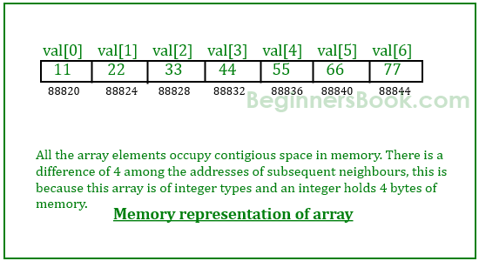
int array
Base address

Slide 30
Addressing an array element
Instead of declaring individual variables, such as number0, number1, ..., and number99, you declare one array variable such as numbers and use numbers[0], numbers[1], and ..., numbers[99] to represent individual variables.
A specific element in an array is accessed by an index.
int a [10]; /* array of 10 ints */
char b [5]; /* array of 10 chars */
char c[6] = {‘h’, ‘e’, ‘l’, ‘l’, ‘o’, 0};
c[0] = ‘h’; /* a character */
c[5] = 0; /* a null character */

Slide 31
Size of array -- Instapoll

Slide 32
Strings
A C-language string is an array of chars, terminated by a null character.
It is essential to terminate a char array with a null character if it is to be interpreted as a string.

Slide 33
Review of the C compiler – which is wrong?

