Slide 1
EE 312
Day 3 & 4: Pointers in C
Dept. of ECE
UT Austin
Vallath Nandakumar
Notes:
Thanks to Omar Mukhtar and SlideShare.

Slide 2
Outline
Review of concepts in previous lectures
C variable types
Global variables
Introduction to pointers
Pointers as function arguments
Pointers and arrays
Pointer arithmetic
Pointer-to-pointer

Slide 3
Review and Background
●
Basic data types
−
Place-holders for numeric data
●
Integer numbers (int, short, long) Real numbers (float, double) Characters / symbols codes (char)
●
●
●
Arrays
−
A contiguous list of a particular data type
●
Functions
−
Give “name” to a particular piece of code Modularization & reuse of code
−

Slide 4
What we did so far
Reviewed syllabus and grading
Installed software on your machines to connect to Linux servers
What is ‘build’?
Preprocess, compile, link, load into memory
What is execute?
Run the program

Slide 5
What we did so far
Wrote a C program in Bash (Linux)
Wrote Hello World source code using text editor
Compiled it into an executable using gcc on the Linux command line
output is a.out
Executed (ran) a.out
Wrote a Makefile

Slide 6
What we did so far
C program on CLion
Installed on your own machines
Wrote a program
Compiled and ran it
Used basics of debugger
Arrays, address of arrays and array elements
Basic pointer arithmetic – addition of 1 to addresses
Array variables as pointers
Behavior of sizeof() with arrays and with pointers
printf() – format specifiers, including %d for ints, %s for strings, and %p for pointers

Slide 7
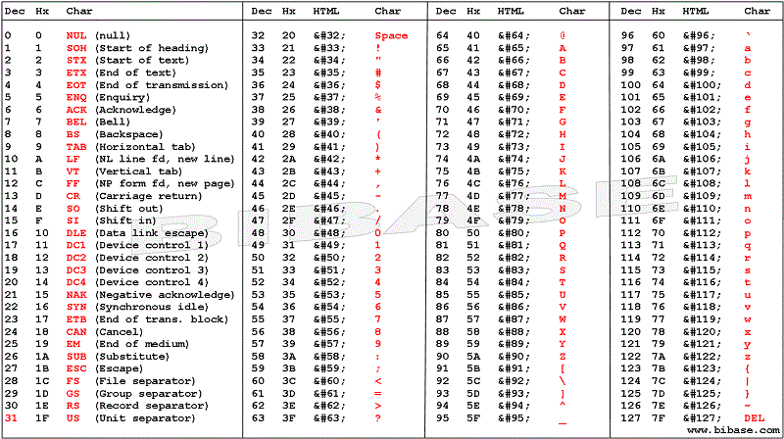

Slide 8
Arrays
An array of xxx occupies a set of contiguous locations in memory
Limited in size by limit of pointer
An array is actually a pointer to the first element’s location in memory
The array variable is thus a pointer variable
Pointers are 4-8 bytes long

Slide 9
Strings and char arrays
A string is an array of chars, terminated by a null character.
An char array variable is a string starting from the character at the pointer location, ending at the null character.
char str [] = {‘a’, ‘b’, ‘c’}; is an array of 3 characters + an automatically inserted null character at the end.

Slide 10
Instapoll 1

Slide 11
Passing arrays to functions
Arrays can be passed to functions as parameters
In reality, what is being passed is a pointer to the array, and not the contents of the array
Changing the pointer value inside the function does not change the actual array contents

Slide 12
Array program

Slide 13
Pointers
●
The most useful and tricky concept in C language
Other high level languages abstract-out this concept
The most powerful construct too
−
●
−
−
Makes C very fast
Direct interaction with hardware
Solves very complicated programming problems
−

Slide 14
What are pointers?
●
Just another kind of “placeholder” to hold “address” of memory location
−
Address is also a number
Itself resides on some memory location
−
Memory Address | Value
0x8004 | ...
0x8008 | 129
0x800C | ...
0x8010 | 0x8008
0x8014 | ...
variable A
address of A

Slide 15
What are pointers?
●
Declare variables a, b
−
int a, b;
●
Declare a pointer
−
int* pa;
●
Set value of a
−
a = 10;
●
Point pa to address of a
−
pa = &a;
●
Set value of a using pa
−
*pa = 12; pa = &b;

Slide 16
Pointer Operators
●
“address-of” operator: &
−
Gets address of a variable
●
De-referencing operator: *
−
Accesses the memory location this pointer holds address of

Slide 17
Pointers and Functions
●
A function can be passed arguments using basic data types
−
int | prod(int | a, | int | b) { | return
a*b; | }
●
How to return multiple values from function?
−
void prod_and_sum(int a, int b,
int* p,
int* a*b;
s)
*s = a+b; }
{ *p =

Slide 18
In & Out Arguments of Function
A function may like to pass values and get the result in the same variables. e.g. a Swap function.
void swap (int* a, int* b) {
int c; // temp variable
c =*b; *b = *a; *a = c;
}
int a = 5; int b = 6;
swap(&a, &b);
// a holds 6 and b holds 5 now

Slide 19
Pointers and Arrays
●
Since arrays are a contiguous set of variables in memory, we can access them with pointers
int arr[5];
●
●
int* p =
*(p+0) =
*(p+1) =
*(p+2) =
*(p+3) =
...
&arr[0];
●
1; // arr[0]
2; // arr[1]
4; // arr[2]
8; // arr[3]
●
●
●
●

Slide 20
Pointer Arithmetic
●
Arithmetic operators work as usual on ordinary data types.
−
int a = 1; a++; // a == 2
It gets a bit complicated when arithmetic operators are used on pointers
int* p = 0x8004; p++;
What does p hold now? 0x8005???
Compiler knows that p is a pointer to integer type data, so an increment to it should point to next integer in memory. Hence 0x8008.
●
●
●
●

Slide 21
The NULL pointer
A special value
The address 0
Doesn’t point anywhere
Can use to compare to other pointers
e.g. as a sentinel
returned by some library functions
Cannot dereference NULL

Slide 22
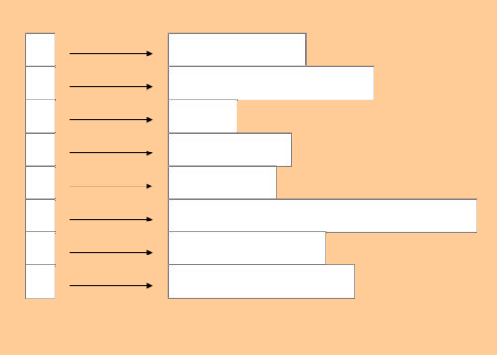
Ragged Arrays
To get a ragged array, use an array of pointers, each pointing to an array.
Pointers to arrays
(perhaps to strings
i.e. pointers to pointers,
since each string variable
is itself
a pointer.)

Slide 23
Instapoll 3

Slide 24
Pointer Arithmetic
●
So an arithmetic operator increases or decreases its contents by the size of data type it points to
●
int* pi = 0x8004; double* pd = 0x9004; char* pc = 0xa004;
●
pi++; pd++; pc++;
// pi == 0x8008
// pd == 0x900c
// pc == 0xa005
●
●
●
Only '+' and '-' operator are allowed. '*' and '/' are meaningless.

Slide 25
Pointer-to-Pointer
●
Pointer variable is just a place-holder of an address value, and itself is a variable.
−
Hence a pointer can hold address of other pointer variable. In that case it is called a “double pointer”.
●
int*p; int** pp; pp = &p;
e.g a function may like to return a pointer value
void pp_example(int** p) { *p =
●
●
0x8004;
int *p;
}
pp_example(&p);
●

Slide 26
Pointer Pitfalls
●
Since pointer holds address of memory location, it must never be used without proper initialization.
An uninitialized pointer may hold address of some memory location that is protected by Operating System. In such case, de- referencing a pointer may crash the program.
An initialized pointer does not know whether the memory location it is pointing to holds a valid value or some garbage.
A pointer cannot track boundaries of an array.
●
●
●

