Slide 1
Recursion Problems
EE 312

Slide 2
Maze
Given a maze
NxN matrix
A rat has to find a path from start to end.
maze[0][x] (a top row cell) is the start and maze[N-1][x](a bottom row cell) is the end.
Some cells are blocked, meaning that the rat cannot enter those cells.
Rat can move in any direction ( left, right, up and down).
Question: Is there a path from start to finish?
Assume, for simplicity, that the maze has no loops.
Means that there exists at most one path from start to finish. (Why?)
Notes:
http://algorithms.tutorialhorizon.com/backtracking-rat-in-a-maze-puzzle/
https://www.cs.bu.edu/teaching/alg/maze/

Slide 3
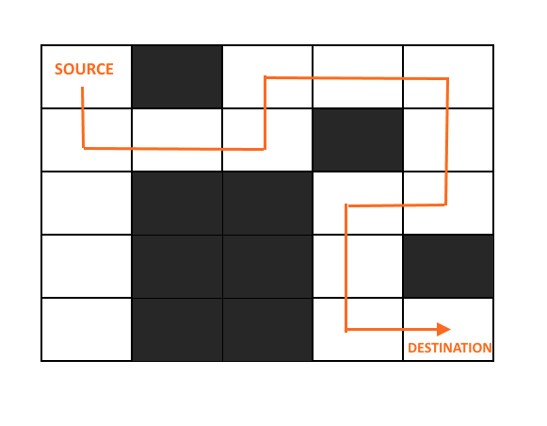

Slide 4
Maze

Slide 5
Recursive Algorithm
Base case
Recursive case that gets smaller and eventually will reach the base case
A ‘belief’ that we have a function that works

Slide 6
For the maze problem
Base case
When we have reached the exit, or
All the reachable squares have been visited, but we have not seen the exit
Recursive case
Mark current cell visited
Move to one of the adjacent cells that are not yet visited
Function
Assume that we have a function that tells us whether we can reach the exit i.e. that tells us “Is there a path from the current cell to the finish?”

Slide 7
Auxiliary output
The auxiliary output is the path from start to finish

Slide 8
Approach
Create a solution matrix of the same structure as maze.
Whenever rat moves to cell in a maze, mark that particular cell in solution matrix as visited

Slide 9
Algorithm – findPath(startx, starty)
Mark cell visited
IF current cell is endpoint (base case)
return true (path exists)
ELSE (recursive case)
Move to each of four adjacent unvisited cells, if possible
Call findPath from each adjacent cell, storing return value (calling function findPath that is assumed to work)
If any return value is true, return true immediately and exit findPath()
If we reach here, it means none of the four adjacent cells resulted in a path; therefore return false

Slide 10
Finding path in maze
The previous slide’s algorithm does not show how to find a path
It only shows how to mark a cell visited
Think about how to determine whether a cell is on a path to the exit.
You may have to mark it on the path, and then unmark it if findPath from it returns false.

Slide 11
Algorithm – findPath(startx, starty) returns true if path found
Mark current cell visited
Add breadcrumb to cell
IF current cell is endpoint
return true (path exists)
ELSE
Move to each of four adjacent unvisited cells, if possible
Call findPath from each adjacent cell, storing return value
If any return value is true, return true immediately and exit findPath()
If we reach here, it means none of the four adjacent cells resulted in a path; therefore
remove breadcrumb
return false

Slide 12
Subset Sum problem
An array x contains n non-negative integers. Write a function that determines if you can add together any k of the elements in x and get precisely v.
Brute force algorithm?
Big-O of brute force algorithm?

Slide 13
Subset Sum example
For example, x might be the array
{ 1, 8, 6, 4, 3 }.
If k were 3 and v were 9, then your function should return 0 (false), since there are no three numbers in x that you can add together to get 9.
If k were 2 and v were 9, then your function would return true, since you get add 1 and 8 or 6 and 3 and get precisely 9.

Slide 14
Recursively solve sumsTo
int sumsTo(uint x[], uint n, uint k, uint v)
Base cases
if v == 0, k == 0 -- return true
else if v != 0, k == 0, -- return false
else n == 0, return false

Slide 15
Recursively solve sumsTo
bool sumsTo(uint x[], uint n, uint k, uint v)
Recursive case – 2 cases
The first number in the array is ‘included’ in the sum v
Reduce the set by x0, reduce v by x0 (only if v >= x0).
found1 = sumsTo(x –{x0}, n-1, k-1, v-x0)
Assume that we have a function available.
The first number in the array is ‘not included’ in the sum v
Reduce the set by x0
found2 = sumsTo(x-{x0}, n-1, k, v)
If found1 || found2, return true, else return false

Slide 16
46 int sumsTo(uint x[], uint n, uint k, uint v) {
47 // printf("x[0], n, k, v: %d, %d, %d, %d\n", x[0], n, k, v);
48 if (v == 0 && k == 0) // used up all numbers to reach sum 0
49 return true;
50 if (v!=0 && k == 0) // used up all numbers without reaching sum 0
51 return false;
52 if (n == 0) // used up all numbers without reaching sum 0
53 return false;
54 int res1 = 0;
55 if (v >= x[0])
56 res1 = sumsTo(x + 1, n - 1, k -1, v - x[0]); // include the first number of the array in the sum
57 int res2 = sumsTo(x + 1, n - 1, k, v); // exclude the first number in the sum
58 if (res1 + res2 > 0)
59 return true;
60 return false;
61 }

Slide 17
Example
Let array be {1, 2, 3}
Let v = 5
Let k = 2
Is there a subset of {1, 2, 3} of cardinality 2 whose members add up to 5?

