Slide 1
EE 312
Day 4 & 5: Pointers in C
Dept. of ECE
UT Austin
Vallath Nandakumar
Notes:
Thanks to Omar Mukhtar and SlideShare.

Slide 2
Outline
Review of concepts in previous lectures
C arrays
Introduction to pointers
Pointers as function arguments
Pointers and arrays
Pointer arithmetic
Pointer-to-pointer

Slide 3
C arrays
C arrays are stored in a contiguous area of memory
int []
char []
float []
The size of the array depends on the size of the item in the array

Slide 4
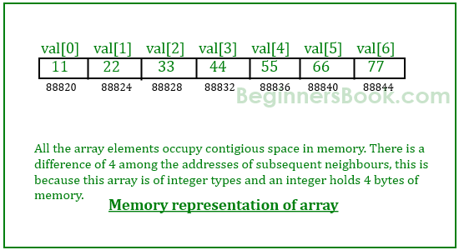
int array
Base address

Slide 5
Addressing an array element
Instead of declaring individual variables, such as number0, number1, ..., and number99, you declare one array variable such as numbers and use numbers[0], numbers[1], and ..., numbers[99] to represent individual variables.
A specific element in an array is accessed by an index.
int a [10]; /* array of 10 ints */
char b [5]; /* array of 10 chars */
char c[6] = {‘h’, ‘e’, ‘l’, ‘l’, ‘o’, 0};
c[0] = ‘h’; /* a character */
c[5] = 0; /* a null character */

Slide 6
Size of array -- Instapoll

Slide 7
Strings
A C-language string is an array of chars, terminated by a null character.
It is essential to terminate a char array with a null character if it is to be interpreted as a string.

Slide 8
Review of the C compiler – which is wrong?

Slide 9
Review and Background
●
Basic data types
−
Place-holders for numeric data
●
Integer numbers (int, short, long) Real numbers (float, double) Characters / symbols codes (char)
●
●
●
Arrays
−
A contiguous list of a particular data type
●
Functions
−
Give “name” to a particular piece of code Modularization & reuse of code
−

Slide 10
What we did so far
Reviewed syllabus and grading
Installed software on your machines to connect to Linux servers
What is ‘build’?
Preprocess, compile, link, load into memory
What is execute?
Run the program

Slide 11
What we did so far
Wrote a C program in Bash (Linux)
Wrote Hello World source code using text editor
Compiled it into an executable using gcc on the Linux command line
output is a.out
Executed (ran) a.out
Wrote a Makefile

Slide 12
What we did so far
C program on CLion
Installed on your own machines
Wrote a program
Compiled and ran it
Used basics of debugger
Arrays, address of arrays and array elements
Basic pointer arithmetic – addition of 1 to addresses
Array variables as pointers
Behavior of sizeof() with arrays and with pointers
printf() – format specifiers, including %d for ints, %s for strings, and %p for pointers

Slide 13
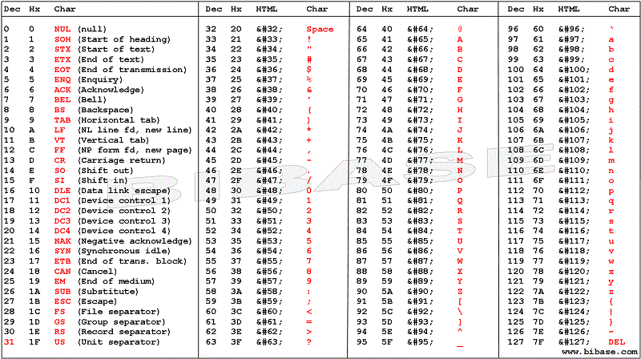

Slide 14
Arrays
An array of xxx occupies a set of contiguous locations in memory
Limited in size by limit of pointer
An array is actually a pointer to the first element’s location in memory
The array variable is thus a pointer variable
Pointers are 4-8 bytes long

Slide 15
Strings and char arrays
A string is an array of chars, terminated by a null character.
An char array variable is a string starting from the character at the pointer location, ending at the null character.
char str [] = {‘a’, ‘b’, ‘c’}; is an array of 3 characters + an automatically inserted null character at the end.

Slide 16
Instapoll 1

Slide 17
Passing arrays to functions
Arrays can be passed to functions as parameters
In reality, what is being passed is a pointer to the array, and not the contents of the array
Changing the pointer value inside the function does not change the actual array contents

Slide 18
Array program

Slide 19
makefile
Purpose of makefile and make
Document dependencies of source files, libraries, header files, object code files etc. on each other
Ensure that modification of a file will be propagated up the chain of dependencies properly, so that nothing is out-of-date
Minimize steps required to update any file in the collection when some file is modified
The make utility uses date stamps on files to determine out-of-date conditions

Slide 20
Why command line, makefile?
CLion good for development, debugging
For running programs, double-click on executable from Windows, or use command line
For maintenance, often easier to make small changes in text editor, and use makefile
Makefile is visible way of documenting dependencies
CLion has internal make-like dependencies
Command line processes are more portable than GUI processes.

Slide 21
Pointers
●
The most useful and tricky concept in C language
Other high level languages abstract-out this concept
The most powerful construct too
−
●
−
−
Makes C very fast
Direct interaction with hardware
Solves very complicated programming problems
−

Slide 22
What are pointers?
●
Just another kind of “placeholder” to hold “address” of memory location
−
Address is also a number
Itself resides on some memory location
−
Memory Address | Value
0x8004 | ...
0x8008 | 129
0x800C | ...
0x8010 | 0x8008
0x8014 | ...
variable A
address of A

Slide 23
What are pointers?
●
Declare variables a, b
−
int a, b;
●
Declare a pointer
−
int* pa;
●
Set value of a
−
a = 10;
●
Point pa to address of a
−
pa = &a;
●
Set value of a using pa
−
*pa = 12; pa = &b;

Slide 24
Pointer Operators
●
“address-of” operator: &
−
Gets address of a variable
●
De-referencing operator: *
−
Accesses the memory location this pointer holds address of

Slide 25
Pointers and Functions
●
A function can be passed arguments using basic data types
−
int | prod(int | a, | int | b) { | return
a*b; | }
●
How to return multiple values from function?
−
void prod_and_sum(int a, int b,
int* p,
int* a*b;
s)
*s = a+b; }
{ *p =

Slide 26
In & Out Arguments of Function
A function may like to pass values and get the result in the same variables. e.g. a Swap function.
void swap (int* a, int* b) {
int c; // temp variable
c =*b; *b = *a; *a = c;
}
int a = 5; int b = 6;
swap(&a, &b);
// a holds 6 and b holds 5 now

Slide 27
Pointers and Arrays
●
Since arrays are a contiguous set of variables in memory, we can access them with pointers
int arr[5];
●
●
int* p =
*(p+0) =
*(p+1) =
*(p+2) =
*(p+3) =
...
&arr[0];
●
1; // arr[0]
2; // arr[1]
4; // arr[2]
8; // arr[3]
●
●
●
●

Slide 28
Pointer Arithmetic
●
Arithmetic operators work as usual on ordinary data types.
−
int a = 1; a++; // a == 2
It gets a bit complicated when arithmetic operators are used on pointers
int* p = 0x8004; p++;
What does p hold now? 0x8005???
Compiler knows that p is a pointer to integer type data, so an increment to it should point to next integer in memory. Hence 0x8008.
●
●
●
●

Slide 29
The NULL pointer
A special value
The address 0
Doesn’t point anywhere
Can use to compare to other pointers
e.g. as a sentinel
returned by some library functions
Cannot dereference NULL

Slide 30
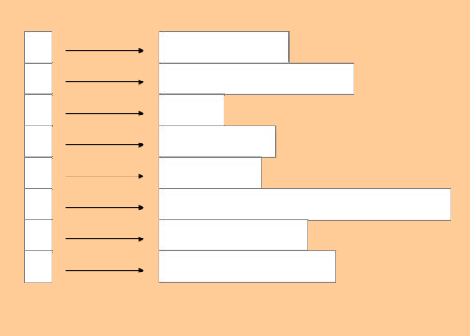
Ragged Arrays
To get a ragged array, use an array of pointers, each pointing to an array.
Pointers to arrays
(perhaps to strings
i.e. pointers to pointers,
since each string variable
is itself
a pointer.)

Slide 31
Instapoll 3

Slide 32
Pointer Arithmetic
●
So an arithmetic operator increases or decreases its contents by the size of data type it points to
●
int* pi = 0x8004; double* pd = 0x9004; char* pc = 0xa004;
●
pi++; pd++; pc++;
// pi == 0x8008
// pd == 0x900c
// pc == 0xa005
●
●
●
Only '+' and '-' operator are allowed. '*' and '/' are meaningless.

Slide 33
Pointer-to-Pointer
●
Pointer variable is just a place-holder of an address value, and itself is a variable.
−
Hence a pointer can hold address of other pointer variable. In that case it is called a “double pointer”.
●
int*p; int** pp; pp = &p;
e.g a function may like to return a pointer value
void pp_example(int** p) { *p =
●
●
0x8004;
int *p;
}
pp_example(&p);
●

Slide 34
Pointer Pitfalls
●
Since pointer holds address of memory location, it must never be used without proper initialization.
An uninitialized pointer may hold address of some memory location that is protected by Operating System. In such case, de- referencing a pointer may crash the program.
An initialized pointer does not know whether the memory location it is pointing to holds a valid value or some garbage.
A pointer cannot track boundaries of an array.
●
●
●

