Slide 1
EE 312 Day 4 The Program Stack
Vallath Nandakumar
Dept of ECE, UT Austin

Slide 2
Agenda
Project 1 questions?
Review of last lecture
Pointers to variables
Char arrays
Arrays of Strings

Slide 3
Stack vs. Heap
Stack and heap are different regions of memory
When a process starts up, the operating system allocates a portion of memory – the stack
Usually a fixed (and not very big, a few MB) size
The heap can occupy a lot of the remaining memory

Slide 4
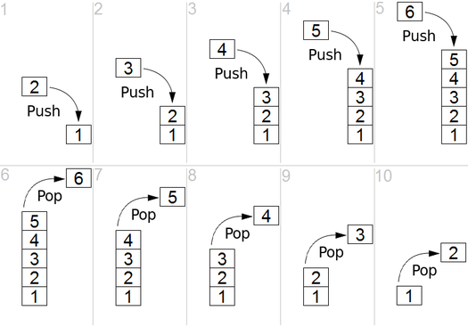
Data Structure Stack operations

Slide 5
Stack overview
Special region of your computer's memory that stores temporary variables created by each function (including the main() function).
Every time a function declares a new variable, it is "pushed" onto the stack. Then every time a function exits, all of these variables are freed (deleted).
Once a stack variable is freed, that region of memory becomes available for other stack variables.

Slide 6
Stack management
Memory in stack is managed for user
Very fast access to stack contents

Slide 7
Stack variables
Local in nature
When a function exits, all of its variables are popped off of the stack (and hence lost forever)

Slide 8
Stack growth -- main
int main () {
int a = 5;
}
00000101

Slide 9
Stack growth – foo called
int main () {
int a = 5;
int b = foo(a);
}
int foo(int x) {
return x + 1; }
00000101
00000101

Slide 10
Stack growth – foo done
int main () {
int a = 5;
int b = foo(a);
}
int foo(int x) {
return x + 1; }
00000101
00000101
00000110

Slide 11
Stack growth – foo returns
int main () {
int a = 5;
int b = foo(a);
}
int foo(int x) {
return x + 1; }
00000101
00000110
00000101
00000110

Slide 12
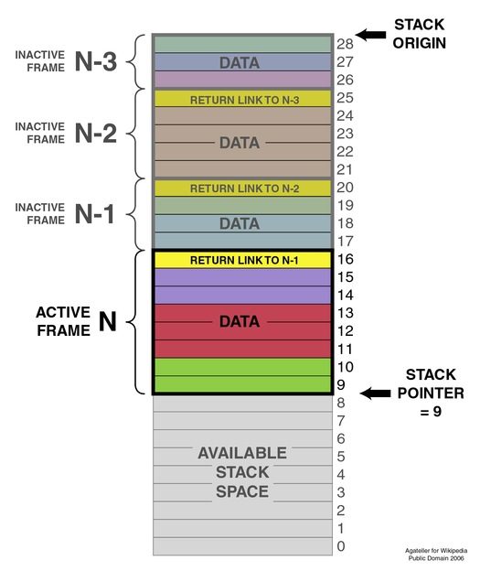

Slide 13
Stack summary
The stack grows and shrinks as functions push and pop local variables
There is no need to manage the memory yourself; variables are allocated and freed automatically
The stack has size limits – typically, a few MB are allocated to each program.
Stack variables only exist while the function that created them is running

Slide 14
Heap
A ‘pile’ of memory
Not as tightly managed by CPU
User has to allocate and de-allocate memory
Allocating some memory, and then not deallocating it even after it is not in use any more results in memory leak
Variables created on the heap are accessible by any function, anywhere in the program. Heap variables are essentially global in scope.
Variable in size

Slide 15
A process's view of memory
4 GB
%esp
Process not allowed to read or write this region
(reserved for OS)
stack
Memory mapped region for shared libraries
heap
uninitialized data (.bss)
initialized data (.data)
program text (.text)
don't touch!
Program loader maps in standard libs here
Dynamically-allocated memory (via malloc)
Global vars Program code
e.g., “int i”
e.g., “int k = 42”
0

