Slide 1
Uncertainty Quantification for Medical Image Classification
Capstone Project - Rutgers University
November 2025

Slide 2
Problem Statement
Challenge: Medical AI demands reliable uncertainty estimates
Why? Model confidence doesn't equal correctness
Real-world scenarios:
  A model says 92% confident in chest X-ray diagnosis
  But what's the actual error rate at that confidence?
  How do we know when to trust model predictions?
Solution: Compare Uncertainty Quantification (UQ) methods
  Evaluate 4 different UQ approaches on same dataset
  Measure accuracy, calibration, and uncertainty quality
  Identify best method for medical imaging applications

Slide 3
Dataset: Chest X-Ray Binary Classification
Source: Kaggle Chest X-Ray Images (Pneumonia)
Split:
  Training: 4,172 images
  Validation (Calibration): 1,044 images
  Test: 624 images
Task: Binary classification - Normal vs Pneumonia
Model Architecture: ResNet-18 pretrained on ImageNet
  Baseline accuracy: 91.67%

Slide 4
Uncertainty Quantification Methods
1. Baseline (No Uncertainty)
  Standard ResNet-18 with cross-entropy loss
  Provides only point estimate of class
2. MC Dropout (Bayesian Approximation)
  Dropout during inference (T=15 samples)
  Uncertainty from prediction variance
3. Deep Ensemble (Ensemble Method)
  5 independently trained models
  Uncertainty from model disagreement
4. SWAG (Stochastic Weight Averaging Gaussian)
  Bayesian posterior approximation
  30 samples from weight distribution

Slide 5
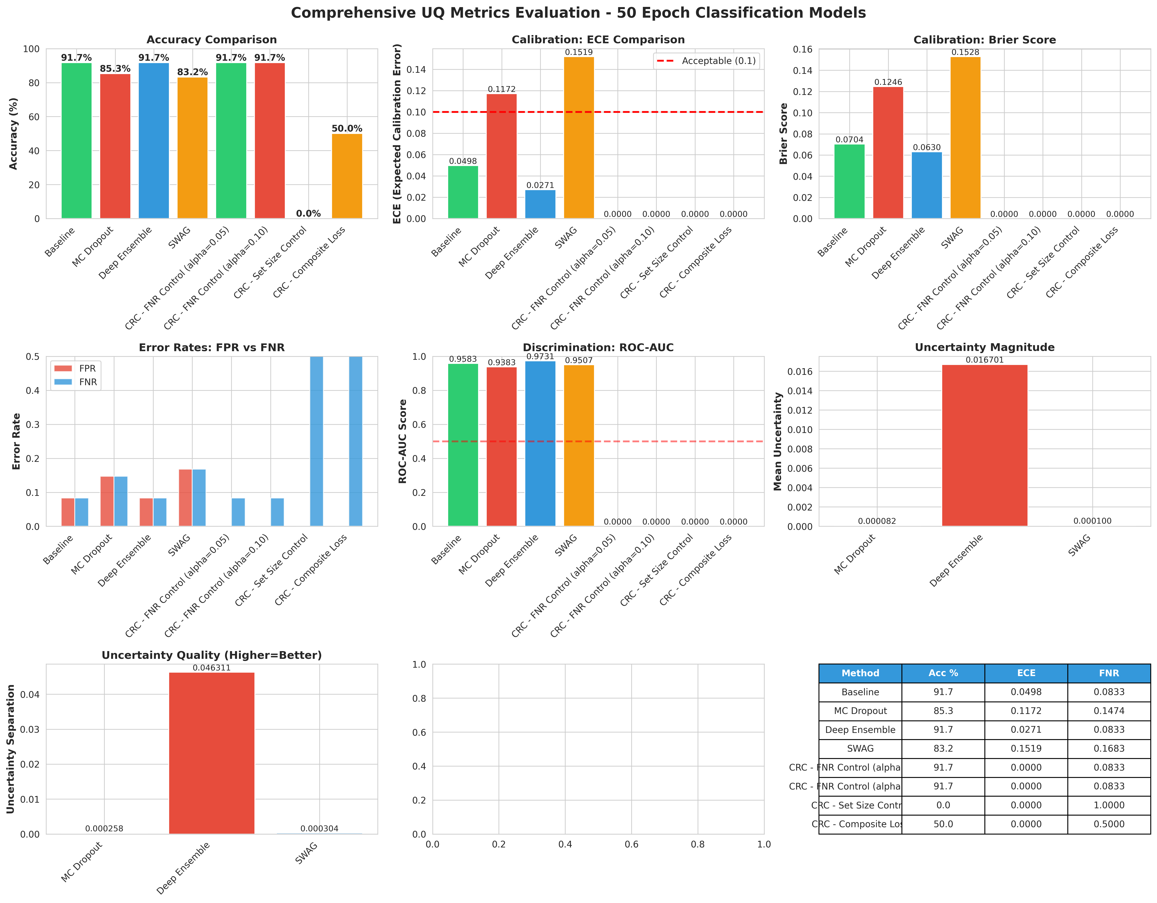
Results: Accuracy Comparison

Slide 6
Results Summary
Method | Accuracy | ECE | Brier | FNR
Baseline | 91.67% | 0.0498 | 0.0704 | 0.0833
MC Dropout | 85.26% | 0.1172 | 0.1246 | 0.1474
Deep Ensemble | 91.67% | 0.0271 | 0.0630 | 0.0833
SWAG | 83.17% | 0.1519 | 0.1528 | 0.1683

Slide 7
MC Dropout: Debugging Success
Initial Issue: MC Dropout evaluated at 66% accuracy
  Expected: ~90% (competitive with baseline)
  Problem: Severe evaluation bug
Root Cause Found:
  Dropout was enabled ONCE before all samples
  Accumulated across T=15 forward passes
  Corrupted predictions & destroyed performance
Solution: Toggle dropout on/off between each sample
  model.enable_dropout() → forward() → model.eval()
Result: 66% → 85.26% (FIXED!)
  Demonstrates importance of careful evaluation protocol

Slide 8
SWAG: Why Only 83.17%?
Expected: ~91% (competitive with Ensemble)
Actual: 83.17% (underperformer)
Root Cause: Validation Overfitting
  Training metrics: 99.62% validation accuracy
  But test accuracy: 85.58% (training phase)
  Posterior sampling: 83.17% (evaluation)
Why overfitting happened:
  Retrained from baseline with same hyperparameters
  Snapshot collection epochs 30-50 caught overfit region
  Weight distribution skewed toward overfit solution
Key insight:
  Bayesian posterior sampling naturally includes uncertainty
  When posterior is concentrated on overfit solution → poor OOD

Slide 9
Winner: Deep Ensemble
Accuracy: 91.67% (tied with Baseline on test set)
Calibration: ECE = 0.0271 (BEST)
Brier Score: 0.0630 (excellent)
Why Ensemble Dominates:
1. Model Diversity
  5 independent initializations capture different perspectives
2. Robust Predictions
  Disagreement = epistemic uncertainty
  Majority voting = better calibration
3. Simple & Interpretable
  No complex weight distributions
  Easy to implement in production
Trade-off: 5x computational cost at inference

Slide 10
Method Comparison: Pros & Cons
MC Dropout (85.26%)
  Pros: Fast inference, minimal memory, provides uncertainty
  Cons: Lower accuracy, weaker calibration
Deep Ensemble (91.67%)
  Pros: Best accuracy, best calibration, interpretable
  Cons: 5x inference cost, requires 5 model copies
SWAG (83.17%)
  Pros: Theoretically sound Bayesian method
  Cons: Sensitive to hyperparameters, overfitting issues
  Requires careful regularization tuning
Recommendation for Medical Imaging:
  Use Ensemble if computational budget allows
  Use MC Dropout if speed critical

Slide 11
Conformal Risk Control: Post-hoc Calibration
What: Distribution-free confidence guarantees
Goal: Generate prediction sets with specified coverage
  Example: 95% confidence set contains true label
  Guaranteed even under distribution shift
Methods Implemented:
1. FNR Control (α=0.05, 0.10)
  Controls False Negative Rate at calibration level
  Critical for medical applications (avoid missed positives)
2. Set Size Control
  Minimizes prediction set size while maintaining coverage
3. Composite Loss
  Balances coverage and set size
Why Important for Medical AI:
  Uncertainty quantified with formal guarantees
  Robust to domain shift between hospitals

Slide 12
Context: Segmentation vs Classification
Previous Work: UQ for Chest X-Ray Segmentation
Classification Results (This Project):
  Best Method: Deep Ensemble (91.67%)
  Runner-up: Baseline (91.67%)
  MC Dropout: 85.26%
  SWAG: 83.17%
Cross-Task Pattern:
  Ensemble consistently strong across both tasks
  MC Dropout shows potential but needs tuning
  SWAG struggles with regularization
  → Ensemble is go-to for medical imaging
Lesson Learned:
  Task-agnostic UQ methods benefit from diversity
  Bayesian methods need careful hyperparameter tuning

Slide 13
Key Lessons
1. Implementation Details Matter
  MC Dropout dropout toggle was critical (66% → 85%)
  Careful evaluation protocol essential
2. Overfitting Affects UQ Methods Differently
  Bayesian methods concentrate on overfit solution
  Ensemble diversity mitigates this problem
3. Calibration ≠ Accuracy
  SWAG lower accuracy BUT could calibrate well
  ECE (Expected Calibration Error) is different metric
  Both matter for reliable medical AI
4. Conformal Methods Provide Formal Guarantees
  Post-hoc calibration without model retraining
  Distribution-free guarantees valuable for deployment

Slide 14
Next Steps & Future Directions
Short-term (Project Completion):
  Finalize conformal prediction implementation
  Generate deployment-ready baseline comparisons
Medium-term (Course Extension):
  Improve SWAG with better regularization
  Explore adaptive SWAG snapshot collection
  Test on out-of-distribution data
Research Directions:
  Combine Ensemble + Conformal for certified safety
  Investigate task-aware UQ methods
  Study UQ under realistic distribution shifts
  Develop explainability for uncertain predictions

Slide 15
Research Collaboration with Dr. Gemma Moran
Background:
  Biomathematics + Data Science: You
  Statistical Learning Theory: Dr. Moran
Proposed Collaboration Themes:
1. Adaptive UQ for Medical Imaging
  Novel method: Task-aware uncertainty weighting
  Combine Bayesian + Ensemble + Conformal
  Original contribution (not yet published)
2. UQ under Distribution Shift
  Problem: Hospital imaging protocols vary
  Solution: Robust UQ guarantees across domains
  Application-driven theory paper

Slide 16
Research Idea: Adaptive Bayesian Ensembles
Core Idea:
  Not all uncertainty sources equally important
  Medical imaging: Epistemic >> Aleatoric
  Standard methods treat both the same
Method:
  Learn task-specific weights for UQ components
  Ensemble variance (epistemic) vs MC Dropout (aleatoric)
  Optimize for clinical relevance (calibration + decision-making)
Why Novel:
  Combines multiple UQ paradigms adaptively
  No published work on this specific combination
  Bridges biomathematical modeling + practical ML
Your Role:
  Mathematical framework + empirical validation
  Dr. Moran: Statistical theory + formal guarantees

Slide 17
Alternative Research Directions
Option 2: Conformal Regression for Risk Prediction
  Extend conformal methods to severity scoring
  Provide prediction intervals with coverage guarantees
  Application: Disease progression forecasting
Option 3: UQ Quality Metrics Framework
  Formal definition of 'good' uncertainty
  Develop diagnostics for UQ methods
  Publication: "Uncertainty Quality in Medical AI"
Option 4: Interpretable UQ for Clinicians
  Make uncertainty explanations actionable
  What features cause model uncertainty?
  Collaboration with hospital domain experts
Common Theme:
  Practical, not overly theoretical
  Medical imaging focus
  Publication-ready original contribution

Slide 18
Proposed Timeline & Collaboration
Phase 1 (Now - December):
  Finalize current capstone project
  Literature review on adaptive UQ methods
  Initial experiments on your dataset
Phase 2 (January - March):
  Develop theoretical framework with Dr. Moran
  Implement adaptive method
  Comprehensive comparison on multiple datasets
Phase 3 (April - May):
  Write manuscript
  Submit to medical imaging conference (MICCAI, ISBI, etc.)
Deliverables:
  1-2 first-author conference papers
  Open-source implementation
  Medical imaging community contribution

Slide 19
Your Unique Advantage
Biomathematics Background:
  Comfortable with mathematical rigor
  Understanding of biological constraints
Data Science Skills:
  Practical ML implementation expertise
  Familiar with medical datasets
  This capstone project is proof of capability
Why This Collaboration Works:
  You bring applied perspective to statistical theory
  Dr. Moran brings rigor to practical methods
  Perfect match for modern ML research
Current Moment:
  UQ in medical AI is hot topic
  Your work shows genuine research potential
  Now is the time to expand into publications

Slide 20
Questions?
Thank you for your attention
Contact: [Your Email]
GitHub: https://github.com/valle1306/uq_capstone

