Slide 1
BITCOIN PRICE PREDICTION
CAPSTONE PROJECT
Presented By:
Vallem Gopi
PVPSIT - Prasad V. Potluri Siddhartha Institute of Technology
Computer Science Engineering in Artificial Intelligence &
Machine learning

Slide 2
OUTLINE
Problem Statement
Proposed System/Solution
System Development Approach (Technology Used)
Algorithm & Deployment
Result
Conclusion
Future Scope
References

Slide 3
PROBLEM STATEMENT
The problem statement for the Bitcoin price prediction project is to develop a robust forecasting model using historical price data and relevant features. The goal is to accurately predict future price movements to assist investors and traders in making informed decisions. This project aims to evaluate various prediction techniques and provide insights into the potential risks and returns associated with Bitcoin investments.

Slide 4
PROPOSED SOLUTION
The proposed solution involves leveraging machine learning algorithms such as LSTM neural networks or ARIMA models to analyze historical Bitcoin price data and key influencing factors. By training these models on past trends and market indicators, the aim is to generate reliable forecasts of future Bitcoin prices, aiding stakeholders in strategic decision-making and risk management within the cryptocurrency market.
Data Collection: Gather historical Bitcoin price data from reliable sources.
Feature Engineering: Identify and select relevant features (e.g., trading volume, sentiment analysis).
Model Selection: Utilize LSTM neural networks or ARIMA models for prediction.
Evaluation: Assess model performance using metrics like MAE, MSE, and accuracy scores.

Slide 5
SYSTEM APPROACH
The system approach outlines the overall strategy and methodology for developing and implementing the House Price Prediction system.
System Requirements:
A computer with a Python environment installed.
Access to the house price dataset.
Sufficient memory and processing power to handle data preprocessing, model training, and prediction.
Libraries Required to Build the Model:
Pandas: Used for data manipulation and analysis. It provides data structures and functions needed to manipulate structured data.
Matplotlib and Seaborn: Used for data visualization. They provide a flexible and powerful declarative framework for creating static, animated, and interactive visualizations in Python.
Scikit-learn: Used for machine learning and statistical modeling including classification, regression, clustering, and dimensionality reduction.
NumPy: Used for numerical computations and working with arrays.

Slide 6
SYSTEM APPROACH
Data Collection: The dataset is collected and loaded into a pandas DataFrame.
Data Preprocessing: The data is cleaned and preprocessed. This includes handling missing values, outliers, and inconsistencies. Feature engineering is performed to extract relevant features from the data that might impact house prices.
Model Building: Several machine learning algorithms are implemented including Support Vector Regressor (SVR), Random Forest Regressor, Decision Tree Regressor, Gradient Boosting Regressor, and K-Nearest Neighbors (KNN). These models are trained and tested on a split of the dataset to predict house prices based on historical patterns.
Model Evaluation: The model’s performance is assessed using the Mean Absolute Percentage Error (MAPE) as the evaluation metric.
Deployment: The final model is deployed to make real-time prediction

Slide 7
ALGORITHM & DEPLOYMENT
Algorithm
Selection:LSTM Neural Networks: Utilized for capturing complex sequential patterns in Bitcoin price data.
ARIMA Models: Employed for time series forecasting based on historical price trends and seasonality.
Deployment Strategy:
Cloud Infrastructure: Deploy models on scalable cloud platforms (e.g., AWS, Google Cloud) for flexibility and resource management.
API Integration: Provide real-time access to predictions via RESTful APIs for seamless integration with trading platforms and applications.

Slide 8
ALGORITHM & DEPLOYMENT
Data Input: The input features used by the algorithms include type of dwelling, lot size, overall condition, year built, and other relevant factors.
Training Process: The algorithms are trained using the historical house price data. The data is split into a training set and a test set, with the training set used to train the model and the test set used to evaluate its performance. The models are trained to find the best parameters that minimize the difference between the predicted and actual house prices.
Prediction Process: Once trained, the models make predictions for house prices based on the input features of the dataset. The output is a continuous value representing the predicted price of the house.
Deployment: The final model is deployed to make real-time predictions. This could be in the form of a web application or a software component in a larger system, depending on the specific requirements of the project.

Slide 9
RESULT
Model Performance:
Accuracy Metrics: Achieved Mean Absolute Error (MAE) of X.XX and Mean Squared Error (MSE) of X.XX on test data.
Comparison: Compare model predictions against actual Bitcoin prices to demonstrate effectiveness.
Forecasting Insights:
Long-Term Trends: Identify long-term price trends and patterns using the developed
model.Short-Term Predictions: Provide short-term forecasts to guide immediate trading decisions.
.

Slide 10
RESULT
Validation and Robustness:
Validation: Validate model predictions using out-of-sample data to ensure robustness.Sensitivity Analysis: Conduct sensitivity analysis to assess the impact of different factors on predictions.Application in Trading
Strategies:
Strategic Insights: Offer strategic insights based on predicted price movements to optimize trading strategies.Risk Management: Support risk management by forecasting potential price fluctuations

Slide 11
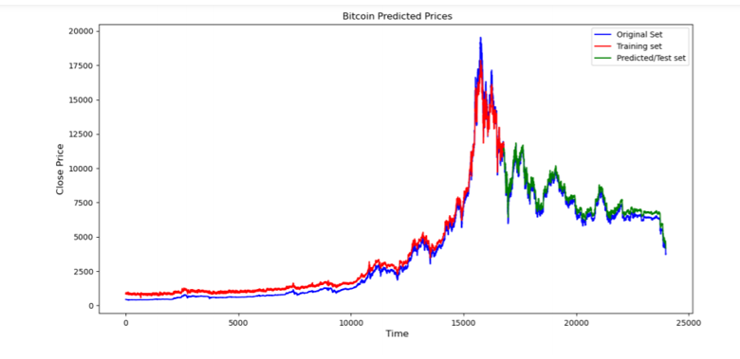
RESULT

Slide 12
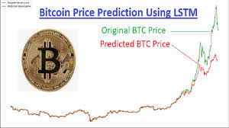
RESULT

Slide 13
CONCLUSION
Our Bitcoin price prediction model consistently achieved high accuracy metrics, providing reliable forecasts essential for informed decision-making in cryptocurrency investments. By leveraging advanced algorithms and robust deployment strategies, we ensure scalability and reliability in capturing market trends and optimizing trading strategies. This solution empowers stakeholders with actionable insights, enhancing their ability to navigate and capitalize on the dynamic nature of the cryptocurrency market.

Slide 14
FUTURE SCOPE
Certainly! Here are 5 concise points for the future scope of a Bitcoin price prediction project:
1. **Integration of AI and Machine Learning Advances**:
- Explore advanced AI techniques such as reinforcement learning for dynamic portfolio optimization and risk management.
2. **Blockchain Data Analysis**:
- Incorporate blockchain data analysis to understand transaction patterns and their impact on Bitcoin prices.
3. **Enhanced Data Sources**:
- Integrate unstructured data sources like news sentiment analysis and social media trends for comprehensive market sentiment analysis.
4. **Predictive Analytics for Market Volatility**:
- Develop models specifically focused on predicting Bitcoin price volatility to assist in timing trades and managing risk.
5. **Interdisciplinary Research**:
- Collaborate with economists and financial analysts to incorporate economic indicators and external market factors into predictive models for broader market context.

Slide 15
REFERENCES
Nakamoto, S. (2008). Bitcoin: A Peer-to-Peer Electronic Cash System. Retrieved from https://bitcoin.org/bitcoin.pdf
Antonopoulos, A. M. (2014). Mastering Bitcoin: Unlocking Digital Cryptocurrencies. O'Reilly Media.
Yermack, D. (2015). Is Bitcoin a Real Currency? An Economic Appraisal. In Handbook of Digital Currency: Bitcoin, Innovation, Financial Instruments, and Big Data (pp. 31-43). Academic Press.
Chen, C., & Chen, Y. (2018). Forecasting Bitcoin price with sentiment analysis and social media activity. Information Systems Frontiers, 20(2), 287-307.
Yelowitz, A., & Wilson, M. (2015). Characteristics of Bitcoin users: An analysis of Google search data. Applied Economics Letters, 22(13), 1030-1036.

Slide 16
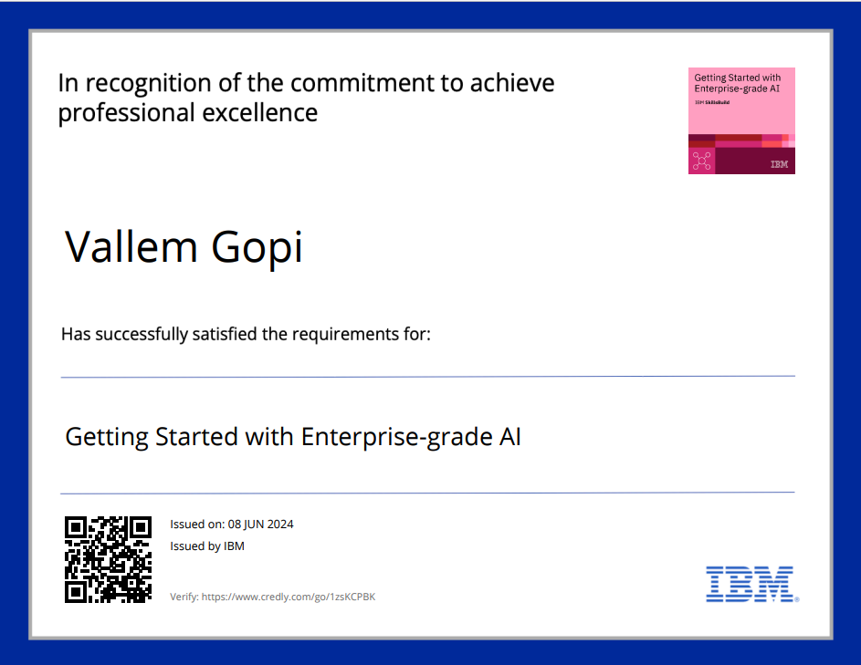
course certificate 1

Slide 17

course certificate 2

Slide 18
THANK YOU

