Slide 1
STAT 8240 — DATA MINING II · CLASS PROJECT
Replicating and Extending IMM-TSF: A Bench Marking Study on Irregular Multimodal EPA-Air Quality Dataset
Dataset: EPA-Air (Multi-Source Asynchrony)
Anchor paper: Chang et al., NeurIPS 2025
Date: April 16, 2026
Team Members : Anil Vallepu
Param Kesireddy
Vineetha Burugupalli
Project Advisor : Dr. Bin Luo

Slide 2
ABSTARCT
This project investigates the challenges of forecasting using "messy" real-world data that includes both numerical sensors data and unstructured textual data. Using the IMM-TSF (Irregular Multimodal Multivariate Time-Series Forecasting) framework.
We focus on the EPA-Air dataset. In Track A, we successfully replicated the baseline performance metrics from the original research, confirming that integrating textual data reduces prediction error. In Track C, we propose an architectural extension to the modality fusion module to further enhance the model's ability to handle asynchronous data streams.

Slide 3
PROBLEM STATEMENT
Traditional time-series models often assume that data is collected at regular intervals and consists only of numbers.
However, real-world environmental data (like air quality) is often irregular and multimodal containing sensor readings alongside text-based reports or location metadata. This project utilizes the TIME-IMM benchmark to bridge the gap between clean laboratory datasets and complex, real-world deployment scenarios.

Slide 4
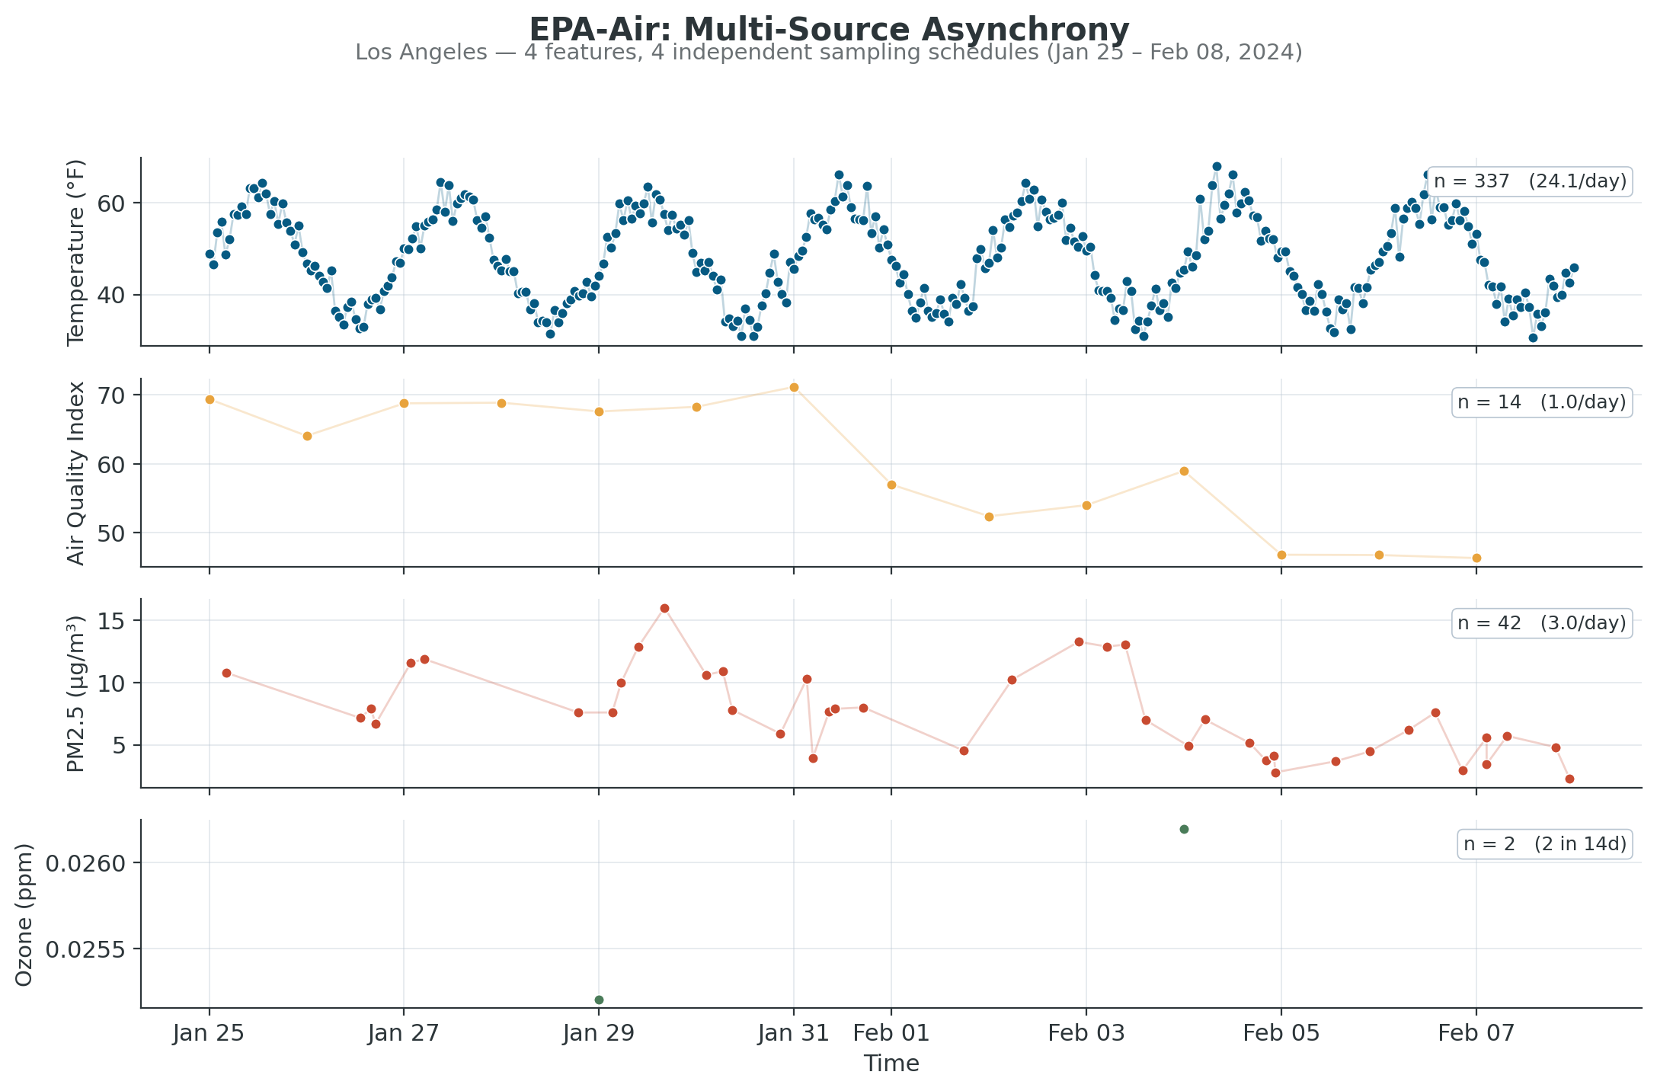
DATASET
EPA-Air: the most irregular dataset in TIME-IMM
8
Counties
4
Features
49,552
Observations
1,244
Text entries
STAT 8240 — Class Project
4 / 12

Slide 5
OUR APPROACH
Two tracks, one dataset [EPA-Air]
TRACK A · REPRODUCTION
TRACK C · METHODOLOGICAL EXTENSION
Rerun 11 baselines on EPA-Air
Three novel ablations
Regular: DLinear, Informer, PatchTST, TimesNet, TimeMixer
Large TS: TTM, TimeLLM
Irregular: tPatchGNN, CRU, LatentODE, NeuralFlow
1
Encoder ablation
GPT-2 vs BERT per model
2
Family interaction
Patch-based vs Non-patch × encoder
7 / 11
successfully reproduced
(~30 min total on A100)
3
Placebo test
Real text vs distribution-matched noise
STAT 8240 — Class Project
3 / 12

Slide 6
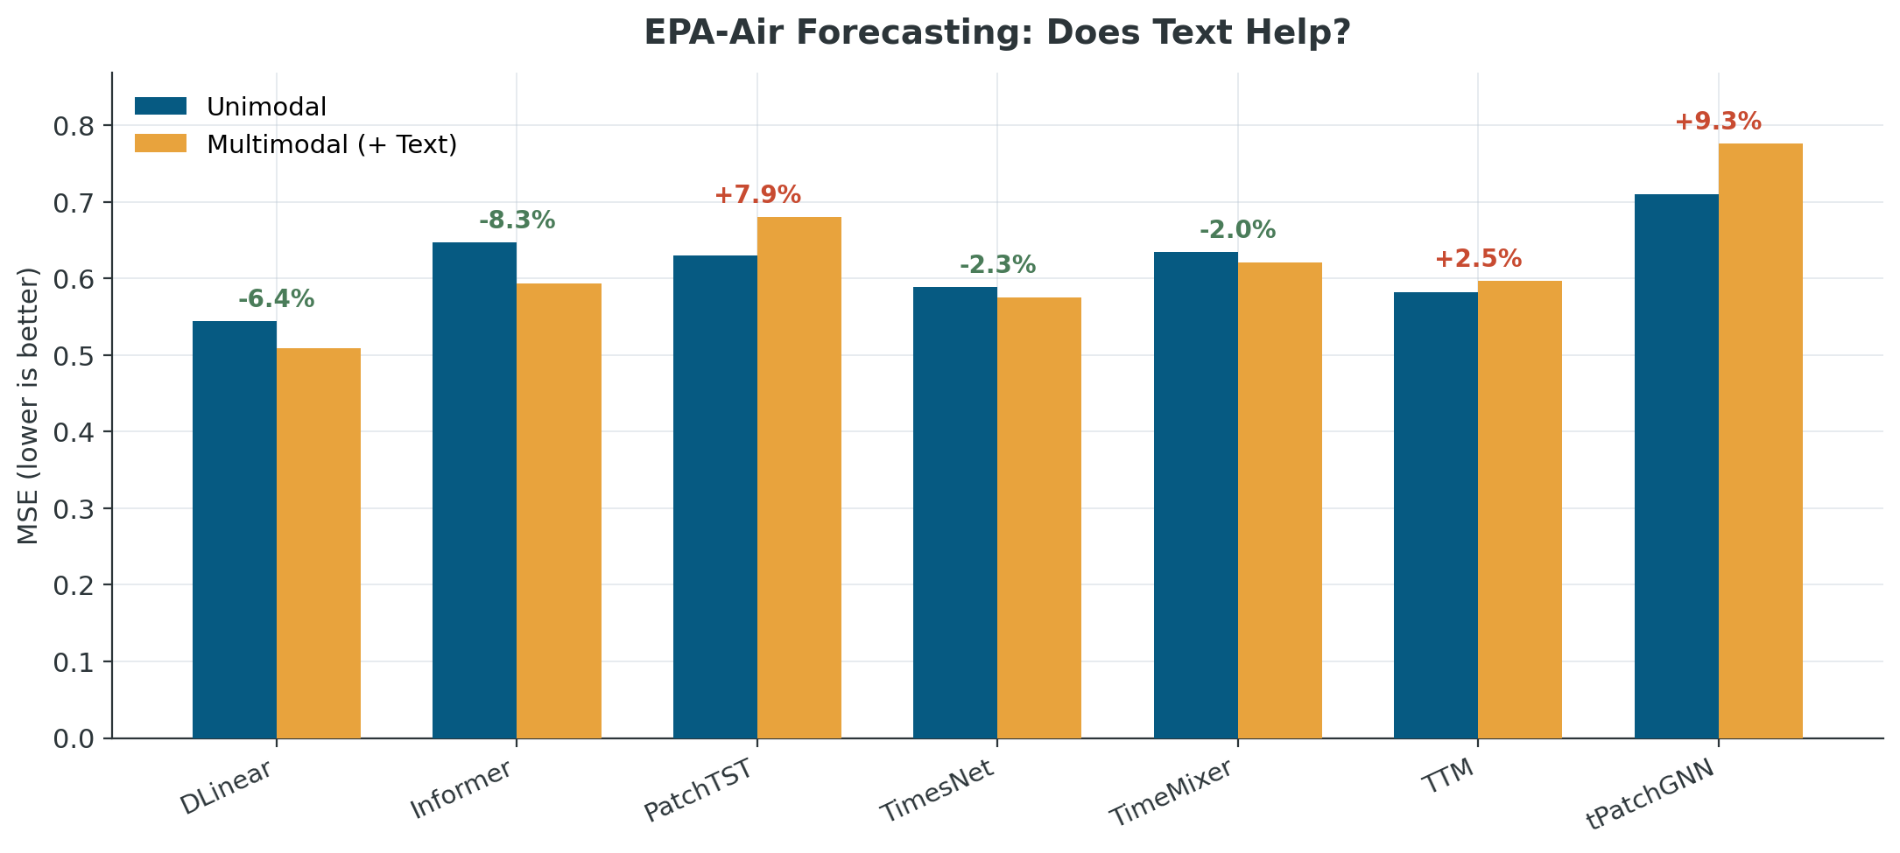
RESULTS — REPRODUCTION
Text helps 4 of 7 models (matches paper's direction)
KEY OBSERVATIONS
DLinear wins overall at 0.509 — simplest model, best accuracy
Text helps 4 / 7 models (green)
Text hurts 3 / 7 models (red) — all patch-based architectures
Largest gain: Informer −8.3%
Average MSE reduction from text: −2.1% · Paper's reported average: −6.7% · EPA-Air text is weaker than the cross-dataset average
STAT 8240 — Class Project
5 / 12

Slide 7
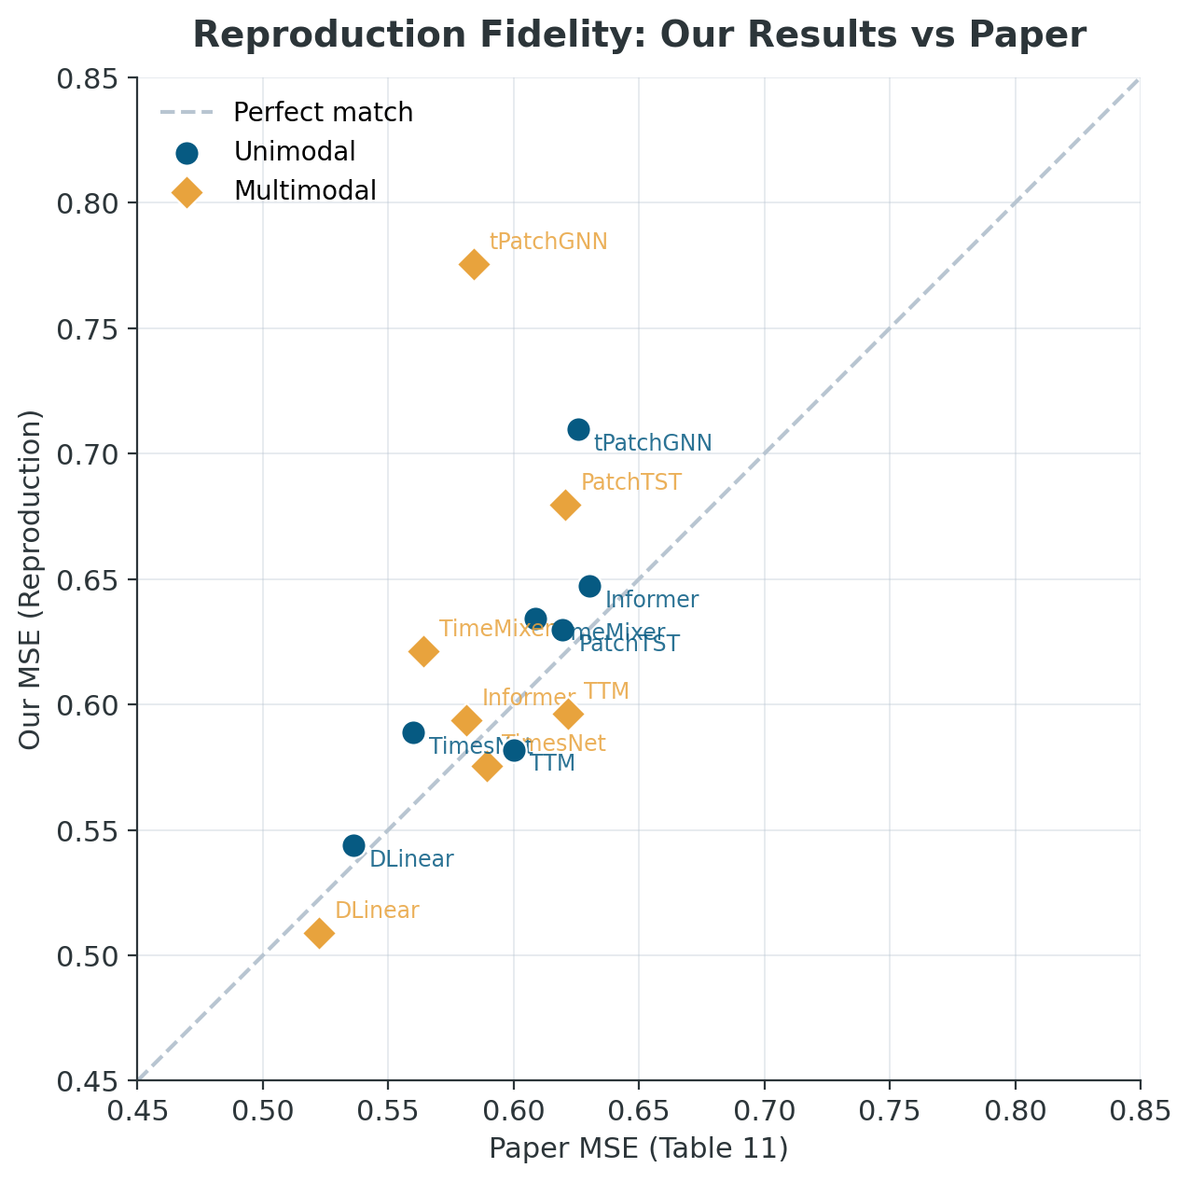
RESULTS — FIDELITY
Numbers track the paper closely
Close to the diagonal
Most points sit within ±0.05 of the paper's reported MSE — indicates reproduction fidelity.
tPatchGNN is the outlier
Default patch_size=24 crashes on EPA-Air's sparsity; we use patch_size=4, which trains but degrades performance.
What this means
Our infrastructure and numbers are trustworthy — a solid base for the Track C extensions that follow.
STAT 8240 — Class Project
6 / 12

Slide 8
CHALLENGES
Why 4 of 11 models failed on EPA-Air
Patch-based models
ODE-based models
Key takeaway
TimeLLM · tPatchGNN*
CRU · LatentODE · NeuralFlow
Default patch_size=24 requires more observations per window than EPA-Air's sparse features can supply. TimeLLM has additional hard-coded token lengths.
Numerical integration at every forward pass is prohibitively slow on asynchronous multi-source data with fine-grained timestamps.
EPA-Air's extreme asynchrony (170× sampling-rate spread) challenges model assumptions across multiple architectures — not just one family.
Feature Observability = 0.38
(lowest in TIME-IMM)
Mean IOI = 1.02 hours
→ expensive ODE solving
Failures are themselves
findings, not setbacks
* tPatchGNN trained with modified patch_size=4
STAT 8240 — Class Project
7 / 12

Slide 9
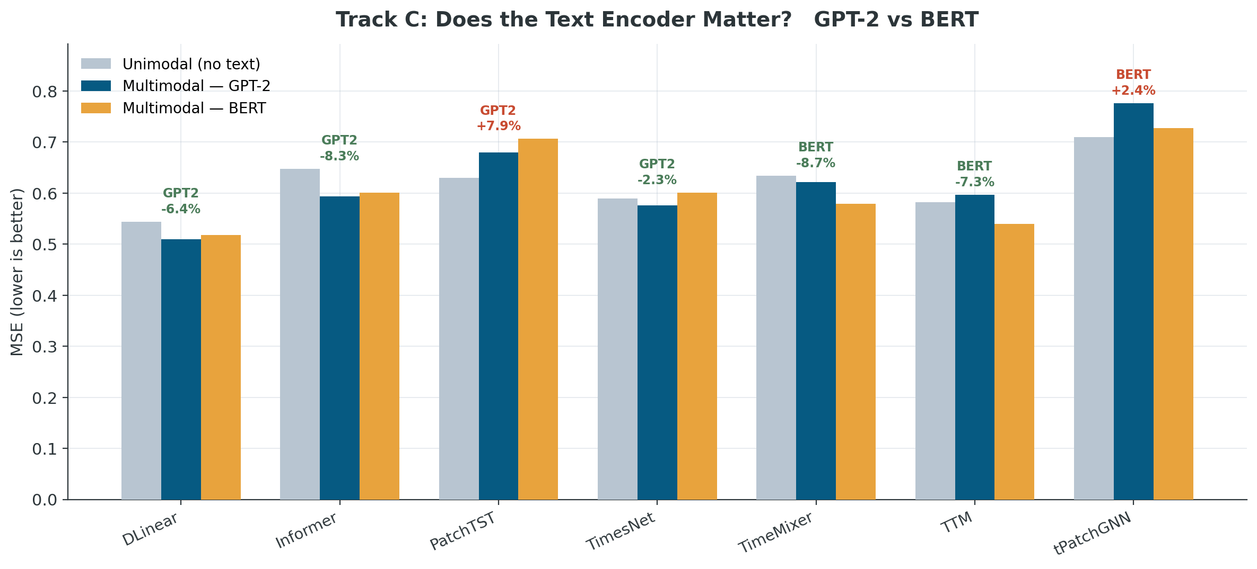
TRACK C · ABLATION 1
Does the text encoder matter?
Paper claims (Fig 6c):
"The choice of LLM backbone does not strongly influence results."
What we find on EPA-Air:
GPT-2 wins: 4 models
BERT wins: 3 models
BERT flips TTM from 'text hurts' to 'text helps' (−7.3%)
On the most irregular dataset, encoder choice matters — a pattern invisible when averaging across datasets.
STAT 8240 — Class Project
8 / 12

Slide 10
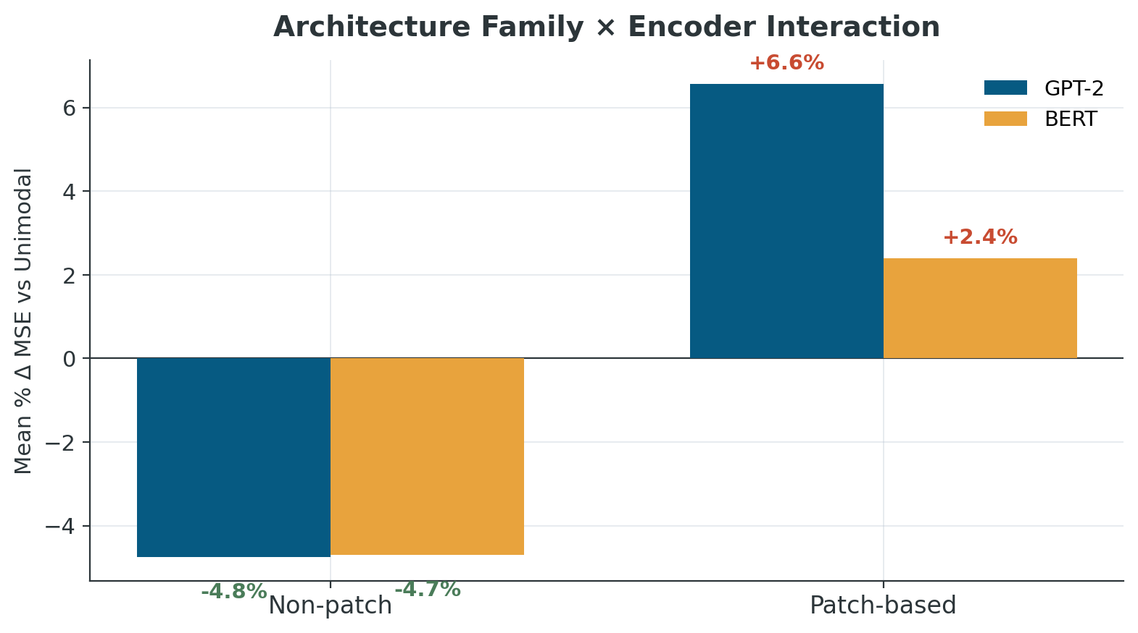
TRACK C · ABLATION 2
The cleaner story: architecture family × encoder
NON-PATCH MODELS
Text reliably helps
Roughly −4.8% with either encoder. GPT-2 and BERT are interchangeable. The paper's Fig 6c claim holds here.
PATCH-BASED MODELS
Text hurts — but BERT hurts less
GPT-2 degrades by +6.5%, BERT by only +2.4%. Encoder choice matters here — encoder-dataset interaction deserves attention.
When you condition on architecture family, encoder effects are large and systematic — the paper's cross-model average masks this.
STAT 8240 — Class Project
9 / 12

Slide 11
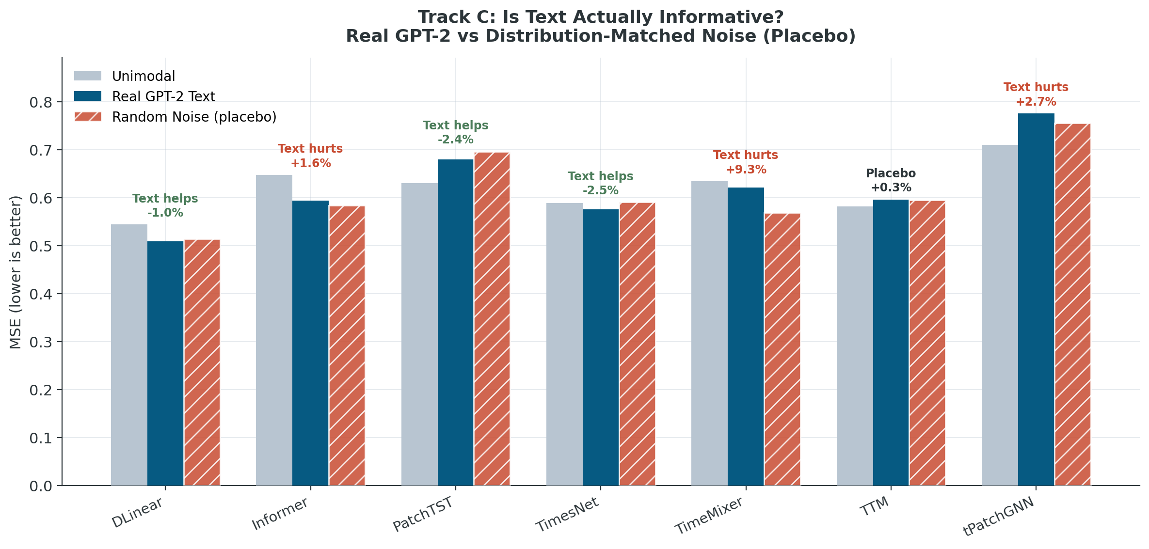
TRACK C · ABLATION 3
Placebo test: is text actually informative?
METHOD: Replace real GPT-2 text embeddings with random noise of matching mean, std, and shape. If models can't tell them apart, the fusion module is acting as a regularizer — not semantic integration.
VERDICT BY MODEL
3
Text helps
DLinear, PatchTST, TimesNet
3
Text hurts
Informer, TimeMixer, tPatchGNN
1
Placebo (tie)
TTM
For 3 of 7 models, random noise outperforms real text — a finding the paper doesn't check for.
STAT 8240 — Class Project
10 / 12

Slide 12
KEY FINDINGS
Three findings from Track C that the paper misses
01
Encoder choice is not uniformly irrelevant
Contradicts Paper Fig 6c. On EPA-Air — the most irregular dataset — GPT-2 vs BERT flips the winner for 3 of 7 models. The interchangeability claim holds only on average.
02
Architecture family predicts encoder behavior
Patch-based models (PatchTST, TTM, tPatchGNN) are hurt by text, but less so with BERT (+2.4% vs +6.5% with GPT-2). Non-patch models are helped equally by either encoder (~−4.8%).
03
Real text can be worse than random noise
For 3 of 7 models, distribution-matched noise beats real GPT-2 embeddings. Suggests part of the 'text helps' gain reported in the paper is regularization, not semantic content.
STAT 8240 — Class Project
11 / 12

Slide 13
NEXT STEPS
From reproduction to poster
BY ANALYTICS DAY (APR 20)
BY MAY 4 (FINAL)
Poster layout using 9 ready figures
3-seed robustness check on the placebo result
Export final figures at poster DPI
6–10 page report with full methodology
Clean, documented GitHub repo (reproducibility)
15-min class presentation
Questions?
Anchor paper: Chang et al., "TIME-IMM: A Dataset and Benchmark for Irregular Multimodal Multivariate Time Series," NeurIPS 2025.

