Slide 1

IMAGE DATASET CLASSIFICATION USING DEEP LEARNING
Project Supervisors:
Dr. Devanayagam Palaniappan (Pal)
Dr. M, Mallikarjunaiah
Dr. Sreelekha Guggilam

Slide 2
Agenda
Objective of the project
TissueMNIST Dataset
Classification of TissueMNIST dataset images
Basic architecture of neural networks
Architecture of convolutional neural network(CNN)
How image is fed to CNN
Convolutional operation
ResNET 18 model and it’s architecture
Activation function(ReLU),
Loss function(CEL)
Optimizer(SGD)
Accuracy comparison

Slide 3
Objective of the project
The primary objective of proposed model to build the deep learning model which is ResNet-18 to automate the process of distinguishing/classifying different types of human kidney tissues by utilizing histopathological image dataset which is TissueMNIST taken from MedMNIST data source.

Slide 4

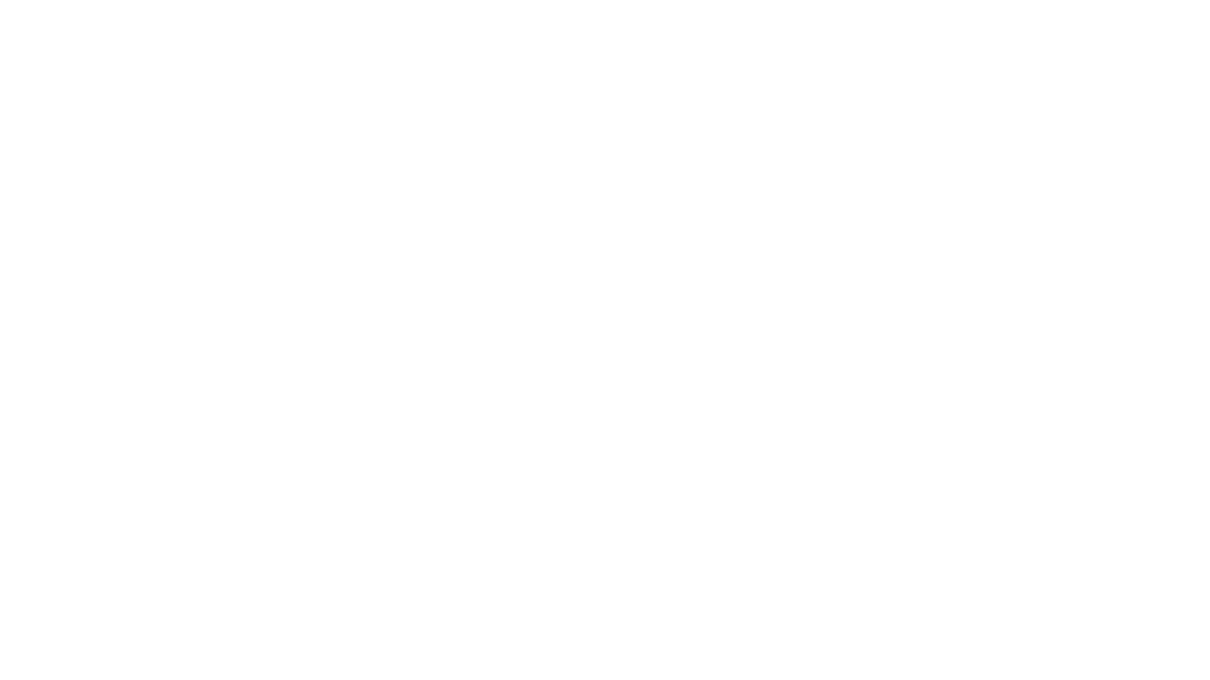
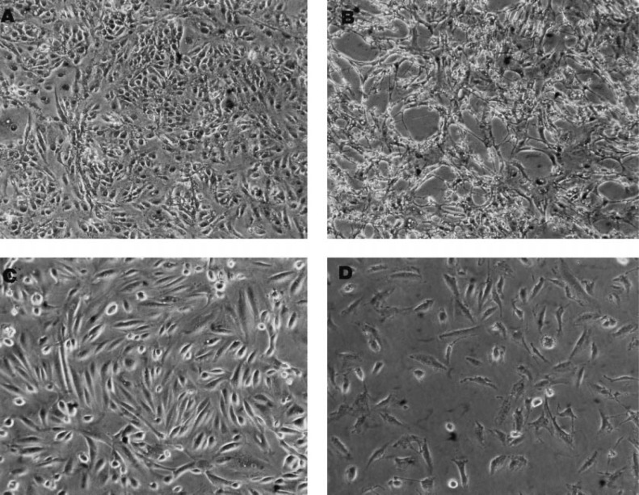
TissueMNIST Dataset
TissuMNIST dataset imported from MedMNIST data source that contains 2D human kidney cortex cells.
Images type: Grayscale with 28x28 pixels
Dataset size(volume)
Number of images: A total of 2,36,386 of
Training set: 1,65,466 images(70%)
Test set: 47,908 images(20%)
Validation set: 23,412 images(10%)
[Charu C, Aggarwal. Neural networks and deep learning: Springer journal, 2018.]

Slide 5
Classification of TissueMNIST dataset Images
We have classified whole dataset into 8 different types based on Tissue type
1.Glomerular: Glomeruli are tiny structures in the nephron responsible for filtering blood to form urine
2.Blood Vessel: Blood vessels transport blood to and from the kidney for filtration and nutrient supply
3.Interstitium: It is connective tissue that providing support between nephrons and blood vessels
4.Artery: This tissue is large blood vessels transporting oxygenated blood into the kidney
5.Vein: Veins transport deoxygenated blood from the kidney back to the heart
6.Tubule: Tubules reabsorb water, ions, and nutrients, and secrete waste into urine
7.Medulla: Inner part of the kidney that helps concentrate urine by facilitating water reabsorption
8.Collecting Duct : Large tubules that collect urine from nephrons and channel it into the renal pelvis.
[Jiancheng Yang,Rui Shi,Donglai Wei,Zequan Liu,Lin Zhao, RWTH Aachen University, Aachen, Germany: MedMNIST, 2019.]

Slide 6
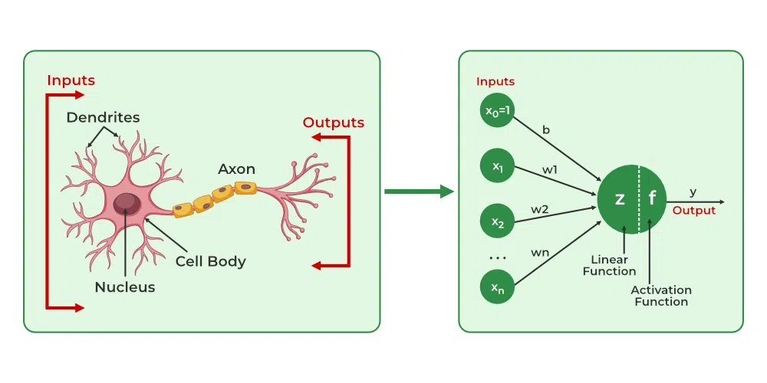
Architecture of Artiﬁcial Neural Networks(ANN)
Here X1, X2, X3…Xn are input features.
W1, W2, W3…Wn are weights
Sigma(Z) = X1*W1+X2*W2+…+Xn*Wn
Bias(b): Additional constant added to Z
[Charu C, Aggarwal. Neural networks and deep learning: Springer journal, 2018.]

Slide 7
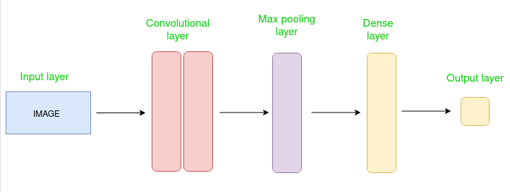
Architecture Convolutional Neural Network(CNN)
CNN architecture typically consists:
Convolutional layers,
Pooling layers
Dense layer or fully connected layer.
[Charu C, Aggarwal. Neural networks and deep learning: Springer journal, 2018.]

Slide 8
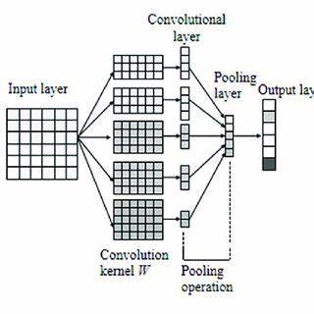
How Image is fed to CNN model?
In a convolutional neural network (CNN), an input image is fed as a numerical representation of matrix, where each pixel represents its color intensity, essentially converting the image into a data structure that the network can process.
[Charu C, Aggarwal. Neural networks and deep learning: Springer journal, 2018.]

Slide 9
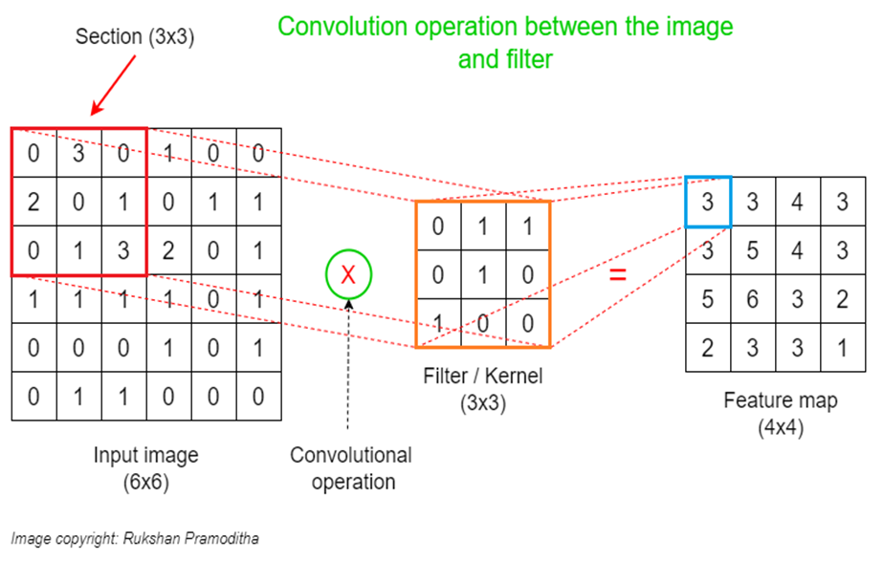
Convolutional operation
Input image: Here in CO the input image is in matrix format.
Filter/Kernal: A "filter" is a small matrix of weights that slides across an input image.
Weights: "weights" refer to the numerical values associated with each filter, which represents strength of the connection between image and filter.
Bias: Bias is an additional constant value that is added to the product of weights.
Add formula: n – f + 1
[Charu C, Aggarwal. Neural networks and deep learning: Springer journal, 2018.]

Slide 10
Pooling Operation in cnn
Pooling layer: It provides a feature extraction operation in convolutional neural networks (CNNs) that reduces the spatial dimensions of an input image.
Types of pooling techniques:
1. Max pooling: Max(Val1, Val2…)
2.Average pooling: Val1+Val2 / 2
[Charu C, Aggarwal. Neural networks and deep learning: Springer journal, 2018.]

Slide 11
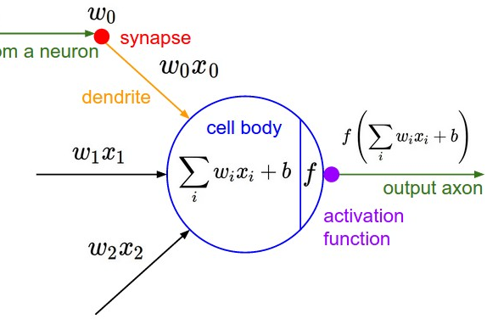
Passing output to Activation Function after max pool operation
An activation function introduces non-linearity into the model, allowing the network to learn and represent complex patterns in the data.
After This the final output passed to either output later or another convolutional layer if we have multiple convolutional layers.
[Charu C, Aggarwal. Neural networks and deep learning: Springer journal, 2018.]

Slide 12
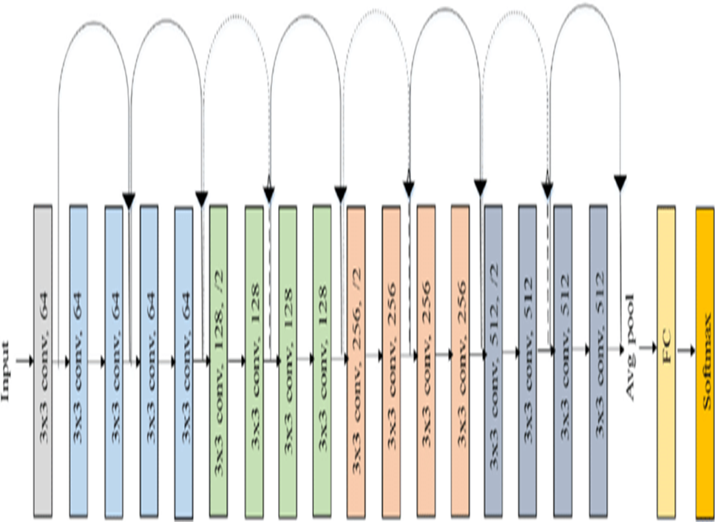
ResNET-18 Architecture
Building blocks of ResNET-18 model are:
Cov1(Beginning layer)
Conv2, Conv3, Conv4 and Conv5 : These layers provides skip connection feature to avoid vanishing gradient problem.
Fully connected FC layer
Note: input & output layers won’t count in ResNET-18 model.
[Charu C, Aggarwal. Neural networks and deep learning: Springer journal, 2018.]

Slide 13
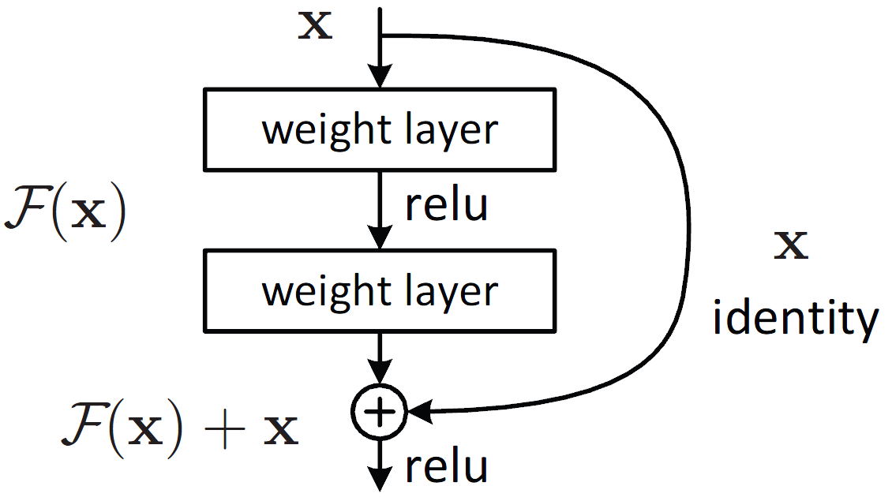
Skip Connection
In the ResNet-18 architecture, The "skip connection" refers to a shortcut connection that allows the one output of a layer to be directly added to the output of a later layer.
That means the input will travel through out and around the all-convolutional layers.
This technique is used to avoid vanishing gradient problem
[Charu C, Aggarwal. Neural networks and deep learning: Springer journal, 2018.]

Slide 14
Activation Function, Loss Function & Optimizer THAT I USED IN ResNET-18 model
Best turning parameter set I found after 14 trails
Activation Function: Rectified Linear Unit(ReLU)
Loss Function: Cross Entropy Loss
Optimizer: Stochastic Gradient Descent(SGD).
[Charu C, Aggarwal. Neural networks and deep learning: Springer journal, 2018.]

Slide 15
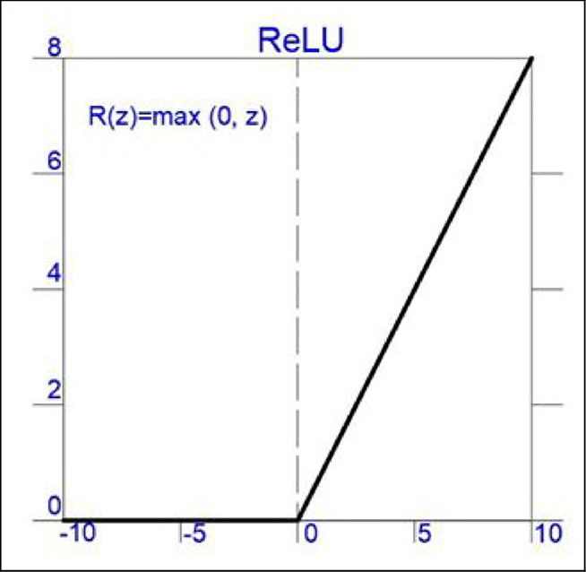
AF: Rectified linear unit
Why ReLU is best AF for ResNET-18 ?
ReLU activates only +Ve values, while the –ve values becomes zero.
ReLU is computationally effective to introduce non-linearity between data.
ReLu helps to improve the model performance by activating concern neurons.
Formula: ReLU=Max(0,z), here z is +ve value
[Charu C, Aggarwal. Neural networks and deep learning: Springer journal, 2018.]

Slide 16
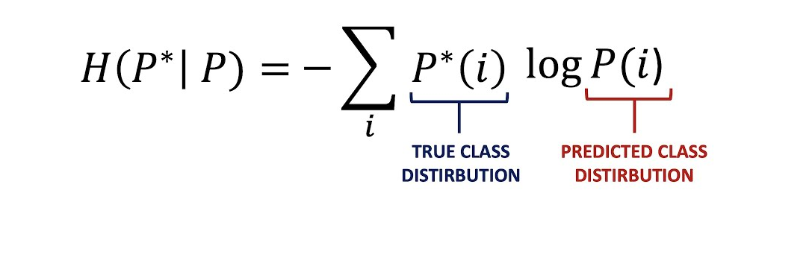
Loss function: Cross Entropy Loss
Why Cross Entropy Loss function is best for ResNET?
Cross entropy is effective for classification problems due to its probabilistic nature(since out problem is related to classification).
It leads to better and faster convergence in classification tasks.
Cross-entropy loss works very well with advanced optimizers such as Adam, SGD.
[Charu C, Aggarwal. Neural networks and deep learning: Springer journal, 2018.]

Slide 17
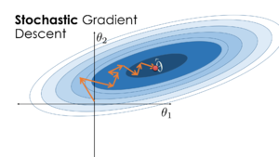
Optimizer: Stochastic gradient optimizer
Why SGD is best for ResNET?
SGD is often the best fit for training deep models like ResNet because it strikes a balance between convergence speed, generalization ability, and resilience to noisy data.
SGD is the preferred choice in most cases for its reliability, simplicity, and flexibility.
[Charu C, Aggarwal. Neural networks and deep learning: Springer journal, 2018.]

Slide 18
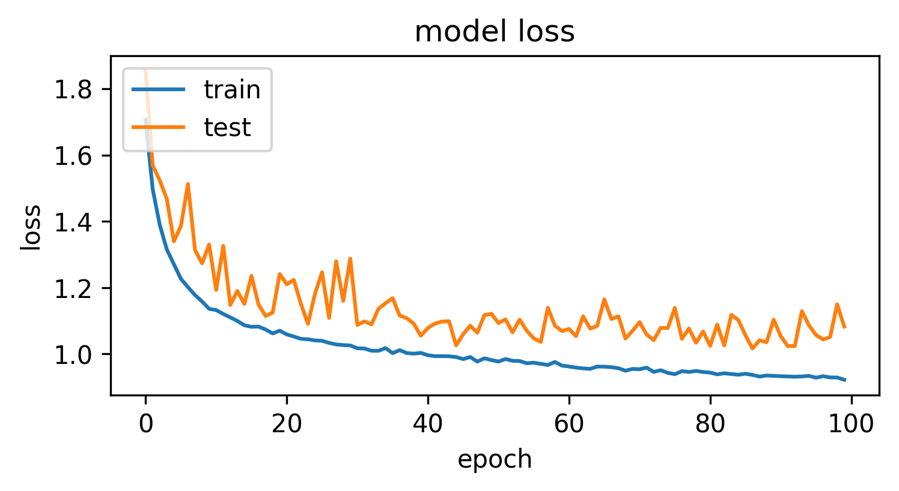
Number of epoch’s vs loss

Slide 19
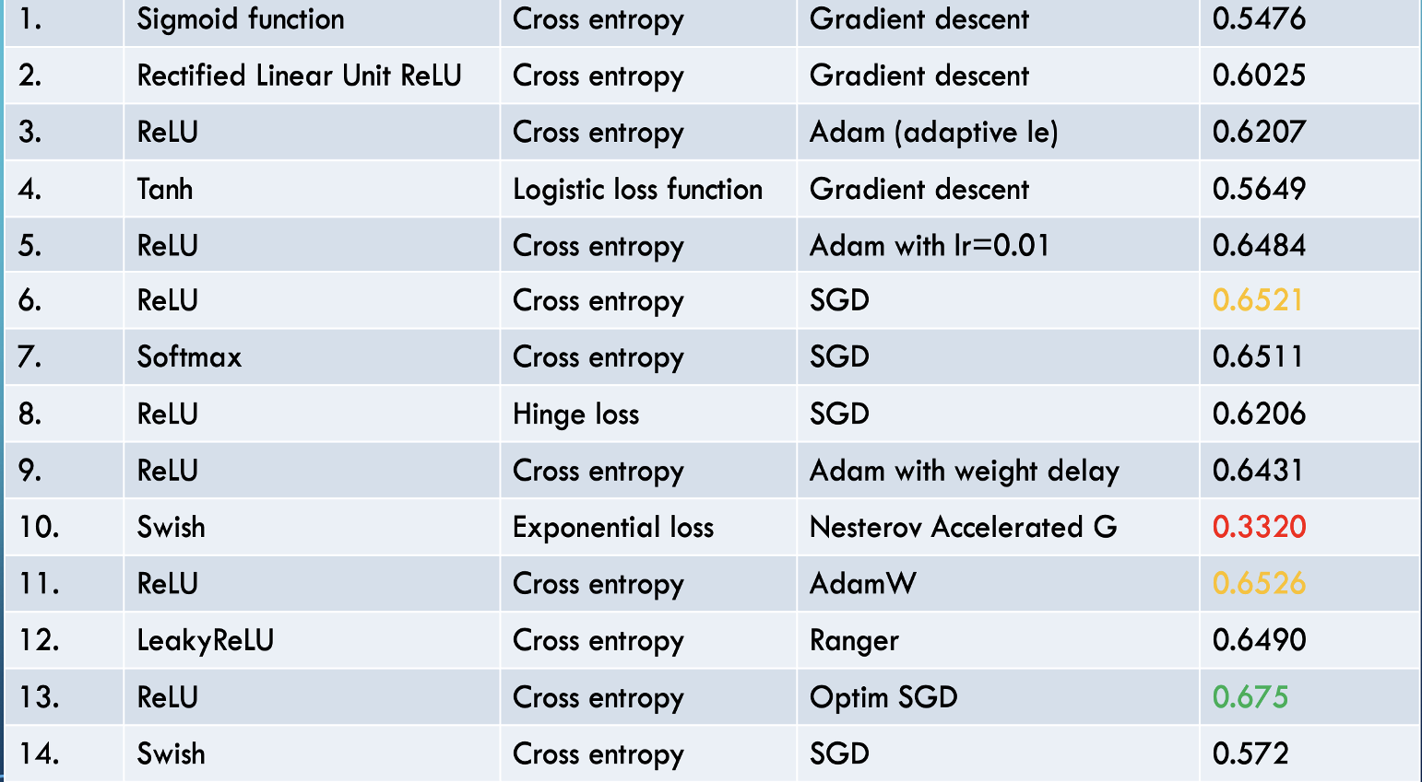
Accuracy comparison

Slide 20
Reference
Filipczuk, P., Fevens, T., Krzyzak, A., Monczak, R.: Computer-aided breast cancer diagnosis based on the analysis of cytological images of fine needle biopsies. IEEE Trans. Med. Imaging 32(12), 2169–2178 (2013).
Vivanti, R., Ephrat, A., Joskowicz, L., Karaaslan, O., Lev-Cohain, N., and Sosna, J., Automatic liver tumor segmentation in follow-up CT studies using convolutional neural networks. Proc. Patch-Based Methods Med. Image Process. Workshop, MICCAI’2015, 54–61, 2015.
Ravishankar, H., Sudhakar, P., Venkataramani, R., Thiruvenkadam, S., Annangi, P., Babu, N., and Vaidya, V., Understanding the mechanisms of deep transfer learning for medical images. In: Proceedings of the Deep Learning in Medical Image Analysis (DLMIA). Lect. Notes Comput. Sci. 10008:188–196, 2016b.
Bi, W.L.; Hosny, A.; Schabath, M.B.; Giger, M.L.; Birkbak, N.J.; Mehrtash, A.; Allison, T.; Arnaout, O.; Abbosh, C.; Dunn, I.F.; et al. Artificial Intelligence in Cancer Imaging: Clinical Challenges and Applications. CA Cancer J. Clin. 2019, 69, 127–157. [Google Scholar] [CrossRef] [PubMed].

Slide 21
Conclusion
The final conclusion of this image classification project is the successful classification of human kidney tissue images using the data science skills I acquired as a Data Science student at TAMUCC. During the replication of this project, I implemented the ResNet-18 model with various activation functions, loss functions, and optimizers, meticulously recording the accuracy of each configuration. Ultimately, I achieved the benchmark accuracy of the ResNet-18 model.

Slide 22

Q & A

