Slide 1


Slide 2
ShowTime – Online Movie Ticket Booking System
Platform: Web Application (PHP, MySQL, HTML/CSS/JavaScript)
Submitted to Prof. Tejas Chauhan
Team Members: Prashanth, Vinay Swamy, Sai Deepak

Slide 3
Project Overview
A full-stack, BookMyShow-style movie ticket booking web app built with PHP and MySQL
Lets users browse movies, view showtimes across theaters, select seats, and book tickets online
Includes an admin panel to manage movies, theaters, screens, shows, and bookings

Slide 4
Problem Statement
Booking movie tickets manually at a theater counter is time-consuming and inconvenient
No easy way for users to check seat availability or showtimes in advance
Theaters need a simple system to manage movies, shows, and bookings without manual bookkeeping

Slide 5
Objectives
Build a user-friendly platform to browse movies and book tickets online
Implement an interactive seat map with tiered pricing (regular / premium / recliner)
Prevent double-booking using a database transaction that re-checks seat availability at confirmation
Provide an admin panel to manage movies, theaters, screens, shows, and bookings

Slide 6
Tools & Technologies
Programming Tools
PHP 8 (PDO)
MySQL / MariaDB
Server
Apache / PHP Built-in Server
Code Versioning
Git & GitHub
Run Locally On
XAMPP / WAMP
Coding Tools
VS Code

Slide 7
System Architecture
Presentation Layer – PHP pages with HTML/CSS/JS (movie listing, seat map, booking flow)
Logic Layer – PHP business logic (booking validation, seat locking, admin operations)
Data Layer – MySQL database (movies, theaters, shows, bookings)

Slide 8
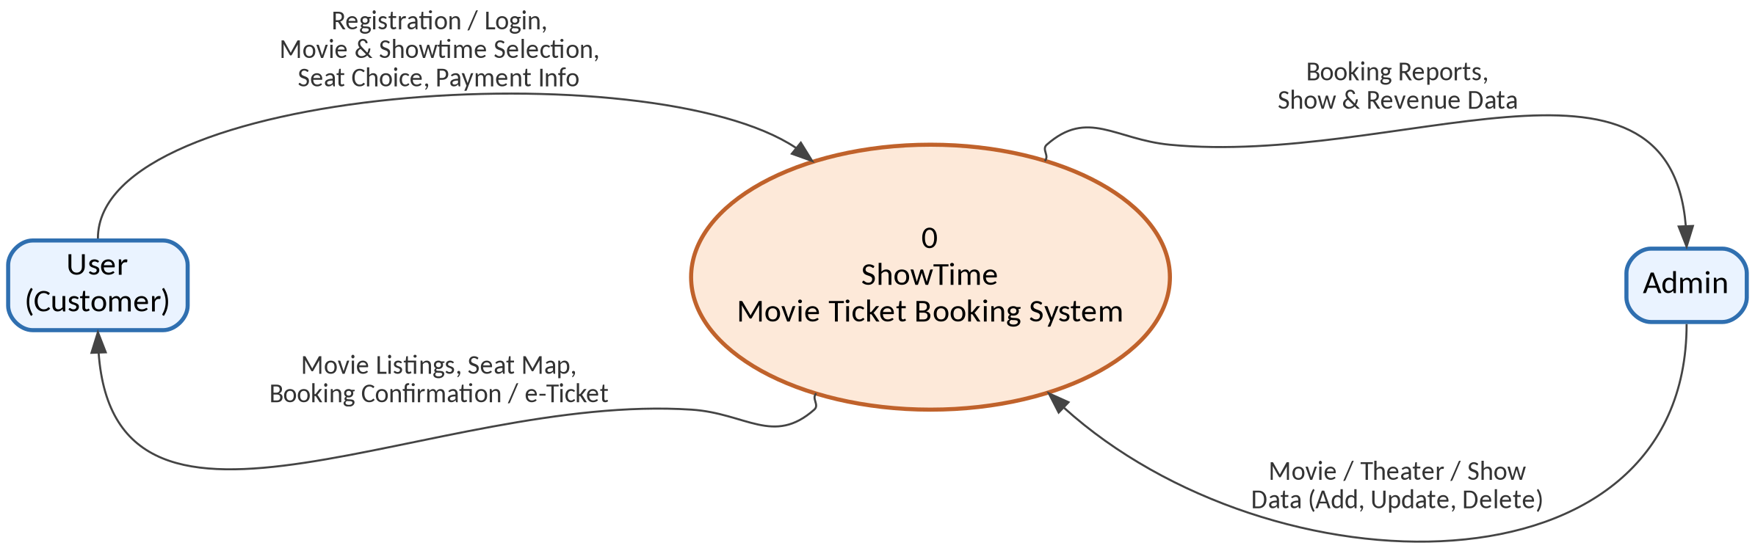
Data Flow Diagram – Level 0 (Context Diagram)

Slide 9
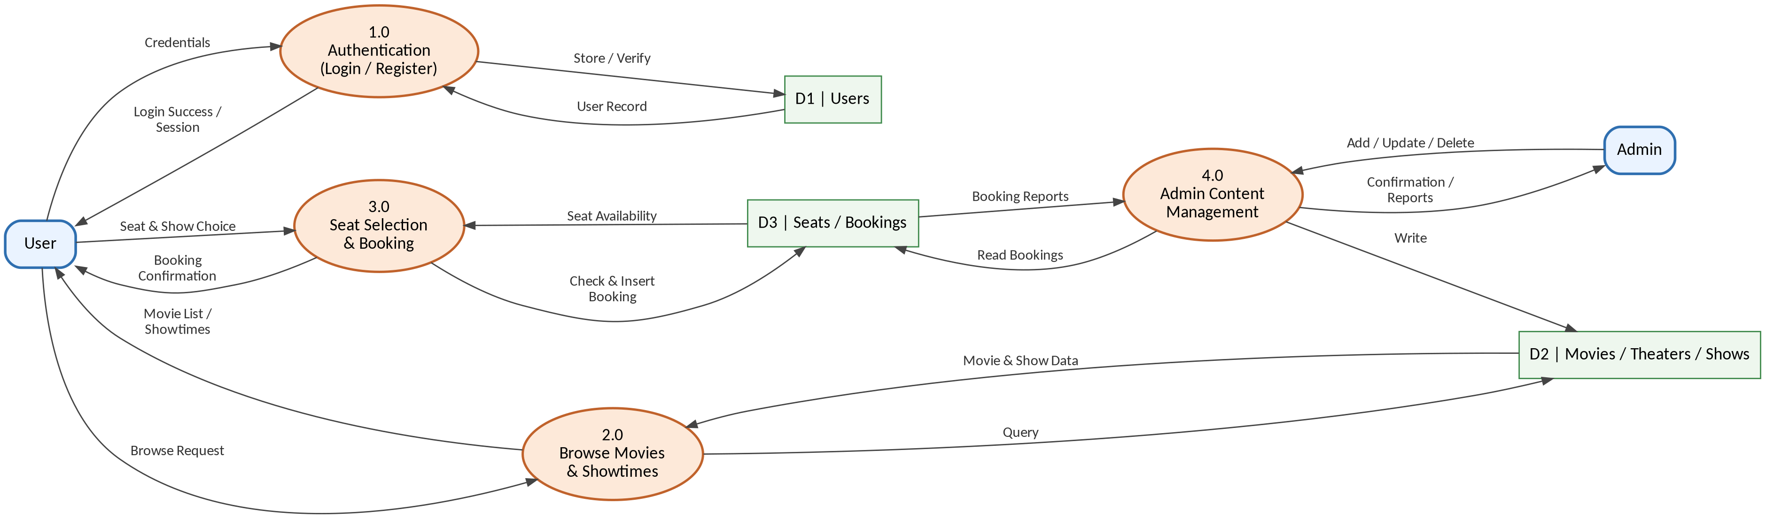
Data Flow Diagram – Level 1

Slide 10
Website Workflow
User Input – Select movie, showtime, and seats
Database Operation – Check seat availability and confirm booking inside a transaction
Output – Generate e-ticket / booking confirmation page

Slide 11
Database Design
Tables: users, movies, theaters, screens, seats, shows, bookings, booking_seats
Primary Keys: unique IDs for each table, linked via foreign keys (e.g. booking_id, seat_id)
CRUD Operations: create/read/update/delete for movies, theaters, shows, and bookings via the admin panel

Slide 12
Modules
User Module – Registration, Login, My Bookings
Booking Module – Movie browsing, seat selection, simulated payment, e-ticket
Admin Module – Manage movies, theaters, screens, shows, and bookings

Slide 13
Screenshots
Login Screen
Home / Movie Listing Screen
Seat Selection Screen
GitHub Screenshot
Repository
Contributors

Slide 14
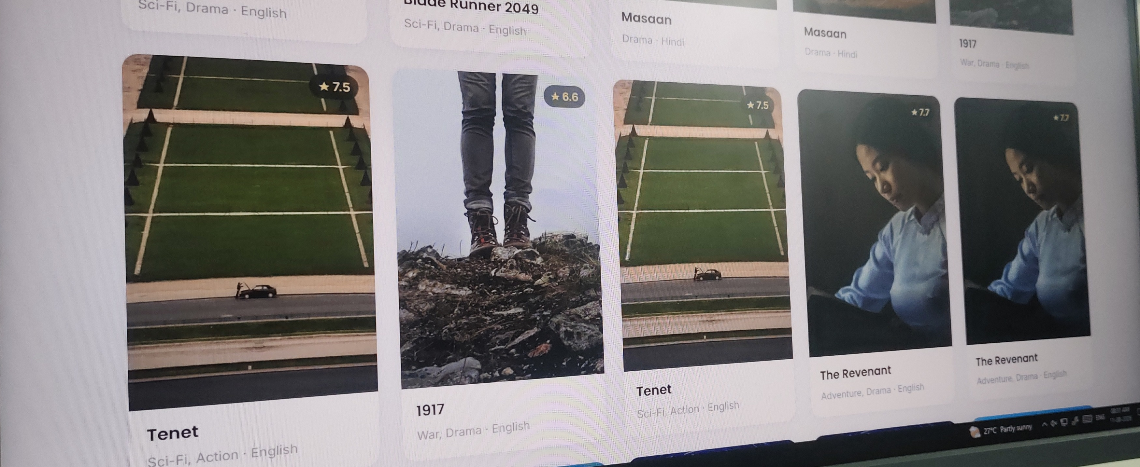
Interface & Output Screenshot
Live screenshot of the running ShowTime application (movie listing / home screen output)

Slide 15
Test Cases
Valid User Login
Already-Booked Seat Selection (Invalid Input)
Successful Booking Insert Inside a DB Transaction

Slide 16
Limitations
No real payment gateway integration (payment is simulated)
Admin panel has a basic UI without advanced analytics

Slide 17
Future Enhancements
Integrate a real payment gateway (e.g. Razorpay / Stripe)
Move to a cloud-hosted database and deploy for public access

Slide 18
Conclusion
Built a working movie ticket booking platform with booking, seat-locking, and admin features
Gained practical experience in PHP, MySQL, and full-stack web development

Slide 19


