Slide 1
Double Slit
Valentin Reichenspurner

Slide 2
Schrödinger Equation

Slide 3

$$iℏ\frac{∂ψ}{∂t}=−\frac{ℏ^{2}}{2m}Δψ+V(\vec{r},t)ψ$$

Slide 4
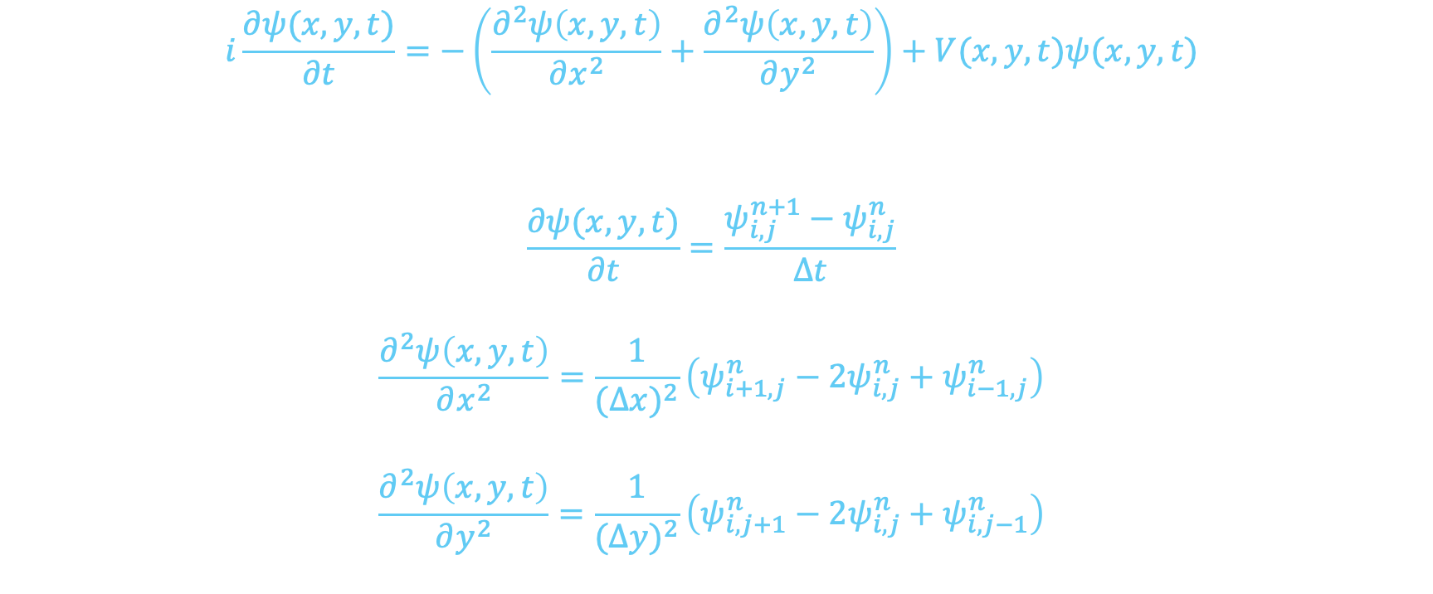
Discretization
$$i\frac{∂ψ(x,y,t)}{∂t}=−\left(\frac{∂^{2}ψ\left(x,y,t\right)}{∂x^{2}}+\frac{∂^{2}ψ\left(x,y,t\right)}{∂y^{2}}\right)+V(x,y,t)ψ(x,y,t)$$
$$\frac{∂ψ(x,y,t)}{∂t}=\frac{ψ_{i,j}^{n+1}−ψ_{i,j}^{n}}{Δt}$$
$$\frac{∂^{2}ψ\left(x,y,t\right)}{∂x^{2}}=\frac{1}{{(Δx)}^{2}}\left(ψ_{i+1,j}^{n}−2ψ_{i,j}^{n}+ψ_{i−1,j}^{n}\right)$$
$$\frac{∂^{2}ψ\left(x,y,t\right)}{∂y^{2}}=\frac{1}{{(Δy)}^{2}}\left(ψ_{i,j+1}^{n}−2ψ_{i,j}^{n}+ψ_{i,j−1}^{n}\right)$$

Slide 5
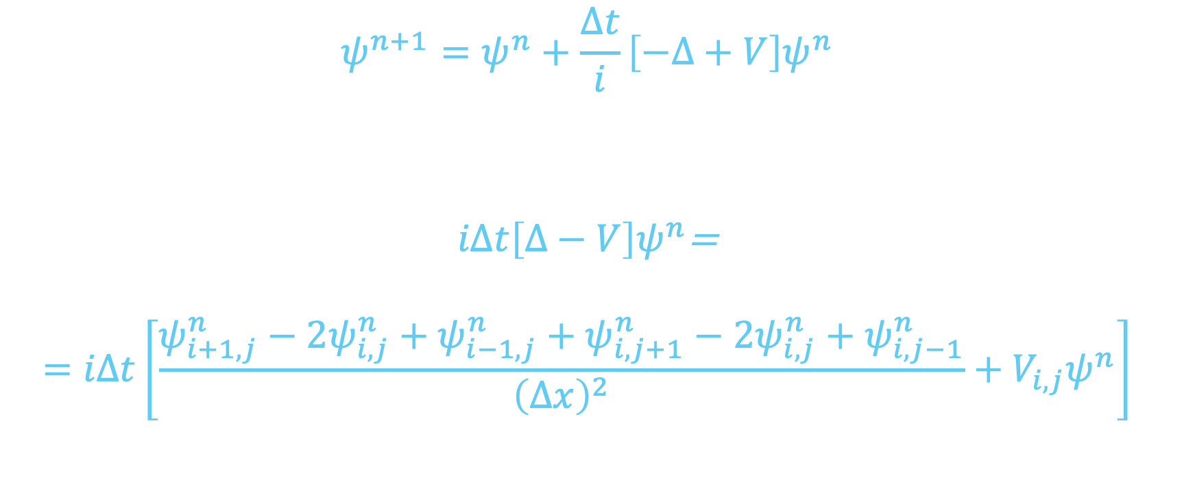
Forward Euler
$$ψ^{n+1}=ψ^{n}+\frac{Δt}{i}\left[−Δ+V\right]ψ^{n}$$
$iΔt\left[Δ−V\right]ψ^{n}$=
$$=iΔt\left[\frac{ψ_{i+1,j}^{n}−2ψ_{i,j}^{n}+ψ_{i−1,j}^{n}+ψ_{i,j+1}^{n}−2ψ_{i,j}^{n}+ψ_{i,j−1}^{n}}{{\left(Δx\right)}^{2}}+V_{i,j}ψ^{n}\right]$$

Slide 6

Notation
$$r=\frac{iΔt}{{\left(Δx\right)}^{2}}$$
$$a_{i,j}=−2r+iΔtV_{i,j}$$

Slide 7
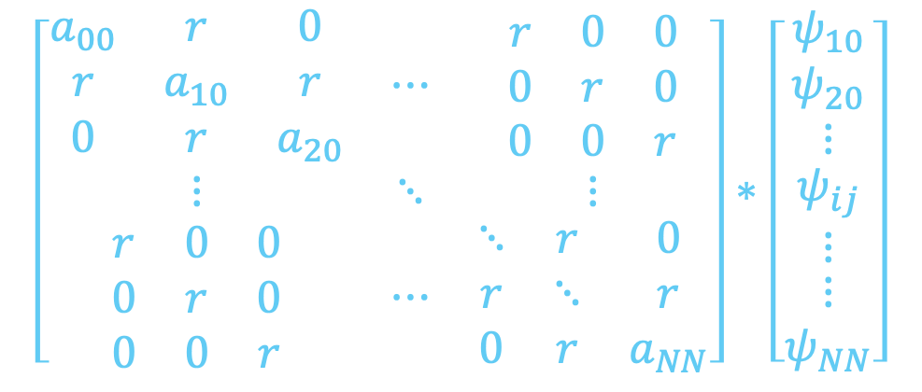
Hamiltonian in Matrix form
$$\left[\begin{matrix}\begin{matrix}a_{00} & r & 0 \\ r & a_{10} & r \\ 0 & r & a_{20}\end{matrix} & ⋯ & \begin{matrix}r & 0 & 0 \\ 0 & r & 0 \\ 0 & 0 & r\end{matrix} \\ ⋮ & ⋱ & ⋮ \\ \begin{matrix}r & 0 & 0 \\ 0 & r & 0 \\ 0 & 0 & r\end{matrix} & ⋯ & \begin{matrix}⋱ & r & 0 \\ r & ⋱ & r \\ 0 & r & a_{NN}\end{matrix}\end{matrix}\right]∗\left[\begin{matrix}\begin{matrix}\begin{matrix}ψ_{10} \\ ψ_{20} \\ ⋮\end{matrix} \\ ψ_{ij} \\ ⋮\end{matrix} \\ ⋮ \\ ψ_{NN}\end{matrix}\right]$$

Slide 8

Runge Kutta method
$$k_{1}=−iℏ∗H∗ψ_{n}$$
$$k_{2}=−iℏ∗H∗\left(ψ_{n}+\frac{Δt}{2}k_{1}\right)$$
$$k_{3}=−iℏ∗H∗\left(ψ_{n}+\frac{Δt}{2}k_{2}\right)$$
$$k_{4}=−iℏ∗H∗\left(ψ_{n}+k_{3}\right)$$
$$ψ_{n+1}= ψ_{n}+\frac{Δt}{6}\left(k_{1}+2k_{2}+2k_{3}+k_{4}\right)$$

Slide 9
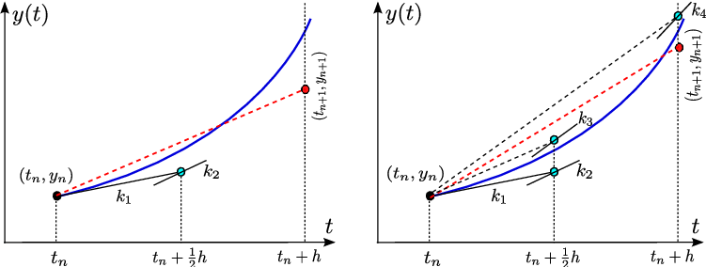

Slide 10

Gaussian wave packet
$$ψ\left(x,y,t=0\right)=e^{−\frac{1}{2σ^{2}}\left[{\left(x−x_{0}\right)}^{2}+{\left(y−y_{0}\right)}^{2}\right]}∗e^{−ik\left(x−x_{0}\right)}$$

Slide 11
CODE

Slide 12
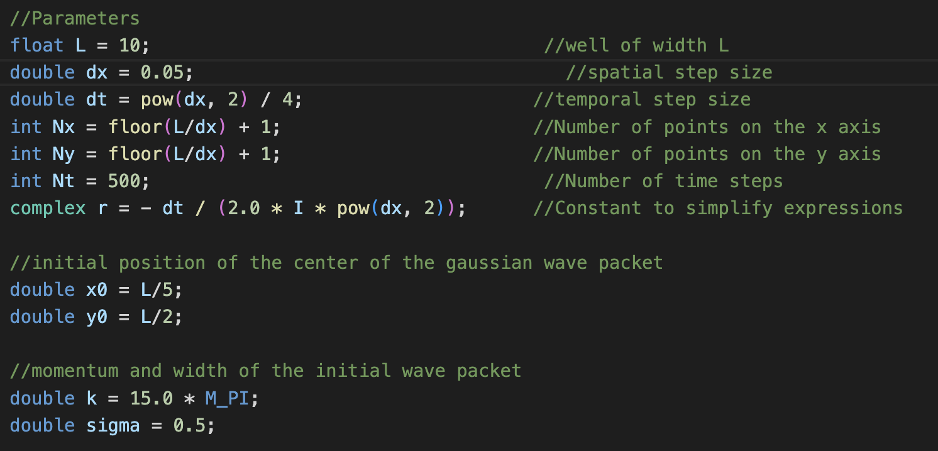
parameters

Slide 13
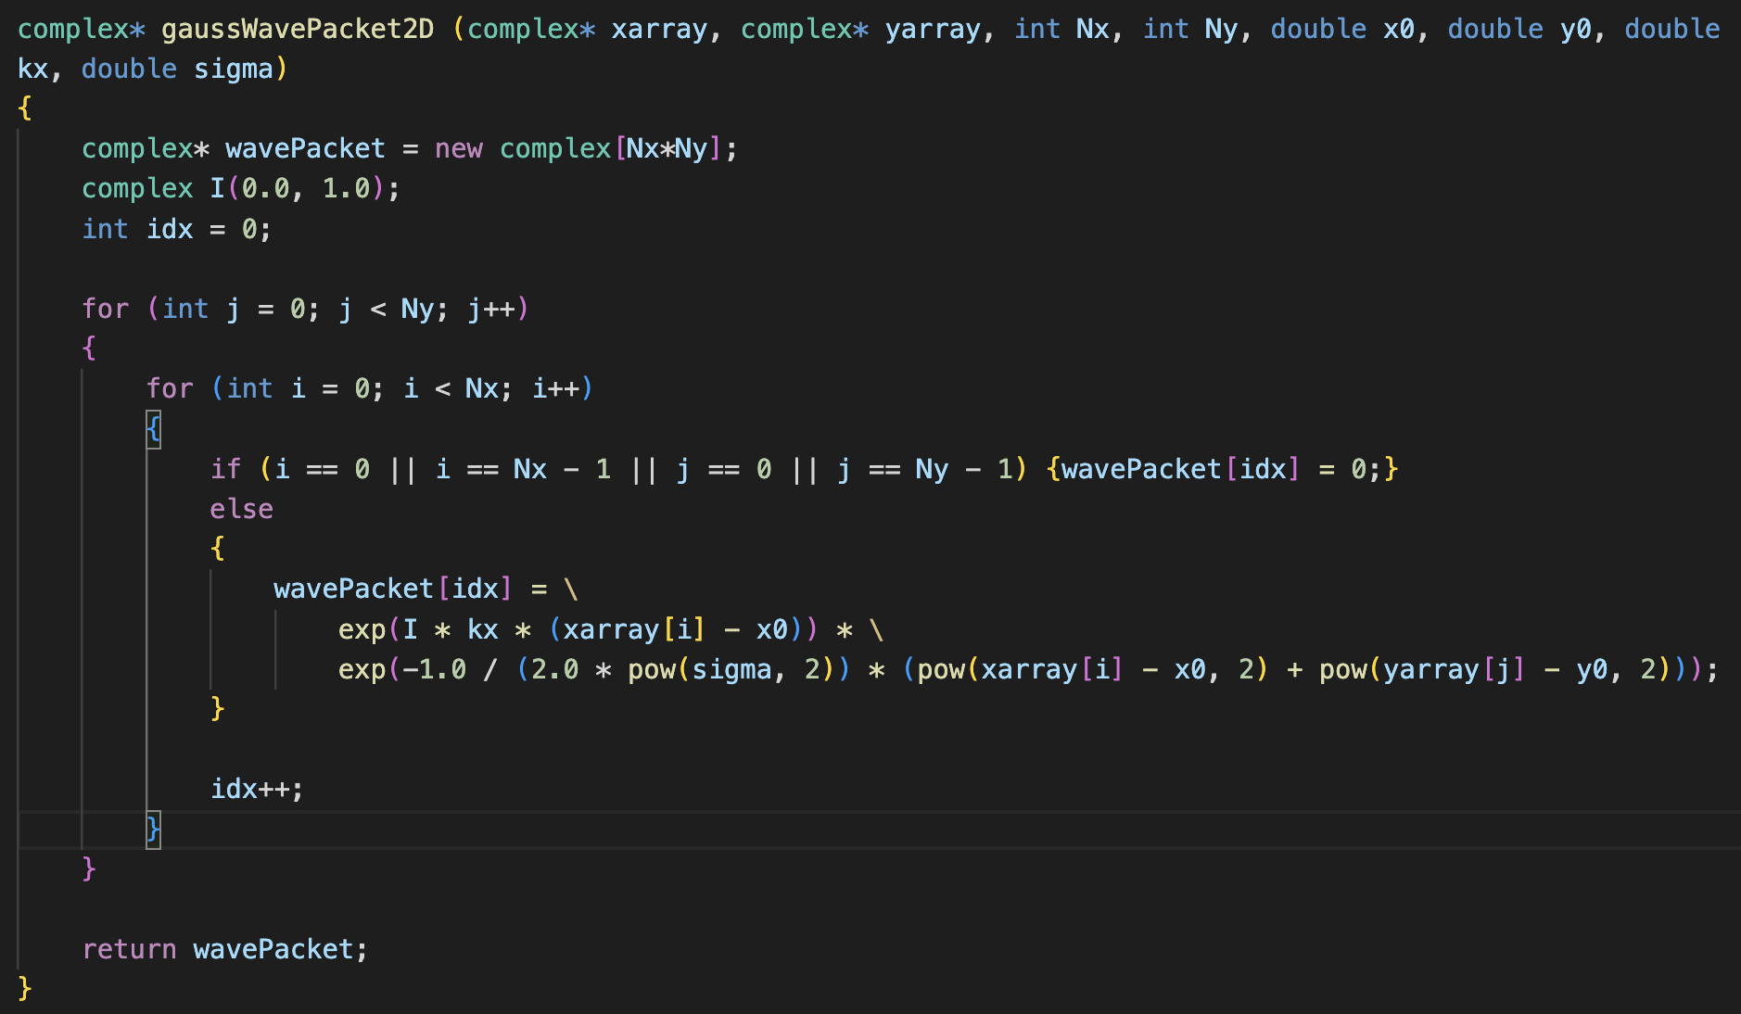
Initial wave packet

Slide 14
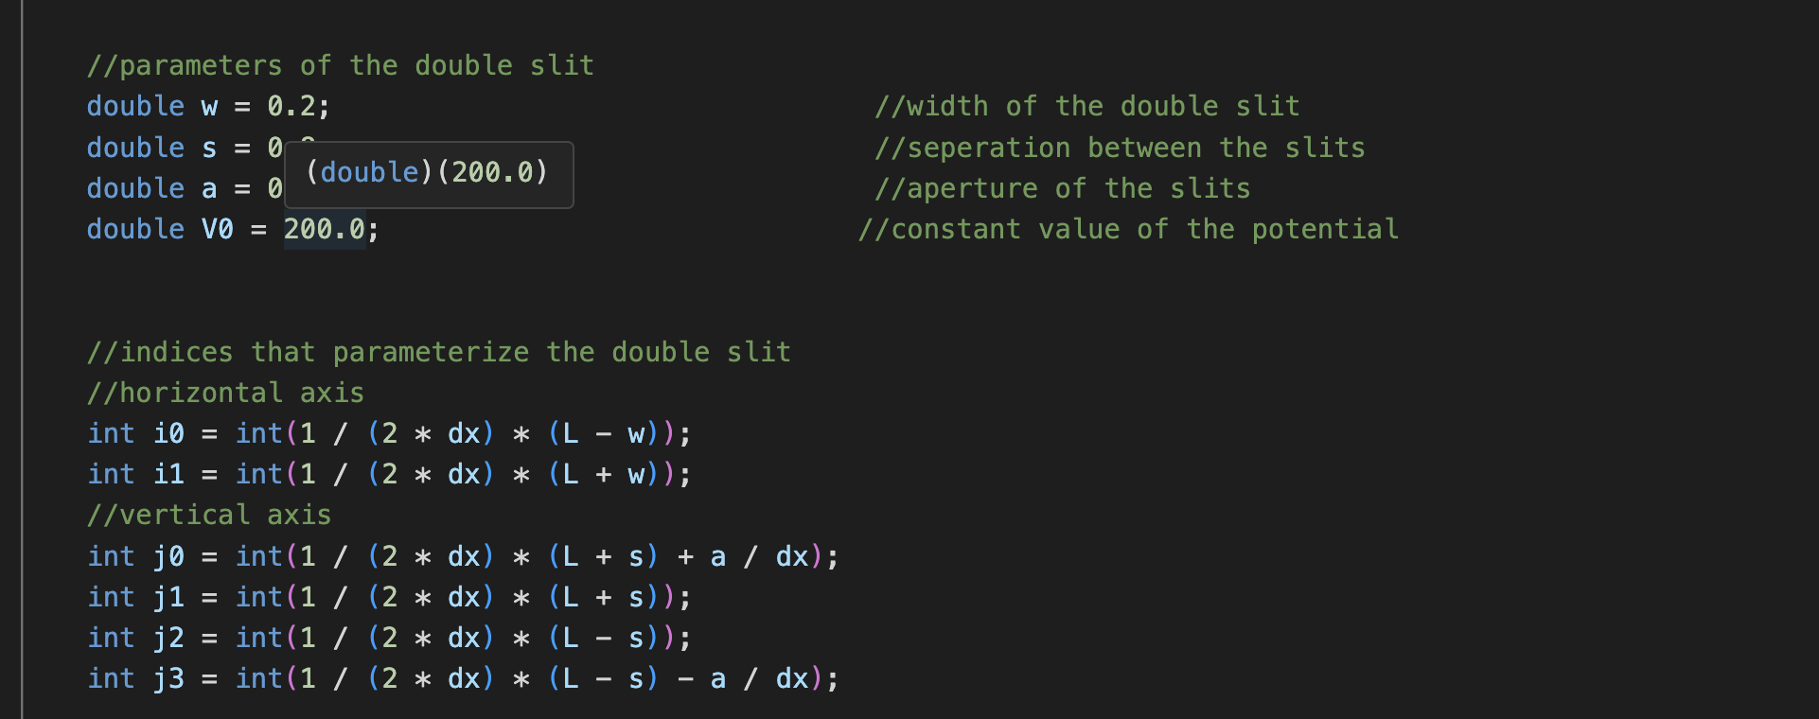
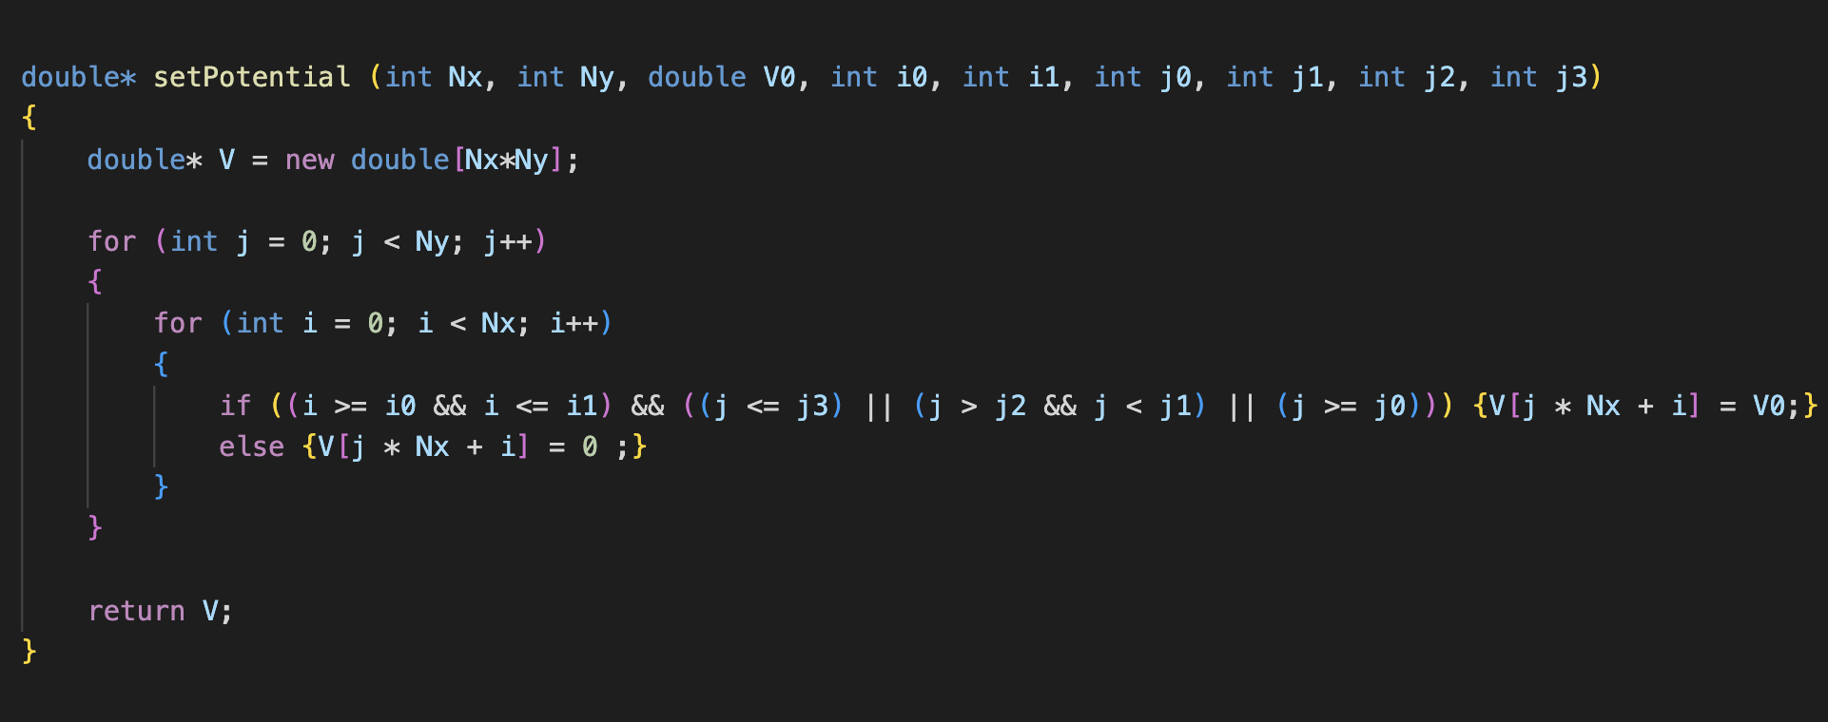
Potential

Slide 15
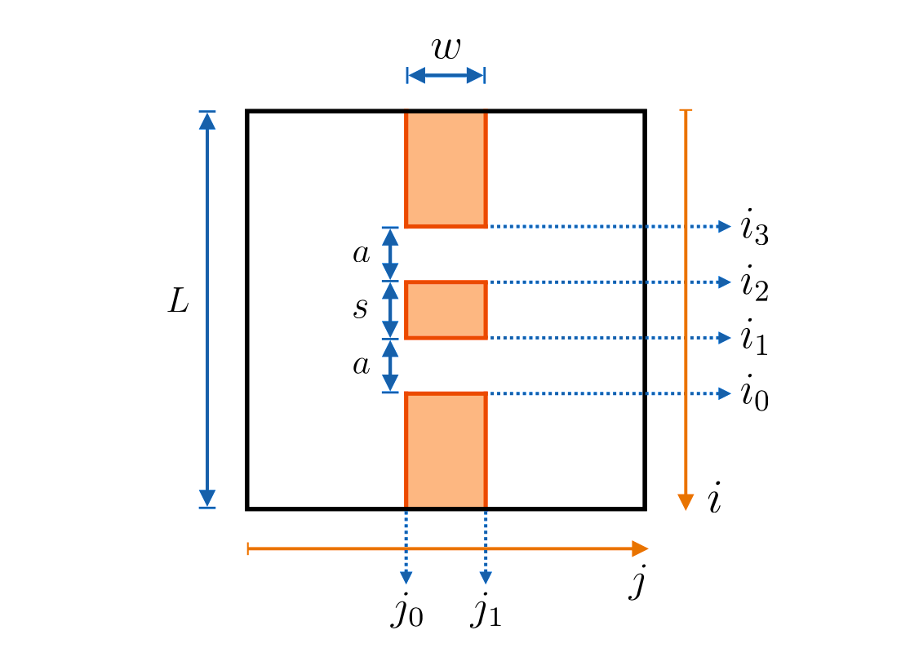

Slide 16
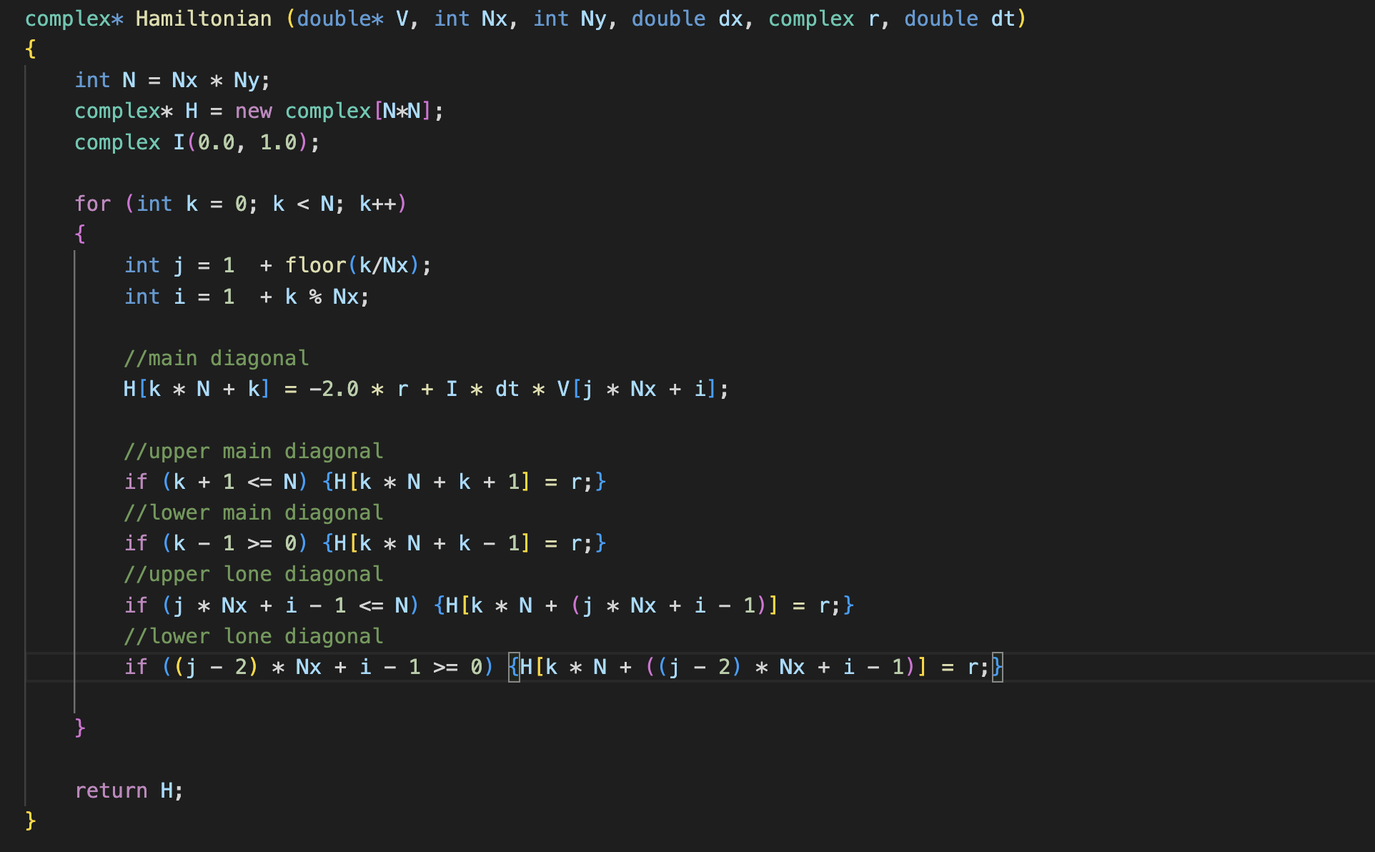
Hamiltonian

Slide 17
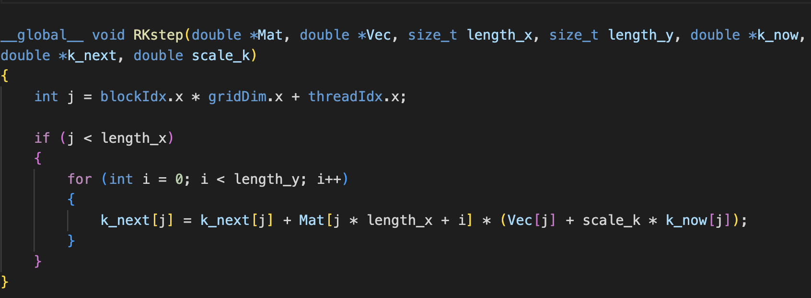
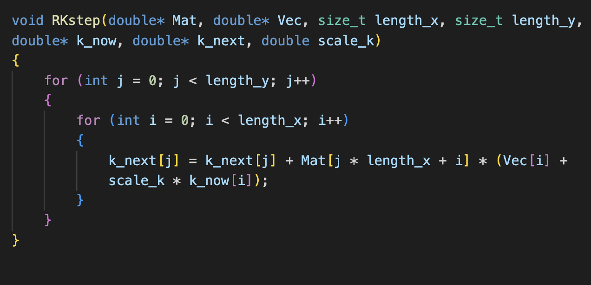
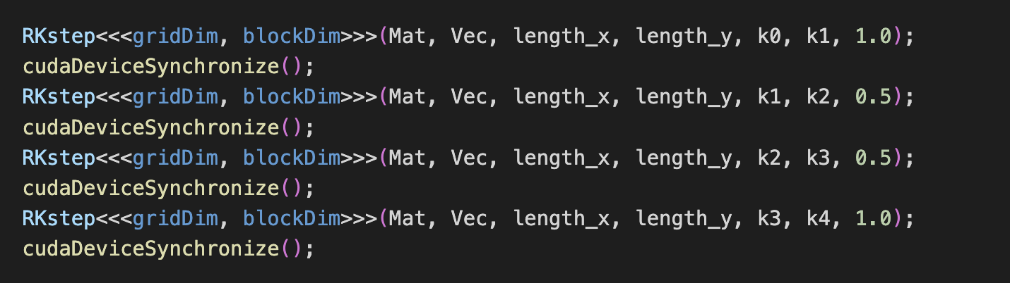
CPP
CUDA

