Slide 1
Cold Chain Logistics Monitoring
Ten container sensors, five risk signals, one live manifest
MSc in Cloud Computing · Fog and Edge Computing (H9FECC)
National College of Ireland

Slide 2
Why periodic checking fails a cold chain
Cargo risk builds in seconds: a reefer container whose window-average temperature drifts above -15 C is already breaching the cold chain.
Every container carries five independent risk signals, storage temperature, humidity, door-open time, shock, and CO2, far more than a clipboard round can track.
A periodic or manual check discovers the breach after the damage is done, and nothing connects the door left open to the load that spoiled.
This project replaces the clipboard: sensors sample every 2-4 seconds and every container is re-scored every 10 seconds, continuously.
-15 C: window-average storage temperature that flags a cold-chain breach.
300 s: average door-open duration that raises an operational alert.
10 s: aggregation window, the longest an exception waits to surface.

Slide 3
How it works: sensors to live manifest
Container sensors: 10 simulated units, 5 reading types across 2 containers, 2-4 second sampling.
Depot relay (fog node): 10-second windows aggregate each reading type and flag exceptions.
Amazon SQS: one aggregate per window, shipped in batches of up to 10 messages.
AWS Lambda: consumes the queue and reshapes every record for storage.
Amazon DynamoDB: durable archive of every window record, keyed per reading type.
Live dashboard: manifest table and temperature trends, served by API Gateway and Amazon S3 on AWS.
Verified end-to-end on Docker with an AWS emulator standing in for SQS, Lambda and DynamoDB: a pipeline script polls until every reading type lands in the store. The same code targets real AWS as a configuration change and deploys in a single scripted step.

Slide 4
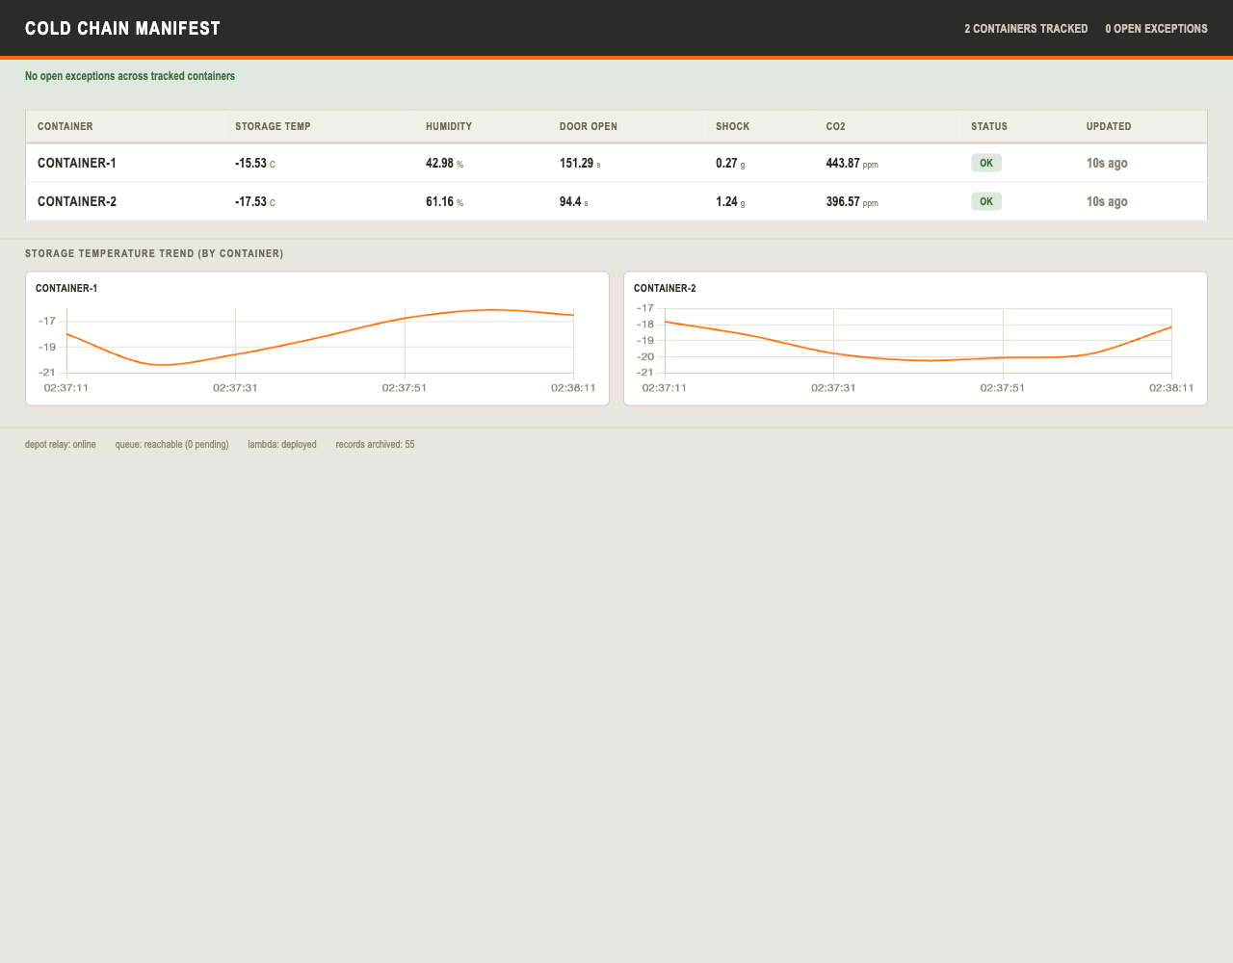
Demonstration highlights
Dashboard captured from the running stack: the per-container manifest, storage-temperature trends, and the pipeline status strip showing depot relay online, queue reachable, Lambda deployed, and records archived.
Exceptions fire live: any container whose window-average temperature rises above -15 C is flagged on the board within 10 seconds.
Health checks all green: depot relay online, queue reachable, Lambda deployed, and records archived climbing.
76 automated tests: unit and endpoint tests across 10 modules, run with pytest.
2,000-message burst absorbed: 32 parallel workers, batched 10 per SQS call, with live dashboard data untouched.

Slide 5
Hardest part: a counter that lied at scale
The problem
The dashboard's records-archived counter used a single DynamoDB Scan to count the table. DynamoDB answers with at most about 1 MB per call, so the counter only ever saw the first page of the table.
Why it was hard
Nothing failed: the call succeeds and the number looks plausible. Every test passed, because small test tables fit inside one page. The undercount only appears once real data outgrows a page, and then it is completely silent.
How it was solved
Follow the paging contract: keep requesting pages through DynamoDB's continuation key until none is left, and sum the per-page counts. New regression tests prove a multi-page table now counts in full.
Before: one call, first page only, so page 1 was counted while pages 2 and 3 were missed.
After: every page is walked and the per-page counts are summed, so pages 1, 2, and 3 are all counted.

Slide 6
Takeaways
Decide at the edge: exceptions are flagged at the depot relay within a 10-second window, with no cloud round-trip in the alert path.
Serverless scales by configuration: the queue, function and store absorbed a 2,000-message burst unchanged, and moving to real AWS is configuration plus one scripted deploy, not a rewrite.
Green tests are not proof at scale: a silent paging undercount passed every test, and the audit and its new regression tests are what made the archive count trustworthy.
Thank you. Questions?

