Slide 1
Elevator and Escalator Fleet Monitoring
Edge-to-cloud safety monitoring for a two-tower elevator and escalator fleet
MSc in Cloud Computing · Fog and Edge Computing (H9FECC)
National College of Ireland

Slide 2
Why periodic checks fail for a lift fleet
Two towers, five metrics each: motor temperature, door cycles, cab vibration, load weight and travel speed. Ten live streams, some sampling every single second.
Faults build between visits. A motor drifting past 85 degrees C, or a cab crawling below 0.5 metres per second, stays invisible until an engineer is standing in front of the unit.
A clipboard round captures one moment in time; the fleet changes state every second, around the clock.
The four fleet-safety rules watched continuously:
Motor overheat: average temperature above 85 C
Ride quality: vibration above 6 mm
Overload: load above 1,000 kg
Stall: speed below 0.5 m/s
Each rule fires on window aggregates, not one noisy reading.
01

Slide 3
How it works: edge to cloud
The pipeline runs from edge to cloud:
Sensors: 10 units across 2 towers
Fog node: window, aggregate, alert
Queue: Amazon SQS
Serverless ingest: AWS Lambda
Store: Amazon DynamoDB
Live dashboard: Amazon S3 and API Gateway
Raw readings stay at the edge. The fog node windows and aggregates ten streams, so only one compact message per window crosses into the cloud.
Verified end to end locally on Docker with an AWS emulator. The same AWS SDK code targets real AWS, so deployment is a single scripted step.
Alerts are decided at the edge.
02

Slide 4
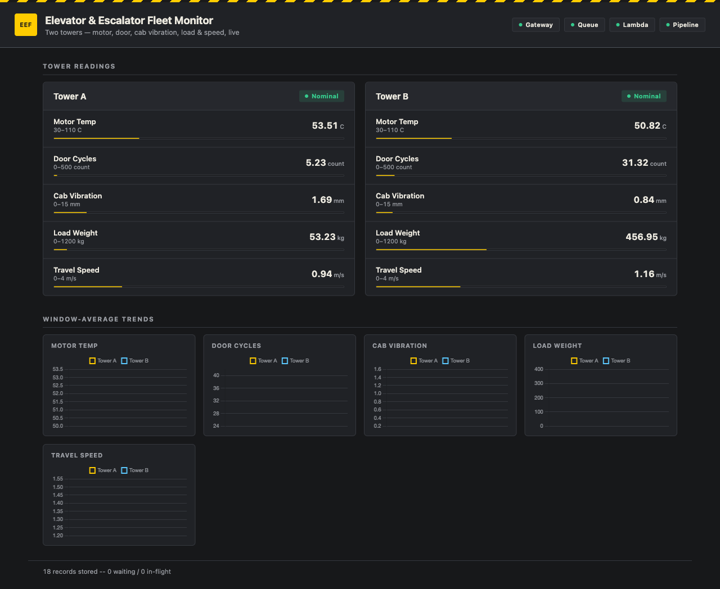
Demonstration highlights
Live dashboard during a local end-to-end run.
117 automated tests pass across the sensor, fog, ingest and dashboard modules.
2,000-message burst from 32 parallel senders absorbed; the queue keeps draining under load.
4 / 4 pipeline health checks green: gateway, queue, Lambda and end-to-end freshness.
Alert chips fire live when a rule trips.
03

Slide 5
Hardest part: did that message really send?
The problem: every window's aggregate is written into a Node stream that sends to Amazon SQS. The stream happily accepts the write; it never says whether that message actually reached the queue.
Why it was hard: streams report on the pipe, not the message, so there is no built-in "chunk N was delivered" signal. A stream error also tears the whole pipeline down, so one failed send could break every window after it.
The fix: tag each message with a sequence number before it enters the stream and hold a pending promise per tag. The queue sink settles exactly one promise per outcome, so a failure rejects only that caller and the stream keeps flowing.
The tagged flow:
Window aggregate, tagged ticket #42
Stream pipeline: pass-through, queue sink
Amazon SQS: fleet aggregates
Ticket #42 delivered, resolved alone
Ticket #43 failed, only #43 rejected
Unit tests prove one bad send leaves every other window's publish untouched.
04

Slide 6
Takeaways
Decide at the edge
Raw readings never leave the building. The fog node aggregates ten streams and applies four safety rules right next to the machines.
Trust through testing
117 automated tests, a scripted end-to-end pipeline check, and a 2,000-message burst test back every claim on these slides.
Cloud-ready by design
The same AWS SDK code runs on the local emulator and on real AWS. Deployment is one scripted step, not a rewrite.
Thank you. Questions?
05

