Slide 1
Industrial Equipment Predictive Monitoring
A fog-to-cloud pipeline that watches five machine signals and raises alarms at the edge
MSc in Cloud Computing · Fog and Edge Computing (H9FECC)
National College of Ireland

Slide 2
Why periodic checks miss the failure
A walk-round inspection reads each gauge once; the fault develops in the minutes between rounds and keeps developing until the next one.
Machine failure rarely shows on one dial: it builds across heat, vibration, bearing noise, speed and power draw at the same time, five signals no walk-round reads together.
Two production lines run in parallel, and each motor needs its own watch: line 1 running cool says nothing about line 2.
By the time a person notices, the machine has been damaging itself the whole time nobody was looking.
Motor temperature alarm limit is 95 degrees C: a winding can sit above it all shift between manual rounds.
Vibration alarm limit is 7 mm/s: drift toward it builds in minutes, not inspection cycles.
Rotation overspeed limit is 3,400 RPM, with an underspeed alarm at 1,000 RPM on the same shaft.

Slide 3
How it works
Machine sensors: six simulated units on two production lines, five signal types.
Fog node: windows 10 s of readings, aggregates, and raises alarms at the edge.
Queue on Amazon SQS: one compact aggregate per window, buffered for the cloud.
Serverless ingest on AWS Lambda: consumes the queue and reshapes each record.
Store on Amazon DynamoDB: keyed by sensor type and site, ready to query.
Live dashboard: site served from Amazon S3, data via Amazon API Gateway.
Runs end-to-end today on Docker with an AWS emulator standing in for the cloud services; moving to real AWS is one scripted deployment step, using the same cloud interfaces throughout.

Slide 4
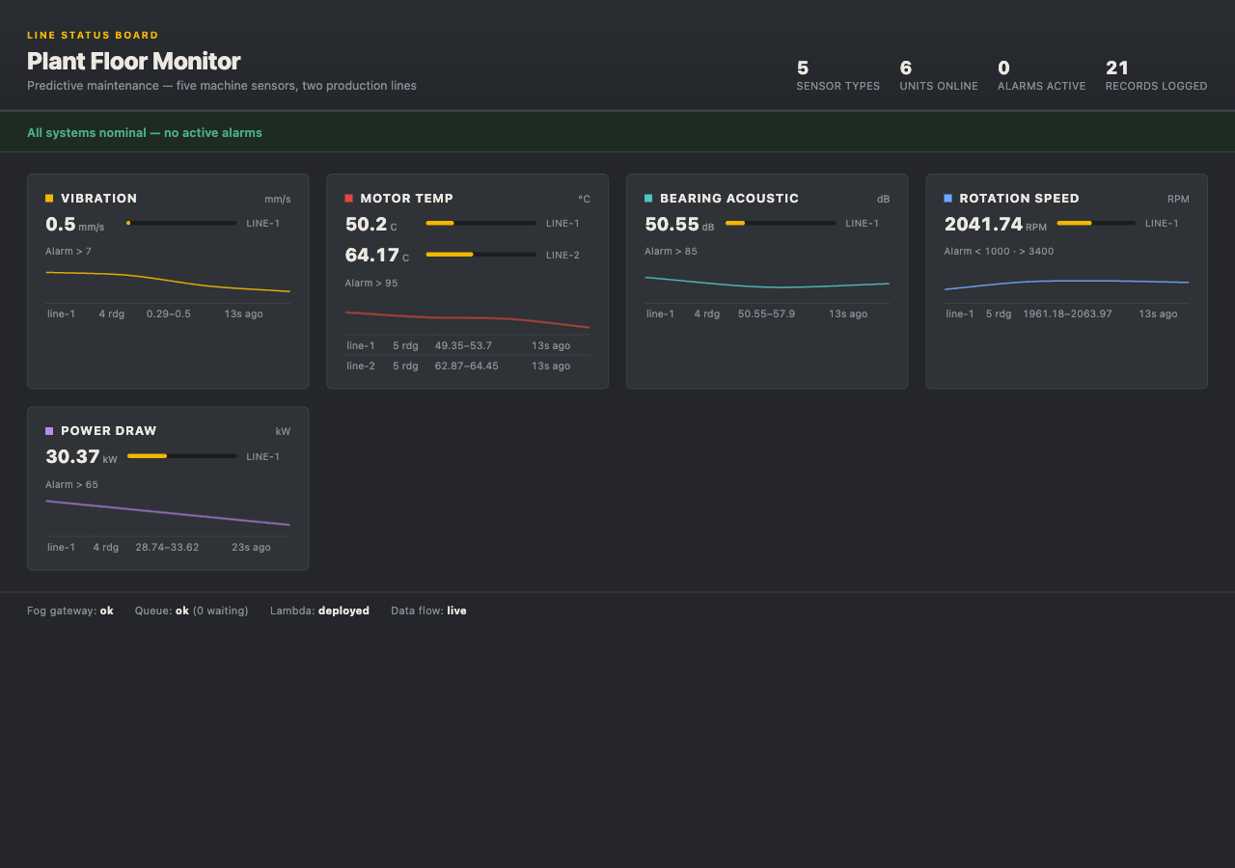
Demonstration highlights
Live dashboard from the running stack: a card per signal with its current reading, real alarm limit and trend, with a health footer along the bottom.
The end-to-end check confirms every one of the five signal types lands in the datastore.
Pipeline health checks: 4 of 4 green across fog gateway, queue, Lambda and data flow.
42 automated tests pass across the sensors, fog, processor and dashboard modules.
A 2,000 message burst absorbed in a load test with 32 senders in parallel.

Slide 5
Hardest part: a bug only real AWS could expose
The trap:
Every cloud-facing component shipped with the local emulator's dummy login hard-wired in. On the laptop stack that is exactly right: the emulator accepts it. On real AWS, every component would introduce itself with fake credentials and be turned away, and the fog node's queue link would crash outright at startup.
Why it was hard:
Nothing local can surface it. The emulator accepts any credentials, so every unit test, the end-to-end check and all four dashboard health lights stay green. The defect exists only in an environment the project had not reached yet: the first deployment to the real cloud.
The fix:
Attach the dummy login only when an emulator address is actually configured. In the real cloud that setting is absent, so each component now falls through to the identity AWS itself issues it at runtime. No rewrite, just one guarded branch in each of the five cloud clients.
All 42 tests passed with the bug in place.
Caught in a pre-deployment audit; the same pass also added multi-page record counting and 10-at-a-time queue batching.

Slide 6
Takeaways
Decide at the edge:
Alarms fire at the fog node inside a ten-second window; the cloud receives one compact aggregate per window, not a firehose of raw readings.
Serverless backbone:
Amazon SQS, AWS Lambda and DynamoDB carry the cloud side; they scale with load and leave no servers to patch or babysit.
Ready for real AWS:
Verified end-to-end on the local stack, 42 tests green, and one scripted step from the real cloud, with the bug that would have broken that move already gone.
Thank you. Questions?

