Slide 1
Public Transit Fleet Monitoring
Real-time bus telemetry from two depots, aggregated at the edge, stored serverlessly
MSc in Cloud Computing · Fog and Edge Computing (H9FECC)
National College of Ireland

Slide 2
Why periodic fleet checks fail
A bus's condition changes minute by minute while it is on the road, but a depot inspection only sees the vehicle once it is parked.
Faults develop mid-route: engine overheating and brake wear build up during service, so by the evening walk-around the damage is hours old.
Some problems cannot wait: overcrowding and low fuel need a response now, not a line in the end-of-shift report.
Too much to watch by hand: five metrics per depot across two depots is ten continuous telemetry streams, far more than staff can reliably eyeball.
10 live telemetry streams.
4 safety alert rules at the edge.
2 depots, one shared fog gateway.

Slide 3
How it works: edge to serverless cloud
Bus sensors: engine temp, brake wear, passengers, fuel and speed, five streams per depot.
Fog gateway: windows and aggregates each stream, and checks four safety rules at the edge.
Queue (Amazon SQS): carries one compact aggregate per window, not raw readings.
AWS Lambda: serverless ingest that consumes the queue and batch-writes records.
Amazon DynamoDB: time-ordered store of per-window fleet records.
Live dashboard: per-depot fleet cards and trends, served by S3 and API Gateway on AWS.
Verified end-to-end locally on Docker and LocalStack, an AWS emulator, and deploys to AWS with a single scripted step.

Slide 4
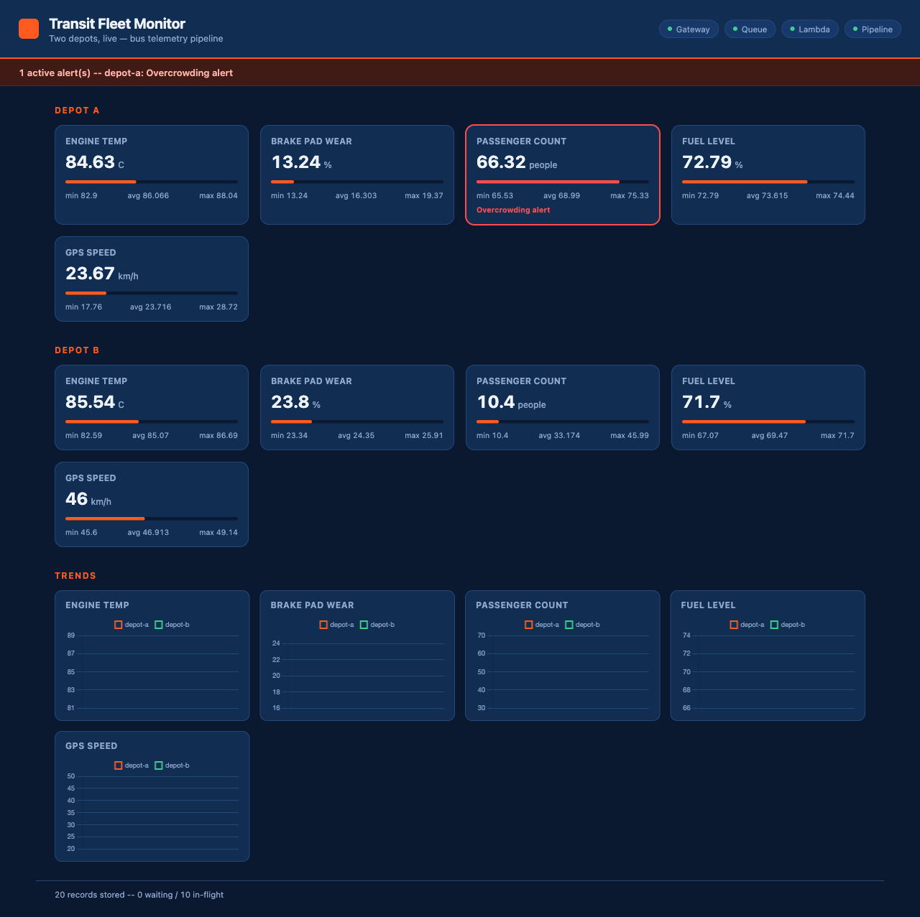
Demonstration highlights
Live dashboard during the local demo run: all four pipeline health checks green (top right) and a real overcrowding alert firing for depot-a.
130 automated tests pass across the four modules.
2,000 message burst absorbed in the load test, using 32 parallel workers.
4/4 health checks green: gateway, queue, Lambda, pipeline.

Slide 5
The hardest part and how it was solved
The problem:
Ten sensor streams post readings to one fog gateway while, at the same moment, a timer thread drains the buffer to build the window aggregates. Every reading must survive that handover.
Why it is hard:
A reading dropped in the race does not crash anything; the fleet averages are just silently wrong. And locking every insert fixes the race only by making ten senders queue behind each other.
The fix:
Make ingest lock-free: each arriving reading is a single atomic enqueue, nothing else. All grouping by depot and sensor type is deferred to a one-thread drain at flush time.
Proven, not hoped: an automated stress test hammers the intake with 32 concurrent threads writing 200 readings each, and after the drain every one of the 6,400 readings is accounted for, with zero lost.

Slide 6
Takeaways
Intelligence at the edge: the fog gateway windows, aggregates and alerts right next to the vehicles, while the cloud stores compact per-window summaries, not raw sensor noise.
Serverless where it scales: Amazon SQS, AWS Lambda and DynamoDB absorb the fleet's writes with no servers to size, patch or babysit.
Verified, then portable: 130 automated tests, an end-to-end verified pipeline, and a single scripted step from the local run to AWS.
Thank you. Questions?

