Slide 1
Two stores, ten sensors, one live edge-to-cloud pipeline
Retail Footfall and Inventory Monitoring
MSc in Cloud Computing · Fog and Edge Computing (H9FECC)
National College of Ireland

Slide 2
Why periodic checking fails
Periodic, manual checks
Empty shelves sit unnoticed between stock walks, and sales are lost silently
A fridge drifting warm between rounds puts the whole cold chain at risk
Checkout queues build in minutes; by the next walk-through, customers are already gone
Continuous edge monitoring
Ten sensors across two stores: footfall, shelf stock, fridge temperature, queue length, energy draw
A fog gateway windows and aggregates readings right beside the shop floor
Four retail-health rules raise an alert the moment a window crosses its threshold

Slide 3
How it works
Store sensors: 5 metrics x 2 stores, sampled every few seconds
Fog gateway: windows, aggregates, and evaluates alert rules
Amazon SQS: one aggregate per window on the queue
AWS Lambda: serverless ingest of each batch
Amazon DynamoDB: durable store of aggregates
Live dashboard: Amazon S3 and API Gateway
Verified end-to-end locally with Docker and an AWS emulator, deploys to real AWS with a single scripted step

Slide 4
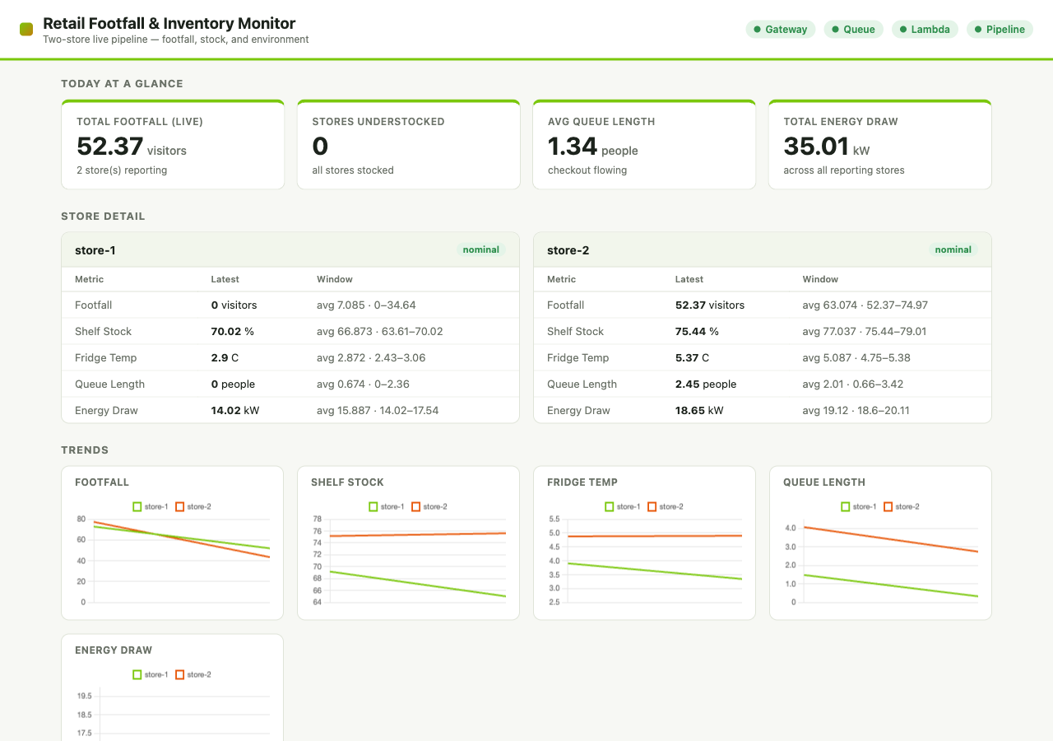
Demonstration highlights
The live dashboard during the local end-to-end run, all four health checks green (top right)
4 / 4 pipeline health checks green: gateway, queue, Lambda, and end-to-end freshness
118 automated JUnit tests pass across the sensor, fog, processor, and dashboard modules
2,000 messages pushed through in a burst load test by 32 parallel workers

Slide 5
Hardest part: one buffer, many writers
The race
Every sensor reading arrives on its own web-server thread
All of them write into one in-memory buffer while a timer empties it for each window
Interleavings that drop readings show up only under load, nearly impossible to reproduce in a test
The fix: an actor mailbox
Only one dedicated thread ever touches the buffer
A request just drops a message into that thread's mailbox queue and returns
A flush is itself a mailbox message, so it can never interleave with a write; the race is structurally impossible, not just locked away
The mailbox flow: 10 request threads, a mailbox queue, a single worker thread, and one windowed buffer

Slide 6
What to take away
Put the intelligence at the edge: windowing and alerting beside the shop floor turn raw readings into store-level decisions in seconds
The whole pipeline is verified end-to-end locally and deploys to real AWS with a single scripted step
Design concurrency out rather than guarding it: the actor mailbox made data races structurally impossible
Thank you. Questions?

