Slide 1
Solar Farm Performance Monitoring
An edge-to-cloud pipeline that watches two panel arrays live
MSc in Cloud Computing · Fog and Edge Computing (H9FECC)
National College of Ireland

Slide 2
The problem: periodic checks miss slow failures
Solar panels lose conversion efficiency as they run hotter: an array's thermal health score falls from 100 at 45 °C to 0 at 72 °C, so heat quietly erodes output long before anything visibly breaks.
Dust builds up gradually: the system raises a cleaning alert once average soiling passes 25 percent, a slow drift that a scheduled walk-through will almost never time correctly.
A fault that appears between manual inspections keeps costing energy, silently, until someone happens to look at that array.
Panel temperature climbs from 45 to 72 °C, the range over which modelled output health slides from 100 down to 0.
Ten sensor streams run across two arrays, each sampling every 2 to 5 seconds, far too much data to check by hand.

Slide 3
How it works: edge first, cloud second
Ten sensors stream irradiance, panel temperature, inverter output, DC voltage and soiling across two arrays.
The fog node buffers, windows, aggregates and raises alerts, producing one summary per window.
Amazon SQS queues the window summaries for the backend.
AWS Lambda provides serverless ingest, triggered straight off the queue.
Amazon DynamoDB stores the windowed records per array and sensor.
A live dashboard on Amazon S3 and API Gateway shows the per-array efficiency heatmap.
Verified end to end locally: the whole pipeline runs on Docker with an AWS emulator standing in for SQS, Lambda and DynamoDB, and one scripted step deploys the identical pipeline to real AWS.

Slide 4
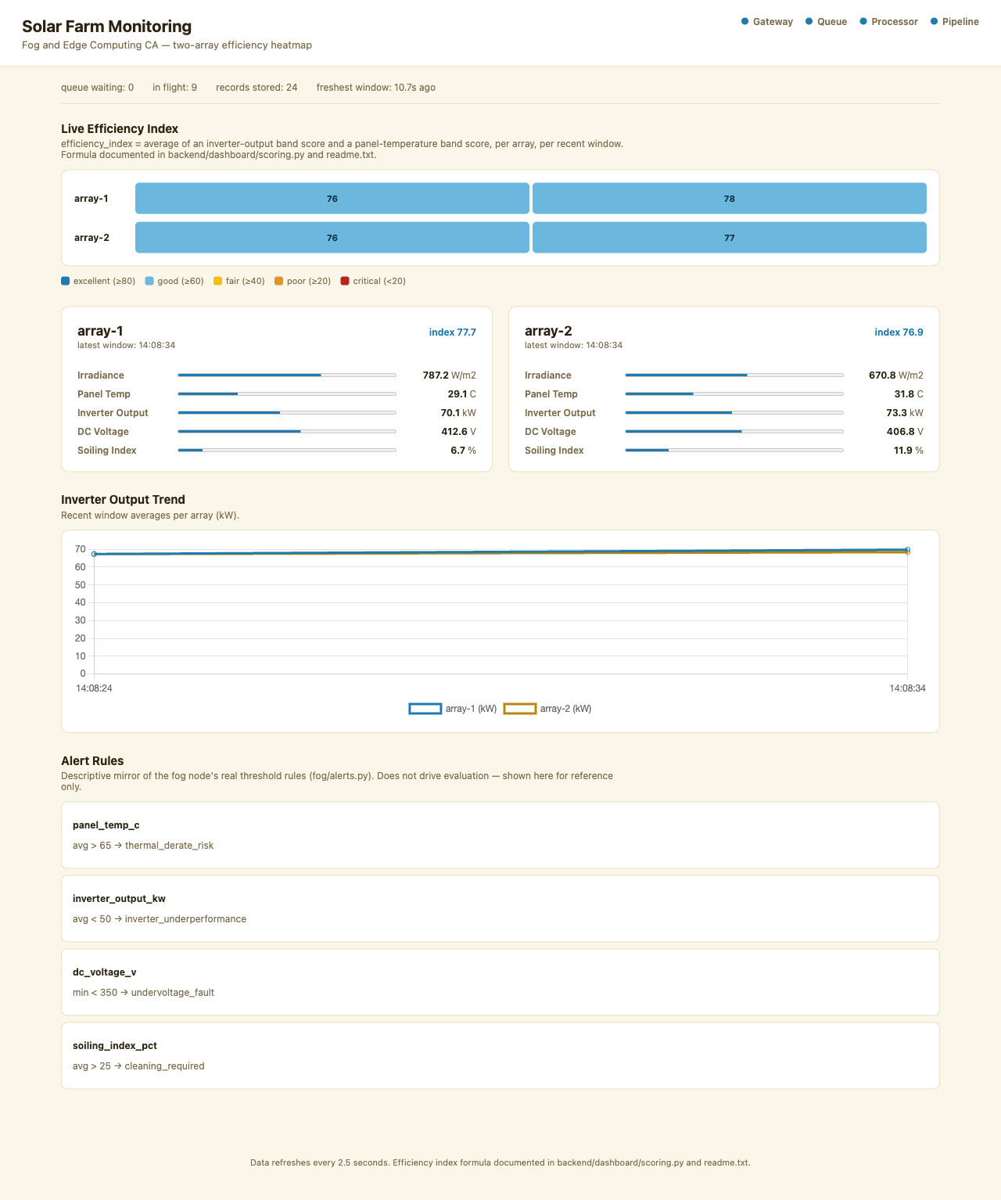
Demonstration highlights
Dashboard during a local end-to-end run: all four pipeline health checks up, the live efficiency heatmap and per-array readings.
Threshold alerts cover thermal derate risk, inverter underperformance, undervoltage and cleaning required.
110 automated tests pass across sensors, fog node, backend and dashboard.
4 of 4 pipeline health checks green: gateway, queue, processor and pipeline.
A 2,000-message burst was pushed through the queue by 32 parallel senders in the load test.

Slide 5
The hardest part: a buffer that never sits still
The problem:
Every few seconds the fog node must take everything buffered so far and aggregate it into window summaries, while ten sensors keep writing new readings into that same buffer.
Why it is hard:
One shared buffer and one lock means aggregation blocks ingest. Copying the buffer under the lock stalls every sensor at every window; skipping the lock loses or double-counts readings. A textbook reader-writer race.
The fix:
Double buffering uses two buffers, one live and one flushing. The lock is held only for an instant pointer swap of the two, so aggregation works on the swapped-out data while new readings flow into the fresh buffer.
The flow: sensors write into the active buffer, a pointer swap under lock moves it to the flushing buffer, then the fog node aggregates and publishes.
Proven by a concurrent-writer stress test: nothing lost, nothing copied.

Slide 6
Takeaways
Push work to the edge: windowing and alerting at the fog node turn a constant stream of raw readings into one compact summary per window before anything leaves the site.
Keep the cloud serverless: Amazon SQS, AWS Lambda and DynamoDB absorbed a 2,000-message burst in the load test with nothing to provision or manage.
Prove it, then ship it: 110 automated tests plus a scripted end-to-end pipeline check, and a single scripted step to deploy the same stack to AWS.
Thank you. Questions?

