Slide 1
Continuous two-pond monitoring: fog aggregation at the edge, serverless ingestion in the cloud, deployed live on AWS.
Aquaculture Fish Farm Water Quality
Anjaneya Reddy Gurram
Student ID 24288853
MSc in Cloud Computing · Fog and Edge Computing (H9FECC)
National College of Ireland

Slide 2
Manual checks leave hours-long blind spots
Standard practice on pond farms is that a technician draws a sample and runs a test kit once or twice a day.
Dissolved oxygen and ammonia do not change slowly: a warm, still night can crash oxygen and push ammonia up over a few hours, entirely inside the gap between two manual readings.
A farm that samples at sunrise sees the excursion only after the fish are already stressed.
The stakes are rising: the UN's latest global assessment records aquaculture overtaking capture fisheries as the majority source of aquatic animal production.
1 to 2 manual water checks per day are the only visibility most pond farms have.
01

Slide 3
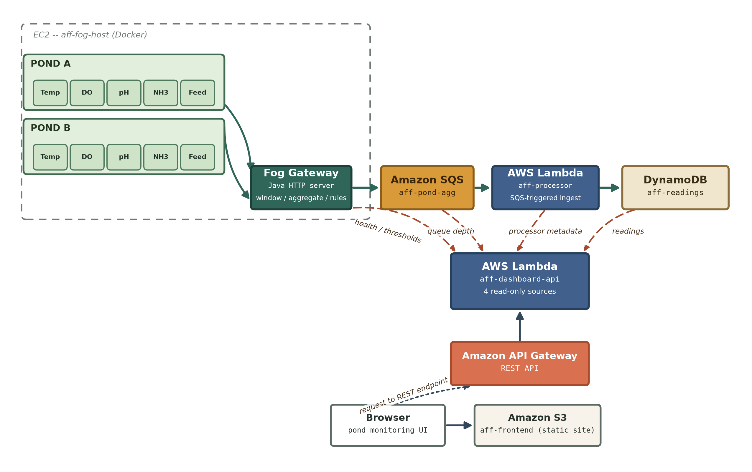
How it works: pond edge to live dashboard
At the pond (edge): 10 sensors across 2 ponds by 5 metrics: temperature, oxygen, pH, ammonia, feed.
Fog gateway: 10-second windows compute count, min, max, and average, and alert rules fire on site.
Amazon SQS receives one batched send per cycle, not one call per window.
AWS Lambda drains each queue batch and writes records in parallel to Amazon DynamoDB, stored by sensor type and time.
API Gateway plus AWS Lambda serves the dashboard's queries on demand, and the live dashboard is a static site hosted on Amazon S3.
Only compact window summaries ever leave the pond: raw readings stay at the edge.
02

Slide 4
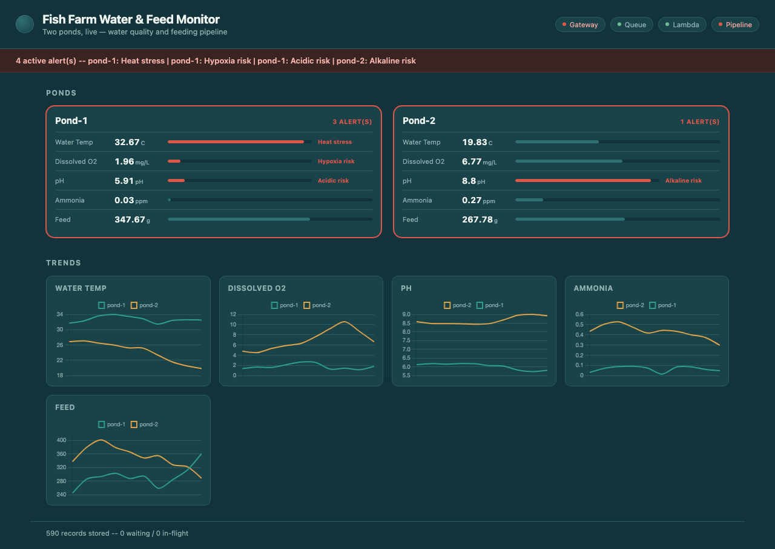
Live on a real AWS account
4/4 pipeline health checks green (gateway, queue, Lambda, pipeline) within a minute of boot.
Under 2 seconds: age of the freshest reading, sensor to dashboard, on the live health endpoint.
156 automated tests pass across the sensor, fog, processor, and dashboard modules.
4 alerts firing live: heat stress, hypoxia and acidic risk on pond-1, alkaline risk on pond-2.
Deployed dashboard captured live from the API Gateway endpoint: 590 records stored and climbing.
03

Slide 5
The hardest part: a hidden concurrency race
The problem
The fog gateway buffers every reading in one shared in-memory map. Ten sensor streams write into it at once while a ten-second flush retires it, and there is deliberately no lock anywhere in that path.
Why it was hard
A 64-thread stress test failed once and readings silently vanished. One field in the accumulator was still mutable, so two simultaneous merges could each read it before either wrote back. Nothing crashed; data just disappeared.
How it was solved
Make the accumulator fully immutable, so every combine returns a fresh value instead of editing one in place. The map's atomic merge is only guaranteed when the merge function has no side effects, a narrower promise than "thread-safe" sounds.
The test suite replays this collision from 64 threads at once, and after the fix not one reading is lost.
04

Slide 6
What this project shows
Fog aggregation pays for itself
Ten-second windows turn a continuous ten-sensor stream into a handful of batched cloud writes, and the alert rules still fire on site, next to the fish.
Serverless absorbs the bursts
A busy flush cycle lands as SQS backlog, never as failed calls; Lambda and DynamoDB scale with it and cost nothing while the ponds are quiet.
Green tests are not proof
A pre-deployment audit caught three defects the passing suite never could: a pagination undercount, unbatched queue sends, and mishandled credentials.
05

