Slide 1
Smart Waste Management
A serverless fog and edge pipeline for condition-driven bin collection
Gundeti Sachin Reddy
Student ID X23432721
MSc in Cloud Computing · Fog and Edge Computing (H9FECC)
National College of Ireland

Slide 2
Fixed Schedules Don't See Inside the Bin
Municipal waste collection runs on a fixed calendar, not on what is actually happening inside each bin.
Trucks roll out to bins that are not yet full, wasting collection runs.
Overflow, fire, gas build-up and tampering stay invisible until the next scheduled visit.
This project monitors two collection districts continuously, so the busiest bin is always collected first.
The four hazard rules this system watches live:
Overflow: collection is flagged the moment average fill passes 85%.
Fire risk: internal bin temperature averaging above 55 degrees Celsius.
Gas build-up: odour or gas level exceeding 400 ppm.
Tampering: lid opened more than 8 times in one window.

Slide 3
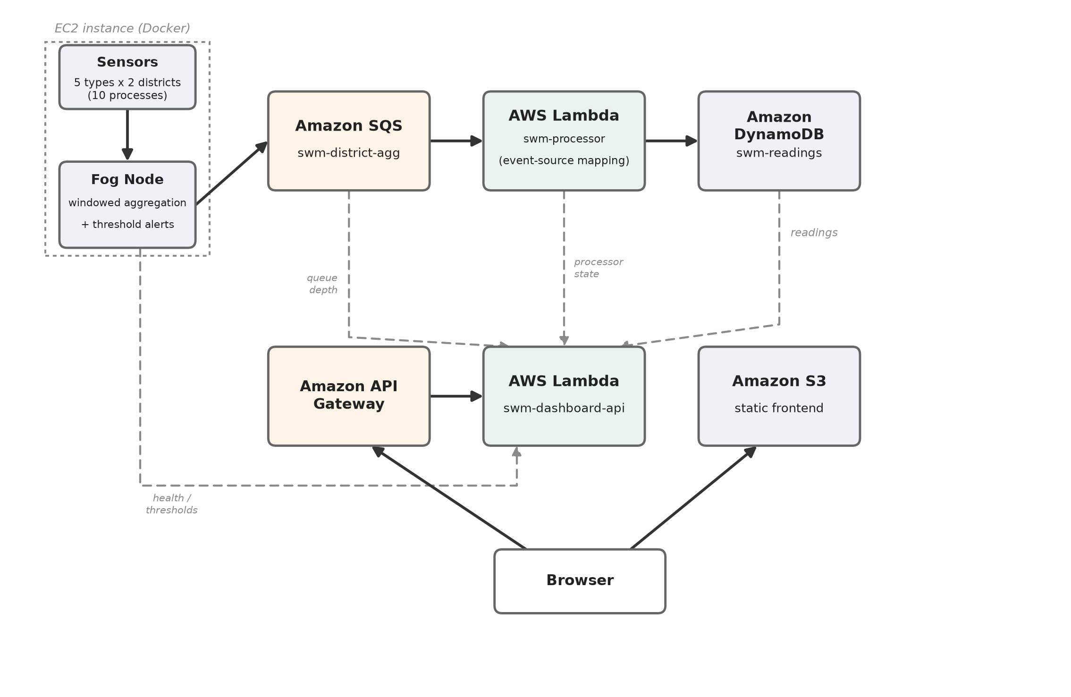
How It Works: Aggregate at the Edge, Scale in the Cloud
Bin sensors: 10 simulated sensors, 5 types across 2 districts, each with its own sampling and dispatch rate.
Fog node on Amazon EC2: buffers readings, aggregates each time window, and fires hazard alerts locally.
Amazon SQS then AWS Lambda: one compact summary per window queues for the cloud where bursts are absorbed, then a queue-triggered ingest function scales with the backlog with no servers to size.
Amazon DynamoDB: every window stored, keyed by sensor type, window time and district.
Live dashboard: a static site on Amazon S3, with its API a second AWS Lambda behind Amazon API Gateway.
Only compact window summaries ever cross into the cloud; raw readings stay at the edge.

Slide 4
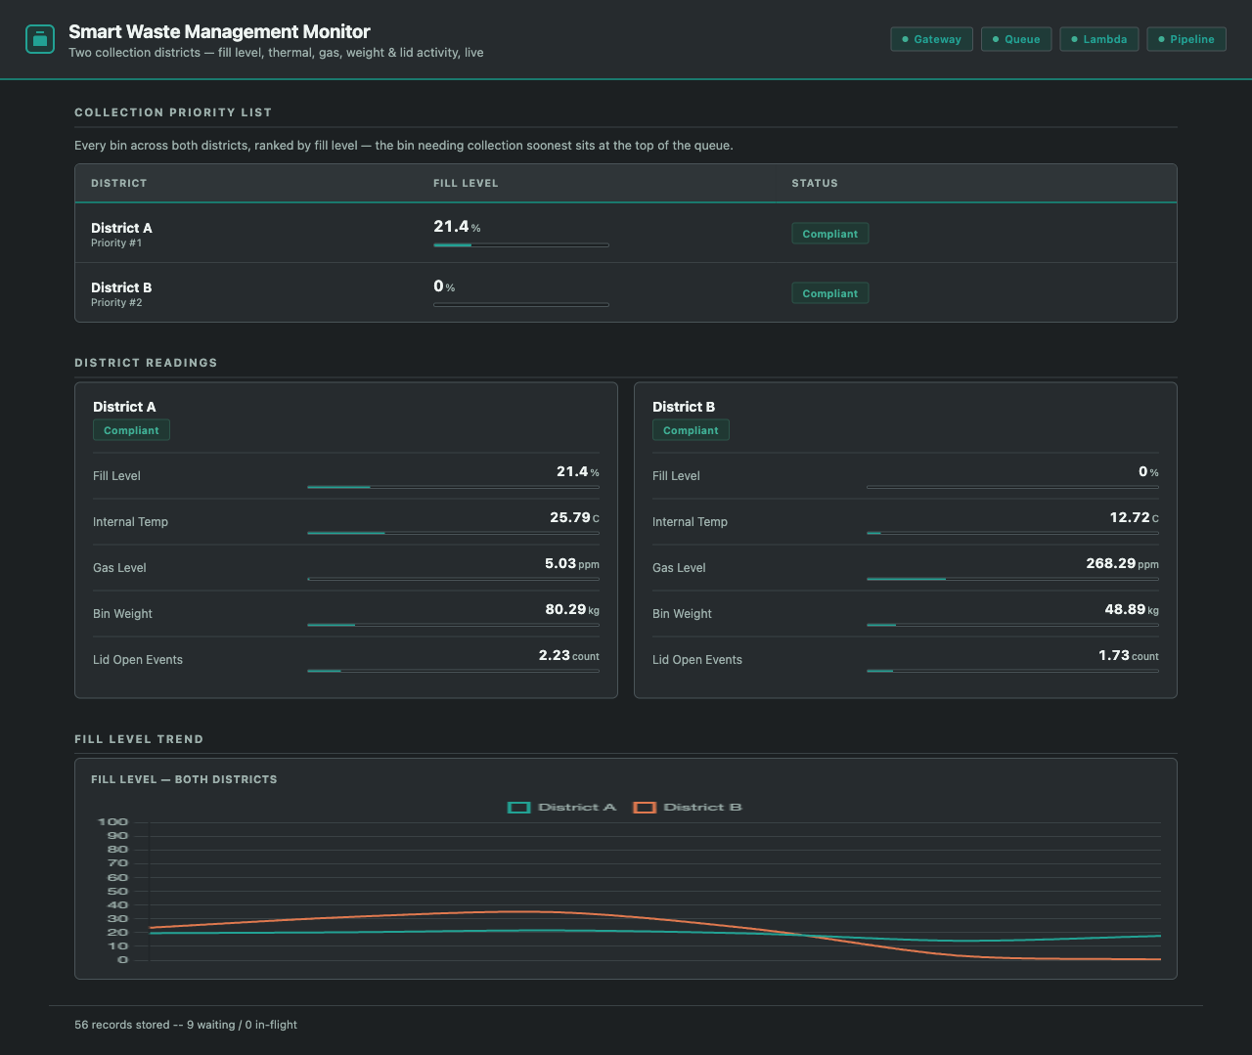
Live on AWS: Demonstration Highlights
The deployed dashboard, served from Amazon S3, captured during live verification.
115 automated tests pass across all four modules: sensors, fog, processor and dashboard, rerun after every fix.
4 of 4 health checks green: gateway, queue, Lambda and pipeline all healthy, with the freshest reading just 0.136 s old.
300-message burst drained: sent to the real queue at about 49 msg/s, and Lambda absorbed it before the follow-up check ran.
Two health polls 15 s apart: stored items climbed 4,083 to 4,093, genuinely live data, not a cache.

Slide 5
Hardest Part: What Only the Real Cloud Revealed
What broke:
First real deployment: every DynamoDB and SQS call failed authentication across fog, processor and dashboard, while CloudFront and public Lambda Function URLs were blocked outright in the academy account.
Why it was hard:
All 115 tests and the full LocalStack integration run passed cleanly, so nothing pointed at the code.
The client swapped in hardcoded emulator credentials whenever an access-key variable was present, and real AWS always sets that variable.
The account blocks are undocumented and surface only as raw access-denied errors.
How it was solved:
Gate emulator credentials on the one truly local signal: the explicit LocalStack endpoint override.
Serve the API through Amazon API Gateway and the frontend from Amazon S3 over HTTPS.
Every fix was re-verified live: a real DynamoDB write and a real 200 through the gateway.
Lesson learned: an emulator pass is not a deployment pass; development, testing and deployment are three different activities.

Slide 6
Three Things This Project Proved
Fog earns its place
Aggregating and alerting at the edge means only compact summaries cross into the cloud, not every raw reading.
Serverless scales itself
Amazon SQS, AWS Lambda and DynamoDB absorbed a 300-message burst with zero capacity planning.
Deploy for real
Three defects passed every local test and surfaced only on the live AWS deployment.
Thank you. Questions?

