Slide 1
EV Charging Network Monitoring
Edge and fog decisions, serverless cloud, deployed live on AWS
Nemi Ishwarlal Vikani
Student ID X24303046
MSc in Cloud Computing · Fog and Edge Computing (H9FECC)
National College of Ireland

Slide 2
Why periodic checks fail at a charging hub
Conditions move in seconds: ten sensors across two charging hubs sample current, battery charge, temperature, grid load and session time every 2 to 5 seconds.
A manual round or an hourly poll leaves an overloaded or overheating bay unnoticed for the whole gap between checks.
Streaming every raw reading to the cloud is the wasteful alternative; the decision has to happen close to the hardware.
The fog node's four live alert rules:
Average charging current above 32 A flags overcurrent.
Station temperature above 45 C flags overheat risk.
Grid draw above 80 kW flags grid strain.
Session length above 180 min flags a stalled session.

Slide 3
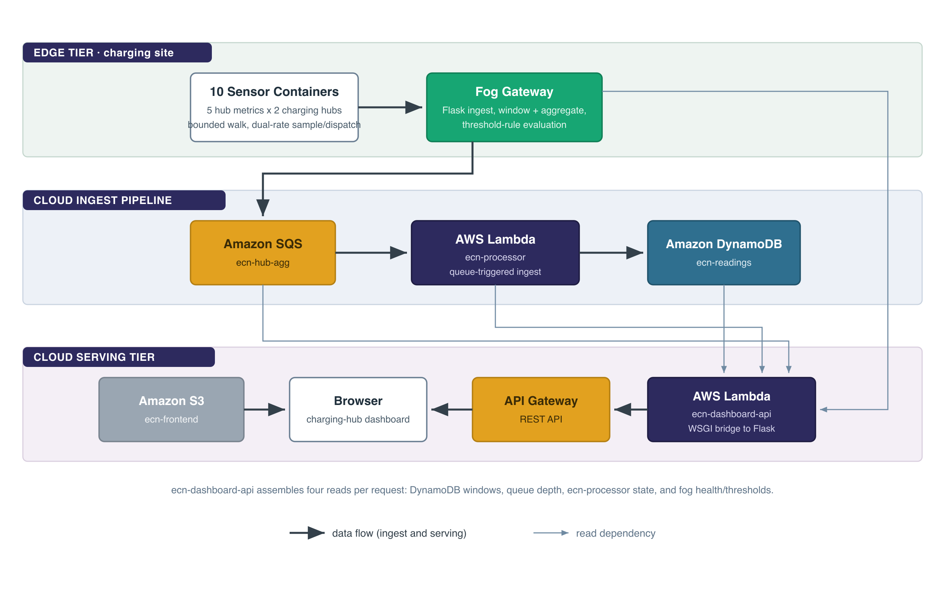
How it works: decide at the edge, scale in the cloud
At the edge:
10 sensors across 2 hubs, 5 metrics each, feed a fog node that windows, aggregates and alerts.
Raw readings stay at the edge: the fog node sends one aggregate per sensor per window, so alerts fire next to the hardware.
In the cloud, serverless end to end:
Amazon SQS carries each window summary, an AWS Lambda ingests it, Amazon DynamoDB is the durable store, and API Gateway with an S3 static site serves the dashboard.
Deployed live on a real AWS account through one infrastructure-as-code apply, not only a local emulator.

Slide 4
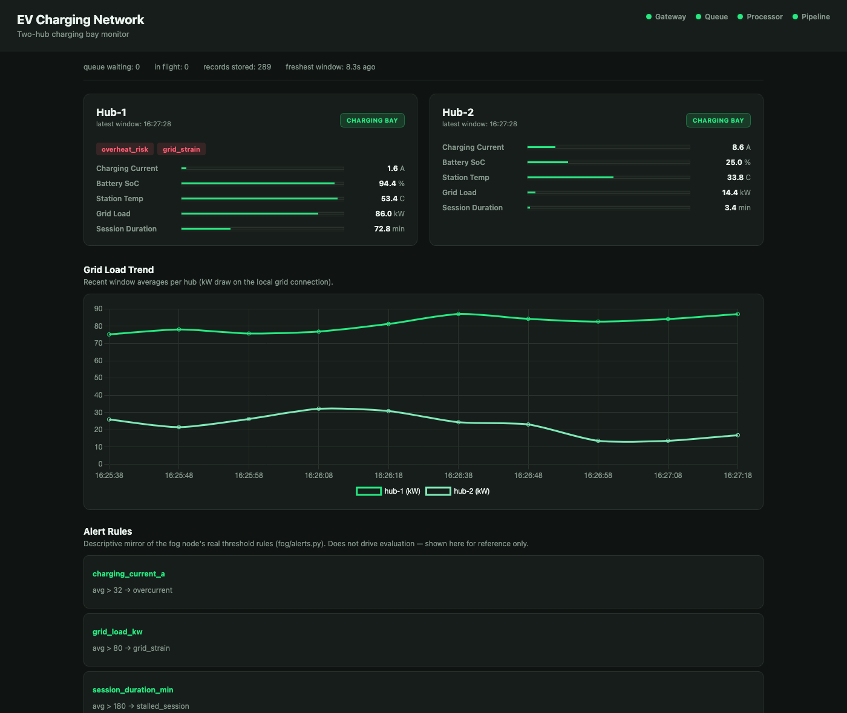
Live on AWS: demonstration highlights
The deployed dashboard, served from Amazon S3 and calling the API through Amazon API Gateway.
Four of four pipeline health checks green on the live account, with the freshest reading a few seconds old.
121 automated tests pass across the sensor, fog, processor and dashboard modules.
Stored records climbed from 26 to 289 across the verification window, confirming genuinely live data.
Two safety alerts firing live on hub-1: overheat risk and grid strain, both raised at the fog node.

Slide 5
Hardest part: one Flask app, two front doors
The problem:
The dashboard is a Flask application, but API Gateway invokes a Lambda with a proxy event, not an HTTP request, so the same code had to answer in both worlds.
Why it was hard:
Re-declaring every route for Lambda would drift from the local server over time, and a third-party adapter would add a dependency to maintain.
How it was solved:
A small hand-rolled bridge turns the API Gateway proxy event into a standard Python web-server environment and invokes the existing Flask app unchanged, with a cross-origin header on every response.
A pre-deployment audit also confirmed the recurring pitfalls, paginated counting, batched publishing and credential handling, were already correct, so no fix was needed there.

Slide 6
What this project shows
Decide at the edge: the fog node turns raw 2-to-5-second readings into one windowed summary and an instant alert, right next to the hardware.
Let the cloud absorb the load: a managed queue and serverless functions scale per request and cost nothing while idle.
Trust is tested, not assumed: 121 automated tests and a live end-to-end verification on real AWS stand behind every number on the dashboard.
Thank you. Questions?

