Slide 1
Bridge Structural Health Monitoring
Continuous fog-and-serverless monitoring of two bridge spans, live on AWS
Kasireddy Vadicherla
Student ID X25104047
MSc in Cloud Computing · Fog and Edge Computing (H9FECC)
National College of Ireland

Slide 2
Why Periodic Inspection Falls Short
Most road authorities still assess bridge condition by visual inspection, on a cycle measured in years, not days.
Between those inspections the deck keeps working: strain cycles from traffic loading, thermal expansion and contraction at the joints, and slow deformation, none of which a scheduled walk-through can catch as it develops.
Streaming every raw sample to a distant data centre is no answer either: it wastes bandwidth on readings that individually rarely matter, and delays the moment a threshold breach needs flagging.
This project closes the gap with continuous sensing: five structural sensor types on each of two spans, aggregated at the edge, alerting in seconds.
The inspection gap in numbers:
Years: the typical cycle between visual inspections of a bridge deck.
24/7: traffic strain cycles and thermal joint movement accumulate between those inspections.
0: visibility into the structure between one walk-through and the next.

Slide 3
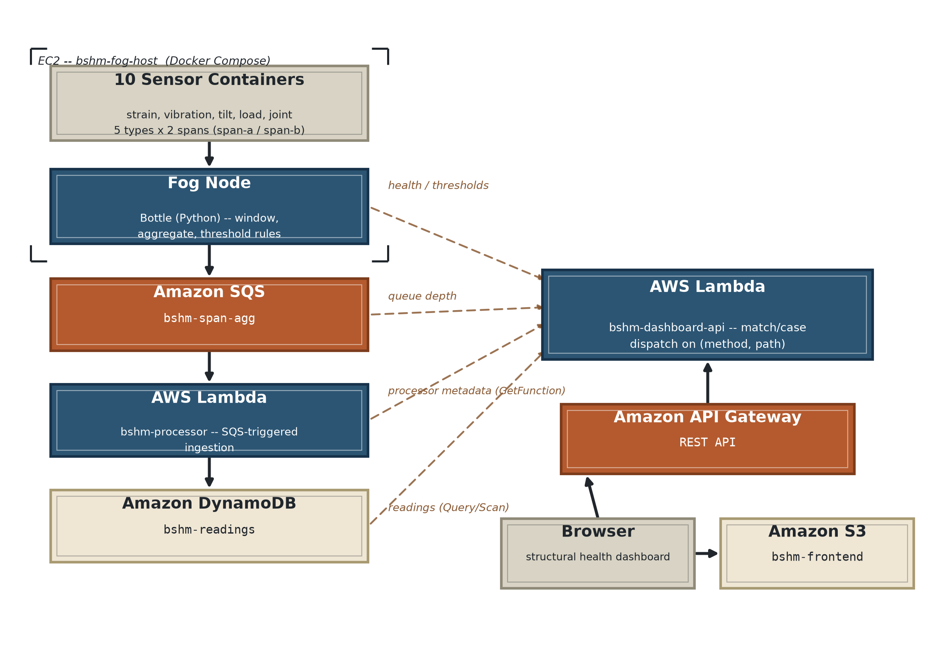
How It Works: Bridge to Browser
At the bridge (edge, EC2): 10 sensors, five types across two spans, feed a fog node that windows, aggregates, and alerts.
AWS cloud (serverless): Amazon SQS carries batched summaries to a Lambda ingest function, into a time-keyed DynamoDB store, surfaced by a dashboard on API Gateway and S3.
Less data, faster alerts:
Raw samples never leave the bridge; every 10-second window becomes one min / max / average summary per sensor, checked against four alert thresholds at the fog node before anything is sent onward.
One number per span:
The dashboard folds each span's strain average and peak vibration into a 0 to 100 structural integrity index, whose critical bound equals the alert threshold, so the index reaches zero exactly where an alert fires.

Slide 4
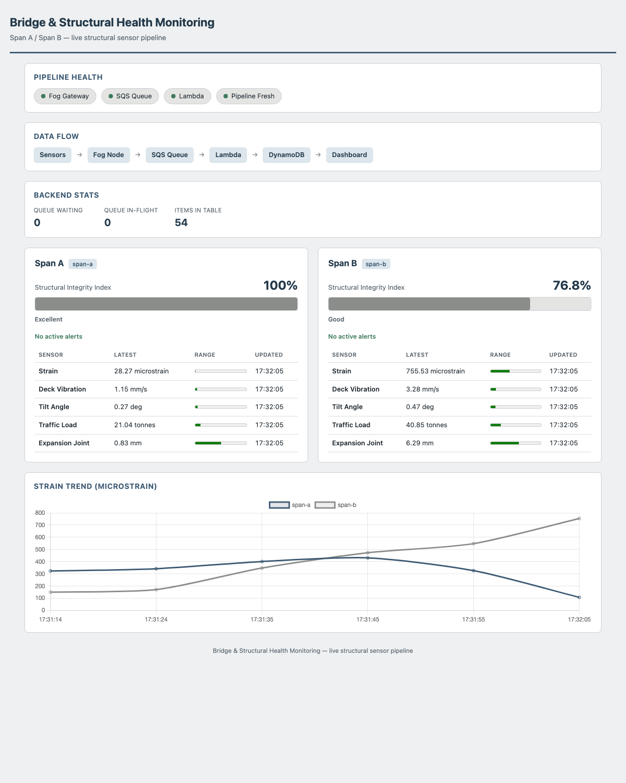
Live on AWS: Demonstration Highlights
Deployed dashboard, captured live from the S3 and API Gateway endpoint.
4 / 4 pipeline health checks green on the live deployment: fog gateway, SQS queue, Lambda, and data freshness all reporting healthy.
115 automated tests pass across fourteen suites: windowing, thresholds, pagination, batching, and real-socket HTTP routing.
Under 10 seconds: age of the freshest window on the live health check; 100 records had landed in DynamoDB within a minute of bootstrap.
Structural integrity index, live:
Span A at 100 percent, excellent with no active alerts; Span B at 76.8 percent, good and tracking real readings.

Slide 5
The Hardest Part: One Risky Apply
The problem:
Every project here deploys through one shared Terraform module, and its local state file already tracked a different live AWS stack under the default workspace.
Why it was hard:
Nothing in this project's code was wrong. Applied against that workspace, Terraform reconciles state and plans to destroy the other deployment's live resources. The only warning is one line of plan output.
The fix:
A dedicated workspace was created first (terraform workspace new bshm); the re-plan read Plan: 24 to add, 0 to change, 0 to destroy, then a single apply built all 24 resources, healthy within a minute.
Never apply an unread plan.
The same pre-deploy audit also caught two silent defects, a DynamoDB scan-pagination undercount and unbatched SQS publishing, both fixed and regression-tested before launch.

Slide 6
What This Project Shows
Aggregate at the edge:
Only compact 10-second summaries ever leave the bridge; alerts fire at the fog node, not after a cloud round trip.
Serverless earns its keep:
SQS, Lambda, and DynamoDB cost nothing while idle, and ran green on a real AWS account, with 115 passing tests behind them.
Read the plan, trust the evidence:
A pre-deployment audit and one carefully read Terraform plan caught every defect before live traffic could.
Thank you. Questions?

