Slide 1
Marine Vessel Condition Monitoring
A fog and edge computing pipeline for two cruise vessels, deployed live on AWS
Gopi Krishnan
Student ID X25112627
MSc in Cloud Computing · Fog and Edge Computing (H9FECC)
National College of Ireland

Slide 2
Between Rounds, the Bridge Is Blind
Fixed rounds find problems late: a fuel-burn spike, a ballast imbalance, or rising hull vibration surfaces only at the next scheduled check, not when it starts.
Continuous data will not fit the link: ten sensor streams, five readings on each of two vessels, produce far more raw data than a narrow, unreliable ship-to-shore link can carry.
So the answer must live on board: aggregate and evaluate readings on the vessel itself, and send ashore only compact window summaries.
10 live sensor streams: engine, fuel, ballast, hull vibration, passengers, on each of two vessels.
Alert rules, checked on every window:
Engine overheat: average above 75 °C.
Excessive fuel burn: average above 350 L/h.
Ballast overfill: average above 90 percent.
Hull stress: maximum above 15 mm/s.

Slide 3
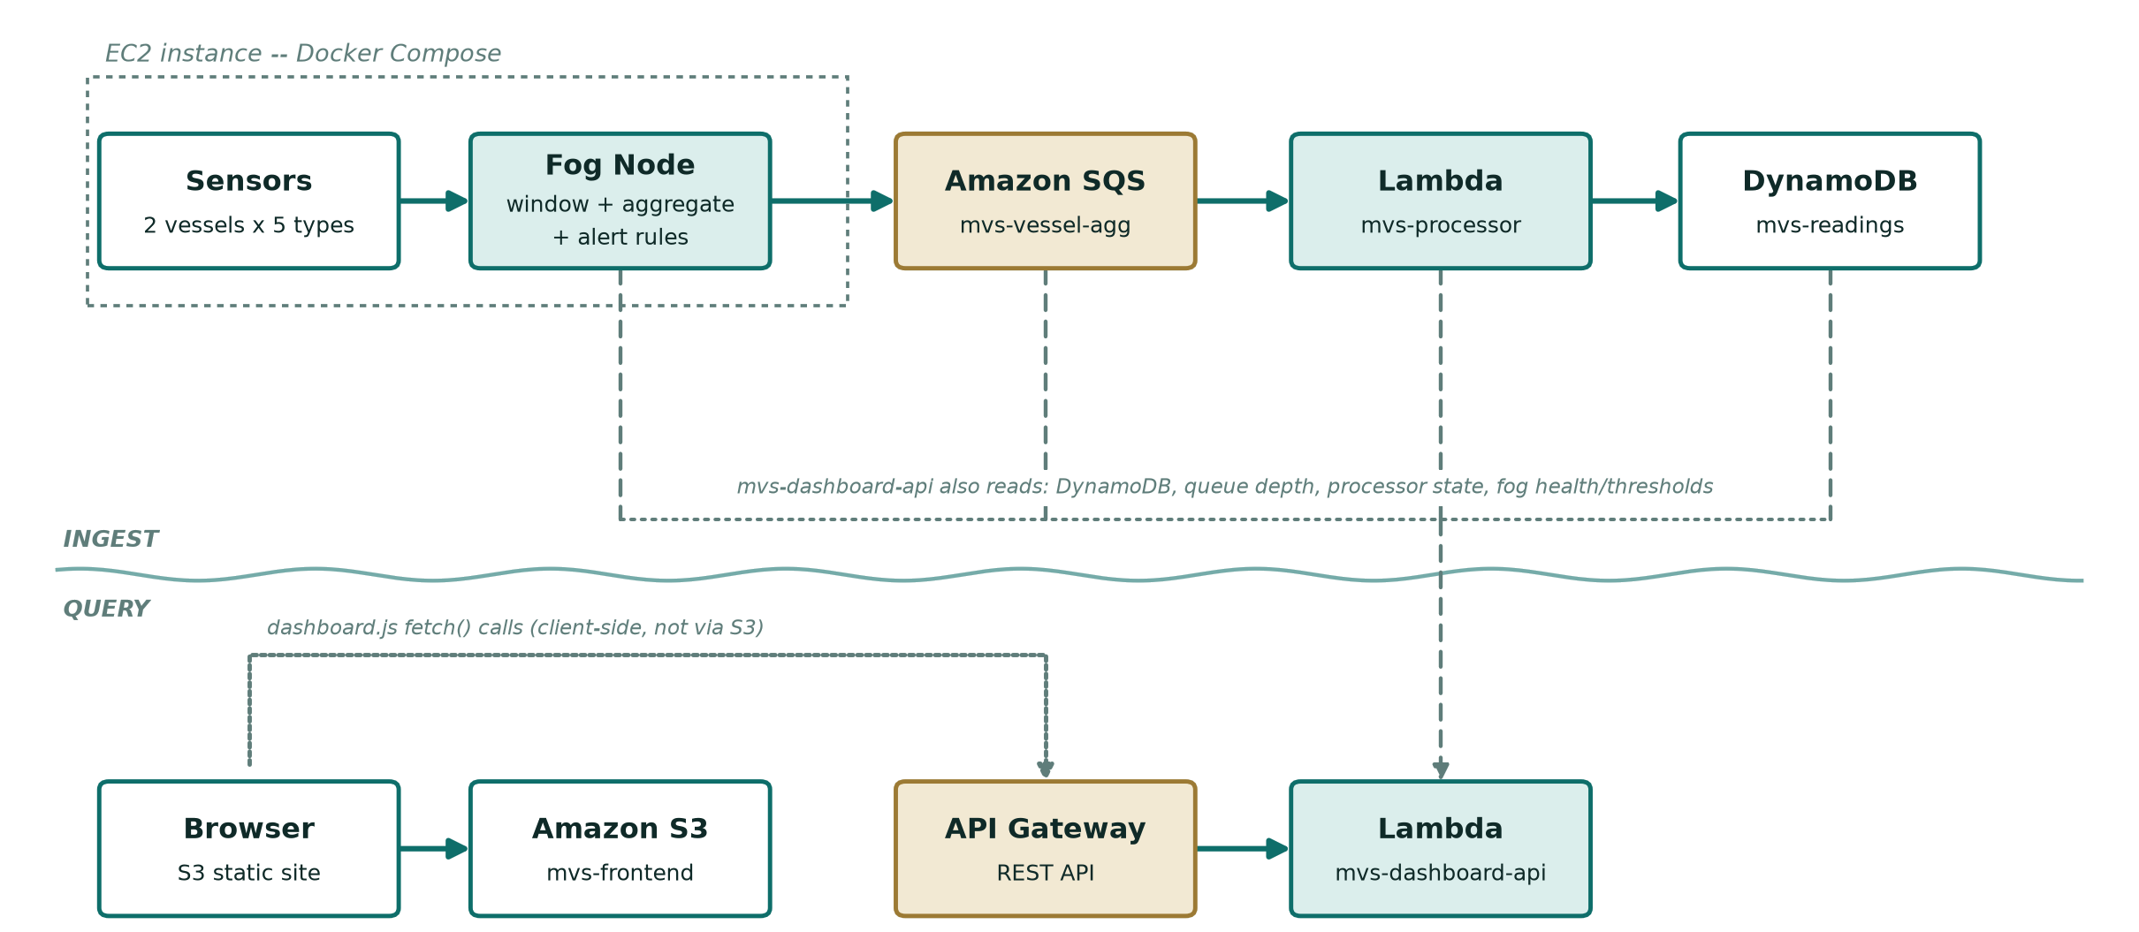
How It Works: From Sensor to Bridge Screen
On board the vessel: sensors produce 10 streams with 5 readings per vessel, and the fog node windows, aggregates, and raises alerts.
AWS cloud, fully serverless: Amazon SQS queues the summaries, AWS Lambda ingests each window, Amazon DynamoDB stores the aggregates, and a live dashboard runs on Amazon S3 and API Gateway.
Aggregate at the edge: each window is reduced to min, max, average, latest and sample count, and checked against the alert rules before anything leaves the vessel.
Only summaries go ashore: compact aggregates cross the narrow ship-to-shore link in batches of up to ten per queue call, and raw readings never leave the ship.
Serverless, scales per request: SQS triggers Lambda per batch and DynamoDB bills per request, so the dashboard stays up even when the vessel itself is offline.

Slide 4
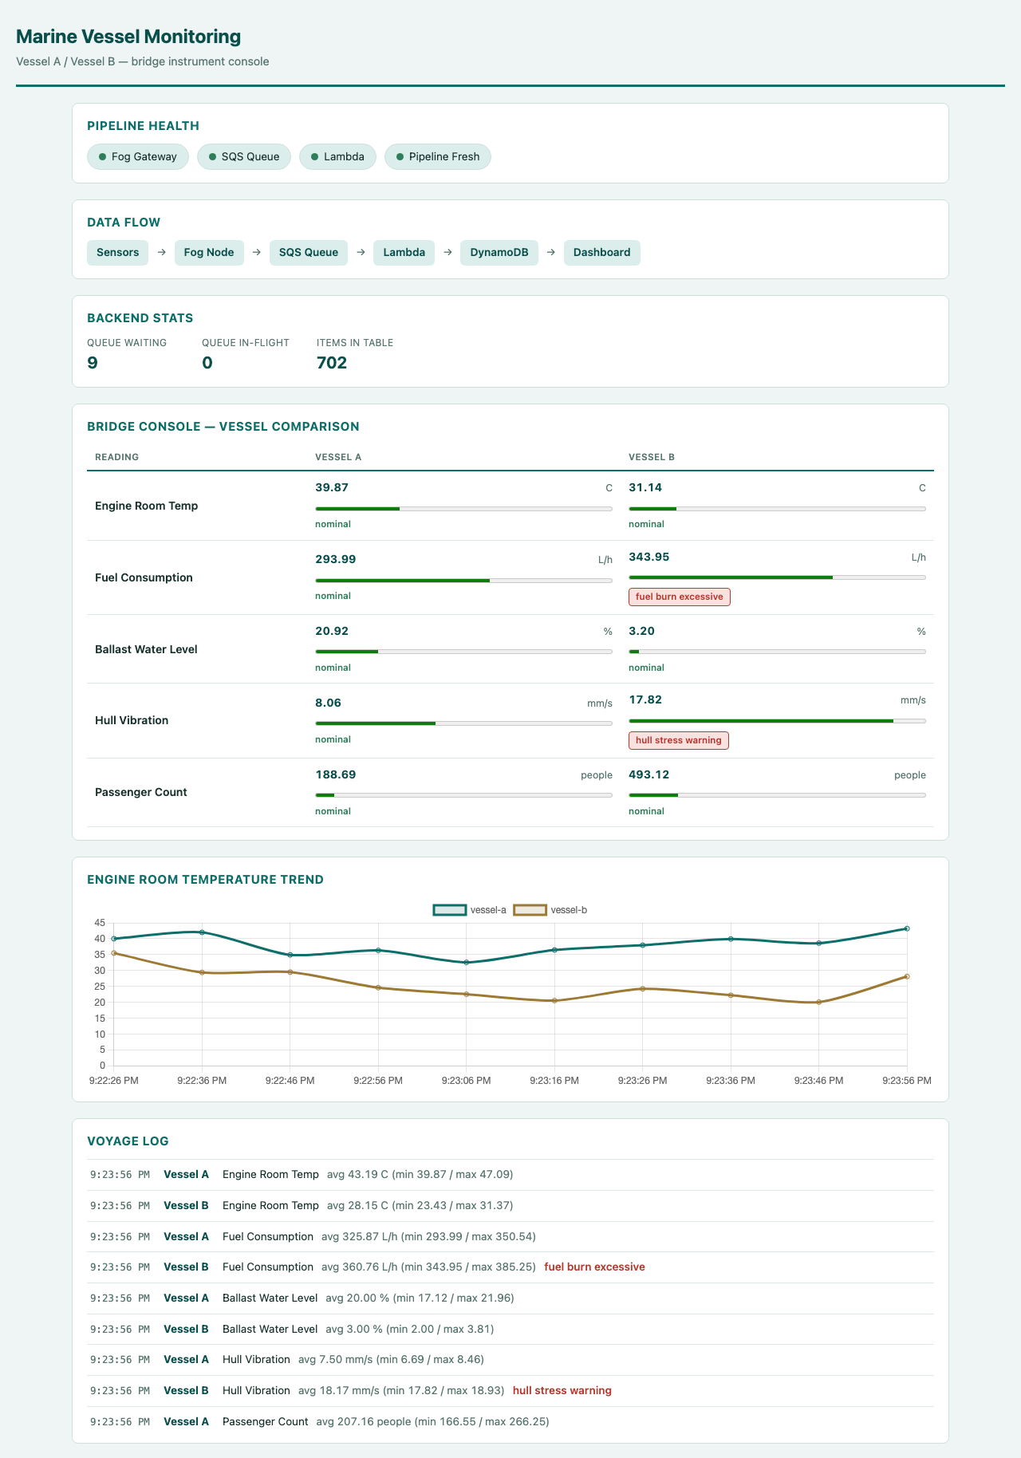
Live on AWS: What the Demo Shows
The deployed dashboard, rendered live in a browser.
Every pipeline health check green: the live health endpoint reports gateway, queue, Lambda and pipeline all true, with the freshest reading under one second old, and all five AWS resources verified healthy independently.
120 automated tests pass: unit and real-socket HTTP tests across every module, sensors, fog, publisher, processor and dashboard, with the critical fixes re-verified against the live account, not just the emulator.
Real data, climbing live: stored items grew 59 to 374 to 425 during verification, and genuine alerts, excessive fuel burn and hull stress, fire on the Bridge Console as thresholds are crossed.

Slide 5
The Hardest Part: Green Checks, Broken Page
The problem:
Deployed to the real AWS account, the dashboard page loaded, but every panel stayed empty. Its stylesheet, script and chart library all returned 404 from S3.
Why it was hard:
Every signal said healthy: 120 tests green, a full LocalStack integration run clean, every curl check on the JSON API returning live data. The upload had flattened the static folder to the bucket root, and nothing was testing the page's own asset requests.
The fix:
Open the real page in a real browser and read its network requests: three 404s, visible immediately. Re-upload preserving the exact paths the page asks for, then re-verify by watching the item count climb across live reloads.
Only the real cloud caught these too:
A count-only database scan silently undercounted the table beyond its first page, fixed by following every pagination cursor.
The fog sent one queue message per aggregate, fixed with batched sends of up to ten per call.
A green API check proves less than it looks.

Slide 6
Three Things to Take Away
Aggregate at the edge: windowing and alert checks run on board, so only compact summaries ever cross the ship-to-shore link.
Serverless where it counts: SQS, Lambda, DynamoDB, API Gateway and S3 scale per request, with no backend server to run or patch.
Test the real thing: the live account and a real browser caught three defects that 120 green tests and an emulator masked.
Thank you. Questions?

