Slide 1
A fog and edge pipeline across two halls and five sensor types, deployed live on AWS
Data Center Environmental Monitoring
Nithin
Student ID X25125338
MSc in Cloud Computing · Fog and Edge Computing (H9FECC)
National College of Ireland

Slide 2
Periodic checks find faults after the fact
An overheating server, a humidity swing toward condensation, or restricted airflow around a rack can each trigger a hardware failure or a costly unplanned outage.
When a facility relies on fixed inspection rounds, these conditions surface only after they have already occurred.
This project replaces the walk-through with continuous sensing: ten sensors across two server halls, with every aggregation window evaluated against explicit threshold rules the moment it closes, without waiting for the next scheduled round.
Threshold rules evaluated on each closed window:
27 degrees C: the average hall temperature above which an overheat alert must fire.
60 percent: the humidity beyond which condensation puts equipment at risk.
400 CFM: the airflow floor below which rack cooling is insufficient.

Slide 3
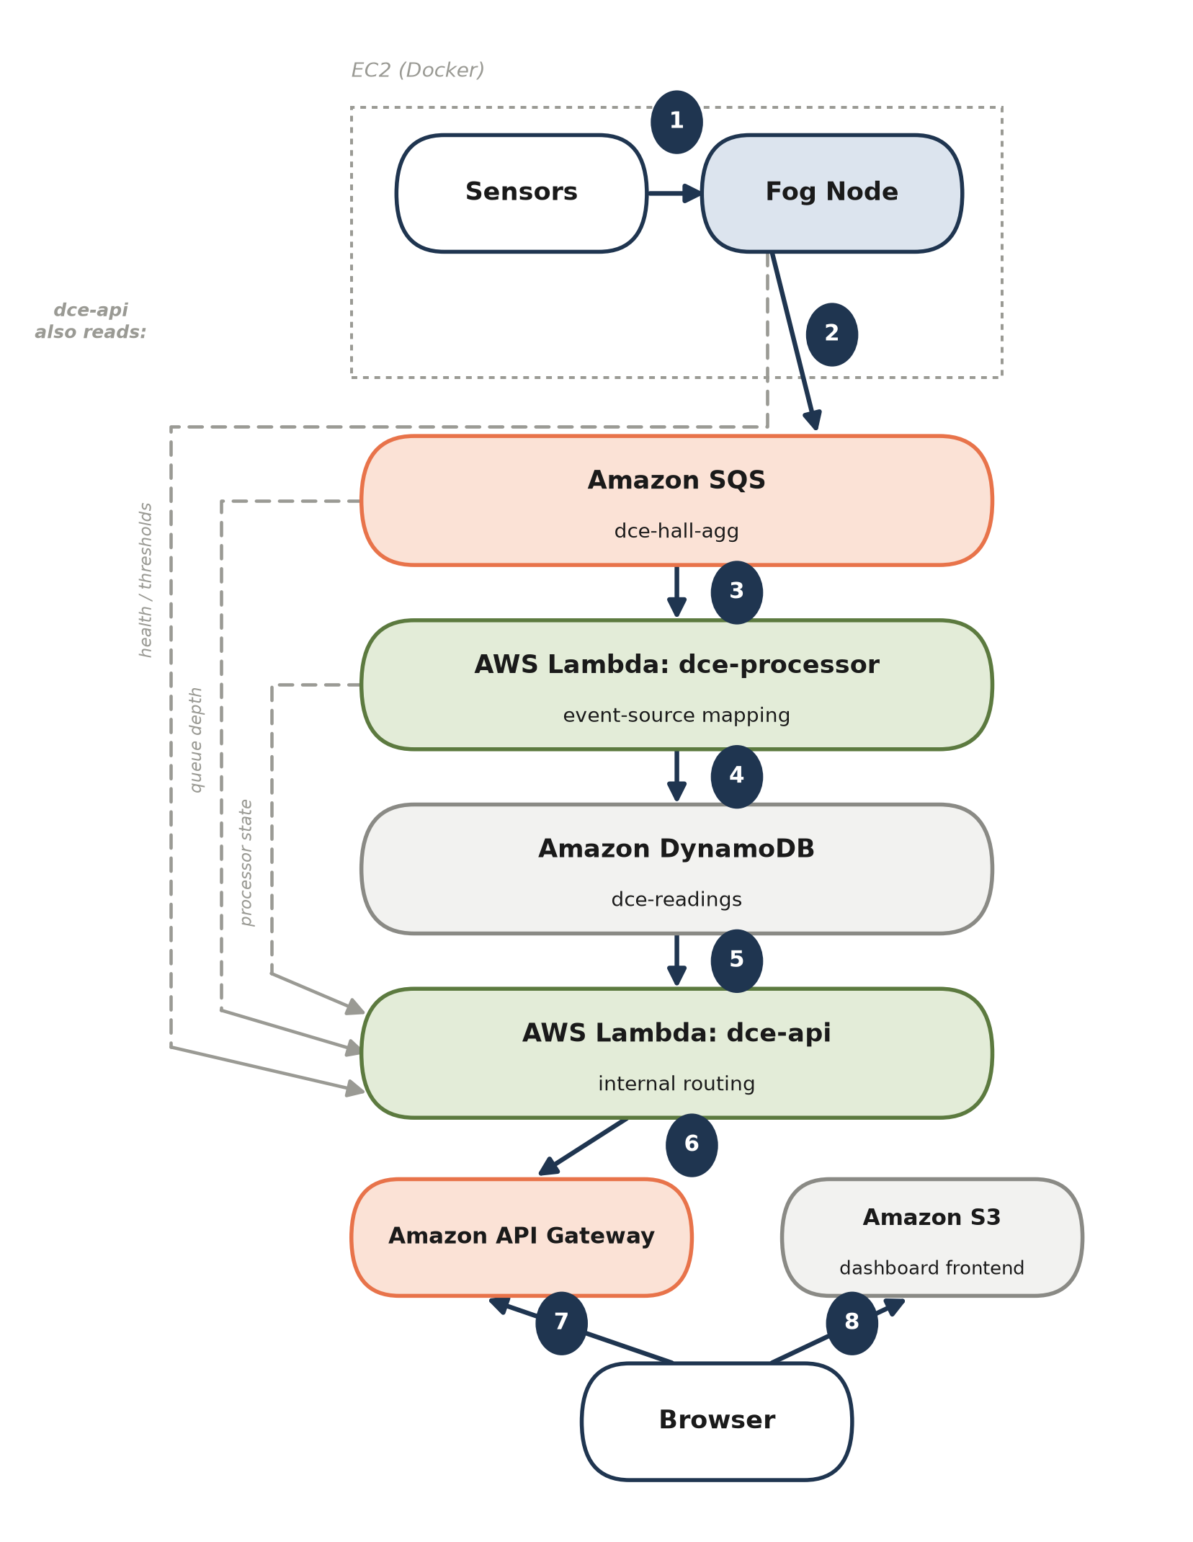
How it works: edge to cloud in one pipeline
Ten sensors across two halls, five metrics each, feed the pipeline.
A fog node windows, aggregates, and raises alerts at the edge.
Window summaries flow through Amazon SQS to an AWS Lambda ingest function, which stores readings in Amazon DynamoDB.
A second AWS Lambda serves the dashboard API behind Amazon API Gateway.
The live dashboard is a static site hosted on Amazon S3.
Alerts fire at the edge, so only compact window summaries ever cross into the cloud.

Slide 4
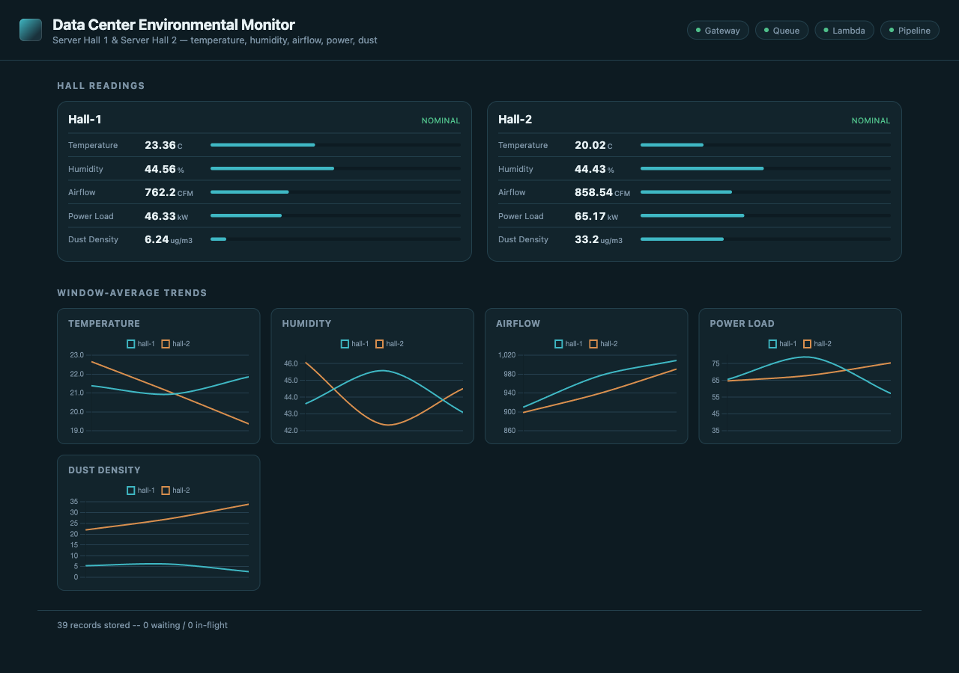
Live on AWS: the deployed dashboard
4 of 4 pipeline health checks healthy on the live deployment: gateway, queue, Lambda, and pipeline.
114 automated tests passing across all five modules.
300 burst messages sent to the real queue in 5.5 seconds, and every one was confirmed stored in DynamoDB.

Slide 5
The hardest part: a fault only real AWS revealed
114 of 114 local tests and the full LocalStack integration run all passed cleanly.
3 files silently replaced real AWS credentials with emulator-only ones on every cloud run.
The fault:
Whenever the AWS access-key environment variable existed, the code swapped in hardcoded emulator credentials; real Lambda and EC2 inject that exact variable automatically, so genuine session credentials were thrown away and every DynamoDB and SQS call would have failed authentication.
Why it slipped through:
Locally the condition happened to be correct, so all 114 tests and the LocalStack integration run passed; the emulator cannot reproduce the trigger at all, so nothing could fail until the same code ran against the real platform.
The fix:
Gate the emulator credentials on a signal unique to local development, the explicit LocalStack endpoint override, applied across all three files each with its own code shape, redeployed, then verified live with an end-to-end DynamoDB write and SQS receive.
The same real-cloud testing also caught a DynamoDB pagination undercount in the item-count endpoint, fixed with two new tests covering it.

Slide 6
What this project shows
Fog-side windowing and alerting catches threshold breaches in seconds, so only compact summaries ever cross into the cloud.
The backend is entirely serverless: Amazon SQS, two AWS Lambda functions, DynamoDB, API Gateway, and S3, scaling per request and costing nothing when idle.
Emulator testing alone is not enough: two real defects surfaced only against the live cloud, and both are fixed and verified on the deployed system.
Thank you. Questions?

