Slide 1
Wildlife Conservation Habitat Monitoring
A fog-to-serverless habitat monitoring pipeline, live on AWS
Hrishikesh Sajeev
Student ID X25132377
MSc in Cloud Computing · Fog and Edge Computing (H9FECC)
National College of Ireland

Slide 2
When patrols find out too late
Fixed patrols learn about events late:
A poaching incident, a drying waterhole, or a sudden movement surge is discovered only when a patrol reaches that spot, not when it starts.
The critical signals are short-lived:
A gunshot-like acoustic spike lasts moments. Continuous sensing raises the alert as the window closes, while a ranger can still respond.
Too many feeds for manual checking:
Two reserves each stream five sensor types: motion, acoustics, waterhole level, temperature, and soil moisture, around the clock.
The thresholds that matter:
75 dB average acoustic level in a window flags possible gunshot or chainsaw activity.
A waterhole level below 20 cm flags drought stress, checked every aggregation window.
All four alert rules are evaluated at the fog node, on site, before anything reaches the cloud.

Slide 3
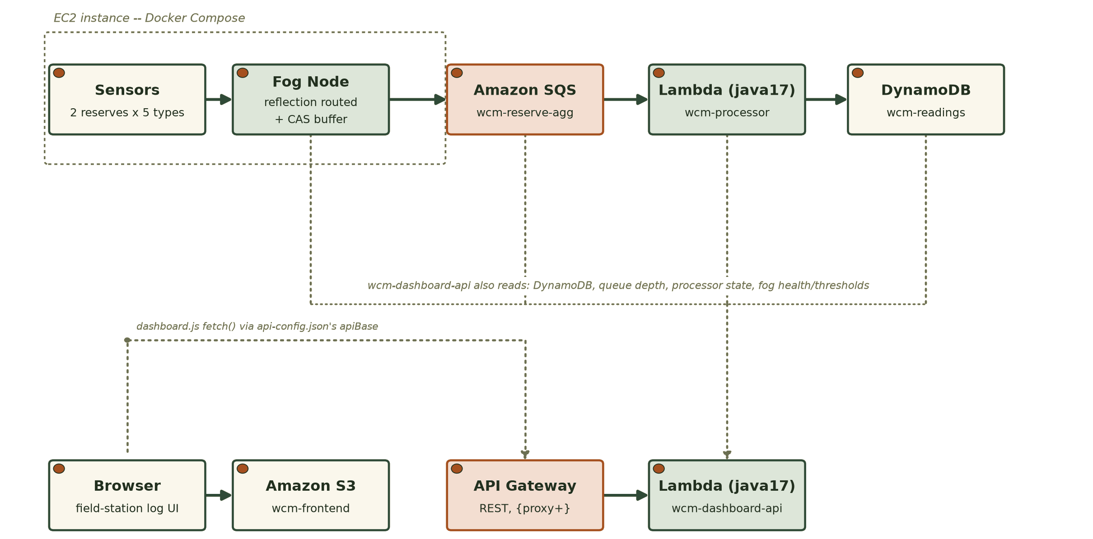
From the reserve to a live dashboard
Ingest, from the sensors into the store:
Field sensors, 10 feeds across 2 reserves, reach the fog node, which windows, aggregates, and alerts, running at the reserve edge on EC2.
The fog node feeds an Amazon SQS aggregate queue, an AWS Lambda serverless ingest, and an Amazon DynamoDB readings store, all managed AWS services with no server to run.
Serve, the dashboard reads back:
An AWS Lambda dashboard API behind an Amazon API Gateway REST API reads the store.
The live dashboard is served from Amazon S3: both reserves side by side, a field-station log, and live alert flags.

Slide 4
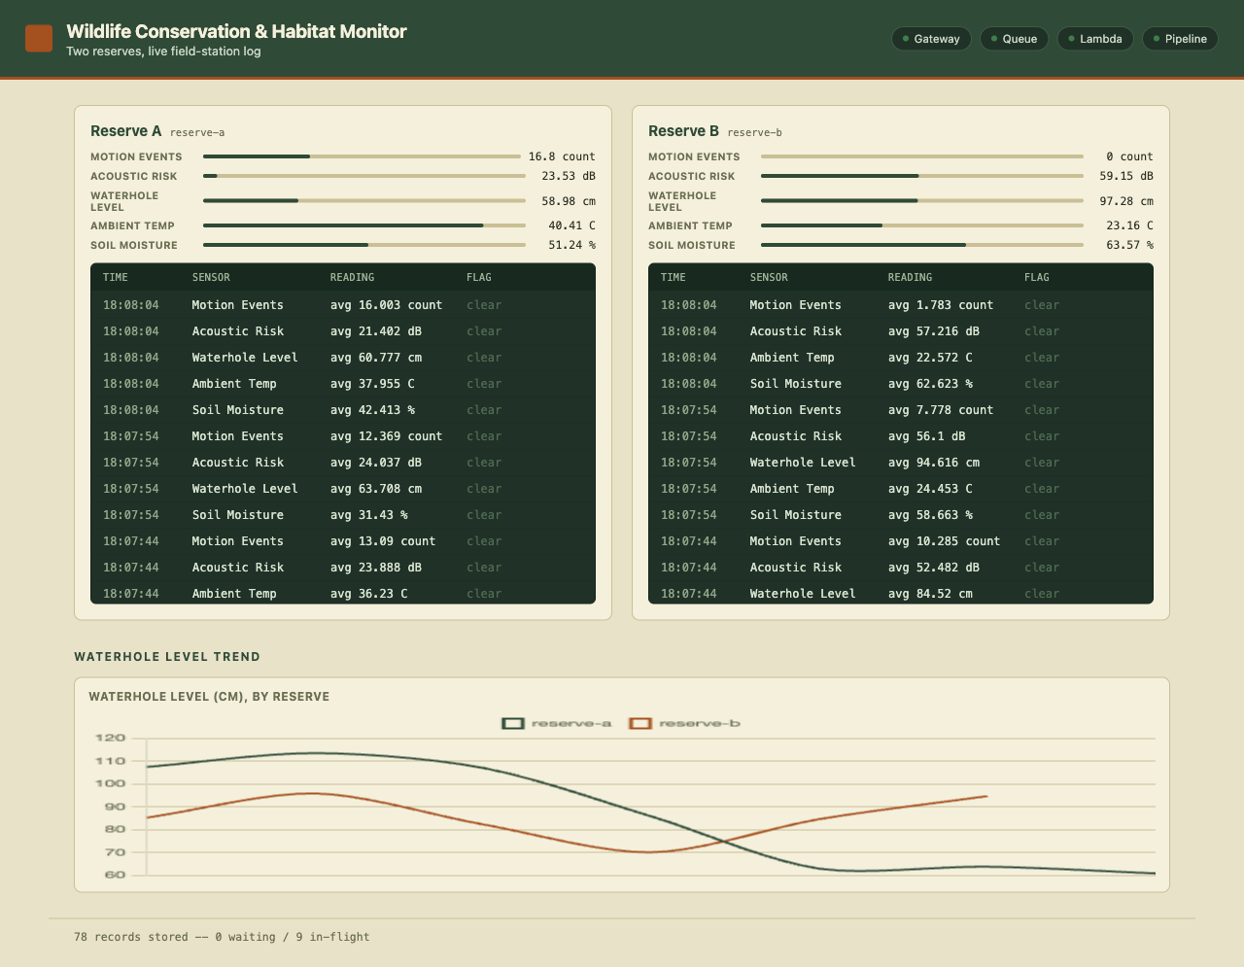
Demonstration: live on AWS
The deployed dashboard during the live browser check, served from the Amazon S3 frontend.
Measured on the live deployment:
4 of 4 pipeline health checks true: gateway, queue, Lambda, pipeline, with the freshest reading under 6 seconds old.
82 tests pass across all four modules: sensors, fog, backend processor, and dashboard.
Stored readings climbed from 362 to 378 in 15 seconds during live verification, with alert flags tripping on real thresholds.

Slide 5
The hardest part
A silent DynamoDB undercount that passed every local test.
The problem:
The dashboard's stored-readings count came from a single DynamoDB scan. One scan call returns only about 1 MB of data and hands back a cursor for the rest, so the count silently stops short, and no error is raised anywhere.
Why it was hard:
All 82 local tests and a full LocalStack integration run stayed green: a small local table fits in one page, so nothing could expose the missing pages. Only a real AWS table growing past that boundary makes the number wrong.
How it was solved:
The count now follows the cursor page by page with the SDK's own paginator, locked in by a four-page regression test and re-verified against the live account. The same audit also caught unbatched SQS sends, now grouped ten per call.
Why local green lied: 82 of 82 local tests green, and the defect still shipped.
About 1 MB is all one scan call returns; the rest hides behind a pagination cursor.
1,287 items summed across four pages (400 plus 400 plus 400 plus 87) by the regression test that locks the fix in.

Slide 6
What this project proves
Decide at the edge:
The fog node windows, aggregates, and raises alerts at the reserve itself, so only compact summaries ever cross to the cloud.
Go serverless where it scales:
Amazon SQS, AWS Lambda, DynamoDB, and API Gateway carry the backend: no server to patch, and cost only per request.
Deployment is the real test:
Two defects passed all 82 local tests and a full emulator run; only the live AWS account exposed them.
Thank you. Questions?

