Slide 1
Ski Resort Avalanche Safety
A fog-to-cloud slope-monitoring pipeline, deployed live on AWS
Ebin Joseph
Student ID X25142224
MSc in Cloud Computing · Fog and Edge Computing (H9FECC)
National College of Ireland

Slide 2
Why scheduled checks fail on a live slope
1
Avalanche danger does not wait for the next patrol round: it develops, peaks, and passes in the gaps between them.
Scheduled patrol rounds:
Conditions are observed only when someone walks the slope.
A seismic spike ahead of a slab release lasts only minutes and can pass entirely between two rounds, which are far sparser.
Wind loading and a warming snowpack build danger silently in those gaps.
Continuous slope sensing:
Ten live sensors, five signal types on each of two slopes, never stop sampling: snowpack depth, snow temperature, wind, seismic vibration, and lift chairs.
A fog node on the mountain checks every window aggregate against four hard alert rules at the edge the moment the window closes.
Wind averaging past 80 km/h raises a lift-halt alert with no patrol involved.

Slide 3
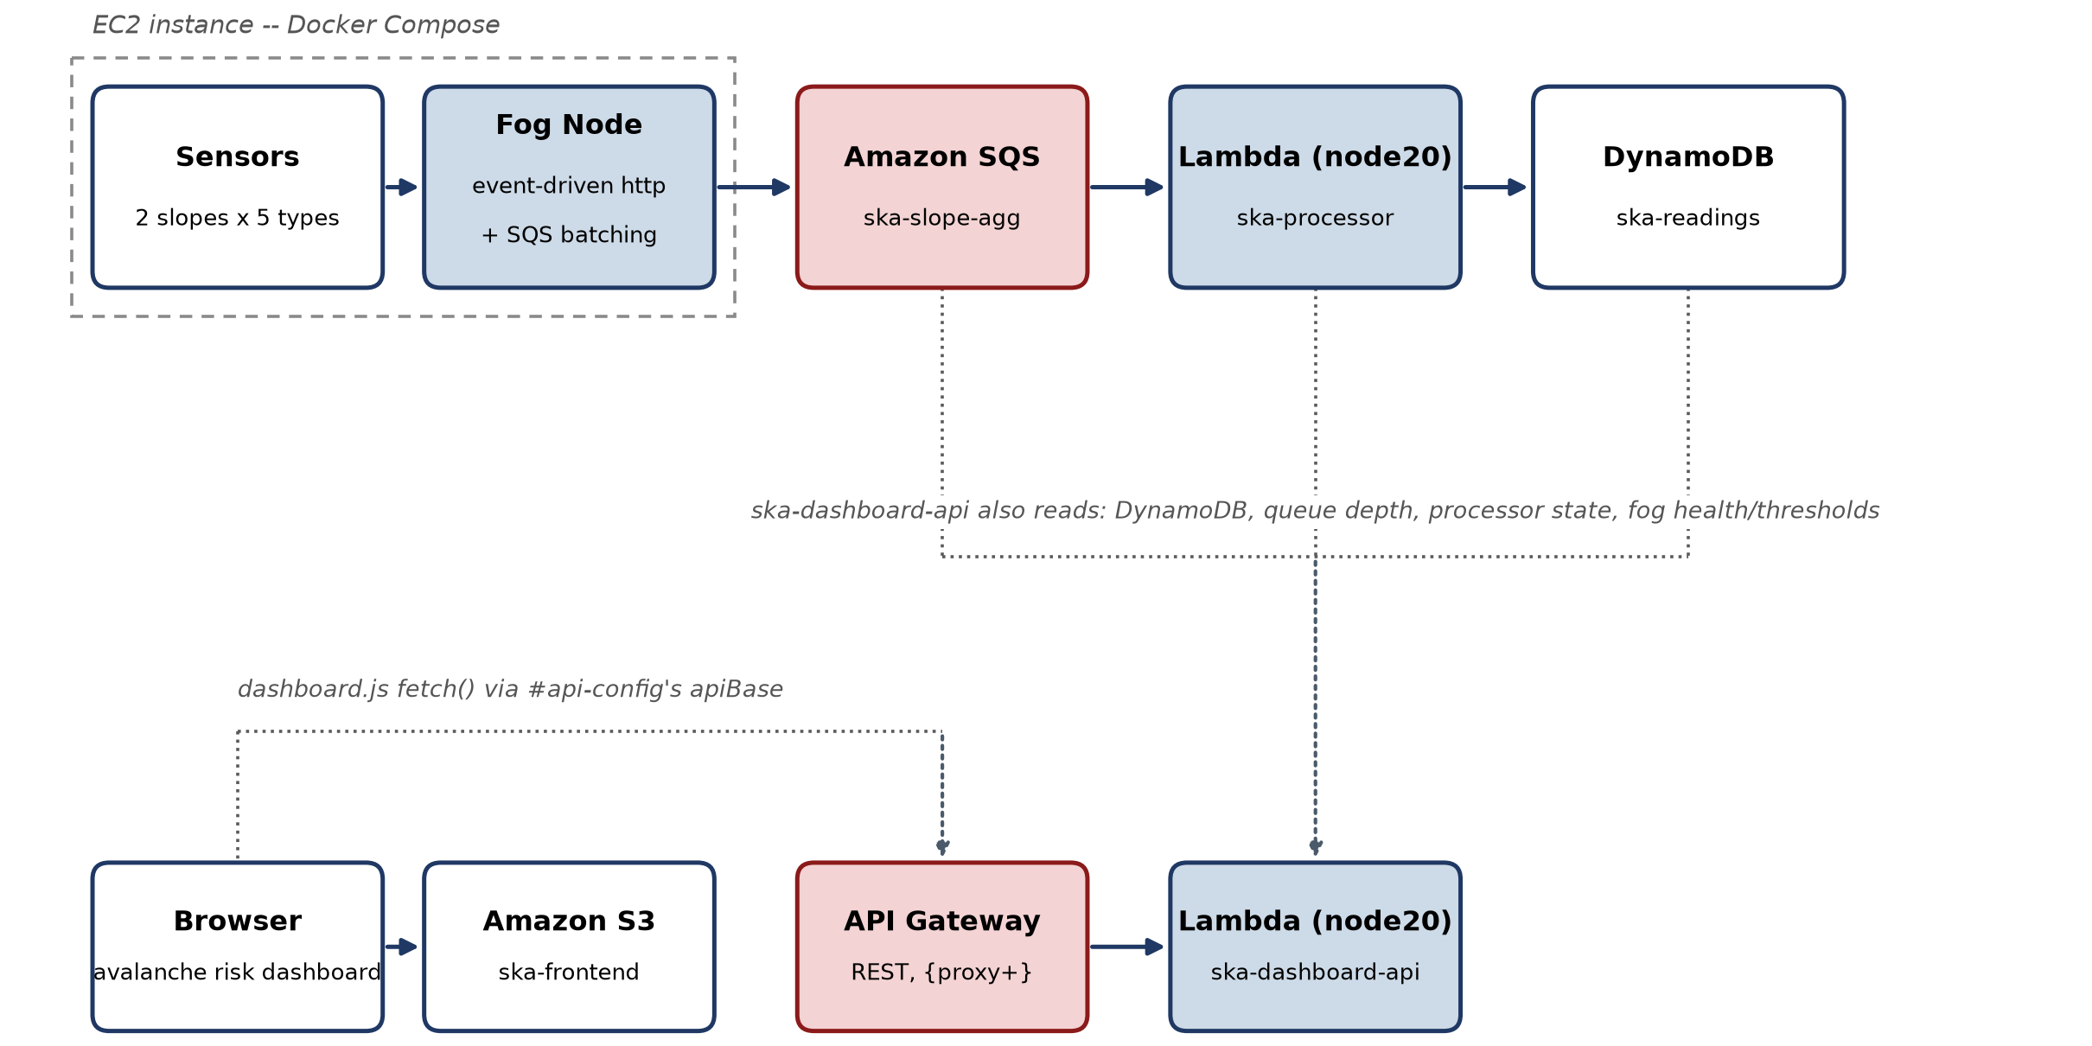
How it works: fog first, cloud second
2
Slope sensors: ten simulated sensors on two slopes, sampling snowpack, snow temperature, wind, seismic vibration, and lift chairs.
Fog node at the edge: buffers raw readings, closes a window on a timer, aggregates them, and checks four alert rules.
Cloud pipeline: Amazon SQS receives one compact summary message per closed window; AWS Lambda wakes only when messages arrive and writes each aggregate to Amazon DynamoDB, which keeps one queryable record per slope per window.
Live dashboard: a static page on Amazon S3, polling AWS Lambda through Amazon API Gateway.
Raw readings never leave the mountain: only one compact summary per window travels to the cloud.
Serverless throughout: nothing between the fog node and the browser runs on a server this project has to patch.

Slide 4
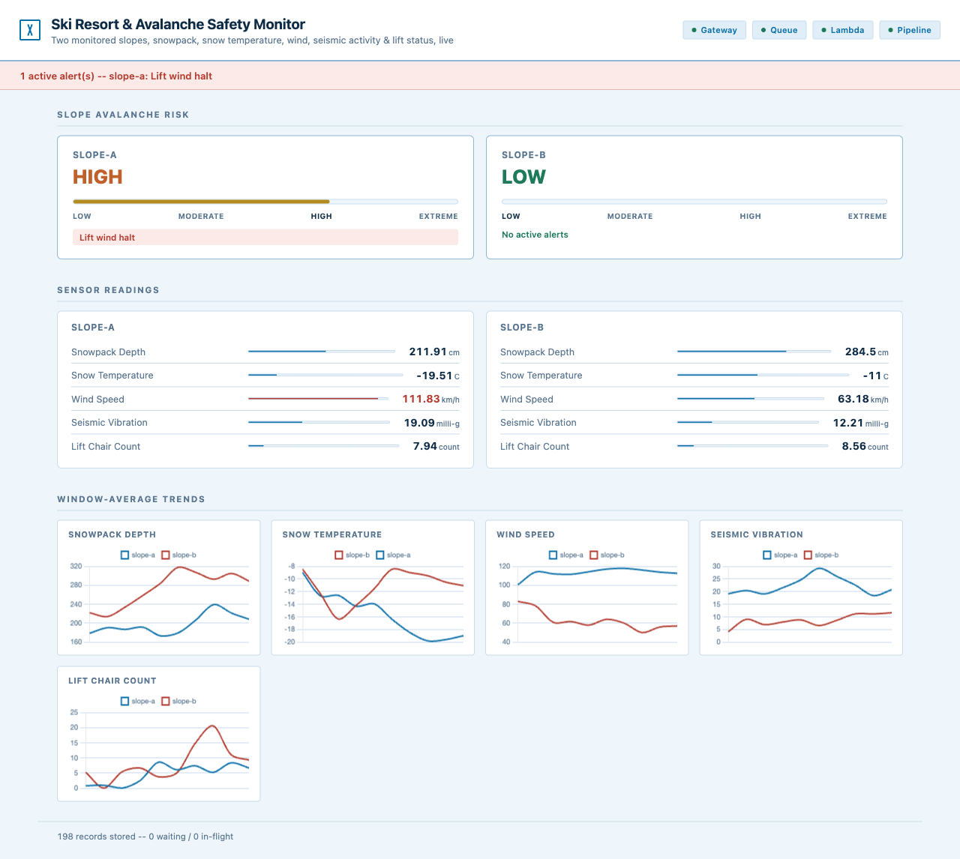
Live on a real AWS account
3
The deployed dashboard, captured live, served from Amazon S3 and polling the API through Amazon API Gateway.
4 / 4 pipeline health checks reporting true: gateway, queue, Lambda, and pipeline.
121 automated tests passing across sensors, fog, processor, and dashboard.
0 to 569 records stored in DynamoDB within about ninety seconds, and still climbing.
Slope-a risk gauge live at HIGH, with wind at 111.8 km/h tripping the "Lift wind halt" alert banner.

Slide 5
The hardest part: the dashboard that lied
4
Two defects existed only in the real cloud: the first, broken Lambda credentials, at least announced itself in the logs and was fixed; the second showed up nowhere at all.
What every check said:
The health endpoint reported gateway, queue, Lambda, and pipeline all true, and curl against the same API returned live JSON data, with the browser console showing zero errors and the network tab zero failed requests.
What the user saw:
Every panel on the deployed page stayed empty, with no data, no gauges, and no alert banner, indistinguishable from still loading, and nothing anywhere pointed at a cause.
Why it stayed invisible:
The API's responses carried no cross-origin (CORS) header, so the browser silently blocked the S3 page's calls before any code saw a response.
The page's polling loop swallowed each failure into a quiet retry, with no error, no log line, and no failed request recorded.
How it was solved:
Add the cross-origin header to every response the API Lambda returns, then redeploy and re-verify in a real browser until every panel filled with live data.
New rule: a green health check proves the API works, but only a browser proves the user sees it.

Slide 6
What this project proved
5
Fog aggregation earns its place: raw readings stay on the mountain, and the cloud only ever receives compact window summaries with alerts already evaluated.
A fully serverless backend of Amazon SQS, AWS Lambda, DynamoDB, API Gateway, and S3 scales per request, with no server to provision or patch.
Live deployment is the real test: two defects existed only on real AWS and in a real browser, and no local test suite could have found them.
Thank you. Questions?

