Slide 1
Smart Mining Safety Monitoring
A fog-to-cloud hazard pipeline for two underground shafts, deployed live on AWS
Jaipal Kasireddy
Student ID X25156381
MSc in Cloud Computing · Fog and Edge Computing (H9FECC)
National College of Ireland

Slide 2
Why periodic checks fail underground
Methane moves in minutes: a ventilation fan can clear a methane pocket in under a minute, or leave it in place for an hour, depending on airflow.
Carbon monoxide gives no visible warning: CO from blasting or equipment exhaust displaces breathable air silently. By the time a round reaches the shaft, the air has already changed.
Rockfall precursors last seconds: ground vibration from an unstable face can precede a rockfall by seconds rather than hours. No inspection schedule is that fast.
Four hard limits, watched continuously:
Methane (window average): 1,000 ppm.
Carbon monoxide (average): 50 ppm.
Respirable dust (average): 10 mg/m3.
Ground vibration (maximum): 25 mm/s.
Every sensor window is checked against these limits at the fog node itself, not on an inspector's schedule.

Slide 3
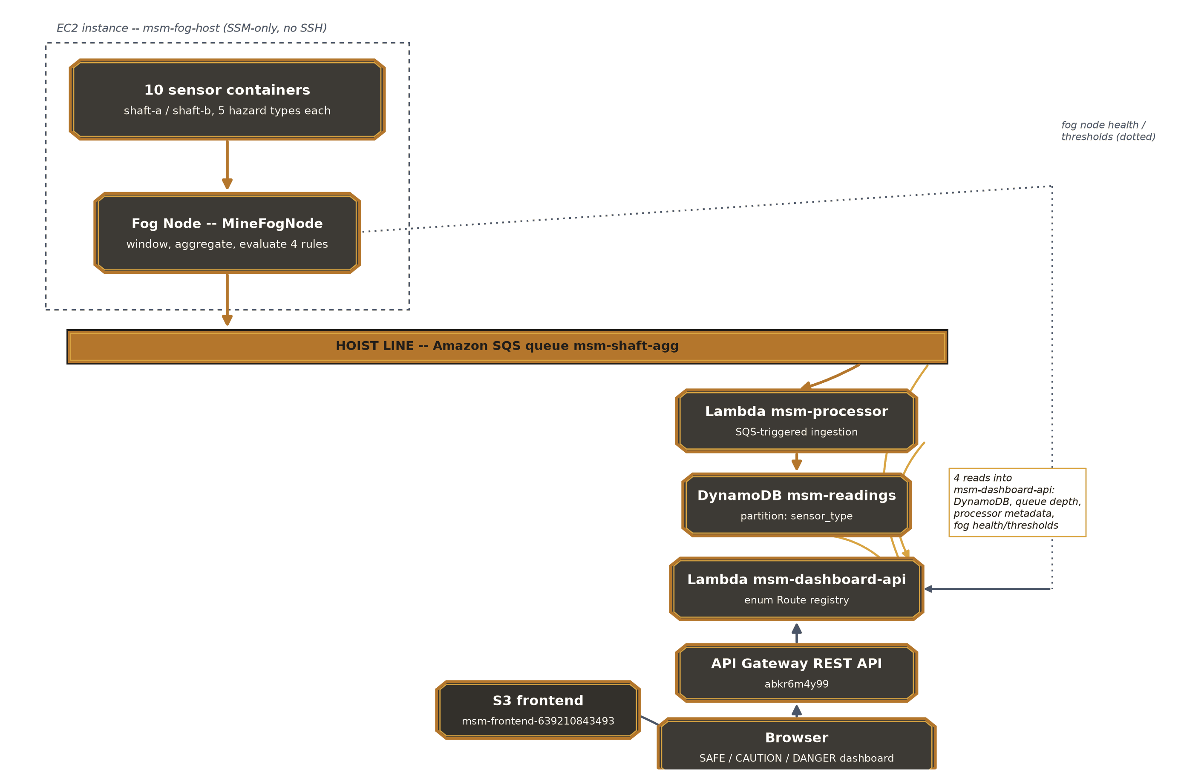
How it works: edge to live dashboard
Underground, edge tier:
Ten sensors (2 shafts x 5 hazard types) post readings continuously; the fog node windows, aggregates and evaluates alert thresholds at the edge.
AWS cloud, serverless tier:
Amazon SQS carries compact window summaries in batches of up to ten; AWS Lambda reads the queue and stores each finished window.
Amazon DynamoDB holds readings history keyed per sensor type and shaft; the live dashboard (Amazon API Gateway plus Amazon S3) shows SAFE, CAUTION or DANGER per shaft.
Only finished window summaries cross the mine uplink; raw readings never leave the edge, and alerts fire in the same process that measured them.

Slide 4
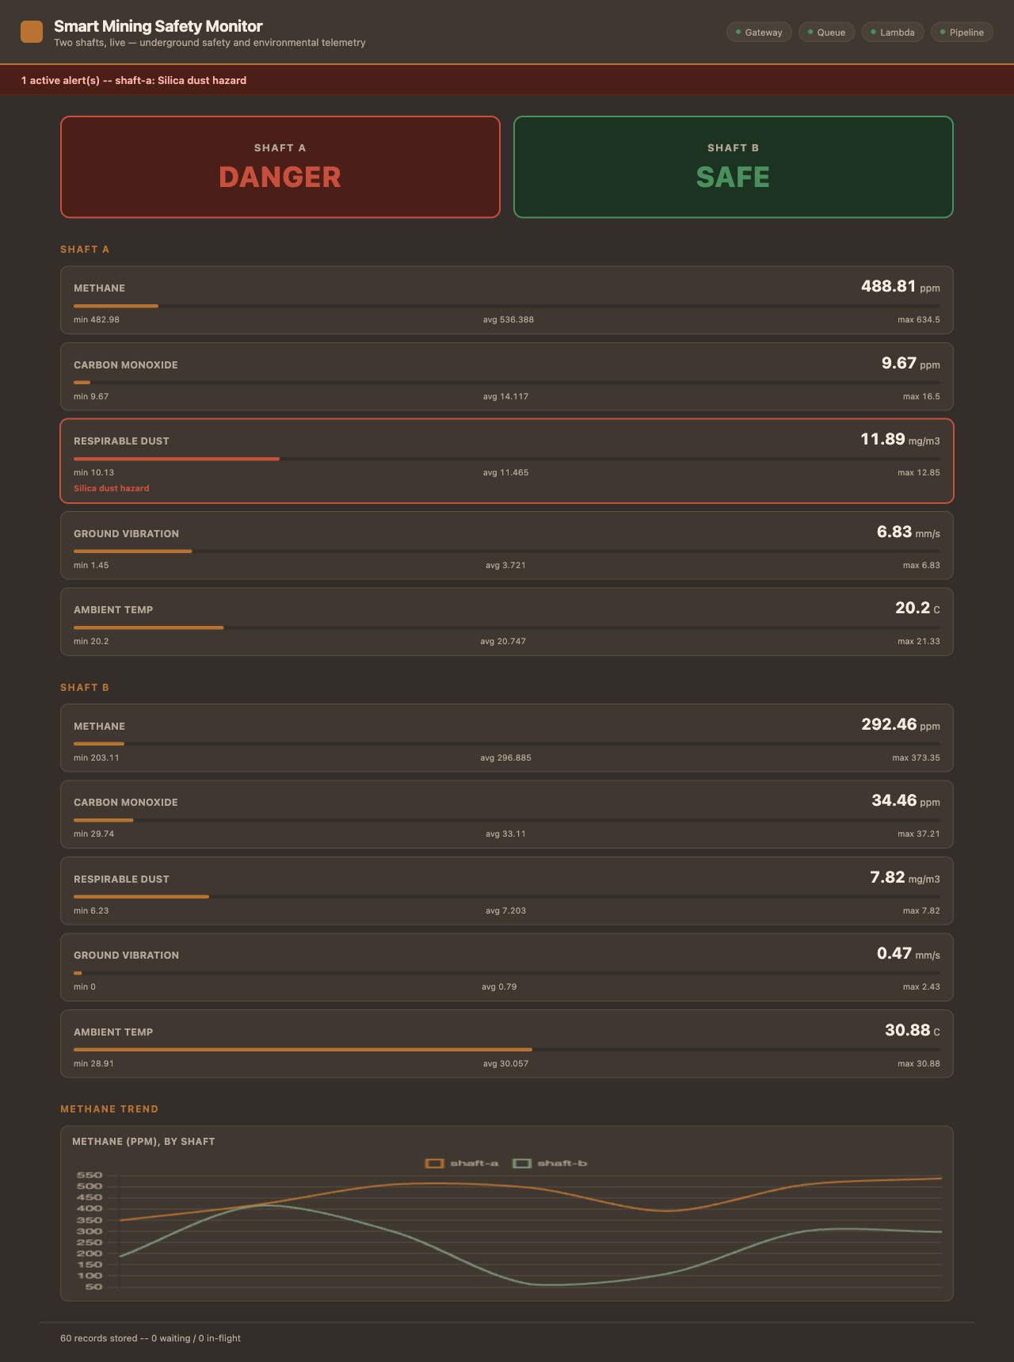
Live on AWS: demonstration highlights
The deployed dashboard in a live browser session.
All four health checks green: gateway, queue, Lambda and pipeline all reported true on the very first check after deployment.
90 automated tests pass across four modules: sensors (5), fog (47), processor (8) and dashboard (30).
Data climbing live: stored readings passed 1,400 during the verification window and kept rising.
Real alerts firing: a silica-dust breach classifies shaft A as DANGER while shaft B stays SAFE, with zero console errors and zero CORS failures.

Slide 5
The hardest part
A credential defect only the real cloud could expose.
The defect:
All three AWS-facing classes (dashboard, processor and queue publisher) hardcoded a fixed pair of test credentials into every client they built.
Why it was hard to see:
LocalStack expects exactly those test values, so all 90 tests passed and every local run looked perfect. On real AWS, the same pair overrides the IAM role, and every call to DynamoDB, SQS or Lambda fails authentication.
How it was solved:
Build static credentials only when a LocalStack endpoint is configured; otherwise fall through to the Lambda role or EC2 instance profile. All three constructors were then audited side by side before deployment.
The payoff:
4 / 4 pipeline health checks true on the very first live check.
Caught in a pre-deployment audit, so the bug never reached the live account: no outage, no fix-forward cycle.

Slide 6
Takeaways
Alert at the edge:
Thresholds are evaluated in the same process that measured the reading, so a breach is flagged in seconds, before data ever crosses the uplink.
Scale without servers:
SQS absorbs bursts as backlog, Lambda and DynamoDB scale on demand, and nothing bills while the mine is quiet.
Audit before deploying:
A pre-deployment code audit caught four defects the local emulator had masked. The first live health check came back all green.

