Slide 1
Smart Port Container Terminal Monitoring
Two-berth quayside safety monitor: fog windowing turns ten live sensor streams into crane, wind and cold-chain alerts, deployed live on AWS
Uday Kiran Reddy Dodda
Student ID X25166484
MSc in Cloud Computing · Fog and Edge Computing (H9FECC)
National College of Ireland

Slide 2
Why Manual Checks Fail at the Quayside
Two berths feed ten live sensor streams: crane load, container stacks, wind, occupancy and reefer temperature.
Sensors sample every 2 to 4 seconds, but a manual walk-round sees each berth only minutes apart.
The dangerous moments are transient: one gust over the wind limit, one overloaded lift, one reefer drifting warm.
A paper log catches these after the fact, when the crane, the cargo or the cold chain is already at risk.
All four limits below are the fog node's real, code-defined alert rules.
34 knots: average wind speed that halts all crane lifts.
32,000 kg: average crane load flagged as overload risk.
-10 degrees Celsius: a reefer running warmer breaches the cold chain.
90 percent: berth occupancy that raises a congestion alert.

Slide 3
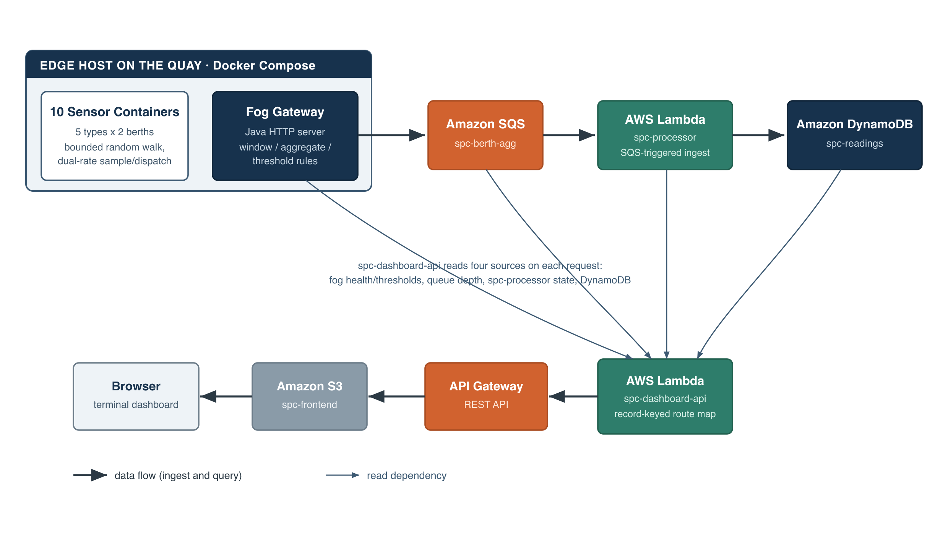
How It Works: Sensors to Live Dashboard
Berth sensors: 10 units across 2 berths feed a fog node that windows, aggregates and raises alerts.
The fog node publishes one batched message per cycle to Amazon SQS, which triggers an AWS Lambda for serverless ingest into DynamoDB's time-ordered store.
A dashboard on Amazon S3 with API Gateway serves the live view.
At the edge: every ten-second window collapses the raw readings into one aggregate per sensor per berth, and the safety rules fire right there, so raw noise never leaves the terminal.
To the cloud: the whole pipeline is verified end to end locally with Docker and an AWS emulator, and the same stack deploys to real AWS in a single scripted step.

Slide 4
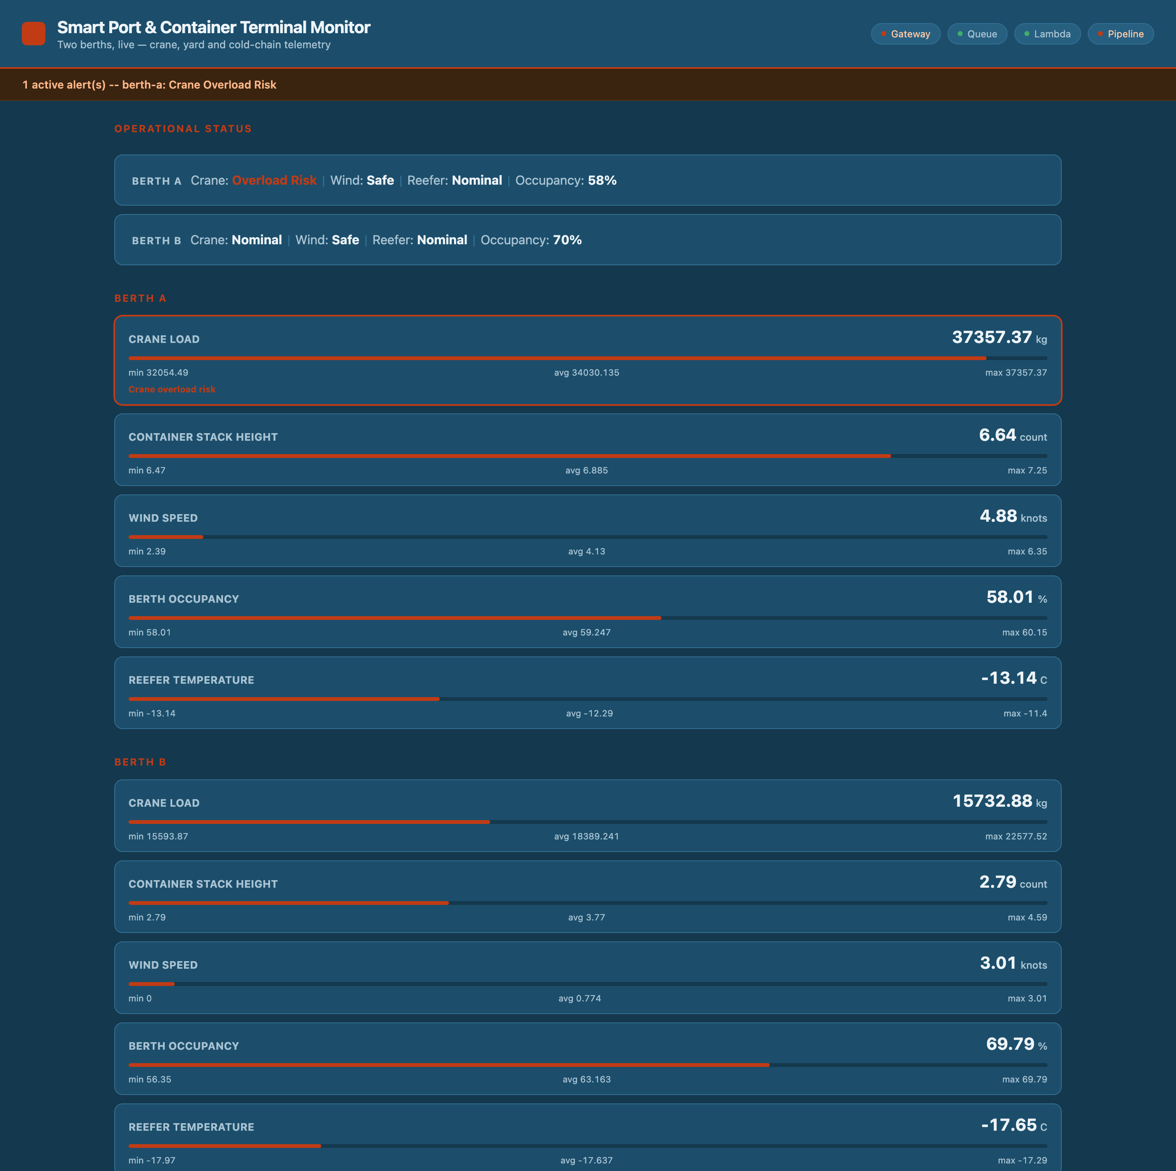
Demonstration Highlights
The deployed dashboard, served from Amazon S3 through API Gateway, captured live on the real AWS account.
4 of 4 pipeline health checks green: gateway, queue, Lambda and pipeline all live, with freshest data only seconds old.
95 automated tests pass across the sensor, fog, processor and dashboard modules.
2,000-message burst absorbed: the load test drains fully through the queue while live berth data stays untouched.

Slide 5
The Hardest Part and How It Was Solved
The problem:
Every ten seconds the fog node must close the current window and publish aggregates, while ten sensors keep posting new readings into the very same buffer.
Why it is hard:
Lock the buffer and ingest stalls on every flush. Clear it naively and any reading that lands mid-drain is lost, or counted twice in the next window.
The fix:
Every reading takes a numbered ticket on arrival. A flush snapshots the latest number as a boundary, then aggregates and removes only readings below it. Later arrivals roll into the next window: no locks, nothing lost, nothing counted twice.
At a flush, ticket-numbered readings below the boundary are sealed, aggregated and removed, while readings that arrived during the drain roll into the next window.
Backed by the fog module's 48 automated tests, including ingest exercised over a real HTTP server.

Slide 6
What This Project Shows
Fog windowing turns ten raw telemetry streams into a handful of meaningful safety signals before anything reaches the cloud.
The serverless backend, SQS, Lambda and DynamoDB, absorbed a 2,000-message burst with no servers to manage.
Every alert on screen traces to a real, code-defined threshold, verified end to end by 95 automated tests.
Thank you. Questions?

