Slide 1
Warehouse Robotics Fleet Monitoring
A fog-to-cloud pipeline for live robot health monitoring
Goutham Uppu
Student ID X25167936
MSc in Cloud Computing · Fog and Edge Computing (H9FECC)
National College of Ireland

Slide 2
Why scheduled checks fail a moving fleet
Ten robots ferry totes across two zones, and their condition changes faster than any inspection round.
Schedules are not condition: fleet health is usually read off nominal schedules, yet dispatch decisions measurably improve when battery, position and task load are known live.
Batteries degrade quietly: battery degradation shows up in continuous telemetry well before outright failure, and a periodic manual check misses the trend entirely.
Known gaps in the field: surveys of warehouse robot deployments still name scheduling, power and safety as open gaps, largely because few fleets are instrumented closely enough.
Fifty live signals: ten robots, two zones, five telemetry channels each, and no inspection round keeps up with fifty moving numbers.

Slide 3
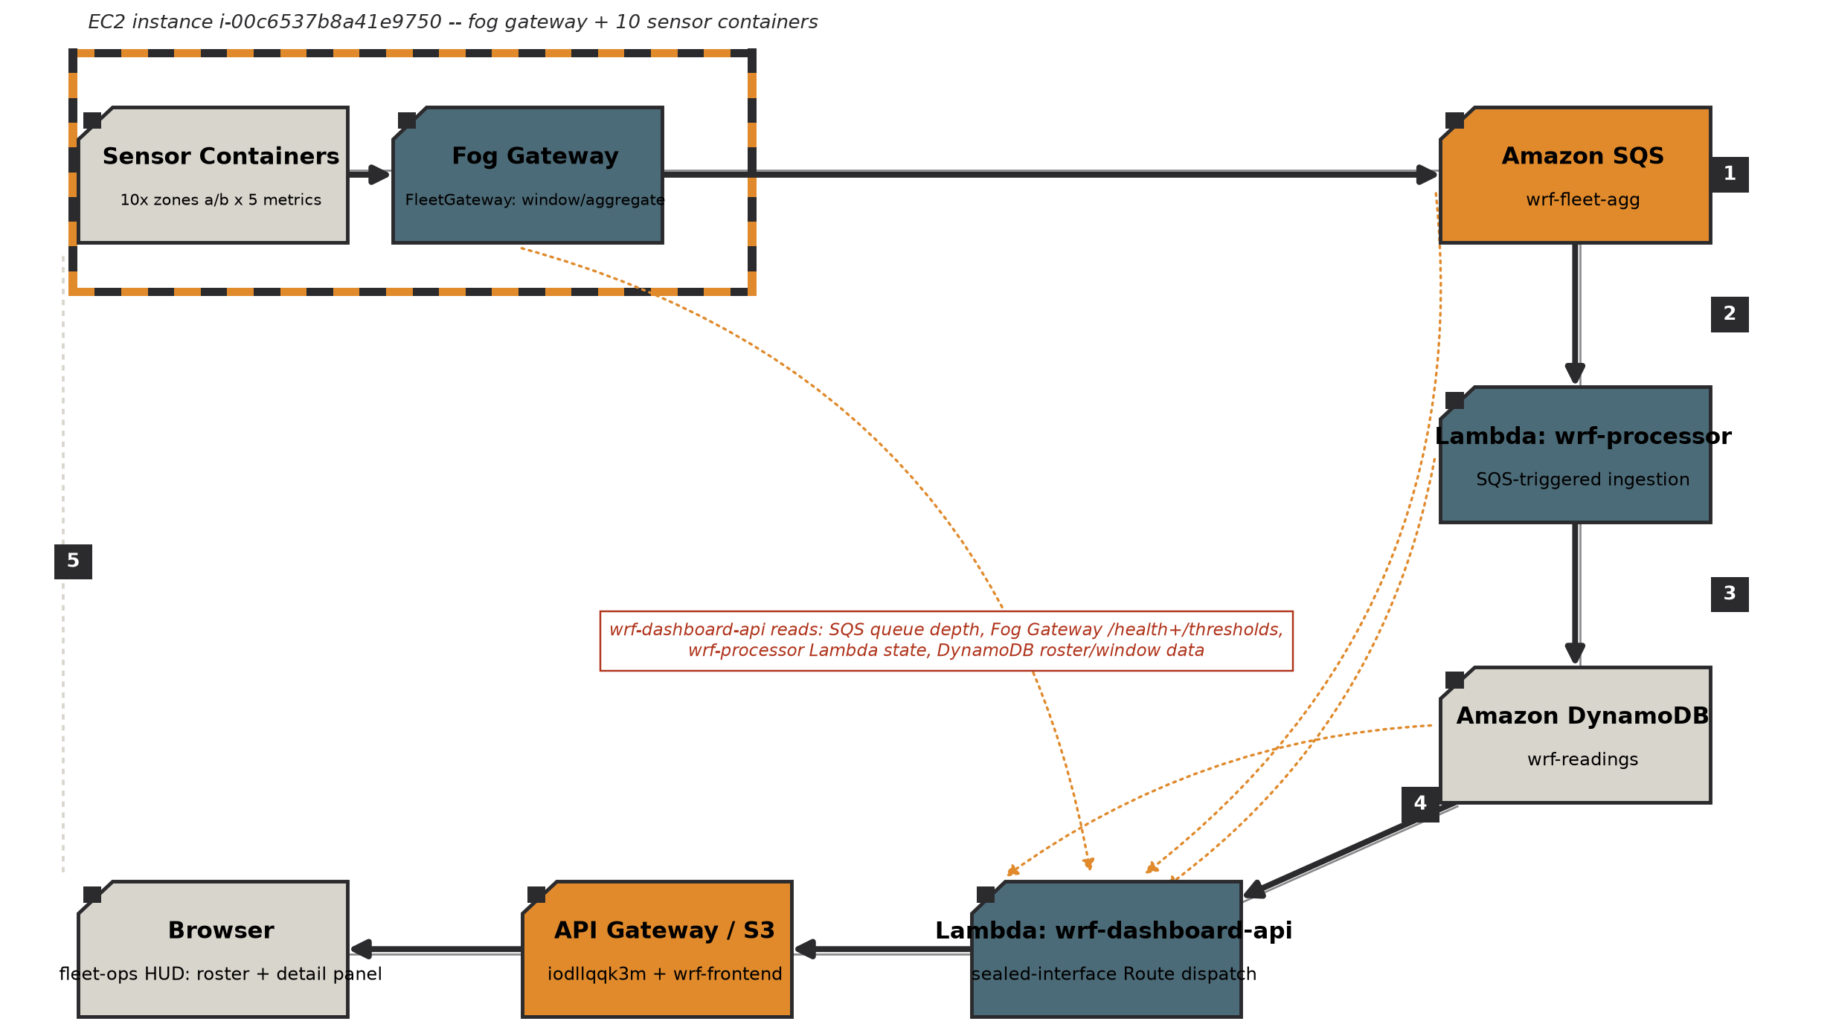
How it works: from robot to dashboard
Robot sensors: 10 containers on Amazon EC2, 5 metrics per robot.
Fog gateway windows and aggregates the readings, then checks alert thresholds.
Message queue: Amazon SQS carries batches of up to 10 aggregates.
Serverless ingest: AWS Lambda writes each closed window into Amazon DynamoDB, which holds the window aggregates.
Live dashboard: Amazon API Gateway with AWS Lambda, and the frontend hosted on S3.
Only compact window aggregates cross to the cloud; raw samples never leave the edge.

Slide 4
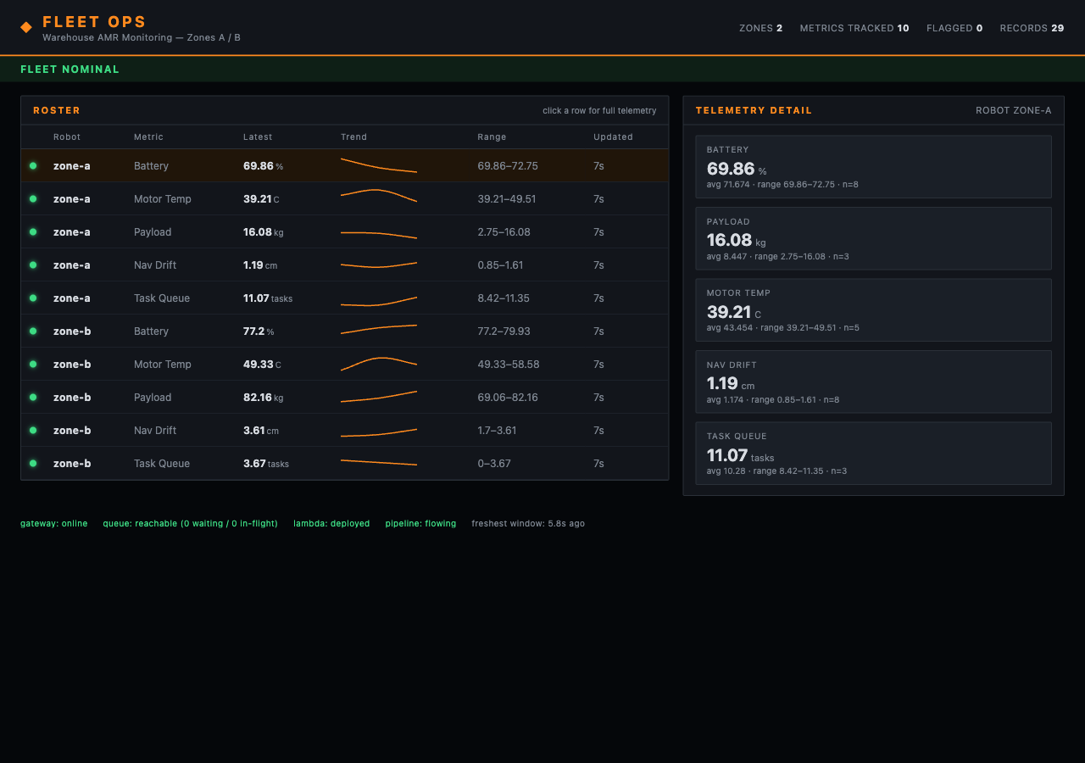
Live on AWS: the deployed dashboard
Captured from the live deployment: the S3-hosted frontend calls the dashboard API through Amazon API Gateway, and the bottom status row shows all four pipeline health checks reporting healthy.
All health checks green: gateway, queue, Lambda and pipeline all healthy, with the freshest window seconds old.
116 automated tests pass across four modules, plus a 2,000-message burst test via 32 workers.
One command to deploy: a single Terraform apply provisioned all 24 AWS resources, and item counts climbed during checks.

Slide 5
The bug only real AWS could expose
The defect: all three AWS-facing components always built static test credentials for the local emulator, and the fog publisher always applied its endpoint override, even on real AWS.
Why it was hard: every one of the 116 tests passed and the full stack ran cleanly on the local emulator. On real AWS, the Lambdas would override their execution-role credentials and be rejected, and the fog node would crash at startup on a missing endpoint.
The fix: gate on the endpoint setting itself. Present means emulator credentials, absent means the real AWS role. Deployed with this fix in place, every health check came up green on the first attempt.
Before and after:
Before: emulator credentials and endpoint applied unconditionally, so real calls are rejected and the fog node crashes on startup.
After: endpoint configured means use the emulator; absent means use the real execution role, exactly as one class already did correctly.
One of four defects caught by a pre-deployment audit; none was visible to a green 116-test suite.

Slide 6
What this project shows
Edge does the heavy lifting: windowing, aggregation and alert checks run beside the robots, and only compact summaries cross to the cloud.
Green tests are not cloud-proof: four real defects hid at boundaries the local emulator masks, and auditing against real service behaviour is its own step.
Declared, not scripted: one Terraform apply, 24 resources, nothing copied by hand, and teardown and rebuild are repeatable.
Thank you. Questions?

