Slide 1
Smart Agriculture Field Monitoring
A fog and edge pipeline, deployed live on AWS
Kondragunta Lakshmi Chaitanya
Student ID X25171216
MSc in Cloud Computing · Fog and Edge Computing (H9FECC)
National College of Ireland

Slide 2
Why Scheduled Field Checks Fail
A field inspected on a fixed schedule reveals a dry root zone, a frost event, or a fungal-risk humidity spell only after the fact, at the next walk-through. Continuous sensing flips that: every reading is checked against an explicit rule the moment it arrives.
2 to 4 seconds between fresh readings from every field sensor.
6 threshold alert rules evaluated at the edge.
Three hazards that a fixed schedule catches too late:
Dry root zone: soil moisture averaging under 20% means irrigation is already overdue, and on a schedule that is found days late.
Overnight frost: a dip below 3 °C damages crops within hours, while a scheduled visit only records the loss afterwards.
Fungal-risk humidity: sustained humidity above 90% quietly builds disease risk in the gap between two inspections.

Slide 3
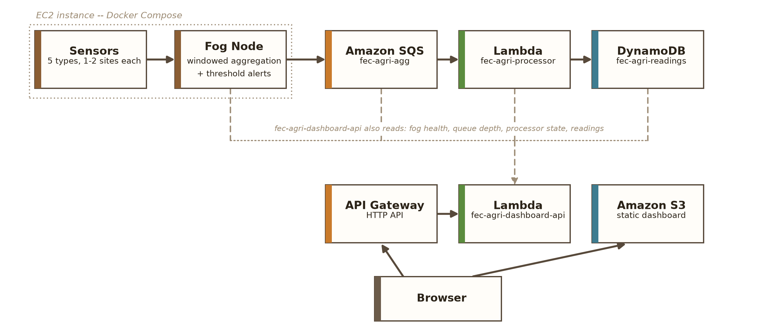
How It Works: Edge to Cloud
Field sensors: five sensor types (soil moisture, temperature, humidity, light, rainfall) sample every 2 to 4 seconds.
Fog node: windows each stream over 10 seconds, aggregates min, max, and average, and raises alerts locally.
Amazon SQS then AWS Lambda: a managed queue absorbs batched window summaries and levels the load, then a serverless function fires on each summary and ingests it with no servers to manage.
Amazon DynamoDB: every window lands as one record, keyed by sensor type and time, ready for fast lookups.
Live dashboard: Amazon API Gateway serves the data API and Amazon S3 hosts the page the browser loads.
Raw readings never leave the edge; only compact ten-second window summaries cross into the cloud.

Slide 4
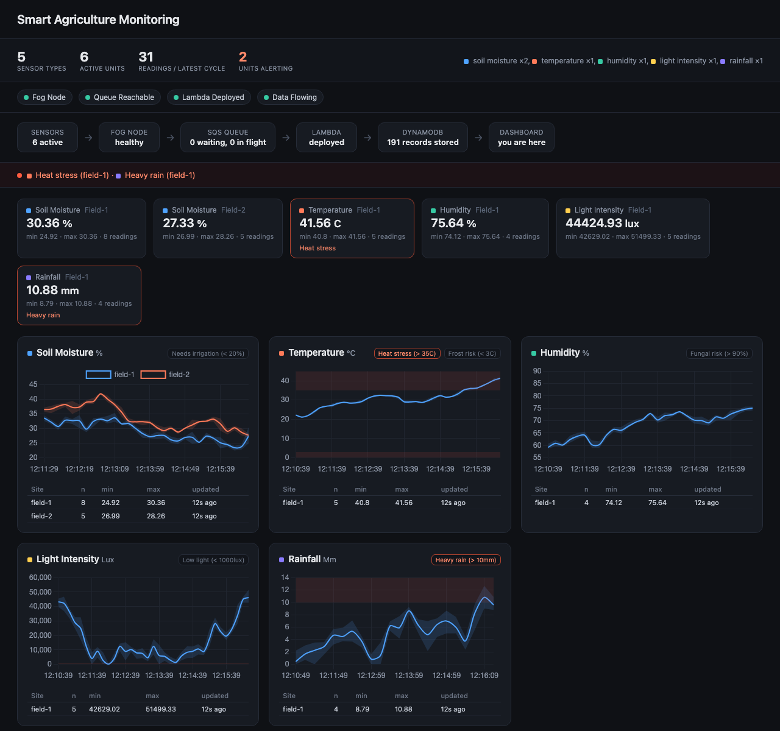
Live Demonstration Highlights
The S3-hosted dashboard during live verification shows per-sensor panels, trend charts, and an active alert banner.
Every pipeline health check green: fog node, queue, Lambda, and end-to-end freshness all report healthy on the live API, with the freshest reading just 1.88 seconds old.
39 automated tests pass, covering the sensors' bounded random walk, fog aggregation and alert rules, SQS batching, and every dashboard route.
300-message burst absorbed: fired at the live queue in 4.5 seconds, about 67 per second, with every message processed and stored, verified directly in DynamoDB.

Slide 5
The Hardest Part: A Defect the Emulator Hid
The problem: a record count that quietly lied
The dashboard totalled its stored records with a single DynamoDB scan. DynamoDB caps every scan at about 1 MB, so beyond the first page the count simply stops, with no error, no warning, just a smaller number.
Why it was hard: nothing ever failed
All 39 tests passed, the full emulator-backed integration run passed, and demo-sized data looked correct. With no failing signal to chase, the defect surfaced only when the pipeline ran on the real AWS account.
The fix: follow the pagination cursor
The count now walks DynamoDB's pagination cursor and sums every page. It is locked in by a three-page test (500 + 500 + 214 = 1,214) and re-verified against the live deployed table.

Slide 6
What This Project Proves
Edge-first design pays off
Aggregating and alerting at the fog node keeps raw readings local; alerts fire seconds after a threshold breaks.
Serverless scales without provisioning
SQS, Lambda, and DynamoDB rode out a 67-message-per-second burst with nothing pre-sized or pre-warmed.
An emulator is not the cloud
Two defects passed every local test and only surfaced against the real AWS deployment.
Thank you. Questions?

