Slide 1
Offshore Wind Farm Turbine Monitoring
A fog-to-cloud pipeline for continuous condition monitoring, deployed live on AWS
Vishvaksen Machana
Student ID X25173421
MSc in Cloud Computing · Fog and Edge Computing (H9FECC)
National College of Ireland

Slide 2
Why Periodic Inspection Fails Offshore
Access depends on the sea: turbines are reached by boat, weather sets the schedule, and technician visits can be weeks apart.
Faults escalate between visits: a bearing overheating, a gearbox losing lubrication pressure, or a blade vibration growing worse, all invisible until the next scheduled inspection.
Streaming raw data is not the fix: the link to shore has limited, variable bandwidth, and a view that dies when connectivity dips fails during exactly the storms that stress turbines most.
2.5 bar: one momentary gearbox-pressure dip below 2.5 bar is a lubrication fault. Only continuous watching of the worst reading in each window catches it; an average, or a visit weeks later, never would.
10 live sensor streams: wind speed, blade vibration, generator temperature, power output, and gearbox pressure on each of two turbines.

Slide 3
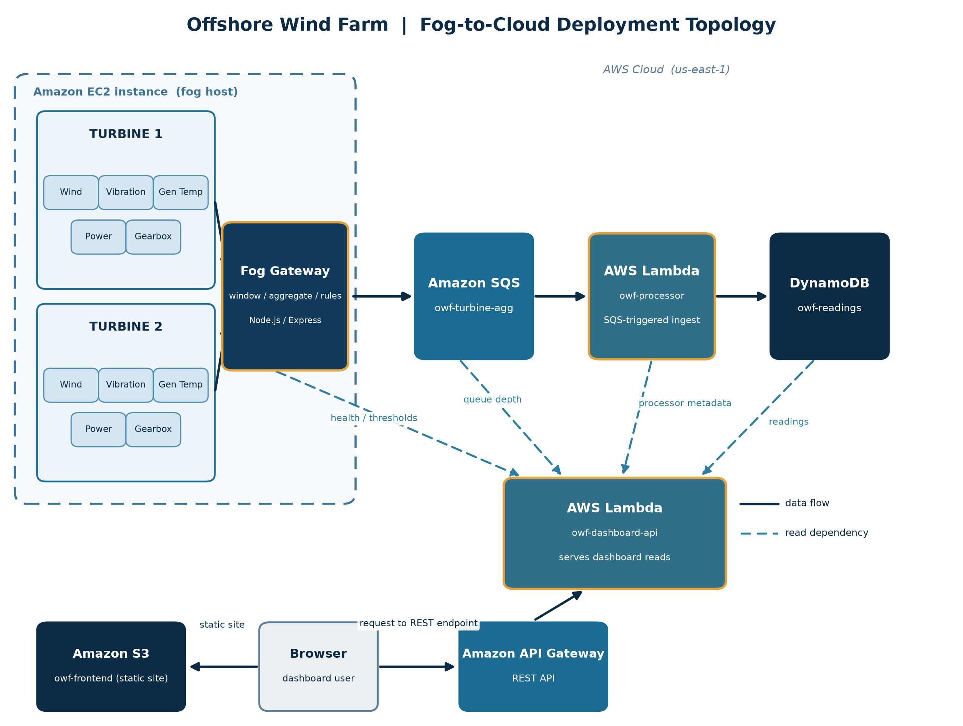
How It Works: Sensor to Live Dashboard
At sea, edge host:
Turbine sensors produce 10 streams (wind, vibration, temperature, power, pressure), and a fog gateway windows, aggregates, and runs alert rules at the edge.
In the cloud, serverless:
Amazon SQS buffers each window's batch, AWS Lambda ingests and stores it in Amazon DynamoDB (a durable, time-ordered store), and a read-only Dashboard API (AWS Lambda behind Amazon API Gateway) feeds a live dashboard, a static page served from Amazon S3 and polled in the browser.
4 condition rules run at the edge (vibration, temperature, wind, gearbox pressure), so a fault is flagged in the same window cycle it appears.
One window cycle equals up to 10 summaries, sent as 1 batched call, not 10.

Slide 4
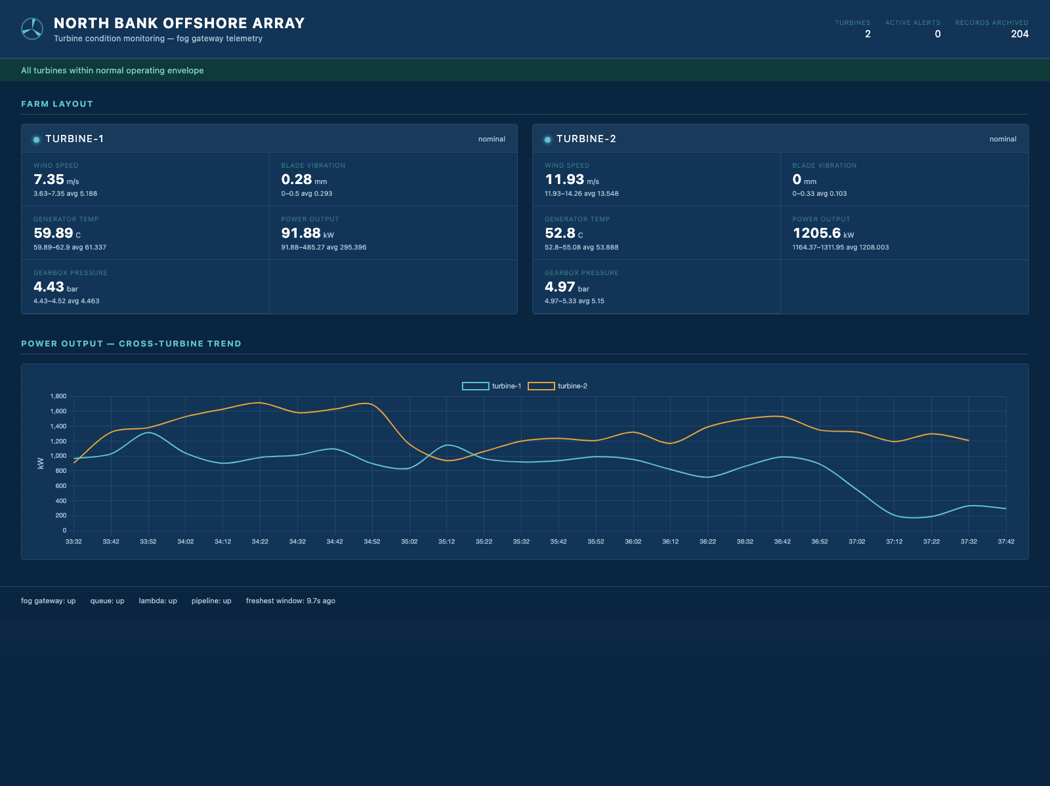
Live on AWS: Demonstration Highlights
The deployed dashboard runs live in a real browser: both turbines' five metrics, the cross-turbine power trend, 204 records archived, and all four pipeline health indicators up in the footer.
4/4 pipeline health checks green within about a minute of start-up, with the freshest stored data roughly 3 seconds old.
71 automated tests pass across the four modules: sensors, fog gateway, ingestion, and dashboard.
204 records stored during live verification, with the count climbing 17 to 132 to 204 across successive polls.

Slide 5
Hardest Part: The Credential Trap
The problem:
Two cloud-facing modules decided they must be in local testing whenever the standard access-key variable was present in the environment, and swapped in fake, emulator-only credentials.
Why it was hard:
The serverless platform always injects that same variable to deliver a function's real credentials. In production, both functions would discard their real identity and fail their very first call to the queue or the store, while every local test kept passing, because locally the assumption is true. The same signal meant opposite things in the two environments.
The fix:
Gate on the local-emulator endpoint variable instead, the one signal that genuinely means local. Deployed functions now fall through to the platform's default credential chain and pick up their real execution-role credentials.
0 defects reached the live account. A pre-deployment audit caught this plus two more, a record-count undercount from unpaginated scanning and a missing message-batching path, and all three were fixed before the first deploy. Every health check was green on the first live poll.

Slide 6
Three Things Worth Remembering
Fog computing earns its place offshore: windows, aggregates, and alert rules run at the turbines, so only compact summaries cross the sea link, and faults are flagged the moment they appear.
A serverless core (Amazon SQS, AWS Lambda, DynamoDB, API Gateway, and S3) ingests, stores, and serves the data elastically, and costs almost nothing when idle.
An emulator cannot prove production readiness: the pre-deployment audit and live verification on the real account turned works locally into works deployed.
Thank you. Questions?

