Slide 1
Wildfire Forest Monitoring
Real-time fire-risk telemetry from remote ranger stations, forest edge to cloud
Deekonda Rakshan
Student ID X25180754
MSc in Cloud Computing · Fog and Edge Computing (H9FECC)
National College of Ireland

Slide 2
Why patrols and periodic checks fail
Wildfire risk moves faster than any inspection schedule.
Ranger stations sit deep in remote forest; patrols and hourly readouts leave long blind windows.
Fire weather compounds quietly: heat, smoke, wind and drying soil each look tolerable alone.
The danger is the combination, and it can develop between two routine checks.
So detection has to run continuously, right next to the sensors, not on a schedule.
1 s between smoke samples at each station: readings arrive far faster than any manual check can follow.
10 sensor feeds streaming at once: five fire metrics across two remote stations.
42 degrees C is the heat hard-alarm line; risk scoring starts climbing from 30 degrees C, well before the alarm fires.

Slide 3
How it works: forest edge to cloud
Field sensors: ten containerised sensors stream temperature, humidity, smoke, wind and soil moisture from two stations.
Fog node, edge gateway: buffers readings, aggregates each time window, and raises fire alerts right at the edge.
Message queue: Amazon SQS receives each window's aggregates in batched sends.
Serverless ingest: an AWS Lambda function consumes the queue and transforms every record.
Cloud store: Amazon DynamoDB keeps the full history of aggregate windows.
Live dashboard: Amazon API Gateway serves the data; the page itself is hosted on Amazon S3, with a 0 to 4 fire-risk dial per station.
Runs end to end locally under Docker with an AWS emulator; a single scripted Terraform step provisions this same pipeline on AWS.

Slide 4
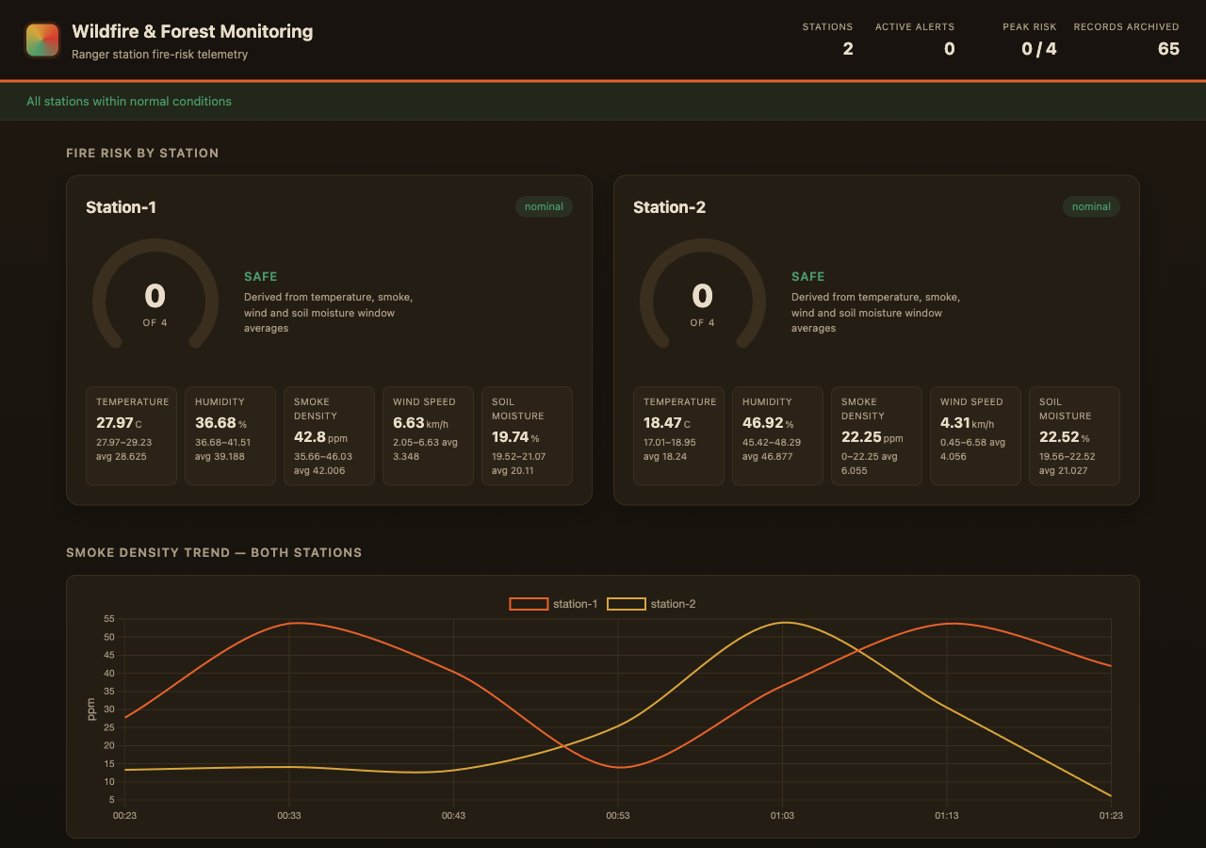
Demonstration: the pipeline end to end
Dashboard captured from the local end-to-end run (Docker plus AWS emulator).
95 automated tests, all passing across the sensors, fog node, queue consumer and dashboard modules.
Every pipeline health check green: a scripted check verifies sensors to fog to queue to ingest to store live, end to end.
2,000-message burst absorbed: 32 parallel senders flood the queue; the serverless consumer keeps draining it without stalling.

Slide 5
The hardest part: an invisible bug
The problem
Locally, the pipeline signs its queue and database calls with the emulator's dummy credentials. The code decided when to use them by checking whether an AWS access-key variable was present.
Why it was hard
Real AWS injects that exact variable into every function it runs, so in production, every queue and database call would be signed with incomplete credentials and rejected. All 95 tests stayed green; nothing could fail until the first real deployment.
The fix
Gate on a signal that only exists locally: the emulator's endpoint address. On real AWS it is absent, so the platform's own credentials take over automatically, and new tests now pin that behaviour down in both profiles.

Slide 6
What this project shows
Decisions at the edge: windows, aggregation and fire alerts run beside the sensors, so warnings never wait on the cloud.
A serverless cloud tier: queue, function, database and dashboard, load-tested with a 2,000-message burst.
Cloud-ready by design: one scripted Terraform step provisions the identical pipeline on AWS.
Thank you. Questions?

