Slide 1
Smart City Environmental Monitoring
Ten street sensors, one edge relay, one serverless cloud pipeline
MSc in Cloud Computing · Fog and Edge Computing (H9FECC)
National College of Ireland

Slide 2
Why occasional checking fails
1
Congestion, pollution spikes and full car parks build and fade within minutes, between any two manual checks.
A patrol or a monthly meter read captures one moment; the breach that matters happens after the clipboard leaves.
Streaming every raw reading to a distant cloud is the other extreme: heavy, slow and costly at city scale.
What a city needs is continuous local watching, with only compact summaries and alerts leaving the street.
35 micrograms per cubic metre is the pipeline's PM2.5 alert line; an air quality breach can rise and fade between manual reads.
75 dB is the noise violation threshold; residents feel every extra minute it goes unnoticed.
Each of ten street sensors reports one reading every 2 to 5 seconds continuously, and no manual process keeps up with that.

Slide 3
How it works: edge to cloud
2
City edge:
Street sensors: 10 devices, 5 metrics, 2 zones.
Fog node windows, aggregates and alerts, with a 10 second aggregation window at the edge relay.
AWS cloud:
Amazon SQS aggregate queue, AWS Lambda serverless ingest, and Amazon DynamoDB durable store.
Live dashboard on Amazon S3 and API Gateway.
5 alert rules are assessed beside the sensors, not in the cloud.
1 scripted step: verified locally on an AWS emulator, deploys to AWS unchanged.
Each zone and metric leaves the street as one compact summary every ten seconds, alerts already attached.

Slide 4
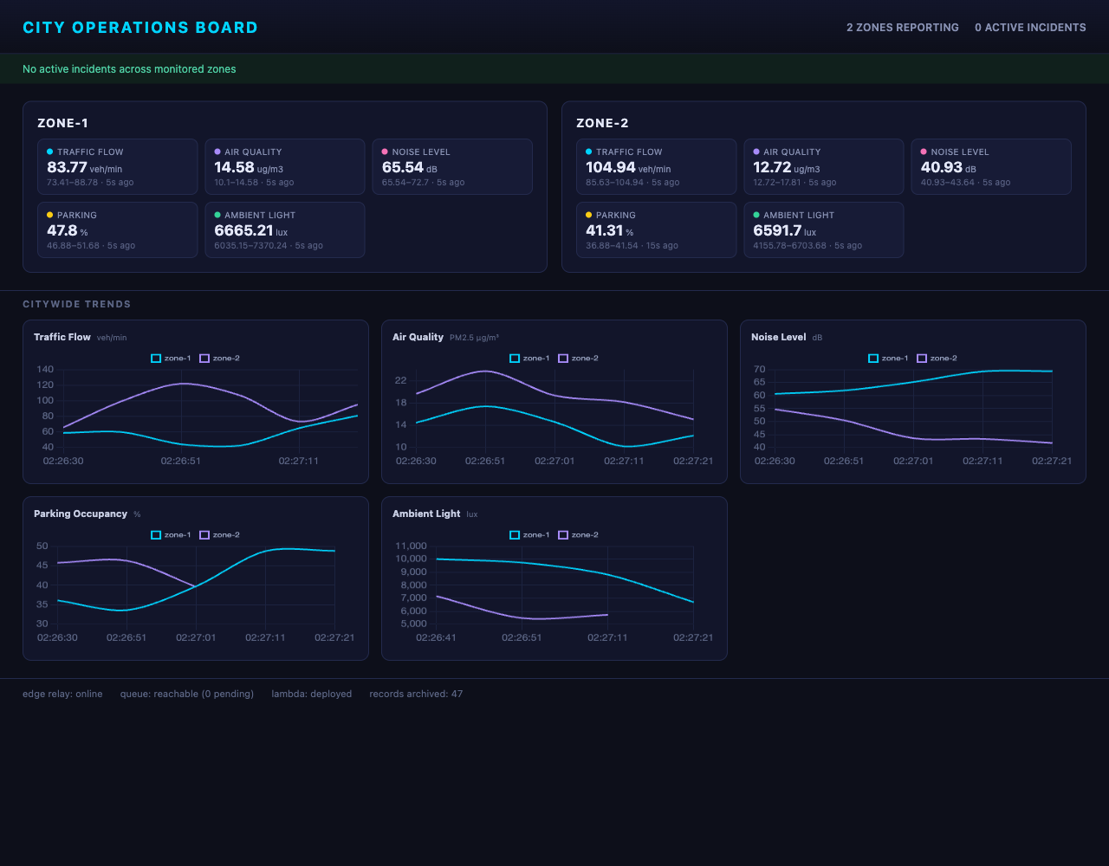
Demonstration highlights
3
Dashboard captured from the running stack.
Two zones reporting, five metrics per zone, citywide trend charts, and the health footer along the bottom edge.
All pipeline health checks green: edge relay online, queue reachable, Lambda deployed, records archived.
61 automated tests pass across the sensor, fog, processor and dashboard modules.
2,000-message burst absorbed: load test fired through 32 parallel workers as scalability evidence.
Five alert rules fire live: congestion, air quality, noise, parking and low visibility.

Slide 5
The hardest part: a silent race
4
Every ten seconds the fog node hands its buffer over for flushing. What happens to a reading that arrives at that exact instant?
The problem:
Sensor posts run on four parallel threads while a timer swaps the window buffer out for flushing. A reading landing mid-swap can be written into the retired buffer after the flush has already read it, and it simply vanishes.
Why it was hard:
Nothing fails: no exception, no log line, just one number quietly missing from a summary. The timing hole is microseconds wide, so ordinary tests pass every time and the loss would only surface under real concurrent load.
The fix:
Each buffer became a fenced generation. The flush closes the fence, waits for writers already inside to finish, then reads. A writer arriving after the fence is turned away and retries into the fresh buffer instead.
The ingest path stays lock-free; every reading now lands in exactly one window, guaranteed by the fence rather than a global lock.

Slide 6
Three things to take away
5
Alerts are computed beside the sensors: ten seconds from street reading to raised incident, and only compact summaries ever leave the edge.
The cloud side is serverless by construction: the same code runs against the local AWS emulator and real AWS, one scripted deployment step apart.
Correctness is proven, not assumed: 61 automated tests, an end-to-end pipeline check, a 2,000-message burst, and a fence for the bug that never showed itself.
Thank you. Questions?

