Slide 1
Two plants; turbidity, pH, chlorine, flow, pressure; edge decisions in seconds
Water Treatment Utility Monitoring
MSc in Cloud Computing · Fog and Edge Computing (H9FECC)
National College of Ireland

Slide 2
Why periodic checking fails
Treatment quality moves second by second, and grab samples and periodic control-room rounds only ever see snapshots.
Ten sensor points across two plants stream turbidity, pH, chlorine, flow and pressure every 1 to 3 seconds, far faster than any manual round.
Transient events vanish into averages: a momentary pressure drop can mean a hydraulic fault even when the daily mean looks perfectly healthy.
This pipeline scores every 10-second window as it closes, so a violation raises an alert in seconds, not at the next scheduled check.
Two thresholds are checked against the window, never the average:
Low-pressure fault at < 2 bar, checked against the window minimum, so a brief dip cannot hide.
Chlorine residual floor at < 0.2 ppm, with an under-chlorination alert firing in the same window it happens.

Slide 3
How it works: intake to dashboard
At the plant, edge:
Sensors: 10 field sensors across 2 plants.
Fog node: 10-second windows, aggregate, alert gates.
AWS cloud:
Amazon SQS: one summary per window, batched.
AWS Lambda: serverless ingest of each summary.
DynamoDB: time-series store of every window.
Live dashboard: served via S3 and API Gateway.
Verified end to end locally with Docker and an AWS emulator, and the same AWS SDK code deploys to real AWS in a single scripted step.

Slide 4
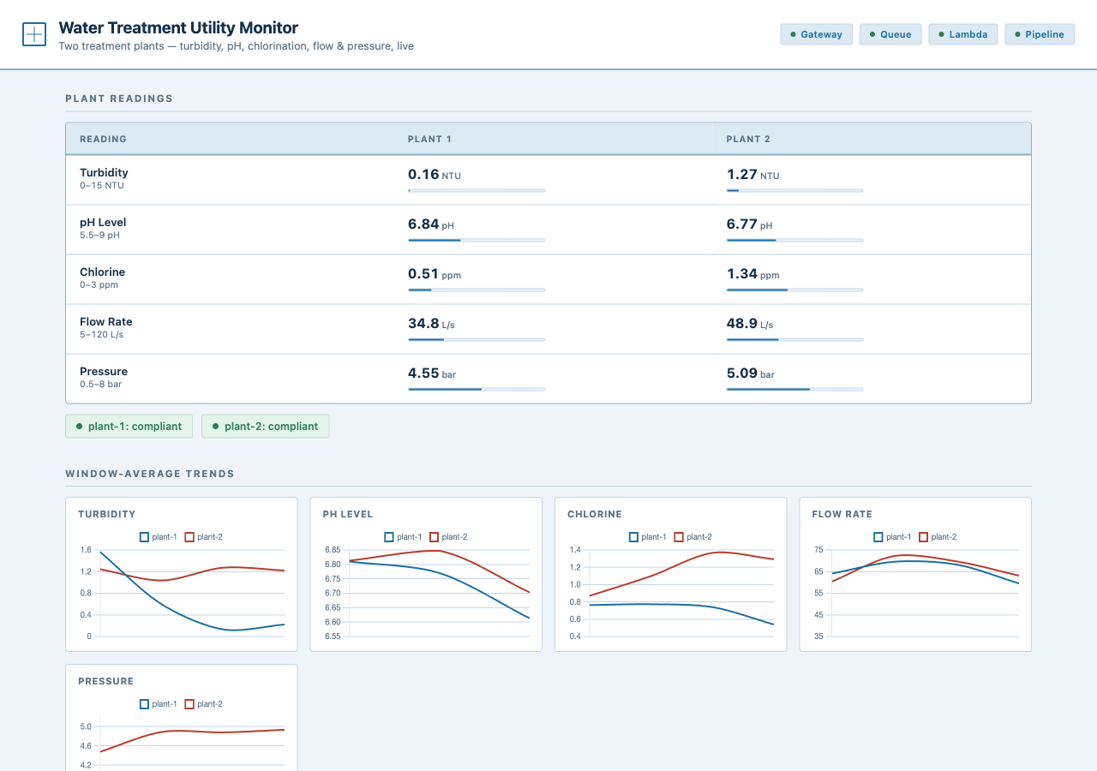
Demonstration highlights
Dashboard during the end-to-end local run: reading-by-plant matrix, compliance strips, cross-plant trends.
4 / 4 pipeline health checks green: gateway, queue, Lambda, and end-to-end pipeline.
107 automated tests pass across sensors, fog, processor and dashboard.
2,000 message burst absorbed by the queue and drained by the consumer.

Slide 5
The hardest part: burst survival
The problem:
Normal traffic is one summary every ten seconds. To claim scalability we fired 2,000 messages at the queue from 32 parallel workers, orders of magnitude above normal load.
Why it was hard:
From outside, a non-empty queue is ambiguous: a slow consumer and a dead one look identical. The emulator runs the Lambda in a single container, so drain time swings wildly, and a naive pass/fail test either flakes or lies.
The fix:
A two-tier check: first assert the queue really absorbed the burst, then require either a full drain in time or a backlog strictly below the post-burst peak. Decreasing numbers prove the consumer is alive and working, not stalled.
Queue backlog over the test: 2,000 after send, falling mid-test, 0 drained.
Strictly decreasing backlog means real progress, not a stall.

Slide 6
What to take away
Decide at the edge: alerts fire the moment a 10-second window closes, on site, with no round trip to the cloud before acting.
Ship summaries, not noise: one aggregate per window flows through Amazon SQS, AWS Lambda and DynamoDB, which is lean, cheap and durable.
Proven and portable: 107 tests pass, a 2,000-message burst drains, and one scripted step moves it onto real AWS.
The pipeline runs end to end: intake, sensing, quality gates, cloud store, outflow.
Thank you. Questions?

